Slide 1
AI Predictive Compliance & Maintenance Orchestrator
40-slide step-by-step lab with code snippets, visuals & Power BI templates
Prepared for class lab

Slide 2
Agenda (Class Lab Overview)
Problem statement & objectives
Architecture walkthrough
Hands-on lab: telemetry ingestion
Model training & evaluation
GenAI RAG for compliance & technician assistant
Orchestration microservices & deployment
DevSecOps pipeline
Power BI dashboard: build & template
Wrap-up & next steps

Slide 3
Learning Outcomes
Understand IoT-to-cloud telemetry pipelines
Implement time-series anomaly detection and predictive models
Build a GenAI RAG compliance assistant
Create microservices (FastAPI) and Dockerize them
Deploy to AKS and implement CI/CD with GitHub Actions
Design a Power BI dashboard and export template

Slide 4
Business Problem
Disconnected systems for diagnostics, compliance, ERP and workshops
Manual recall and vendor matching processes
Unplanned downtime; high cost for fleet operators
Need for predictive maintenance + automated compliance actions

Slide 5
Solution Overview
Azure IoT ingestion → Data lake → ML Predictive Engine
GenAI RAG for regulation interpretation and troubleshooting
Maintenance orchestration integrated with ERP/SAP
Technician Copilot + Power BI dashboards

Slide 6
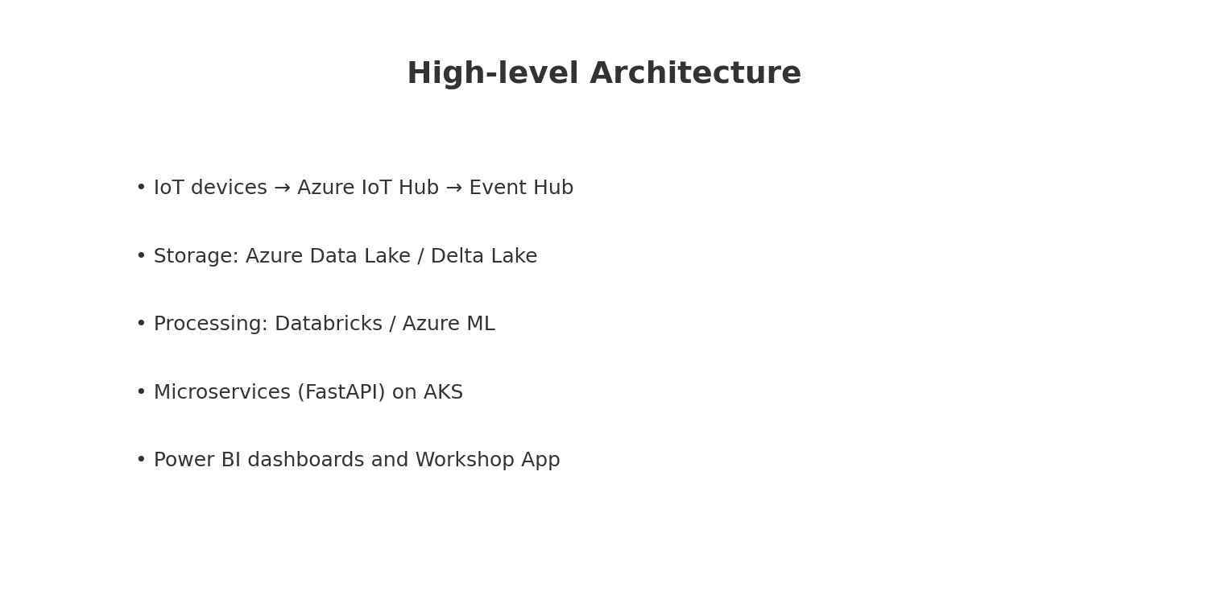
Architecture Diagram

Slide 7
Data Sources & Schema
CAN bus / ECU telemetry (JSON / Avro) — timestamped metrics
Workshop logs (structured)
ERP/SAP master data (vehicles, VIN, parts)
Vendor recall feeds (API / CSV)
Regulatory documents (for RAG indexing)

Slide 8
Telemetry Ingestion Design
Azure IoT Hub for device connectivity
Event Hub for high-throughput streaming
Stream processing with Databricks Structured Streaming
Sink to Delta Lake tables partitioned by date and VIN

Slide 9
Lab: Telemetry Generator
Run a synthetic telemetry generator (Python) to simulate CAN messages
Publish to Azure IoT Hub using Device SDK or to Event Hub directly
We'll provide a local simulator that publishes to a REST-ingest microservice for the lab

Slide 10
Code: Telemetry Simulator (Python)
# telemetry_simulator.py
import time, json, random, requests
API_ENDPOINT = "http://localhost:8000/ingest"
def gen_record(vin):
return {
"vin": vin,
"timestamp": int(time.time()*1000),
"engine_temp": round(70 + random.gauss(0,5),2),
"brake_pressure": round(30 + random.gauss(0,3),2),
"vibration": round(abs(random.gauss(0,0.5)),3)
}
if __name__ == '__main__':
for i in range(1000):
rec = gen_record("DTRK"+str(i%10).zfill(5))
requests.post(API_ENDPOINT, json=rec, timeout=2)
time.sleep(0.1)

Slide 11
Ingest Microservice (FastAPI)
Receives telemetry JSON over HTTP or AMQP
Validates and enriches (geolocation, VIN lookup)
Publishes to Event Hub or writes to Delta via write-api
Implements auth + rate limiting

Slide 12
Code: FastAPI Ingest Endpoint
# ingest_service/main.py
from fastapi import FastAPI, HTTPException, Request
from pydantic import BaseModel
import asyncio, json
class Telemetry(BaseModel):
vin: str
timestamp: int
engine_temp: float
brake_pressure: float
vibration: float
app = FastAPI()
@app.post("/ingest")
async def ingest(data: Telemetry):
# basic validation
if not data.vin:
raise HTTPException(status_code=400, detail="vin required")
# publish to Event Hub / write to DB (pseudo)
await asyncio.sleep(0) # placeholder for async publish
return {"status":"accepted"}

Slide 13
Stream Processing & Feature Store
Use Databricks Structured Streaming to compute rolling aggregates
Feature store for ML features (e.g., temp_mean_1h, vibration_std_24h)
Store features in Delta tables and serving layer

Slide 14
Model Design
Time-series models: LSTM / Transformer for sequence forecasting
Anomaly detection: Isolation Forest / Autoencoder
Graph Neural Network for part-relationship impact
Model outputs: risk_score, failure_type, time_to_failure

Slide 15
Code: Model Training (PyTorch Simplified)
# train_model.py (simplified)
import torch, torch.nn as nn
from torch.utils.data import DataLoader, Dataset
class SimpleLSTM(nn.Module):
def __init__(self, input_size, hidden=64):
super().__init__()
self.lstm = nn.LSTM(input_size, hidden, batch_first=True)
self.fc = nn.Linear(hidden, 1)
def forward(self, x):
out, _ = self.lstm(x)
return self.fc(out[:, -1, :])
# dataset, dataloader omitted for brevity
# train loop
model = SimpleLSTM(input_size=3)
optimizer = torch.optim.Adam(model.parameters(), lr=1e-3)
criterion = nn.MSELoss()
# for epoch, batch in loader: ...

Slide 16
Model Evaluation
Metrics: RMSE, Precision@K for failures, ROC-AUC for anomaly detection
Backtesting on historical telemetry & maintenance logs
Model explainability: SHAP for feature importance
Model registry: Azure ML / MLflow for versioning

Slide 17
GenAI RAG: Compliance & Troubleshooting
Index regulations, manuals, and SOPs into a vector store
Use RAG (Retrieval-Augmented Generation) to answer compliance queries
Translate legal text into machine-readable rules for enforcement
Use for technician assistant and compliance auditor alerts

Slide 18
Code: RAG Flow (Pseudo)
# rag_example.py (pseudo)
from langchain import OpenAI, VectorstoreRetriever
llm = OpenAI(model='gpt-4o-mini')
retriever = VectorstoreRetriever.from_local_index('regulations_index')
def answer(query):
docs = retriever.get_relevant(query, k=5)
prompt = """Use the following docs to answer and then produce machine-check logic:\n{docs}\nQuestion:{query}"""
return llm.generate(prompt.format(docs=docs, query=query))

Slide 19
Technician Copilot (UX)
Chat + voice assistant in workshop app
Auto-suggested step-by-step repairs with torque specs
Inline links to diagrams and historical repairs
Ability to create a maintenance order automatically

Slide 20
Maintenance Orchestration Microservice
Consume model risk scores and decide actions
Check spare parts inventory (ERP) and schedule workshop
Create work orders in SAP via API
Notify fleet manager and confirm appointment

Slide 21
Code: Orchestration Endpoint (FastAPI)
# orchestrator/main.py
from fastapi import FastAPI
app = FastAPI()
@app.post("/orchestrate")
def orchestrate(payload: dict):
# payload contains vin, risk_score, predicted_failure
# 1) check parts via ERP API
# 2) schedule workshop slot
# 3) create work order in SAP
# 4) notify stakeholders
return {"status":"scheduled","eta_days":3}

Slide 22
Vendor Recall Auto-Matching
Ingest vendor recall feeds (API / CSV)
Match part lot numbers to VINs via parts graph
Auto-open recall jobs and notify affected owners
Measure recall closure rate in dashboard

Slide 23
Power BI Dashboard: Requirements
Fleet health overview (risk distribution)
Map view of active incidents
Workshop utilization & backlog
Recall impact and remediation progress
Technician performance metrics

Slide 24
Power BI Data Model
Tables: TelemetryFeatures, Vehicles, WorkOrders, RecallEvents, Workshops
Relationships: Vehicles(VIN) → TelemetryFeatures; Vehicles → WorkOrders
Measures: ActiveRiskCount, AvgTimeToRepair, RecallOpenRate

Slide 25
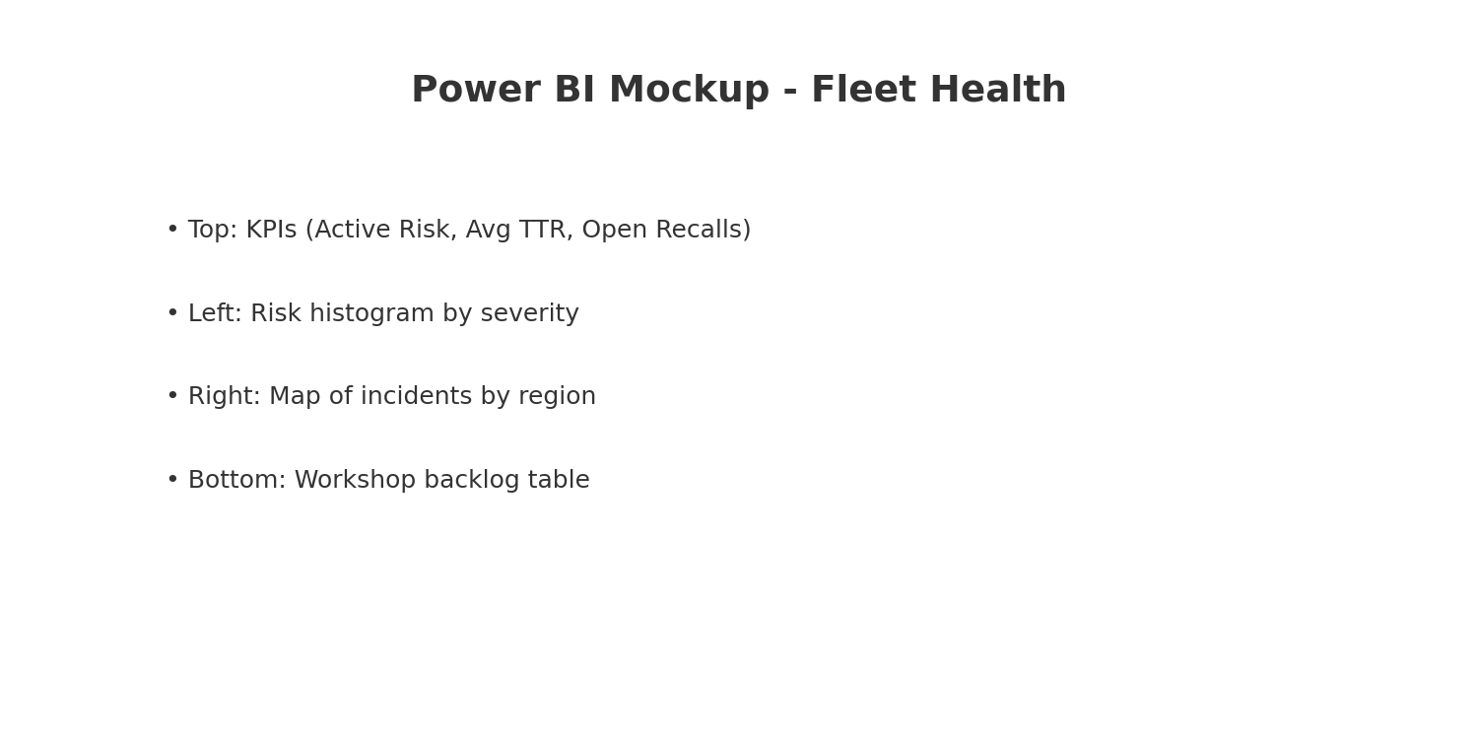
Power BI Mockup - Fleet Health

Slide 26
Power BI: Lab Steps
Connect to Azure Data Lake / Delta tables (or CSV for lab)
Import tables and define relationships
Create measures using DAX: ActiveRiskCount = COUNTROWS(FILTER(TelemetryFeatures, TelemetryFeatures[risk]>0.7))
Build visuals: KPI cards, map (use lat/long), bar charts, tables
Publish to Power BI Service and create dashboards

Slide 27
GitHub Repo Structure (Suggested)
telemetry-sim/ # simulator
ingest-service/ # FastAPI ingest
orchestrator/ # FastAPI orchestration
models/ # training & notebooks
infra/ # Dockerfiles, k8s manifests
powerbi/ # report .pbix or instructions
docs/ # lab guide and README

Slide 28
Dockerfile Example
# Dockerfile (ingest service)
FROM python:3.11-slim
WORKDIR /app
COPY requirements.txt .
RUN pip install -r requirements.txt
COPY . .
CMD ["uvicorn", "main:app", "--host", "0.0.0.0", "--port", "8000"]

Slide 29
Kubernetes Deployment (AKS) Example
# deployment.yaml (simplified)
apiVersion: apps/v1
kind: Deployment
metadata:
name: ingest-service
spec:
replicas: 2
selector:
matchLabels:
app: ingest
template:
metadata:
labels:
app: ingest
spec:
containers:
- name: ingest
image: myregistry/ingest:latest
ports:
- containerPort: 8000

Slide 30
GitHub Actions: CI/CD Workflow
# .github/workflows/ci-cd.yaml
name: CI/CD
on: [push]
jobs:
build:
runs-on: ubuntu-latest
steps:
- uses: actions/checkout@v4
- uses: actions/setup-python@v4
with: python-version: '3.11'
- run: pip install -r requirements.txt
- run: pytest
- run: docker build -t myregistry/ingest:${{ github.sha }} .
- run: docker push myregistry/ingest:${{ github.sha }}

Slide 31
DevSecOps Checks (Lab)
Static analysis: Bandit for Python, Snyk/Dependabot for deps
SAST + DAST scanning in pipeline
SBOM generation and vulnerability gating
Secrets scanning and policy enforcement

Slide 32
IoT Security Considerations
Device identity & provisioning (X.509 certs)
Data encryption in transit (TLS) and at rest
Firmware signing and secure OTA
Throttling and anomaly detection for device compromise

Slide 33
Observability
Metrics: Prometheus + Azure Monitor
Tracing: OpenTelemetry
Logging: ELK or Azure Log Analytics
Alerting: PagerDuty or Teams integration for critical failures

Slide 34
Class Lab: Demo Plan (2.5 - 3 hours)
Part A (30m): Run telemetry simulator & ingest service
Part B (45m): Stream processing & feature extraction (notebook)
Part C (45m): Train a simple model & generate risk scores
Part D (30m): RAG demo for compliance queries
Part E (30m): Deploy services to AKS (optional) and view Power BI dashboard

Slide 35
Troubleshooting Scenarios
High false positives in anomaly detection — tune thresholds
Model drift — schedule retraining & monitoring
Latency in ingest pipeline — scale Event Hub / partitions
Missing parts in ERP — fallback to nearest dealer

Slide 36
Lab Resources & Requirements
Python 3.11, Azure CLI (or local alternatives), Docker
Power BI Desktop (for dashboard build)
Optional: Azure subscription for full cloud deployment
GitHub account for repo and Actions

Slide 37
Using GitHub Copilot: Prompt Example
# Example prompt for GitHub Copilot:
"""Write a FastAPI endpoint that validates telemetry, enriches with VIN metadata,
and publishes to Azure Event Hub using asyncio."""
# Copilot will generate the function body which you should review and secure.

Slide 38
Assessment & Deliverables
Working ingest service and telemetry simulator
Trained predictive model with evaluation report
RAG-based compliance assistant demo
Power BI dashboard (published or PBIX file)
README and deployment guide in GitHub repo

Slide 39
Next Steps & Extensions
Integrate real CAN bus data and OEM diagnostics
Add OTA remediation for certain failures
Marketplace for predictive maintenance as subscription
Enhance technician assistant with AR overlays

