Slide 1

232,112,113
64,64,64
2
0
2
0
The demonstration for
Orion's Orbits online system
汇报人：0184411-殷鹏飞 时间：2020年04月

Slide 2
目录
01
02
03
Opening speech
Function illustration
Peroration

Slide 3
01
Opening speech

Slide 4
Opening speech
Thank you for giving me this opportunity to demonstrate online.
I'm Gary from action software company.
Next, I will show our design and development plan in two parts.
I hope my presentation can satisfy everyone.

Slide 5
02
Function illustration

Slide 6
Function illustration
functional requirement
The system provides customers with ticket booking, refund and other related content and management.It provides accurate, precise and rapid air ticket sales information for decision makers of enterprises, provides convenience for passengers to travel, facilitates airport staff to manage air ticket information, and improves the work efficiency of airport staff in air ticket management.

Slide 7
Function illustration
non-functional requirements
The system's page requirements: in order to facilitate visitors to browse the website, the system is required to have friendly interface design, appropriate layout, good vision, practical system functions and simple operation.
Reliability Requirement: Reliability is the basic requirement for software. The designed system needs to run smoothly and cannot stop responding after running for a period of time. Therefore, the reliability requirement is crucial.

Slide 8
Function illustration
non-functional requirements
Portability Requirement: The design of air ticket reservation system can run normally after the software configuration is correctly installed.
Security requirements of the system: a large amount of relevant data is stored in the system, and some of the information is confidential, so security measures need to be taken.

Slide 9
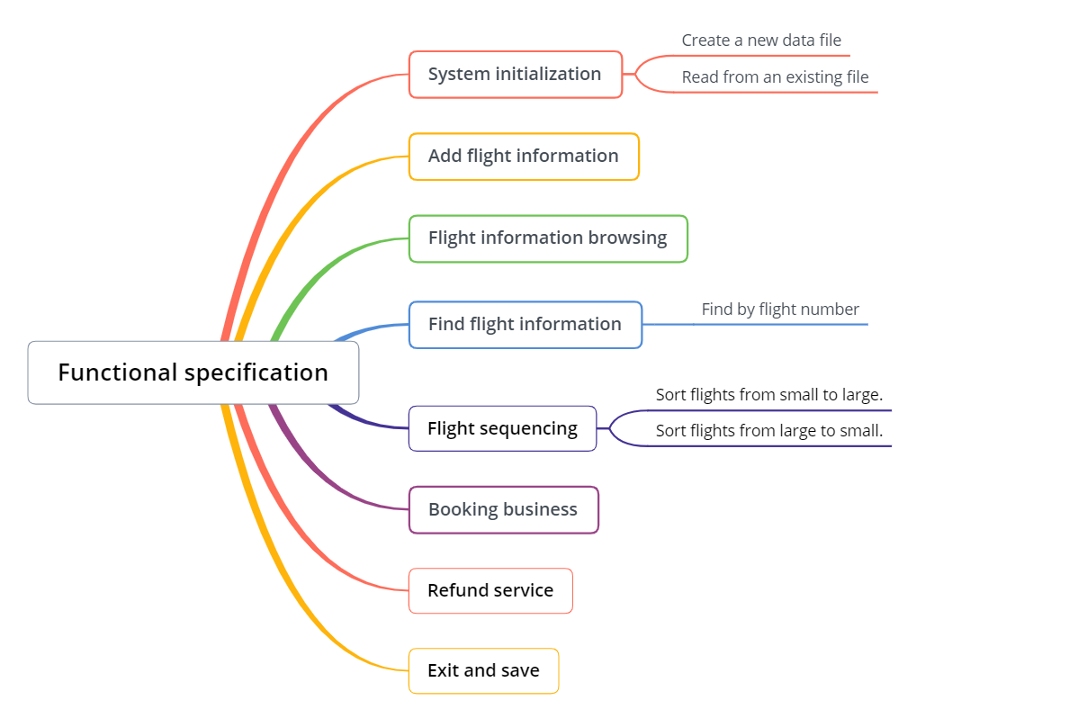
Function illustration
Structure

Slide 10
Specific function
User login management
Subscribers first register a user and enter the corresponding user name and password to log in from the home page.
User information management
It is used to modify, update and delete the user's own information.

Slide 11
Specific function
Flight information management
Used for a series of management of flights.
Order information management
Used for the operation of information after the user has booked the air ticket.

Slide 12
03
Peroration

Slide 13
Peroration
Our team has done detailed research work on the airplane ticketing system, and our development capability is very mature. There are strict arrangements from the requirement analysis to the final function realization to the test launch. I believe we will make this system perfect.
Thank you again for letting me demonstrate our plan.

Slide 14
232,112,113
64,64,64
2
0
2
0
The demonstration for
Orion's Orbits online system
汇报人：0184411-殷鹏飞 时间：2020年04月
THANKS

