Slide 1
Homework
Please read job recruitment advertisements below, and design a resume apply for the one that interest you.

Slide 2
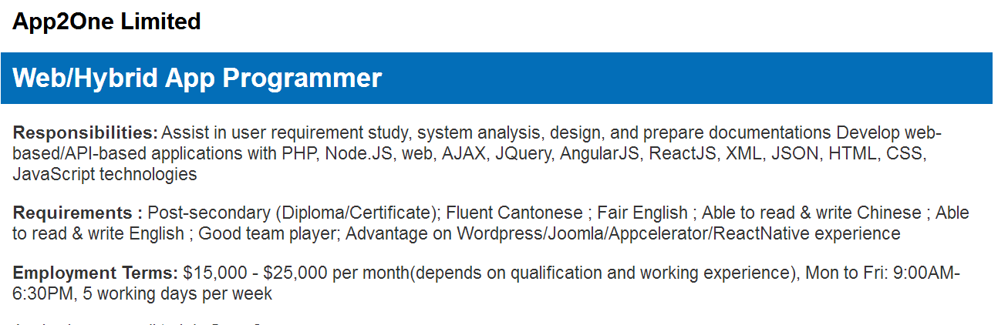
Job 1

Slide 3
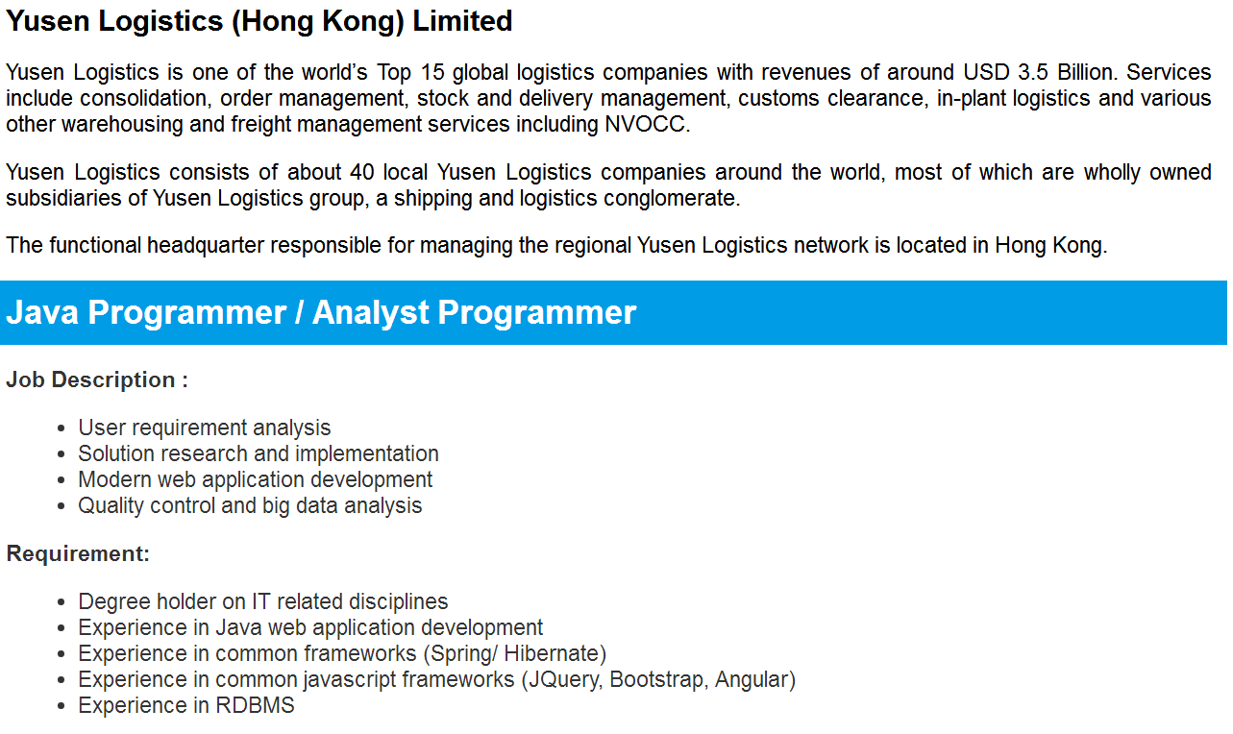
Job 2

Slide 4
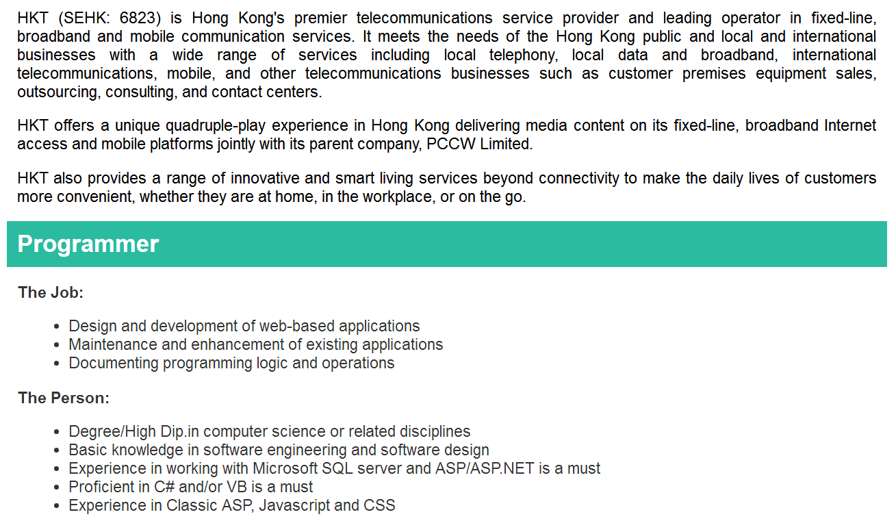
Job 3

