Slide 1


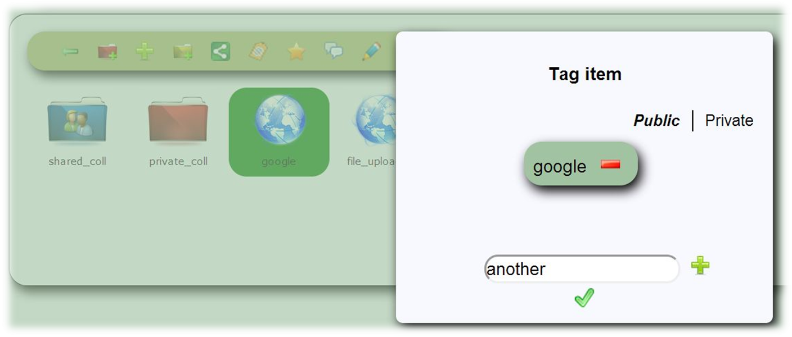
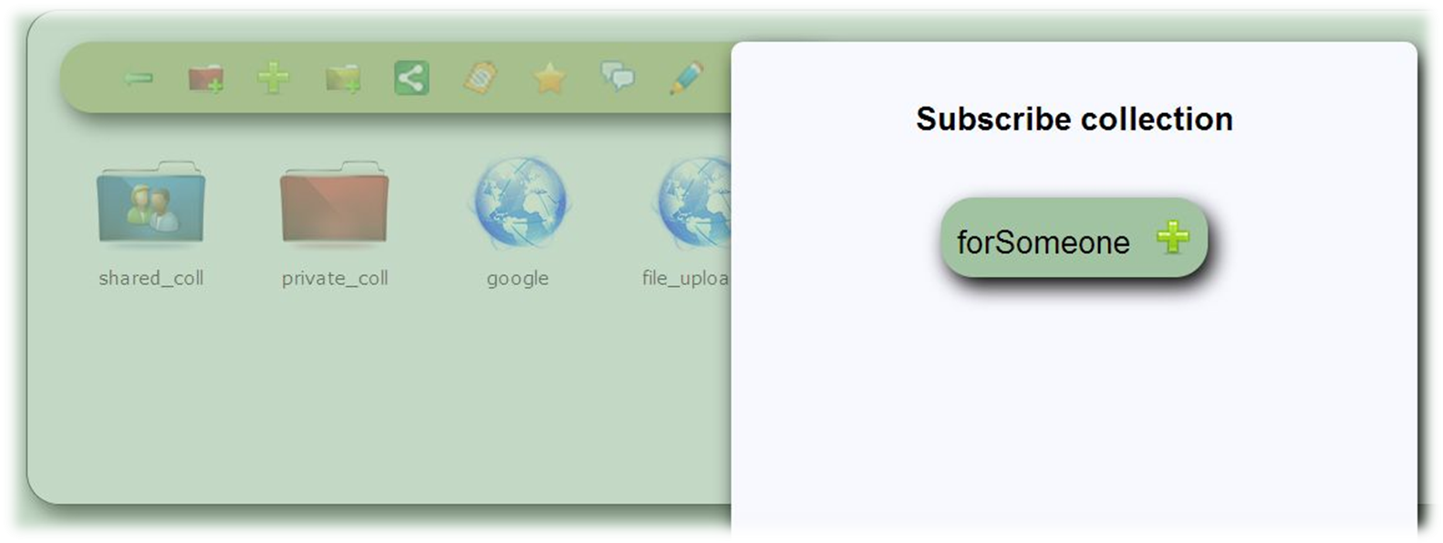
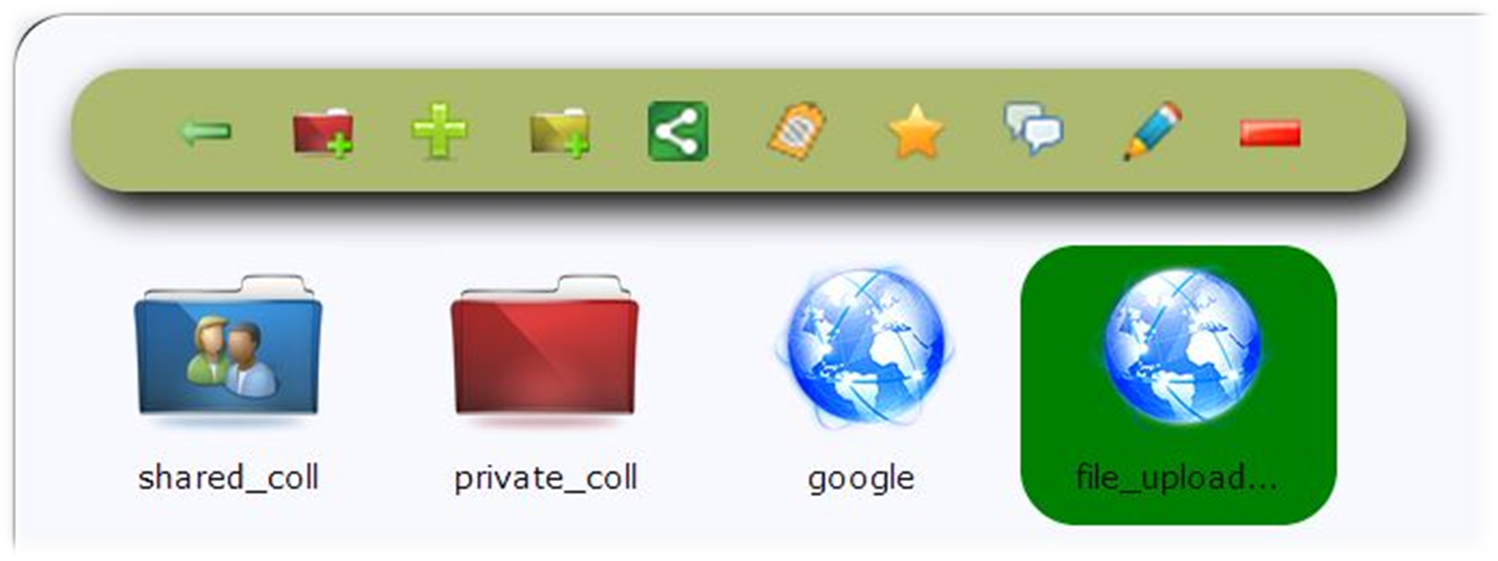
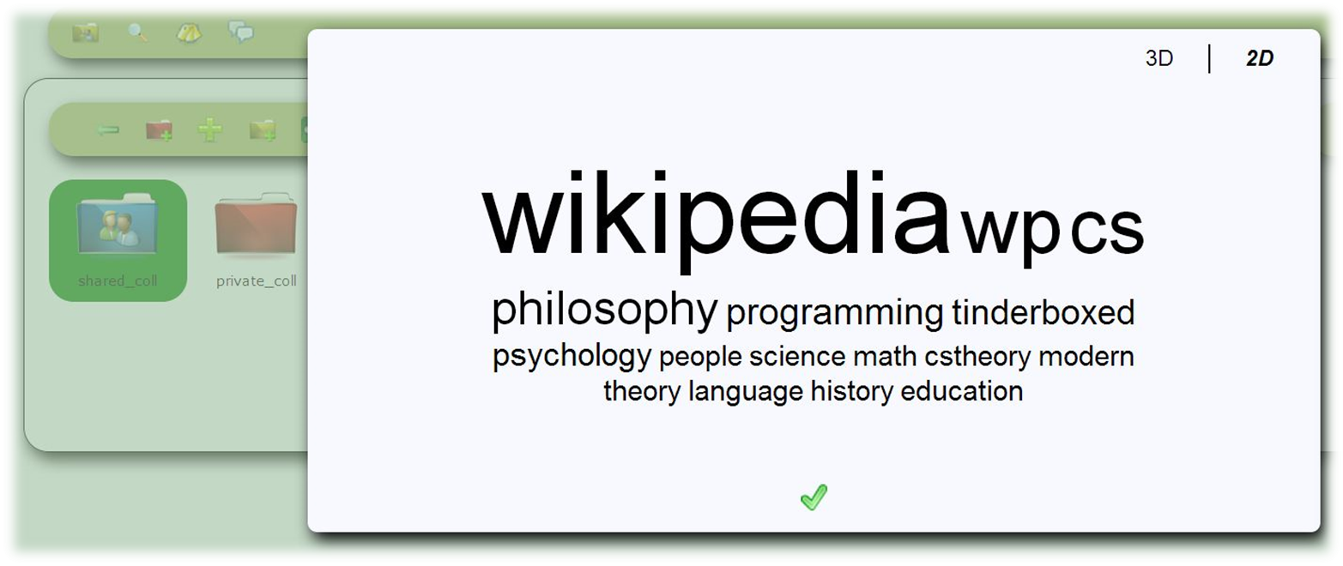
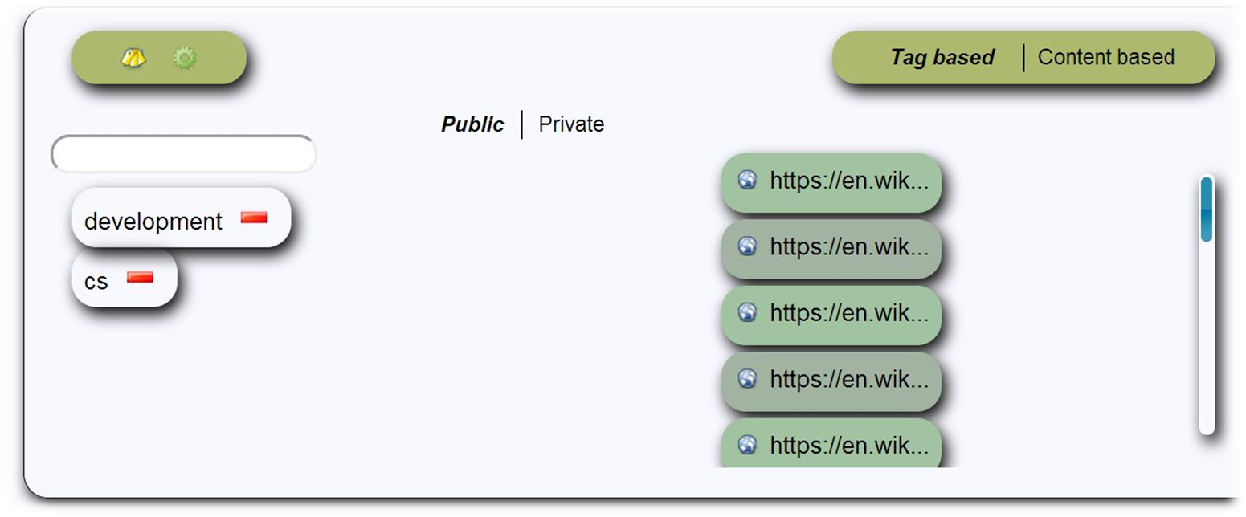
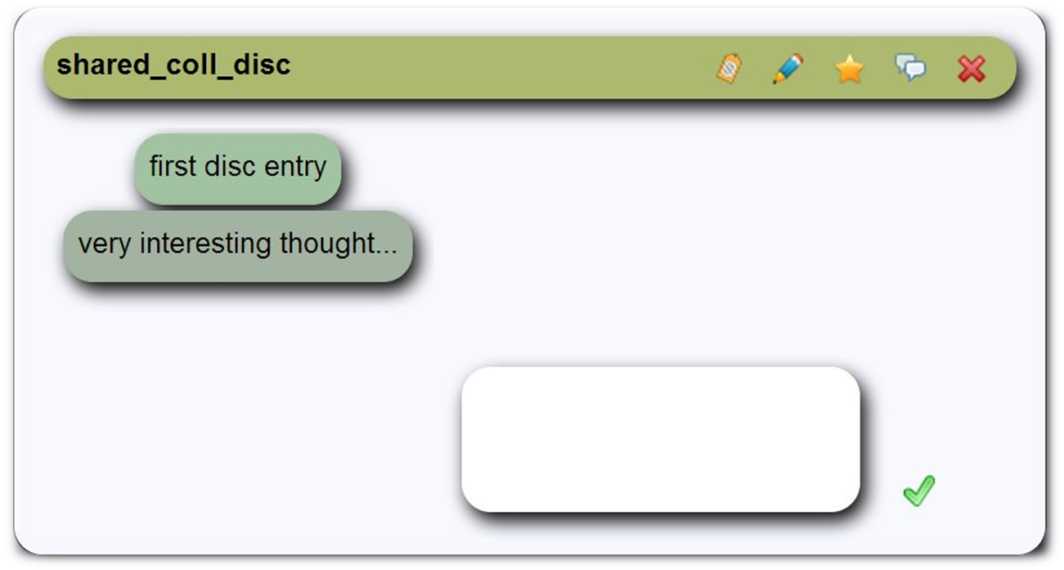
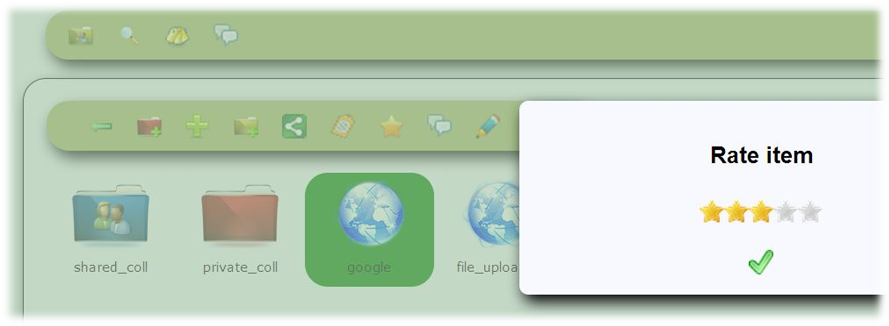
WP5: Social Semantic Server Functionalities
Dieter Theiler, Dominik Kowald, Sebastian Dennerlein, Christoph Trattner
Knowledge Technologies Institute (TU Graz), Inffeldgasse 13, Graz, Austria
Content Structuring
Annotating
Reflecting
Sharing
Learning Layers use case breakdown
Collect and aggregate bits collaboratively in collections
Add tasks to white folder
Capture and create content
Current support to
Add or upload entities (e.g. text, notes, pics, audio, voice, video, links) to collections
Structure entities in collection hierarchies
Copy or move entities throughout collections
Order collection entities with regard to their sequence
Open or download various entity types from collections and search results
Outlook for support to
Structure entities via
  metadata (e.g. categories)
  sections (e.g. ordered sequences of sections within a guideline)
  pre-defined categories (e.g. given structure from white folder)
Attach various other entities to entities of various types (e.g. collections, discussions, questions, answers, guidelines)
Aggregate bunches of entities [attached to other entities] to collections (e.g. entities of a complete discussion thread)
Learning Layers use case breakdown
Tag bits and pieces
Annotate information
Current support to
Annotate entities with metadata (tag and label)
Outlook for support to
Add extended sets of metadata to entities (e.g. questions, comments)
  e.g. geo-locations, stati, (pre-defined) categories, user-based favorite flags, QR-tags, priority, what, why, what next, highlight (section) information
Learning Layers use case breakdown
(Self-) reflection
Support reflection of collected bits and pieces
Awareness of hot topics
Access updated information
Current support to
Retrieve (aggregated) information for entities, e.g.:
  content
  metadata (e.g. overall ratings, author)
  usage-based indicators (e.g. maturing indicators)
  updates (e.g. alerts, reminders) on, e.g. subscribed collections, discussions, entities in general, guideline sections
  recommended tags on entity and user basis
Outlook for support to
Edit (e.g. also split, merge, customize) existing entities (e.g. questions, comments, guideline (-sections), user’s profiles)
Aggregate information on, e.g. updates, changes on (e.g. guideline sections)
Recommend entities (e.g. users, links, collections, questions, answers, white folder items, guidelines) and metadata (e.g. tags, labels, descriptions, geo-locations, categories) based on, e.g.:
  given metadata (e.g. ratings, likes, geo-locations, time)
  emerging semantic structure (e.g. user-entity relations, (in-) direct links in general, connectivity, metadata similarities, to entities attached other entities, structured entities)
  aggregated information within profiles (the context) of users and entities
      e.g. entities’ helpfulness, quality, likelihood to be consulted, trustiness, expertise level, [learning style]
  exploitation of usage traces for users and entities
      e.g. actions, frequencies, times
  access restriction system
  [content-based similarities of entities]
Learning Layers use case breakdown
Share relevant information
Share white folder items and reflection questions
Current support to
Keep entities private via private metadata or private collections
Share (private) collections with other users
Share entities via public metadata
Subscribe to collections
Outlook for support to
Use fine-grained sharing and restricting on entity and user basis (access restriction system)
  share entities, subscribe to entities and metadata, invite user (-groups) to entities, confirm information, message information with entities attached, …
  based on, e.g.:
    user (-group(s)), organizations, links, collections, guidelines, comments on guidelines, questions, answers
Searching
Learning Layers use case breakdown
Search for/find relevant information
Find a way how to do particular task or part of a task
Current support to
Search for entities via
  metadata (e.g. tags, labels, indicators)
  content (e.g. keyword-based)
  access restrictions (currently private or public)
Filter search results with regard to
  entity type
  metadata available for found entities
Outlook for support to
Search within entities (e.g. white folders, collections, discussions, comments, guidelines)
Use facetted search, browse and rank based on available information for found entities
  same data could be useable here as for recommendations
Rank search results with regard to collaborative feedback on search results
Discussing
Learning Layers use case breakdown
Create questions
Comment information
Seek support
Current support to
Create, comment or answer discussions and questions [based on various entities]
Outlook for support to
Rank, e.g. answers for entities (e.g. discussions) with regard to their metadata or contents
Use discussions, comments and answers for metadata as well
Rating
Learning Layers use case breakdown
Rate information
Current support to
Rate various types of entities and search results
Outlook for support to
Rate entities with the help of extended metadata sets (e.g. likes, dislikes)

