Slide 1




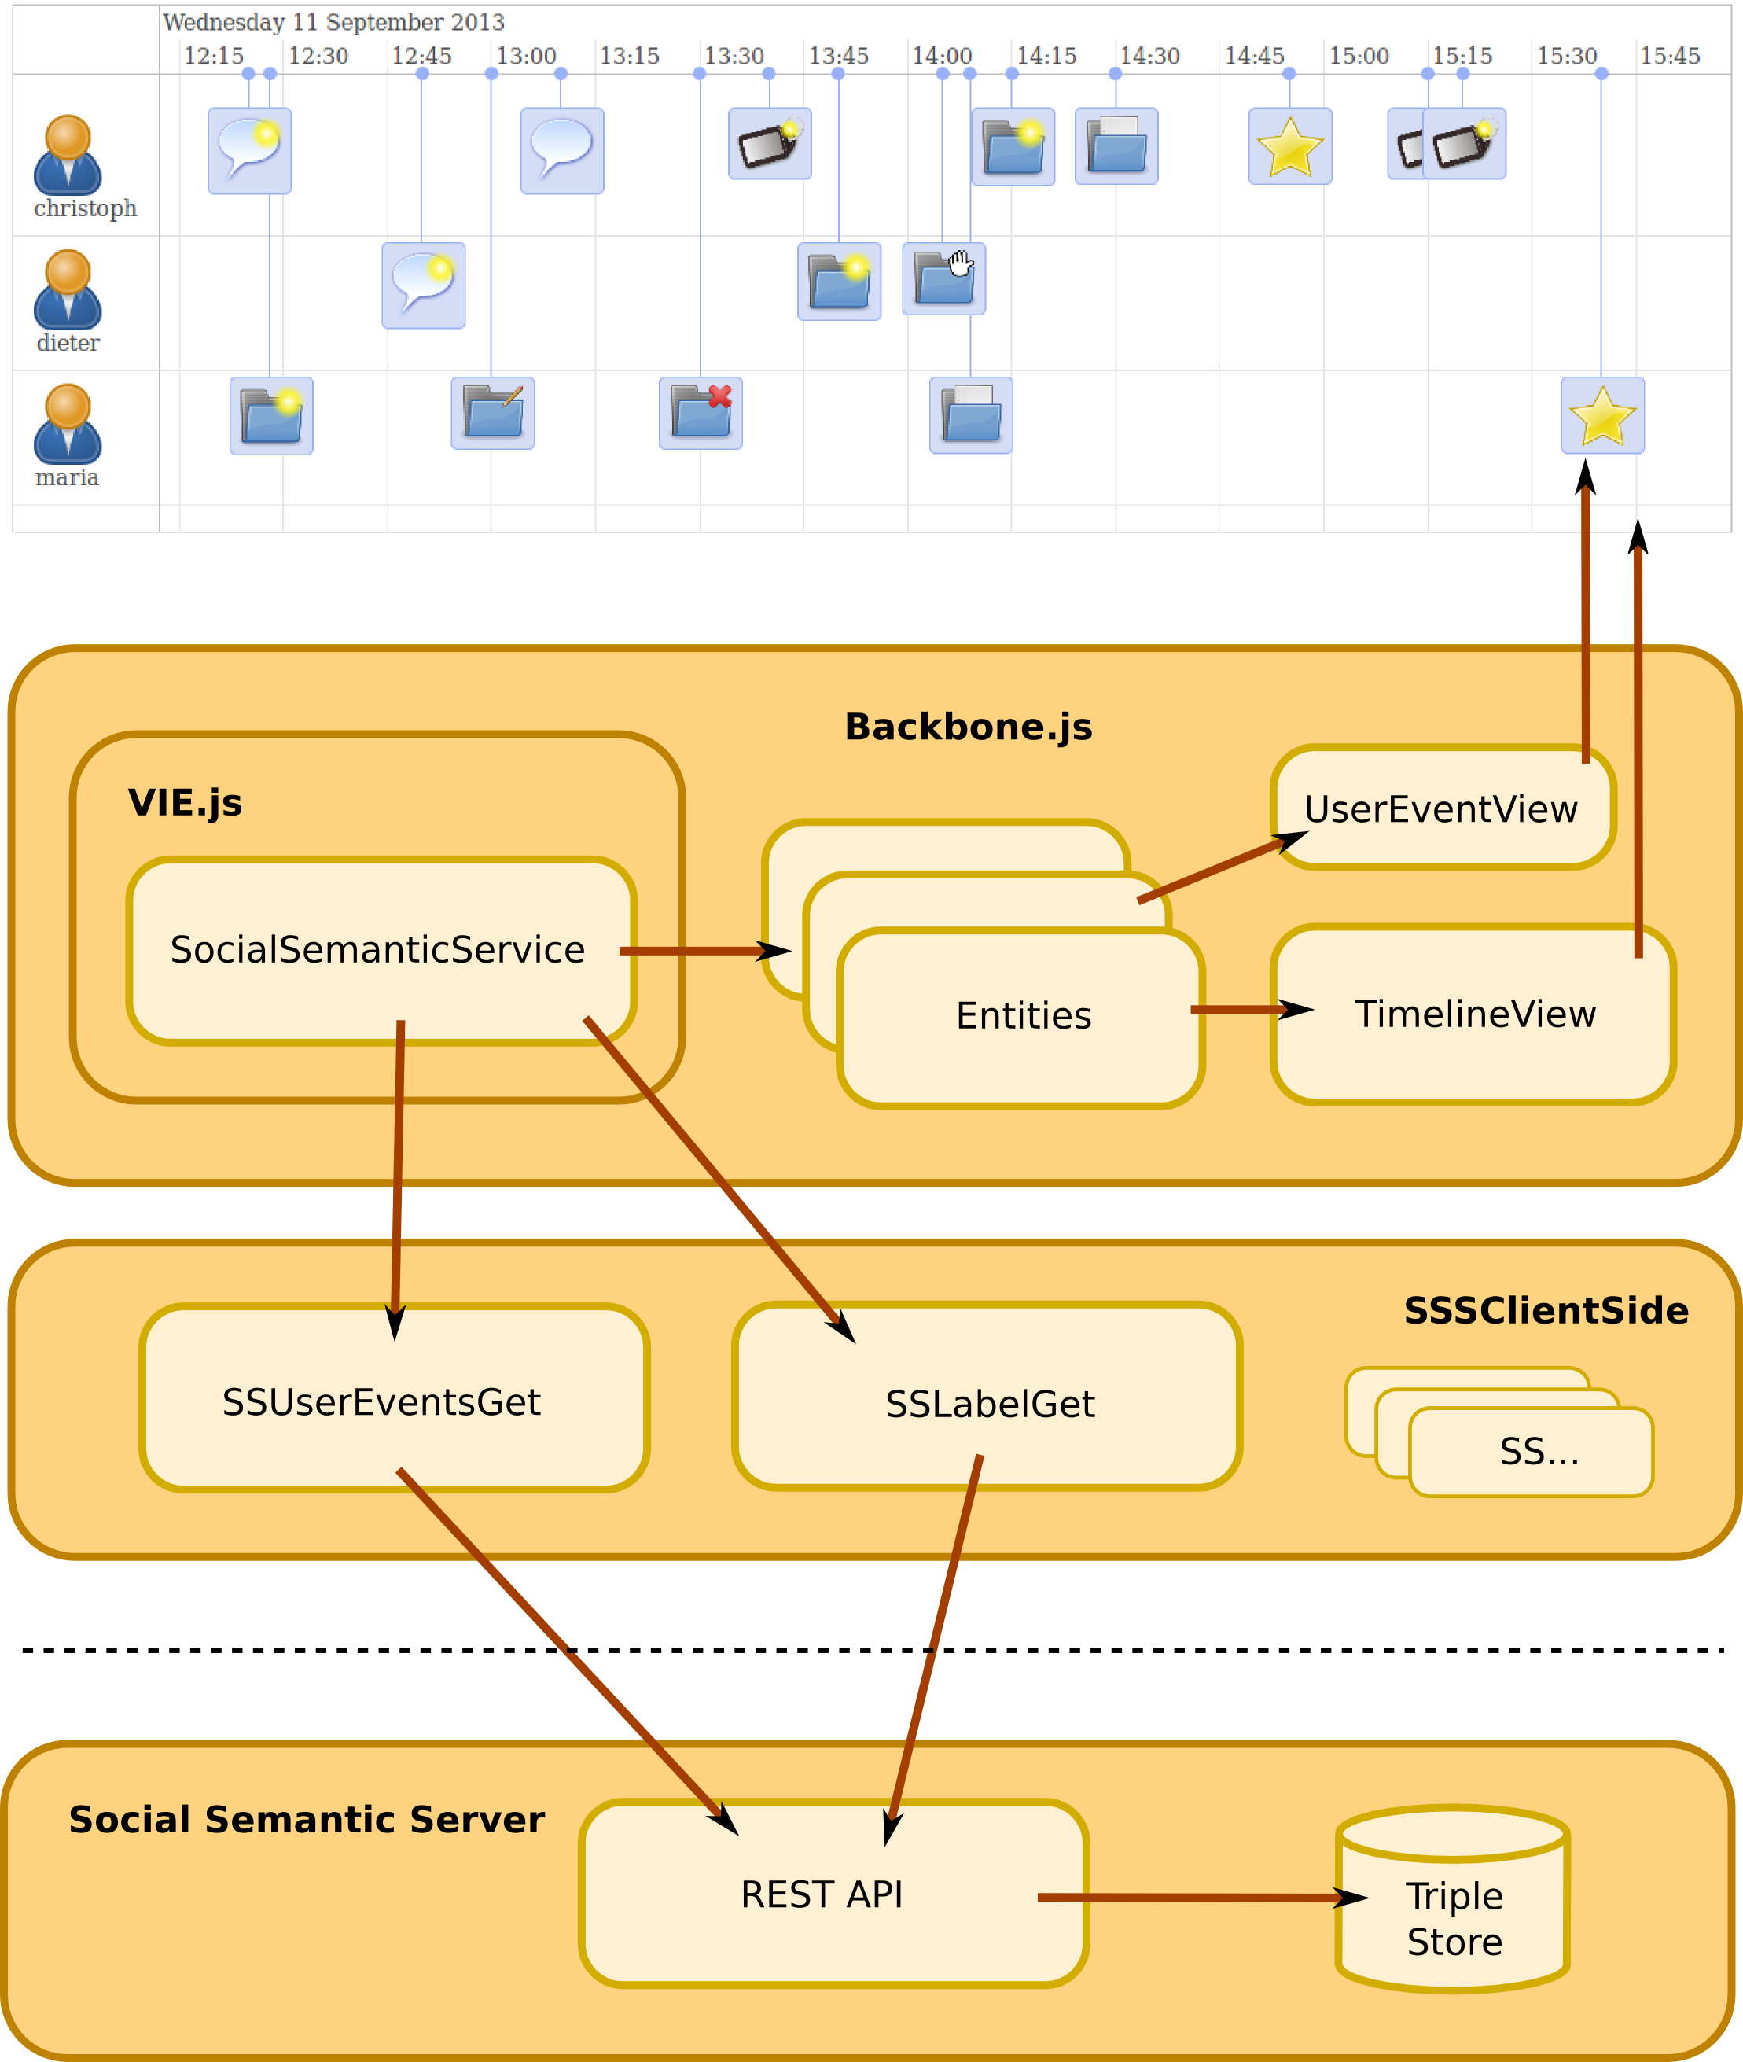
Implementing a User Interface for the Social Semantic Server
Matthias Rella, Dieter Theiler, Dominik Kowald, Sebastian Dennerlein, Christoph Trattner
Knowledge Technologies Institute (TU Graz), Inffeldgasse 13, Graz, Austria
Download & Setup
Server Side Implementation
A Timeline View of User Events
Client Side Implementation
Download the client-side javascript library:
http://sourceforge.net/p
/learning-layers/code
/HEAD/tree/trunk
/SocialSemanticServer
/SSSClientSide/
Request your
Social Semantic Server playground:
ctrattner@know-center.at
Read the documentation:
developer.learning-layers.eu
/documentation
/social-semantic-server/
Use SSSClientSide connectors to communicate with the Social Semantic Server over JSON-LD
3rd party timeline library
http://almende.github.io
/chap-links-library/
Backbone.js
(MVC-Framework)
Binds views to entities,
auto triggers re-draw of TimelineView on data change
VIE.js (Semantic Interaction Framework)
Bridges Backbone.js and
the Semantic Web,
implements a service for
the Social Semantic Server,
built-in support for
JSON-LD
Ex.: JSON-LD Response
{"@context":{ … }
"userEventsGet": {
"userEvents": [
{
„uri“:
„http://sss.ll/event/471/“, „user“:
„http://sss.ll/user/maria/“,
„resource“:
„http://sss.ll/coll/815/“, „type“:
“createPrivateCollection“,
„content“: „NA“,
„timestamp":1378898207405
}
]
},"error":false
}
Ex.: SSUserEventsGet
„Request user events of user Maria on collection 815“
new SSUserEventsGet().handle(
resultHandlerFunction,
errorHandlerFunction,
<applicationUserURI>,
<userKey>,
„http://sss.ll/coll/815/“,
„http://sss.ll/user/maria/“,
1378898207000,
1378898208000);

