Slide 1
An Empirical Replication and Extension of Model:
Comparison Study on Predicting Co-Occurring Test
and Source Code Refactoring
Presented by: Zhouyiyang Yang

Slide 2
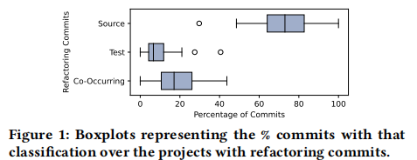

Background & Motivation
• Software requires continuous refactoring to maintain quality.
• Source code refactoring is well-studied, but test code refactoring is often overlooked.
Key findings from Nagy & Abdalkareem (2022):
• 17.9% of refactoring commits are co-occurring (both test and source code).
• This is more than double the 8.2% of test-only refactoring commits.
Motivation: Understanding and predicting this co-occurrence can lead to smarter developer tools that proactively suggest test refactoring.

Slide 3
Original Study and Research Gap
What the original paper did:
• RQ1: Empirical study on frequency and types of co-occurring refactorings.
• RQ2: Used a Random Forest model to predict co-occurrence.
Limitations:
• Model Singularity: Only explored Random Forest.
• Limited Interpretability: Lack of explanation for model decisions.

Slide 4
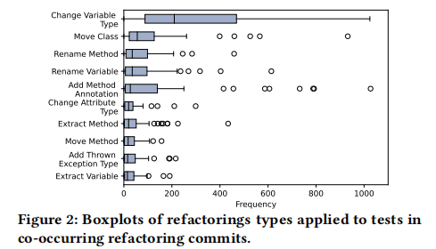
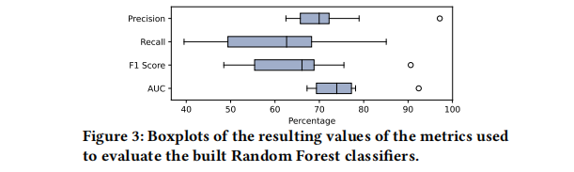
Research Objectives & Questions
Overall Goal: To provide a more comprehensive and interpretable model analysis for predicting co-occurring refactoring through replication and extension.
Research Questions:
• RQ1 (Replication): Can we replicate the original study's findings on co-occurring refactorings?
• RQ2 (Replication & Extension):
– Replication: Can we replicate the Random Forest baseline?
– Extension: Can XGBoost outperform Random Forest?
– Extension: Can SHAP Analysis identify key predictive features? Any difference with original Gini analysis?

Slide 5
Research Phases
Phase 1: Replication
• Data Loading & Preprocessing
• Replicate RQ1 (Descriptive Statistics)
• Replicate RQ2 (Random Forest Baseline)
Phase 2: Extension
• Train & Compare XGBoost and RF
• SHAP Analysis for feature importance

Slide 6
Extension: XGBoost & SHAP
XGBoost: An efficient gradient boosting decision tree algorithm.
• Performs well on structured data, demonstrates strong generalization ability.
• Random Forest uses a bagging approach, XGBoost adopts a boosting strategy which achieves higher accuracy.
SHAP (SHapley Additive exPlanations):
• a game theory–based interpretability method designed to explain the output of machine learning models.
• Provides a grounded measure of feature importance, and explains model behavior.

Slide 7
Technology Stack & Data
Core Libraries: (Python)
• pandas, numpy – data processing
• scikit-learn – ML models, cross-validation
• XGBoost – gradient boosting
• SHAP – interpretability
• matplotlib, seaborn – visualization
Data Source:
• follows the original paper by adopting the SmartSHARK 2.1 dataset
• The replication package from the original study was downloaded, included preprocessing scripts rather than a finalized dataset.

Slide 8
Evaluation & Success Criteria
Evaluation Metrics:
• AUC (primary), F1-Score, Precision, Recall.
• 10-fold cross-validation for robustness.
Success Criteria:
• Successful Replication: Similar RQ1 stats and RF performance.
• Model Improvement: XGBoost improves or decreased AUC/F1 significantly compared to RF.
• Deeper Insights: SHAP gives clear feature importance ranking.

Slide 9


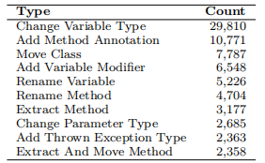
Replication of RQ1
Production-only refactorings-73.72%, co-occurring refactorings-17.96%, and test-only refactorings-8.32%.
Replicated distribution closely aligns with the results reported in the original paper.
Change Variable Type, Move Class,and Rename Method are the most frequent refactoring operations, consistent with the findings of the original study.

Slide 10
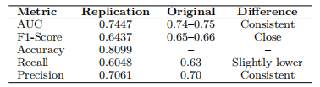
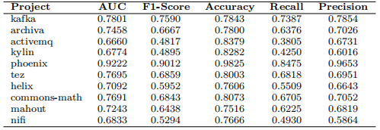
Replication of RQ2
RF baseline achieved an average AUC of 0.7447 across 10 projects, closely matching the original study's range of 0.74-0.75
Performance varied significantly by project: Phoenix-exceptional performance (AUC: 0.9222), ActiveMQ-lower predictability (AUC: 0.6660).
The model shows consistent performance across metrics with F1-score: 0.6437, Precision: 0.7061, and Recall: 0.6048.

Slide 11

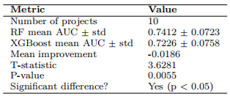
Expansion: Model Comparison
Random Forest significantly outperformed XGBoost (AUC: 0.7412 vs 0.7217, F1: 0.6380 vs 0.6055).
Statistical Significance Test:
t-value: 3.6281
p-value: 0.0055<0.05
=>Performance difference is significant.

Slide 12
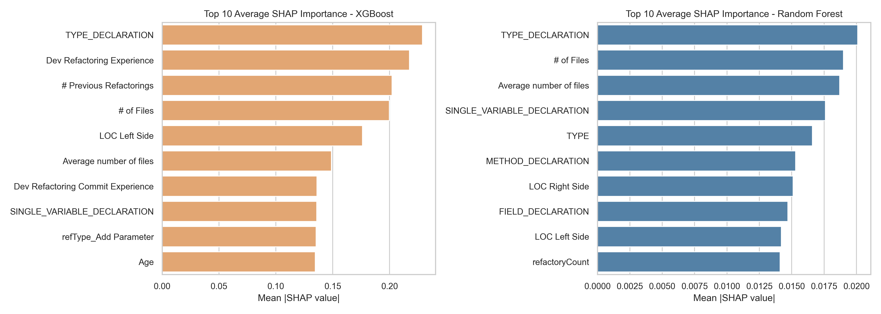
Expansion: Feature Importance
Both models identify TYPE_DECLARATION as important, highlighting the role of type-level refactorings in triggering synchronized test code changes.
XGBoost focuses on code structure (TYPE_DECLARATION) and developer experience, indicating it captures complex code semantics. RF shows a more balanced use of features, including refactoring scale (# of files) and code elements (SINGLE_VARIABLE_DECLARATION).

Slide 13
Conclusion & Discussion points
Replication confirms that co-occurring refactoring is a stable phenomenon in software development, not an artifact of specific datasets.
Random Forest outperforms XGBoost in this task, showing that advanced models do not always guarantee better performance.
File history, refactoring scale, and developer experience are key predictive features in SHAP; intelligent tools should focus on these dimensions.

Slide 14
Limitations & Future Work
Limitations:
• Language scope (Java only)
• Data timeliness (historical data)
• Potential for further parameter tuning of XGBoost.
Future Work:
• Multi-language validation
• Comparing more models (e.g., LightGBM, CatBoost)
• Innovative feature engineering based on SHAP insights.

