Slide 1
The Human Body

Slide 2
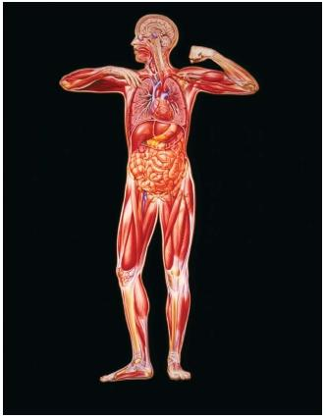
Respiratory System
Circulatory System
Digestive System
Muscular System
Skeletal System

Slide 3
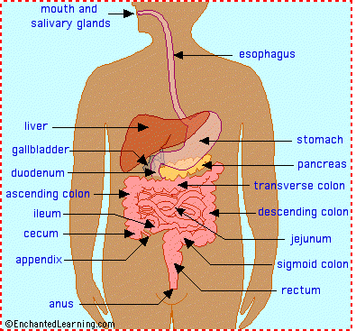
Digestive System

Slide 4
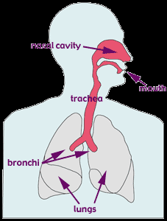
Respiratory System

Slide 5
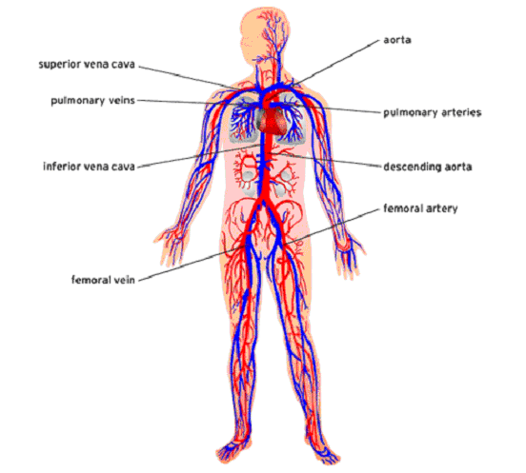
Circulatory System

Slide 6
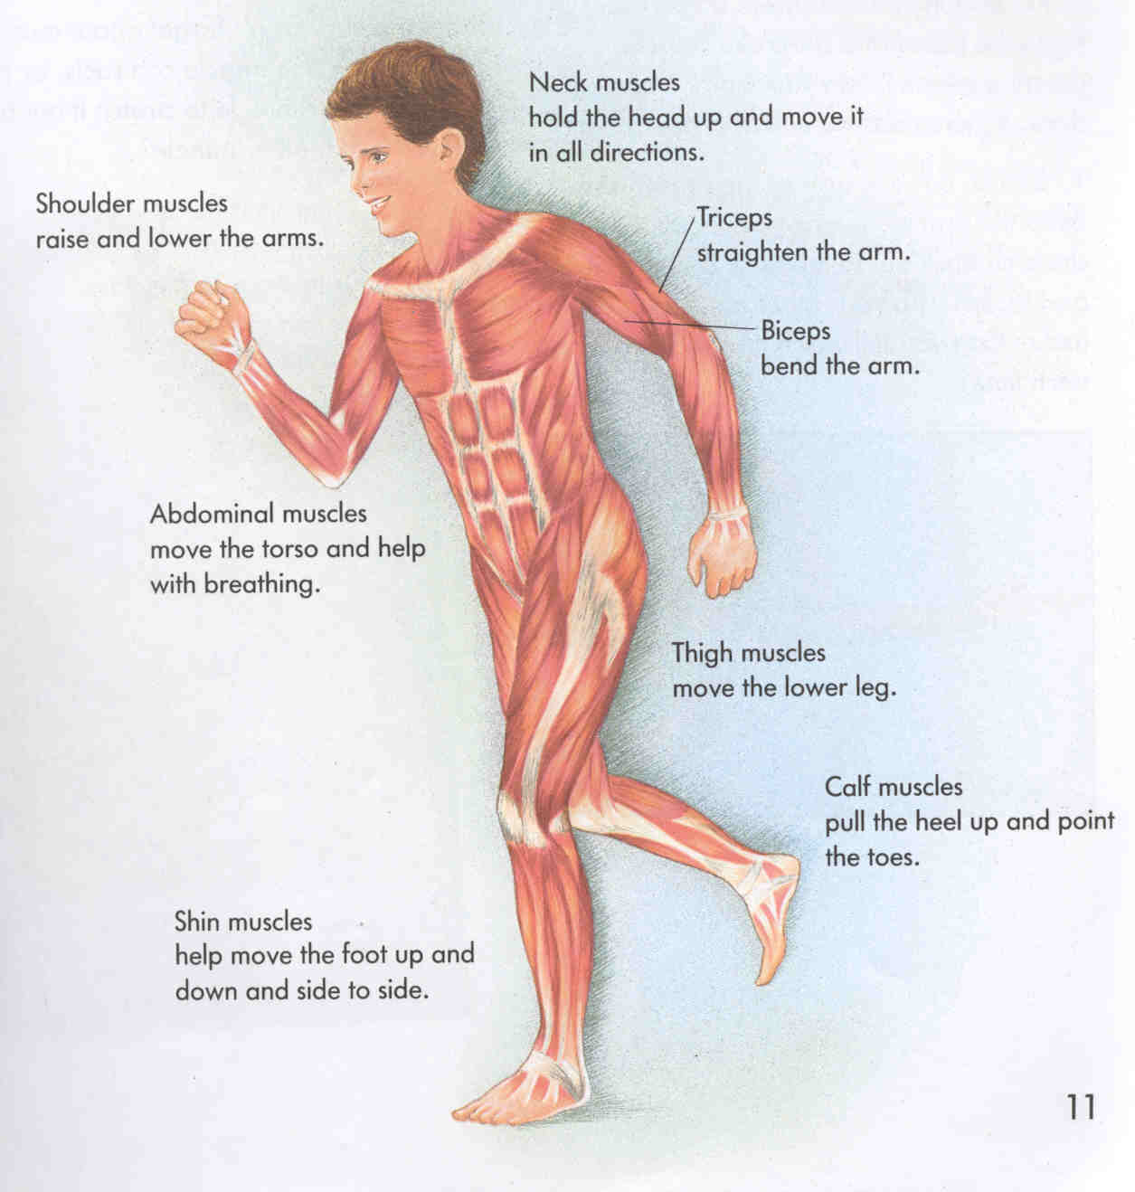
Muscular System

Slide 7
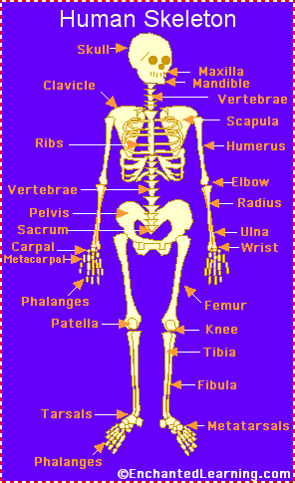
Skeletal System

Slide 8
Digestive System
Gross and Cool Facts!
HOW LONG ARE YOUR INTESTINES? At least 25 feet in an adult. Be glad you're not a full-grown horse -- their coiled-up intestines are 89 feet long!
Chewing food takes from 5-30 seconds
Swallowing takes about 10 seconds
Food sloshing in the stomach can last 3-4 hours
It takes 3 hours for food to move through the intestine
Food drying up and hanging out in the large intestine can last 18 hours to 2 days!
Americans eat about 700 million pounds of peanut butter.
Americans eat over 2 billion pounds of chocolate a year.
In your lifetime, your digestive system may handle about 50 tons!!

Slide 9
Respiratory System
Gross and Cool Facts!
Your lungs contain almost 1500 miles of airways and over 300 million alveoli.
Every minute you breathe in 13 pints of air.
Plants are our partners in breathing. We breathe in air, use the oxygen in it, and release carbon dioxide. Plants take in carbon dioxide and release oxygen. Thank goodness!
People tend to get more colds in the winter because we're indoors more often and in close proximity to other people. When people sneeze, cough and even breathe -- germs go flying!

Slide 10
Circulatory System
Gross and Cool Facts!
The body of an adult contains over 60,000 miles of blood vessels!
An adult's heart pumps nearly 4000 gallons of blood each day!
Your heart beats some 30 million times a year!
The average three-year-old has two pints of blood in their body; the average adult at least five times more!
A "heartbeat" is really the sound of the valves in the heart closing as they push blood through its chambers.

Slide 11
Muscular System
Gross and Cool Facts!
You have over 30 facial muscles which create looks like surprise, happiness, sadness, and frowning.
Eye muscles are the busiest muscles in the body. Scientists estimate they may move more than 100,000 times a day!
The largest muscle in the body is the gluteus maximus muscle in the buttocks.

Slide 12
Skeletal System
Gross and Cool Facts!
The human hand has 27 bones; your face has 14!
The longest bone in your body? Your thigh bone, the femur -- it's about 1/4 of your height. The smallest is the stirrup bone in the ear which can measure 1/10 of an inch.
Did you know that humans and giraffes have the same number of bones in their necks? Giraffe neck vertebrae are just much, much longer!
You have over 230 moveable and semi-moveable joints in your body.

