Slide 1
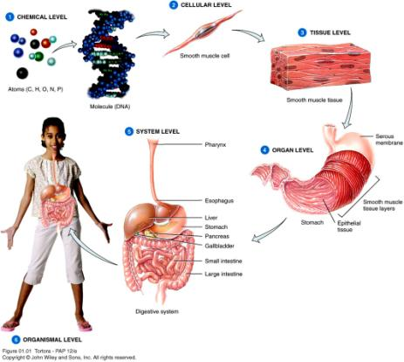
Levels of Structural Organization
Six levels of organization

Slide 2
Levels of structural organization
CHEMICAL LEVEL
  Basic level
    Atoms the smallest unit of matter
      Essential atoms for life include carbon (C), hydrogen (H), oxygen (O), nitrogen (N), phosphorus (P), calcium (Ca), and sulfur (S)
    Molecules two or more atoms joined together
      Deoxyribonucleic acid (DNA)
      Glucose

Slide 3
Levels of structural organization
CELLULAR LEVEL
  Molecules combine to form cells
    Cells are the basic structural and functional units of an organism
    Many kinds of cells in the body
    Muscle cells, nerve cells, epithelial cells, etc.

Slide 4
Levels of structural organization
TISSUE LEVEL
  Tissues are groups of cells and materials surrounding them
    Four basic types of tissues:
      Epithelial
      Connective
      Muscular
      Nervous

Slide 5
Levels of structural organization
ORGAN LEVEL
  Tissues are joined together to form organs
    Organs are structures that are composed of two or more different types of tissues
    Specific functions and recognizable shapes
      Examples:
      Heart, lungs, kidneys
      Stomach is made of several tissues
      Serous membrane, smooth muscle and epithelial layers for digestion

Slide 6
Levels of structural organization
SYSTEM LEVEL
  A system consists of related organs with a common function
  Organ-system level
    Digestive system breaks down and absorbs food
    It includes organs such as the mouth, small and large intestines, liver, gallbladder, and pancreas
    Eleven systems of the human body

Slide 7
Levels of structural organization
ORGANISM LEVEL
  An organism or any living individual
  All parts of the body functioning together

