Slide 1

Distributed Systems
Unit 5 NAMING
Ling ZHOU
School of Computer Science and Engineering
College of Software Engineering,
Southeast University, Nanjing
ling.zhou@seu.edu.cn

Slide 2

Unit 5 – Naming: Outline
Names, Identifiers, and Addresses
Flat Naming
Structured Naming
Attribute-based Naming
Summary
Three different classes of naming systems

Slide 3
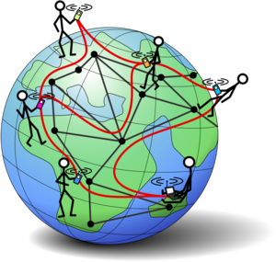
Background
Name resolution allows a process to access the named entity.
The difference between naming in DS and non-DS lies in the way naming systems are implemented.
In a DS, the implementation of a naming system is distributed across multiple machines.
Three important ways of naming in DS:
Flat-naming (entities referred by identifiers)
Structured naming (e.g., DNS)
Attribute-based naming (notoriously difficult in searching)

Slide 4



Names
Names are used to denote entities in a distributed system.
An entity in a DS can be anything.
Typical examples include resources such as hosts, printers, disks, and files; Other well-known examples are processes, users, mailboxes, newsgroups, Web pages, graphical windows, messages, network connections, and so on.
To operate on an entity, we need to access it at an access point.
Access points are entities that are named by means of an address.
Note
A location-independent name for an entity E, is independent from the addresses of the access points offered by E.

Slide 5

Address of an Entity
An entity can offer more than one access point.
A telephone can be viewed as an access point of a person
In a DS, a typical example of an access point is: a host running a specific server, with its address formed by the combination of an IP address and port number.
An entity may change its access points in the course of time.
Using the address of an access point as a regular name of the entity is inflexible and human unfriendly.
Solution: Having a single name for an entity that is independent from its address (location independent) is often much easier and more flexible.

Slide 6


Identifiers
Identifiers are another type of names, to uniquely represent an entity.
Properties of a TRUE identifier:
An identifier refers to at most one entity.
Each entity is referred to by at most one identifier.
An identifier always refers to the same entity (i.e., it is never reused)
If an address can be reassigned to a different entity, we cannot use an address as an identifier.
Notes:
Identifies are names that are used to uniquely identify an entity.

Slide 7
Bit/Character Strings
Addresses and identifiers are two important types of names that are each used for very different purposes.
In many computer systems, addresses and identifiers are represented in machine-readable form only (i.e., the form of bit strings)
E.g., 48-bit Ethernet address, 32-bit/64-bit memory addresses
Human-friendly names: another important type of name is tailored to be used by humans, and generally represented as a character string

Slide 8
How to Resolve Names to Addresses?
There is often a close relationship between name resolution in DS and message routing
In principle, a naming system maintains a name-to-address binding , e.g., (name, address) pairs.
In DS, a centralized table cannot work.
A name is often decomposed into several parts such as ftp.cs.vu.nl and that name resolution takes place through a recursive lookup of those parts
E.g., routing the name resolution request as NS(.) → NS(nl) → NS(vu.nl) → address of ftp.cs.vu.nl
Interesting to note that the boundaries between name resolution and message routing are starting to blur.
Notes:
NS(.) denotes the server that can return the address of NS(nl), also known as the root server.

Slide 9
Unit 5 – Naming: Outline
Names, Identifiers, and Addresses
Flat Naming
Structured Naming
Attribute-based Naming
Summary
Three different classes of naming systems

Slide 10
Flat (Unstructured) Naming
In many cases, identifiers are simply random bit strings, which we conveniently refer to as unstructured, or flat names.
Property of an unstructured name: it does not contain any information whatsoever on how to locate the access point of its associated entity.
Problem: Flat name resolution
Simple solutions
Home-based approaches
Distributed Hash Tables (structured P2P)
Hierarchical location service

Slide 11
Simple Solutions (1)
Broadcasting
Broadcast the ID, requesting the entity to return its current address.
E.g., use Address Resolution Protocol (ARP): IP address --> MAC address
Can never scale beyond LANs, otherwise becomes inefficient
Requires all processes to listen to incoming location requests
One possible variant solution is to switch to multicasting (only a restricted group of hosts receives the request)
E.g., Ethernet network support data-link level multicasting directly in hardware.
Notes:
A multicast address is a logical identifier for a group of hosts in a computer network, that are available to process datagrams or frames intended to be multicast for a designated network service. Multicast addressing can be used in the Link Layer (Layer 2 in the OSI model), such as Ethernet multicast, and at the Internet Layer (Layer 3 for OSI) for Internet Protocol Version 4 (IPv4) or Version 6 (IPv6) multicast.
Ethernet frames with a value of 1 in the least-significant bit of the first octet[note 2] of the destination address are treated as multicast frames and are flooded to all points on the network.
Hardware Support for Multicasting
Support for multicasting may exist at the physical and data-link layers. Many shared medium networks, such as Ethernet, support the option of broadcasting and multicasting packets, and corresponding addressing mechanisms. However, processors are often required to perform extra processing when receiving a multicast packet since, for example, many Ethernet controllers only support partial address filtering[57]. This is a result of the fact that Ethernet physically broadcasts all packets and only the address identifies a packet as unicast, multicast or broadcast. While a unicast filter is simple to implement in hardware taking advantage of the factory installed addresses, multicast filters are more difficult to implement because hosts can join and leave multicast groups at will, so they have to be programmable in software. Despite its problems, such hardware support is very important even in an internetwork, since packets that reach the lowest level LANs can be efficiently multicast there using native hardware mechanisms.
When network switches are actually point to point devices, we would like the hardware to automatically recognize multicast addresses as such and transmit multicast packets through multiple links using the same buffers. ATM switch designs[58][59] increasingly support parallel transmission of multicast packets over multiple links in hardware, increasing peak switching speeds. In contrast, in older internetwork designs, switching among lower level network links (that may or may not support multicasting in hardware) was designed for heterogeneity. Therefore, the hardware was optimized for the lowest common denominator, namely unicasting. Although such hardware optimizations were conceived as improvements over the original software switches, they can conflict with the needs of new software switches that support multicasting, thus incurring a speed penalty for multicast transmissions[60]. In this sense, hardware optimizations targeted for unicast in both LANs and WANs, may have to be reexamined and probably augmented in light of the increasing popularity of multicasting. The emphasis placed on high speed network switches to support multicasting[61][62][63][64] could influence more conventional hardware.

Slide 12

Simple Solutions (2)
Forwarding pointers (another popular approach for locating mobile entities)
When an entity moves, it leaves behind a pointer to next location
Simplicity
A chain for a highly mobile entity can become too long to locate (prohibitively expensive).
All intermediate locations in a chain will have to maintain their part of the chain as long as needed
The vulnerability to broken links
Geographical scalability problems: To keep chains relatively short, and to ensure that forwarding pointers are robust.

Slide 13
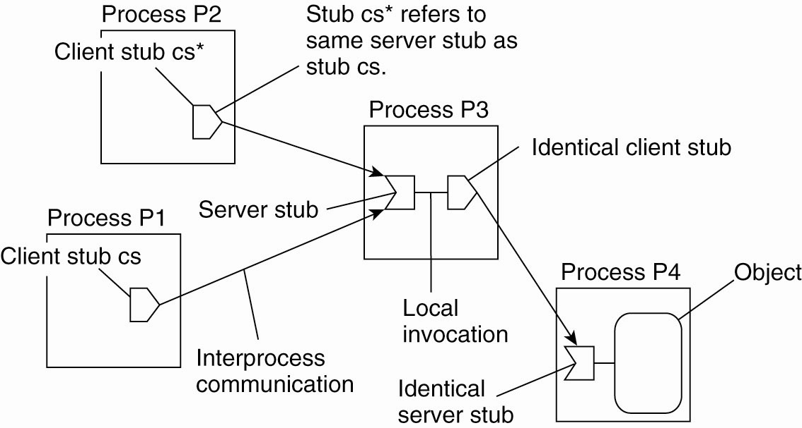
Forwarding Pointers
SSP chains: remote objects can be accessed by means of a RPC.
Each forwarding pointer is implemented as a (client stub, server stub) pair.
Whenever an object moves from address space A to B, it leaves behind a client stub in its place in A and installs a server stub that refers to it in B.
A server stub contains
a local reference to the actual object
or a local reference to a remote client stub for that object.
Observation: Migration is completely transparent to a client. The only thing the client sees of an object is a client stub; a client’s request is forwarded along the chain to the actual object.

Slide 14
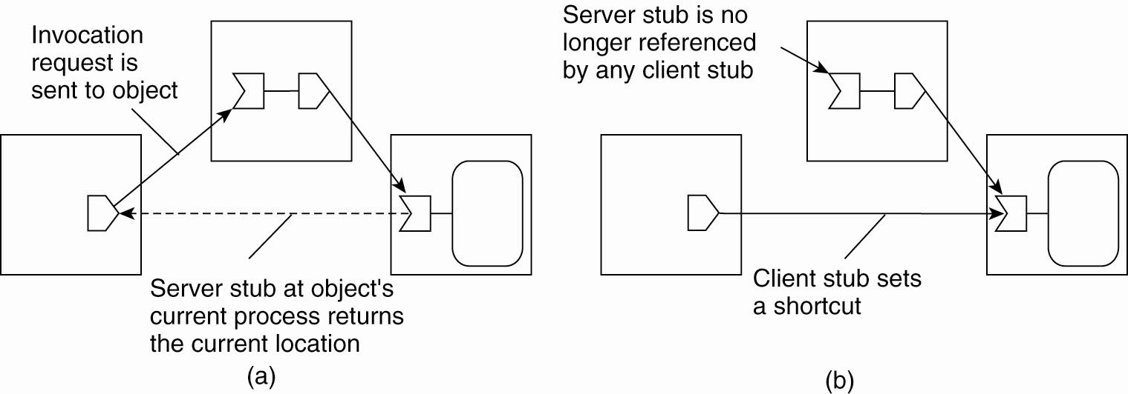


SSP chains: Redirecting a forwarding pointer by storing a shortcut in a client stub
Allows adjustment of all intermediate stubs
can be removed
Sending response faster, but only initiating client stub can be adjusted.
There is a trade-off between sending the response directly to the initiating client stub, or along the reverse path of forwarding pointers.
Notes:
There is a trade-off between sending the response directly to the initiating client stub, or along the reverse path of forwarding pointers.

Slide 15
Flat (Unstructured) Naming
Property of an unstructured name: it does not contain any information whatsoever on how to locate the access point of its associated entity.
Problem
Given an essentially unstructured name (e.g., an identifier), how can we locate its associated access point?
Simple solutions
Home-based approaches
Distributed Hash Tables (structured P2P)
Hierarchical location service

Slide 16
Home-Based Approaches (1)
Reason: The use of broadcasting and forwarding pointers imposes scalability problems.
Broadcasting or multicasting is difficult to implement efficiently in large scale networks
Long chains of forwarding pointers introduce performance problems and are susceptible to broken links.
The home-based approach supports mobile entities in large-scale networks by introducing a home location.
is the place where an entity was created.
keeps a reference to the current location of an entity.
The approach is used as a fall-back mechanism for location services based on forwarding pointers, one example is in Mobile IP.
Notes:
fall-back mechanism 后退机制

Slide 17
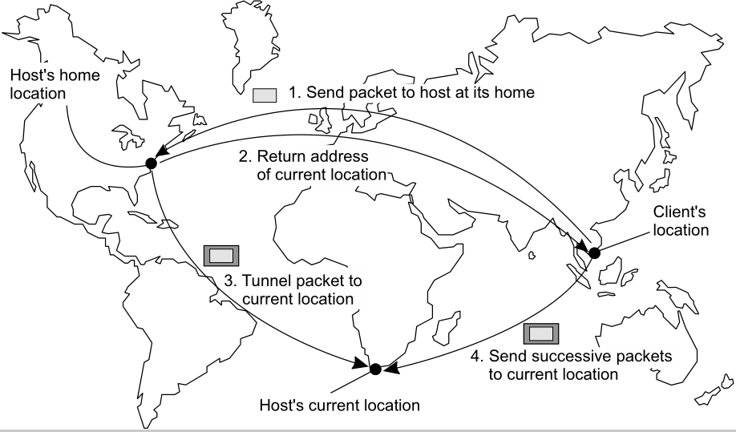

Example: The Principle of Mobile IP
Any drawbacks?
care-of address is registered at the home agent
Notes:
When the home agent receives a packet for the mobile host, it looks up the
host's current location. If the host is on the current local network, the packet is
simply forwarded. Otherwise, it is tunneled to the host's current location, that is,
wrapped as data in an IP packet and sent to the care-of address. At the same time,
the sender of the packet is informed of the host's current location.

Slide 18
Problems with Home-Based Approaches
Home address has to be supported for entity’s lifetime
considering that the home location may not always exist
Home address is fixed → unnecessary burden (communication latency increases) when the entity permanently moves
Poor geographical scalability (entity may be next to client)
Question: How can we solve the “permanent move” problem?
Solution: to register the home at a traditional naming service (e.g., DNS) and to let a client first look up the location of the home

Slide 19
Flat (Unstructured) Naming
Property of an unstructured name: it does not contain any information whatsoever on how to locate the access point of its associated entity.
Problem
Given an essentially unstructured name (e.g., an identifier), how can we locate its associated access point?
Simple solutions
Home-based approaches
Distributed Hash Tables (structured P2P)
Hierarchical location service

Slide 20
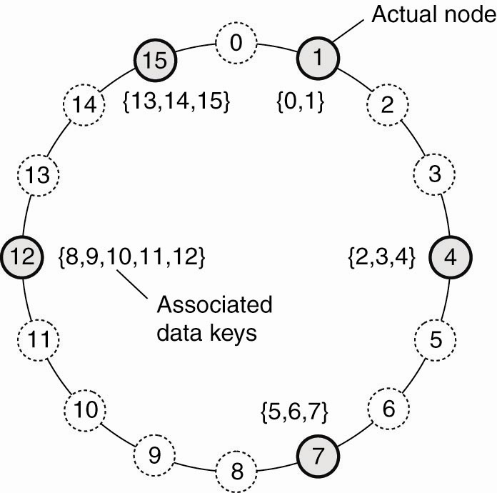
Distributed Hash Tables (DHT)
The goal is to find how to resolve an identifier to the address of the associated entity.
The Chord system : an easy-to-explain DHT-based systems
Consider the organization of many nodes into a logical ring
Each node is assigned a random m-bit identifier.
m is usually 128 or 160
Every entity is assigned a unique m-bit key.
Entity with key k falls under jurisdiction of a node with smallest id ≥ k. The node is referred to as the successor of k, succ(k).
Main issue in DHT-based systems: to efficiently resolve a key k to the address of succ(k).

Slide 21
DHTs: Key LOOKUP(k)
The linear approach A lookup will generally require O( log ( N )) steps, with N being the number of nodes in the system.
Each node p keep track of its neighbors, i.e., succ(p+1) and pred(p), resolve key k when pred(p) < k ≤ p, return the address of p
Finger Table Principle
Each node p maintains a finger table FT_{p}[] with at most m entries:
FT_{p}[i] = succ(p+2^{i-1}) 1 ≤ i ≤ m
Note: FT_{p}[i] points to the first node succeeding p by at least 2^{i-1}.
To look up a key k, node p forwards the request to node with index j satisfying
q = FT_{p}[j] ≤ k < FT_{p}[j +1]
If p < k < FT_{p}[1], the request is also forwarded to FT_{p}[1]
Notes:
Finger
查找器（查找因特网用户的程序）

Slide 22
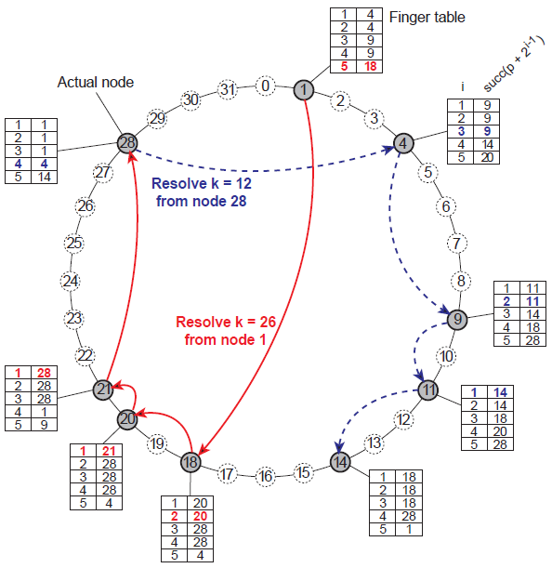
5-bit key
Notes:
2⁵=32

Slide 23
DHTs: Exploiting Network Proximity
Problem: The logical organization of nodes in the overlay may lead to erratic message transfers in the underlying Internet: node k and node succ(k +1) may be very far apart.
→ Designing a DHT-based system requires taking the underlying network into account.
Topology-aware node assignment: When assigning an ID to a node, make sure that nodes close in the ID space are also close in the network. This can be very difficult.
Proximity routing: Maintain more than one possible successor, and forward to the closest.
Proximity neighbor selection: When there is a choice of selecting who your neighbor will be (not in Chord), pick the closest one.

Slide 24
Flat (Unstructured) Naming
Property of an unstructured name: it does not contain any information whatsoever on how to locate the access point of its associated entity.
Problem
Given an essentially unstructured name (e.g., an identifier), how can we locate its associated access point?
Simple solutions
Home-based approaches
Distributed Hash Tables (structured P2P)
Hierarchical location service

Slide 25
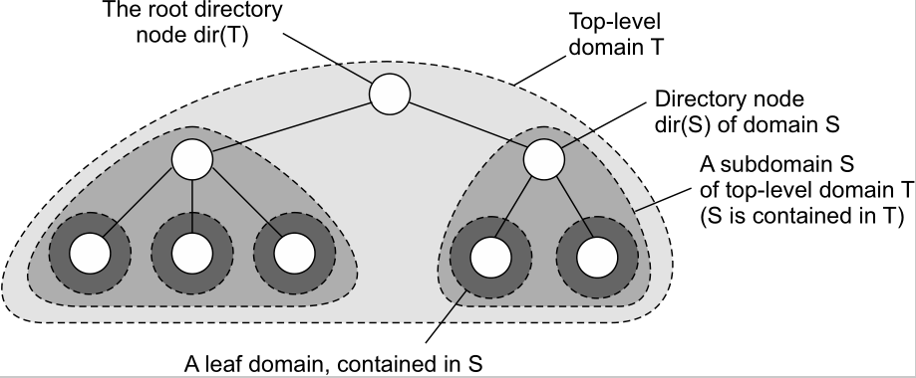
Hierarchical Location Services (HLS) -- general approach
Basic idea: Build a large-scale search tree for which the underlying network is divided into hierarchical domains. Each domain is represented by a separate directory node.
Directory node dir ( D ) keeps track of the entities in domain D.
Root node ,
knows about all entities.
A leaf domain , typically corresponds to a LAN in a computer network or a cell in a mobile telephone network.

Slide 26
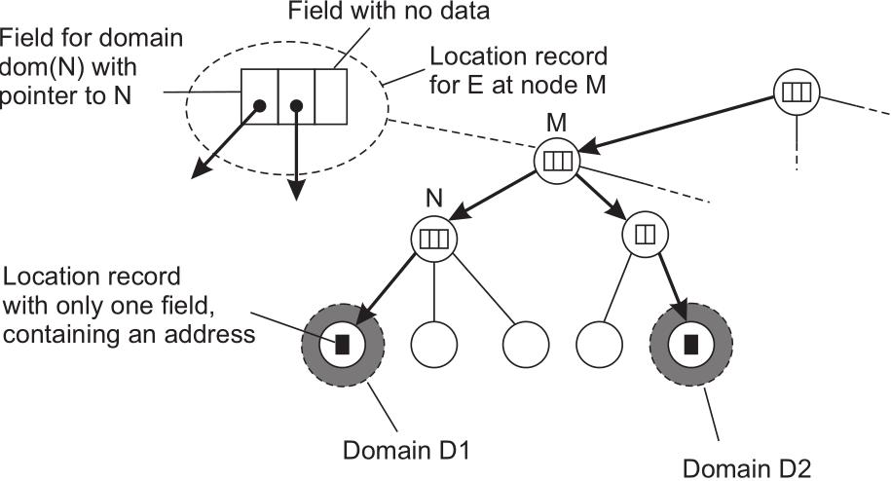
HLS: Tree organization
Invariants
Each entity in a domain D is represented by a location record, which contains its current address
Address of entity E is stored in a leaf or intermediate node
Intermediate nodes contain a pointer to a child iff the subtree rooted at the child stores an address of the entity
The root knows about all entities
NOTE:
An entity may have multiple addresses, e.g., if it is replicated. If an entity has an address in leaf domain D₁ and D₂ respectively, the directory node will have two pointers.

Slide 27
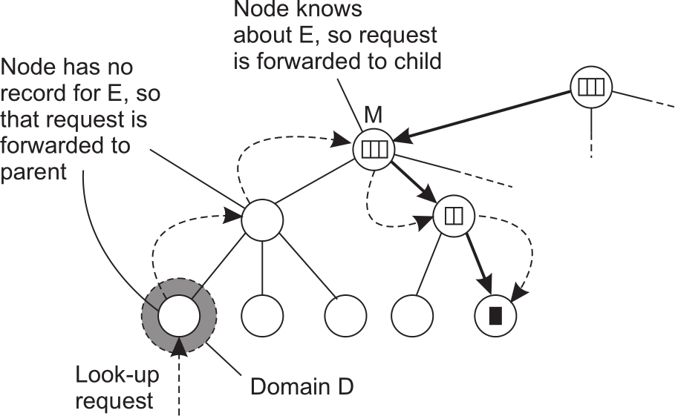
HLS: Lookup operation
Basic principles
Start lookup at local leaf node
Node knows about E → follow downward pointer, else go up
Upward lookup always stops at root

Slide 28
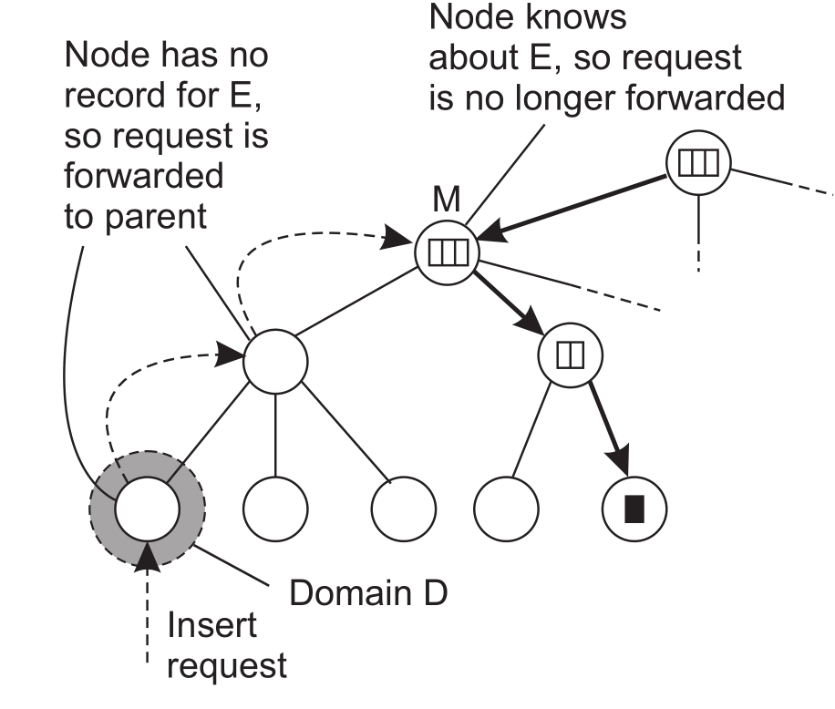
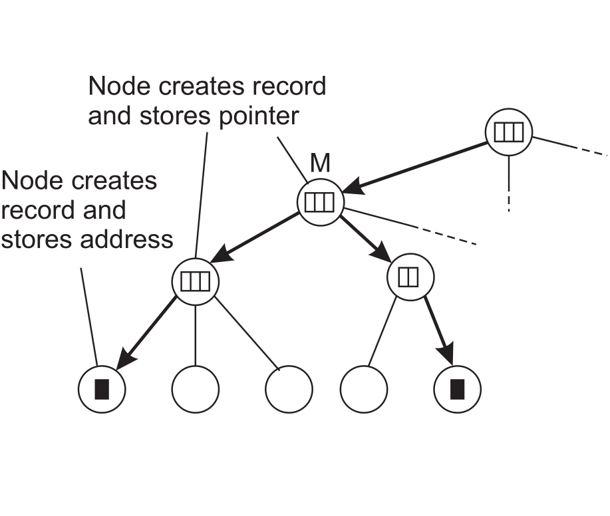
HLS: Insert operation
NOTE: the lookup and update operations exploit locality. The entity is searched in a gradually increasing ring centered around the requesting client.
In the following figure, consider an entity E that has created a replica in leaf domain D for which it needs to insert its address.
An insert request is forwarded to the first node that knows about E
A chain of forwarding pointers to the leaf node is created

Slide 29
HLS: Insert and Delete Operations
Insert operation: two approaches
To install the chain of pointers in a top-down fashion starting at the lowest-level directory node that has a location record for entity E.
To create a location record before passing the insert request to the parent node, i.e., the chain of pointers is constructed from the bottom up.
Advantage: an address becomes available for lookups asap. → if an parent node is temporarily unreachable, the address can still be looked up within the node’s domain
Delete operation: analogous to an insert operation

Slide 30

Can an HLS scale?
Observation
A design flaw seems to be that the root node needs to keep track of all identifiers ⇒ make a distinction between a logical design and its physical implementation.
Basic idea for scaling
Choose different physical servers for the logical name servers on a per-entity basis
(at root level, but also intermediate)
Implement a mapping of entities to physical servers such that the load of storing records will be distributed.

Slide 31
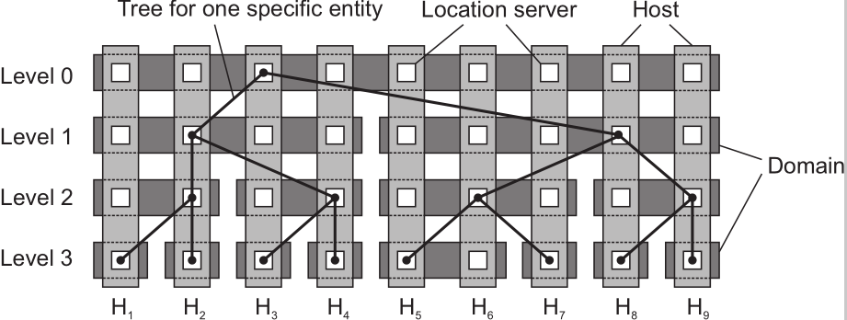
Can an HLS scale?
By judiciously choosing which host should run a location server for E , we can combine the principle of local operations (which is good for geographical scalability) and full distribution of higher level servers (which is good for size scalability).

Slide 32
Unit 5 – Naming: Outline
Names, Identifiers, and Addresses
Flat Naming
Structured Naming
Attribute-based Naming
Summary
Three different classes of naming systems

Slide 33


Structured Naming
Flat names are good for machines, but are generally not very convenient for humans to use.
Naming systems generally support structured names that are composed from simple, human-readable names.
E.g., File / host naming on the Internet follow this approach
Key points:
Name space
Name resolution
The implementation of a name space
Example: DNS (seminar topic)

Slide 34
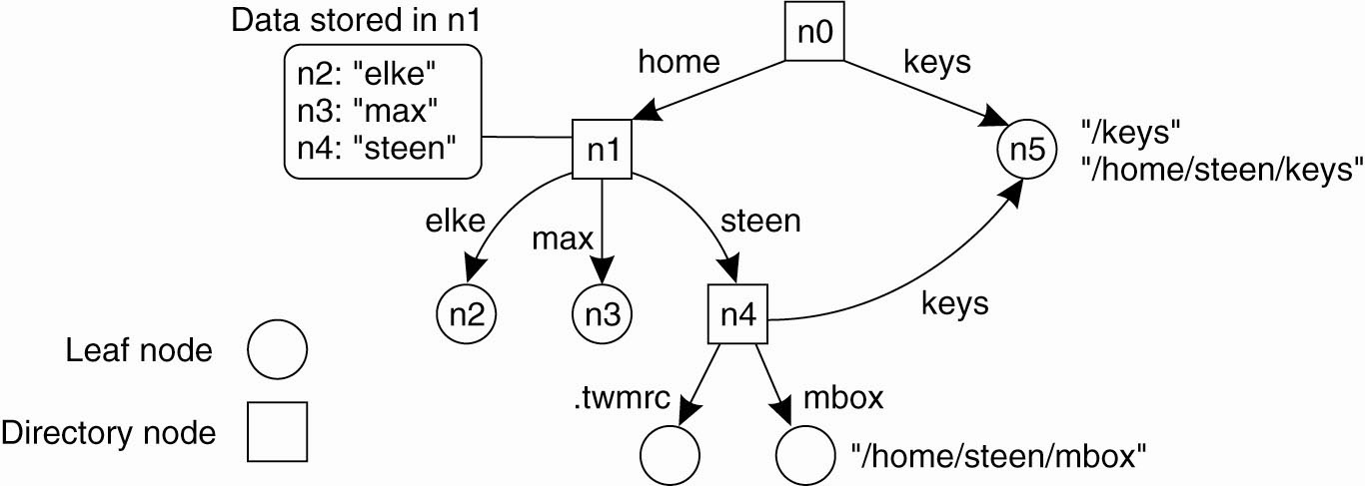
Name Spaces
Name spaces for structured names can be represented as a labeled, directed graph.
Leaf node represents a named entity and has no outgoing edges
A Directory node is an entity that refers to other nodes and contains a table of (node identifier , edge label) pairs.
Each path can be referred to
Path name N:<label-1, label-2, …, label-n>, N refers to the first node in the path
as a single string separated by a special separator character , e.g., a slash (“/”)
A general naming graph with a single root node
Directed acyclic
graph
Root (node) has only outgoing and no incoming edges
Node can be represented by different path names if several paths lead to the same node.
Notes:
Although it is possible for a naming graph to have several root nodes, for simplicity, many naming systems have only one.

Slide 35
Name space
Names are always organized in a name space.
In many cases, a name space is also strictly hierarchical in the sense that the naming graph is organized as a tree.
We can easily store all kinds of attributes in a node
Type of the entity
An identifier for that entity
Address of the entity’s location
Nicknames
...
Note
Directory nodes can also have attributes, besides just storing a directory table with (identifier, label) pairs.

Slide 36
Name Resolution
Name resolution: the process of looking up a name
Closure mechanism: The mechanism to select the implicit context from which to start name resolution.
www.seu.edu.cn: start at a DNS name server
/home/steen/mbox: start at the local NFS(Network File System) file server (possible recursive search)
0031204447784: dial a phone number
58.192.112.13: route to the SEU Web server
NOTE: Closure mechanisms are necessarily partly implicit and may be very different when comparing them to each other.
Notes:
closure mechanism 封闭机制
Sun’s Network File System (NFS) is a distributed file system
Name resolution can take place only if we know how and where to start.
Essentially, a closure mechanism deals with selecting the initial node in a name space from which name resolution is to start.
A completely different example is the use of the string "0031204430784".
Many people will not know what to do with these numbers, unless they are told
that the sequence is a telephone number.

Slide 37
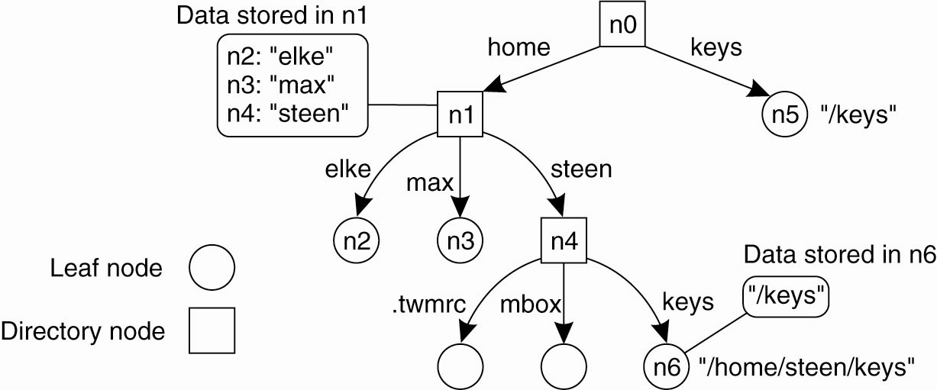
Name Resolution: Linking
Two ways to implement an alias (another name for the same entity)
Hard links (in UNIX terminology): To allow multiple absolute paths’ names to refer to the same node in a naming graph (like n5 in slide 34)
Symbolic links (in UNIX terminology): To represent an entity by a leaf node, but instead of storing the address or state of that entity, the node stores an absolute path name

Slide 38
Name Resolution: Mounting (1)
Name resolution as described so far takes place completely within a single name space
Name resolution can also be used to merge different name spaces in a transparent way through mounting.
Terminology
Foreign name space: the name space that needs to be accessed
Mount point: the node in the current name space containing the node identifier of the foreign name space
Mounting point: the node in the foreign name space where to continue name resolution
Mounting across a network requires the following information which is unnecessary in a non-distributed system.
The name of an access protocol.
The name of the server.
The name of the mounting point in the foreign name space.

Slide 39
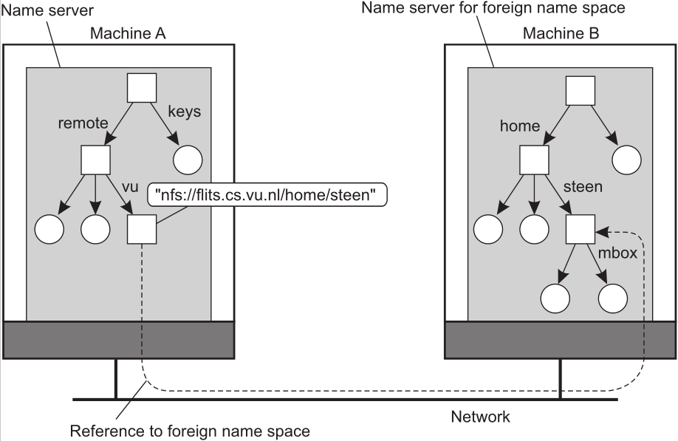
Name Resolution: Mounting (3)
Consider the name /remote/vu/mbox, mounting remote name spaces through a specific access protocol, then forming a single name space.
Some loss in performance is noticed compared to accessing locally-available files.
form a single name space

Slide 40
The Implementation of A Name Space
If a DS is restricted to a LAN, only a single name server may be needed to implement a naming service.
In large-scale DS with many entities, it is necessary to distribute the implementation of a name space over multiple name servers.
Key points
Name Space Distribution
Implementation of Name Resolution

Slide 41
Name Space Distribution (1)
Name spaces for a large-scale DS are organized hierarchically. Distinguish three layers:
Global level: Consists of the high-level directory nodes (incl. root). Nodes are stable and may represent different organizations, or groups of organizations.
Administrational level: Contains mid-level directory nodes that are relatively stable and belong to the same organization/administrational unit
Managerial level: Consists of low-level directory nodes that may change regularly and are maintained not only by system administrators, but also by individual end users of a DS.

Slide 42

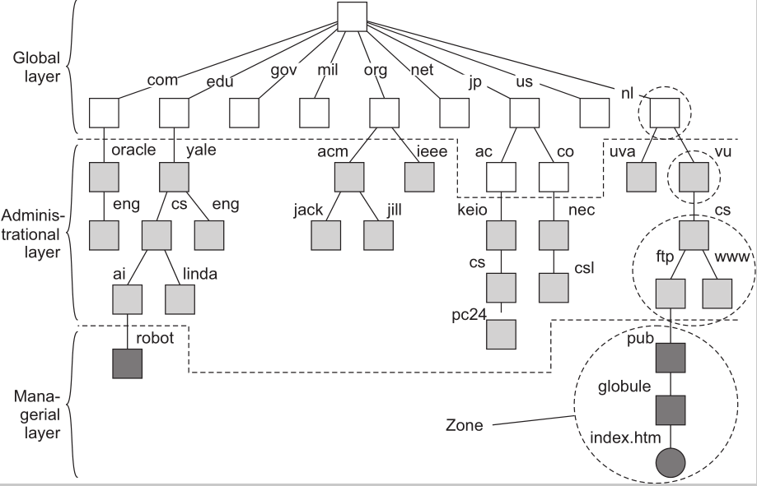
Name Space Distribution (2): Partitioning of the DNS name space
The name space is divided into non-overlapping parts, called zones in DNS
A zone is implemented by a separate name server.

Slide 43
DNS
Essence
Hierarchically organized name space with each node having exactly one incoming edge ⇒ edge label = node label.
domain: a subtree
domain name: a path name to a domain’s root node.

Slide 44
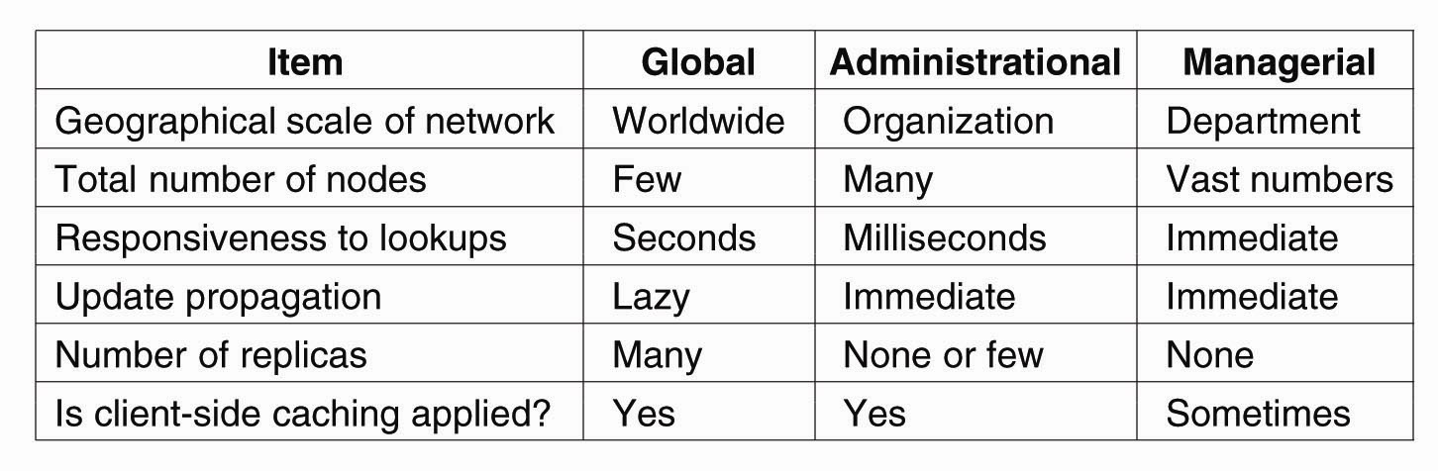
Name Space Distribution (3): Comparison between name servers for different layers

Slide 45
Implementation of Name Resolution
The distribution of a name space across multiple name servers affects the implementation of name resolution.
To explain the implementation, assume that name servers are not replicated and that no client-side caches are used.
Each client has access to a local name resolver, for ensuring that the name resolution process is carried out.
Example: Refer to Fig. in Slide 42, the path name
root:<nl, vu, cs, ftp, pub, globe, index.html>
is to be resolved. Using a URL notation, it is correspond to ftp://ftp.cs.vu.nl/pub/globe/index.html
Two ways to implement name resolution
Iterative name resolution
Recursive name resolution

Slide 46
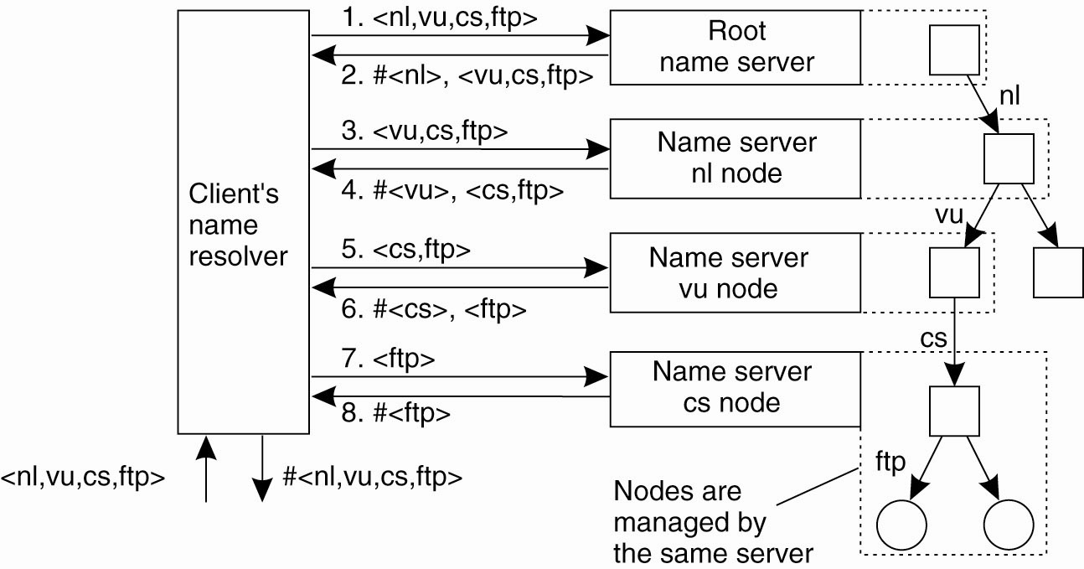
Iterative Name Resolution
resolve(dir,[name1,...,nameK]) sent to Server0 responsible for dir
Server0 resolves resolve(dir,name1)  dir1, returning the identification (address) of Server1 (#<server 1>), which stores dir1.
Client sends resolve(dir1,[name2,...,nameK]) to Server1, etc.
In practice, a client’s name resolver accept path name referring only to nodes in the global or administrational layer of the name space.
To resolve the part corresponding to nodes in the managerial layer, a client will separately contact the name server

Slide 47
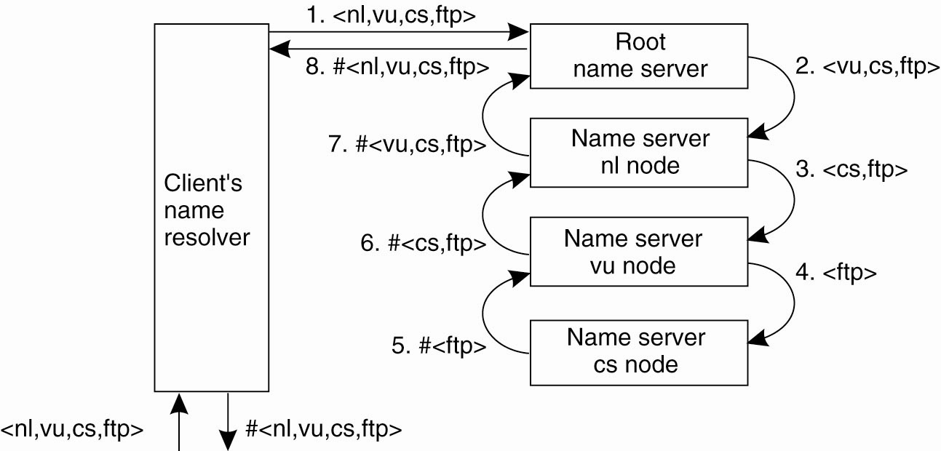
Recursive Name Resolution (1)
resolve(dir,[name1,...,nameK]) sent to Server0 responsible for dir
Server0 resolves resolve(dir,name1)  dir1, and sends resolve(dir1,[name2,...,nameK]) to Server1, which stores dir1.
Server0 waits for result from Server1, and returns it to client.

Slide 48
Recursive Name Resolution (2)
Main drawback: Puts a higher performance demand on each name server
A name server is required to handle the complete resolution of a path name, although it may cooperate with other name servers.
This additional burden is generally so high that name servers in the global layer of a name space support only iterative name resolution.
Two important advantages:
Caching results is more effective compared to iterative name resolution
Communication costs may be reduced.

Slide 49
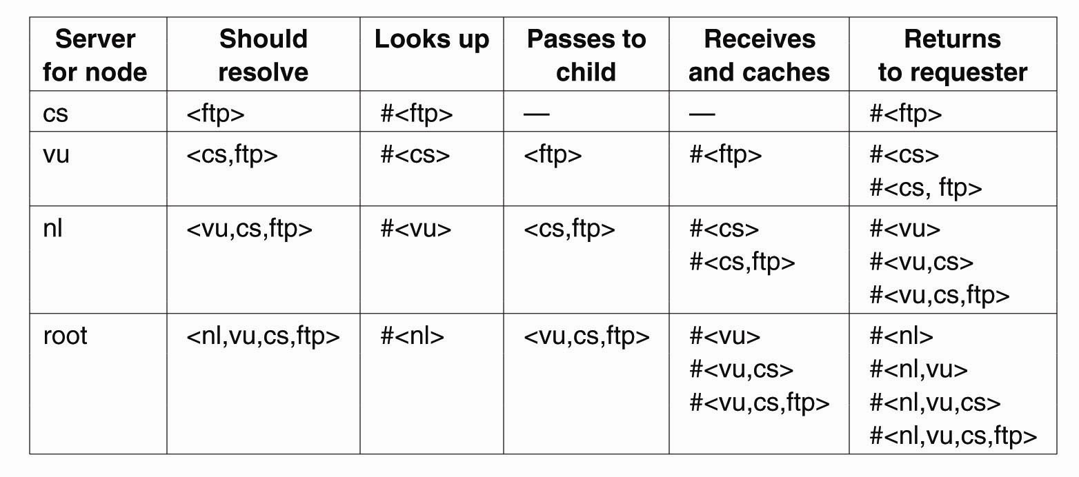
Recursive Name Resolution (3)
Caching in recursive name resolution of <nl, vu, cs, ftp>. Name servers cache intermediate results for subsequent lookups
Suppose that another client later requests resolution of the path name root:<nl, vu, cs, flits>.
This name is passed to the root, which can immediately forward it to the name server for the cs node and request it to resolve the remaining path name cs:<flits>

Slide 50
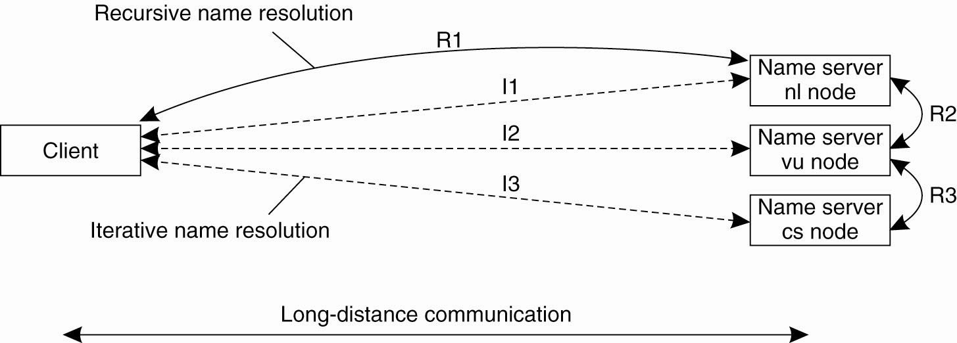
The comparison between recursive and iterative name resolution with respect to communication costs.

Slide 51
Scalability Issues
Size scalability: We need to ensure that servers can handle a large number of requests per time unit  high-level servers are in big trouble.
Solution: Assume (at least at global and administrational level) that content of nodes hardly ever changes. We can then apply extensive replication by mapping nodes to multiple servers, and start name resolution at the nearest server.
Observation: An important attribute of many nodes is the address where the represented entity can be contacted. Replicating nodes makes large-scale traditional name servers unsuitable for locating mobile entities (MA).
Notes:
The implementation of DNS we described so far is the standard one. It follows
a hierarchy of servers with 13 well-known root servers and ending in millions
of servers at the leaves. An important observation is that higher-level nodes
receive many more requests than lower-level nodes. Only by caching the nameto-
address bindings of these higher levels is it possible to avoid sending requests
to them and thus swamping them.

Slide 52
Scalability Issues
Geographical scalability: We need to ensure that the name resolution process scales across large geographical distances.
Problem: By mapping nodes to servers that can be located anywhere, we introduce an implicit location dependency.

Slide 53
Unit 5 – Naming: Outline
Names, Identifiers, and Addresses
Flat Naming
Structured Naming
Attribute-based Naming
Summary
Three different classes of naming systems

Slide 54
Attribute-Based Naming (1): for effective search
Flat and structured names generally provide a unique and location-independent way of referring to entities.
Structured names even provide a human-friendly way to name entities
In most cases, it is assumed that the name refers to only a single entity.
Problem: it becomes important to effectively search for entities.  requires that a user can provide merely a description of what he is looking for
A popular way in DS: to describe an entity in terms of (attribute, value) pairs, i.e., attribute-based naming.
It is up to the naming system to return one or more suitable entities.

Slide 55
Attribute-Based Naming (2) directory services
Attribute-based naming systems (a.k.a., directory services)
Whereas structured naming systems are generally called naming systems
In some cases, the choice of attributes can be relatively simple
E.g., in an e-mail system, messages can be tagged with attributes for the sender, recipient, subject, and so on
However, designing an appropriate set of attributes is not trivial even in the case of e-mail.
In most cases, attribute design has to be done manually.
Notes:
Even if there is consensus on the set of attributes to use, practice shows that setting the values consistently by a diverse group of people is a problem by itself.

Slide 56
Resource Description Framework (RDF)
RDF is used to unifying the ways that resources can be described.
Resources are described as triplets consisting of a subject, a predicate, and an object
E.g., (Person, name, Alice) describes a resource Person whose name is Alice.
In RDF, each subject, predicate, or object can be a resource itself.
References in RDF are essentially URLs.
In this example, the resource descriptions are stored at a central location.
Problem: Not having the descriptions in the same place may incur a serious performance problem
Notes:
predicate
英 [ˈpredɪkət] 美 [ˈpredɪkət]
vt.断言，断定; 宣布，宣讲; 使基于;
vi.断言，断定;
n.谓语; 述语;

Slide 57

Hierarchical Implementations: LDAP
A common approach to tackling distributed directory services is to combine structured naming with attribute-based naming.
This approach has been widely adopted.
Example: Lightweight Directory Access Protocol (LDAP) is used in MS Active Directory service and other systems.

Slide 58
Hierarchical Implementations: LDAP
An LDAP directory service consists of a number of records (directory entries, comparable to a resource record in DNS)
Each record -- a collection of (attribute, value) pairs, where each attribute has an associated type.
Single-valued attributes
multiple-valued attributes (typically represent arrays and lists)
directory information base (DIB): the collection of all directory entries in an LDAP directory service
Each record in a DIB has a globally unique name (appearing as a sequence of naming attributes)
Each naming attribute is called a relative distinguished name (RDN)

Slide 59
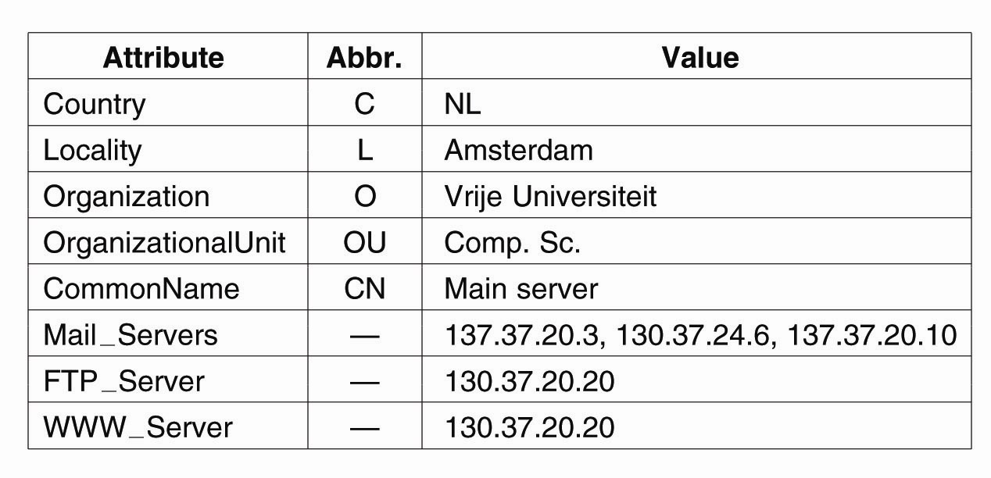
A simple example of an LDAP directory entry using LDAP naming conventions
One attribute has multiple values
These attributes have only a single value
The attributes Country, Organization, and OrganizationUnit could be used to form the globally unique name /C=NL/O=Vrije Universiteit/OU=Comp. Sc. analogous to the DNS name nl.vu.cs.

Slide 60
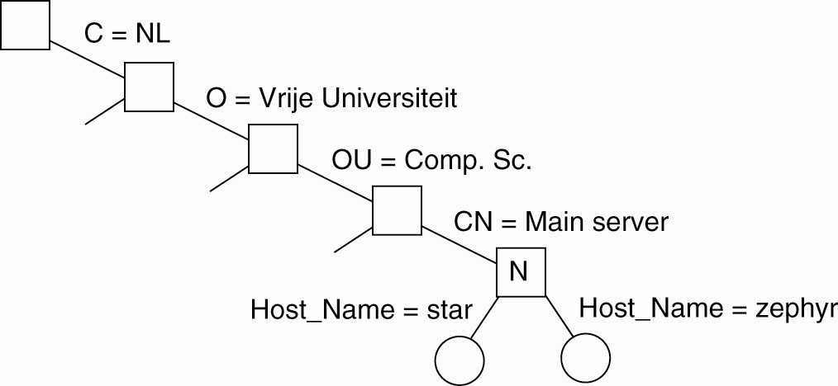
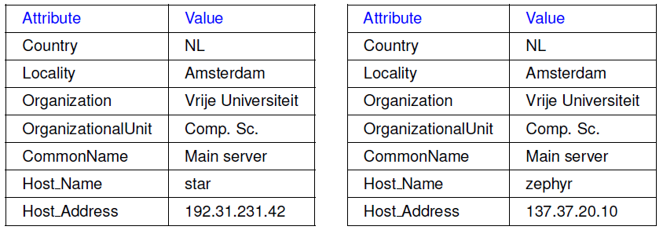
Directory Information Tree (DIT)
DIT: a hierarchy of the collection of directory entries
Each node in a DIT represents a directory entry / an LDAP record.
Result of search(‘‘(C=NL)(O=VU University)(OU= * )(CN=Main server)’’)
Two directory entries having Host_Name as RDN

Slide 61


Attribute-based naming Sum-UP
Observation
In many cases, it is much more convenient to name, and look up entities by means of their attributes ⇒ traditional directory services (aka yellow pages).
Problem
Lookup operations can be extremely expensive, as they require to match requested attribute values, against actual attribute values ⇒ inspect all entities (in principle).
Solution:
Implement basic directory service as database, and combine with traditional structured naming system.

Slide 62
Decentralized implementations
P2P systems are often used to store files. Initially, files could not be searched
They could only be looked up by their key
However, having the possibility to search for a file based on descriptors can be extremely convenient.
each descriptor is nothing but an (attribute, value) pair.
Problem: Querying every node in a P2P system to see if it contains a file matching one or more of such pairs is infeasible.
Solution: What we need is a mapping of (attribute, value) pairs to index servers , which, in turn, point to files matching those pairs.

Slide 63
Distributed index
Basic idea
a search query is formulated as a list of (attribute, value) pairs, like LDAP.
The result should be a list of (references to) entities that match all pairs.
In the case of a P2P system storing files, a list of keys to relevant files may be returned.
The client can then look up each of those files using the returned keys.

Slide 64
Decentralized Summary
There are indeed many different ways of supporting attribute-based naming systems in a decentralized fashion.
Essence:
assign attributes to servers so that clients know where to direct their queries
make sure that there is a balance in the load for the set of servers.

Slide 65
Summary
Flat naming systems:
Simple solution: Broadcasting/multicasting (with limited scalability); Forwarding pointers;
Home-based approaches;
Distributed Hash Tables;
Hierarchical location service
Structured naming systems: convenient to organize human-friendly names.
Attribute-based naming systems: entities are described by a collection of (attribute, value) pairs.
Notes:
In traditional network applications, communication is often based on the low-level message-passing primitives offered by the transport layer.

Slide 66
Seminar Topics
Domain Name System （DNS）
LDAP
https://securityboulevard.com/2017/12/openldap-as-a-service/
http://www.redbooks.ibm.com/redbooks/pdfs/sg244986.pdf
Basics of Hash Tables
https://www.hackerearth.com/zh/practice/data-structures/hash-tables/basics-of-hash-tables/tutorial/
DHT

Slide 67
Seminar Topics (continue…)
5. ZeroMQ (Refer to the textbook)
6. Compare an email system and an MQ system (Refer to the textbook)
7. Flooding-based multicasting (Refer to the textbook)
8. Detailed introduction about Chord system (Refer to the textbook)

