Slide 1

Distributed Systems
Unit 6 Coordination
Ling ZHOU
School of Computer Science and Engineering
College of Software Engineering,
Southeast University, Nanjing
ling.zhou@seu.edu.cn

Slide 2

Unit 6 – Coordination: Outline
Clock synchronization
Logical clocks
Mutual exclusion
Election algorithms
Location systems
Summary

Slide 3
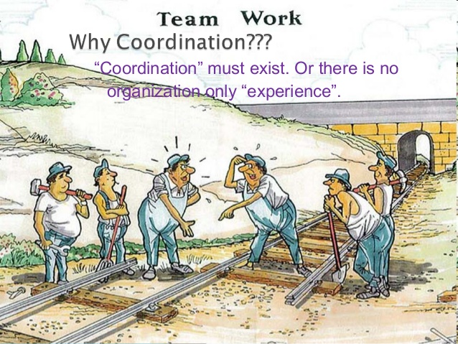
Background
Process cooperation is partly supported by means of naming.
Unit focus: processes synchronization and coordination, e.g.,
Multiple processes do not simultaneously access a shared resource, but instead cooperate in granting each other temporary exclusive access
Multiple processes may sometimes need to agree on the ordering of events
Observation:
Coordination in DS is much more difficult compared to synchronization in uniprocessor or multiprocessor.

Slide 4

Synchronization and Coordination
Process synchronization: one process waits for another to complete its operation.
Data synchronization: is to ensure that two sets of data are the same.
The goal of coordination is to manage the interactions and dependencies between activities in a distributed system.
Conclusion: coordination encapsulates synchronization
Coordination
synchronization

Slide 5
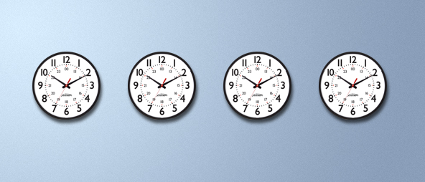
Clock Synchronization
Physical clocks
Clock synchronization algorithms

Slide 6
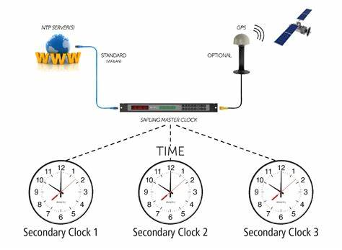
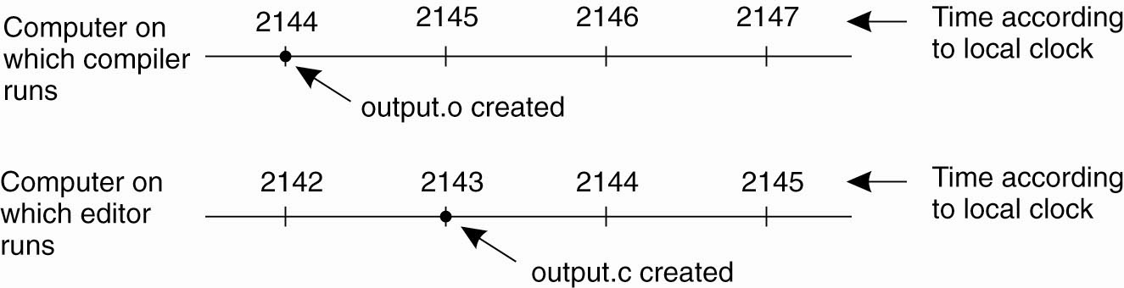
Clock Synchronization
In a centralized system, time is unambiguous.
In a DS, achieving agreement on time is not trivial.
In UNIX, large programs are split up into multiple source files, so that a change to one source file only requires one file to be recompiled.
What if no global agreement on time in DS?
An event that occurred after another event may be assigned an earlier time
Necessary recompiling is missed
The resulting executable binary program will contain a mixture of object files from the old sources and the new sources  Program may crash

Slide 7
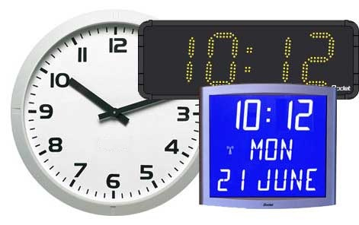
Software Clocks
Nearly all computers have a circuit for keeping track of time (Timer). A computer timer is usually a precisely machined quartz crystal.
Basic principle:
When kept under tension, quartz crystal oscillate at a well-defined (stable) frequency depending on the kind of crystal
Associated with each crystal are a counter and a holding register
Each oscillation of the crystal decrements the counter by one
When counter = 0, an interrupt is generated and the counter is reloaded from the holding register.
In this way, it is possible to program a timer to generate an interrupt 60 times a second or any other desired frequency. (software clock)
Each interrupt is called one clock tick.

Slide 8
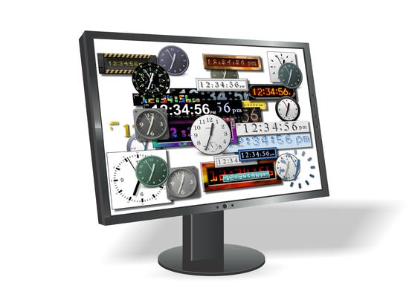

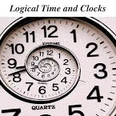
Problem of Software Clocks
With a single computer and a single clock, it does not matter much if the clock is off by a small amount.  relative times really matter
The n software clocks in a DS gradually get out of synch and give different values when read out.
Clock skew: difference in time values  time-associated programs may fail.

Slide 9
Physical Clocks
Problem: Sometimes we simply need the exact time (e.g., real-time systems), not just an ordering.
Solution: Universal Coordinated Time (UTC), International Atomic Time (TAI)
Based on the number of transitions per second of the cesium 133 atom (pretty accurate).
At present, the real time is taken as the average of some 50 cesium-clocks around the world.
Introduces a leap second from time to time to compensate that days are getting longer.
Notes:
To provide UTC to people who need precise time, the National Institute of
Standard Time (NIST) operates a shortwave radio station with call letters WWV
from Fort Collins, Colorado. WWV broadcasts a short pulse at the start of each
UTC second. The accuracy of WWV itself is about ±l msec, but due to random
atmospheric fluctuations that can affect the length of the signal path, in practice
the accuracy is no better than ±10 msec. In England, the station MSF, operating
from Rugby, Warwickshire, provides a similar service, as do stations in several
other countries.
Several earth satellites also offer a UTC service. The Geostationary Environment
Operational Satellite can provide UTC accurately to 0.5 msec, and some
other satellites do even better.
Using either shortwave radio or satellite services requires an accurate knowledge
of the relative position of the sender and receiver, in order to compensate
for the signal propagation delay. Radio receivers for WWV, GEOS, and the other
UTC sources are commercially available.

Slide 10

Physical Clocks (2)
Note:
UTC is broadcast through short wave radio (accuracy is no better than ±10 msec) and satellite (accuracy is ±0.5 msec).
Using either method requires an accurate knowledge of the relative positions of the sender and receiver, in order to compensate for the signal propagation delay.
Hardware clocks in most computers use a stable quartz crystal oscillator although not as stable as that of atomic clocks.
A software clock in a computer is derived from that computer’s hardware clock

Slide 11
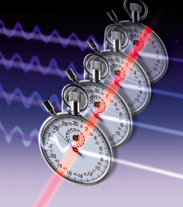
Clock Synchronization Algorithms: Introduction (1)
Problem: Suppose we have a DS with a UTC-receiver (which are not equipped in all machines) somewhere in it  we still have to distribute its time to each machine.
Basic principle
Every machine has a timer that generates an interrupt H times per second.
C_{p}(t): denotes the value of the software clock on machine p, where t is the UTC time.
Ideally, we have that for each machine p, C_{p}(t) = t, or, in other words, dC/dt = 1.

Slide 12
Clock Synchronization Algorithms: Introduction (2)
Precision
The goal is to keep the deviation between two software clocks on any two machines within a specified bound, known as the precision π:
∀ t,∀ p, q : |C_{p}(t)−C_{q}(t)| ≤ π
C_{p}(t) the computed clock time of machine p at UTC time t.
Accuracy
In the case of accuracy, we aim to keep the clock bound to a value α: ∀ t,∀ p : |C_{p}(t) − t| ≤ α
Synchronization
Internal synchronization: keep clocks precise
External synchronization: keep clocks accurate

Slide 13

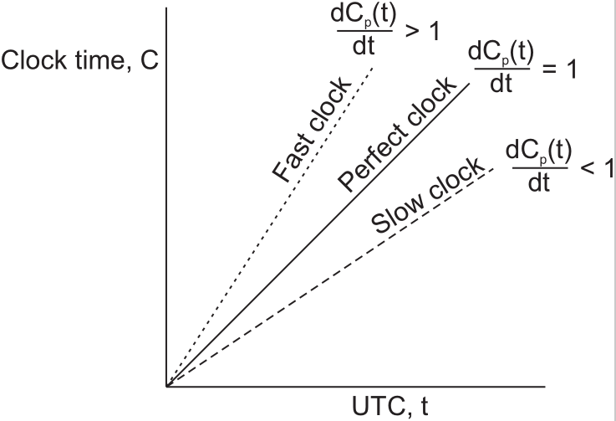


Clock drift (1)
Clock specifications
A clock comes specified with its maximum clock drift rate ρ.
F(t) denotes oscillator frequency of the hardware clock at time t
F is the clock’s ideal (constant) frequency ⇒ living up to specifications:
∀ t : (1−ρ) ≤ F(t)/F ≤ (1+ρ)
By using hardware interrupts we couple a software clock to the hardware clock, and thus also its clock drift rate:

Slide 14
Clock drift (2)
Observation:
A set of clocks that are accurate within bound α , will be precise within bound π = 2 α .
However, being precise does not allow us to conclude anything about the accuracy of clocks.
If two clocks are drifting from UTC in the opposite direction, at a time ∆t after they were synchronized, they may be as much as 2 ρ · ∆t apart.
To guarantee a precision π (i.e., no two clocks ever differ by more than π seconds, 2 ρ · ∆t ≤ π), clocks must be resynchronized (in software) at least every ∆t ≤ π/(2 ρ) seconds.
The various algorithms differ in precisely how this resynchronization is done.

Slide 15
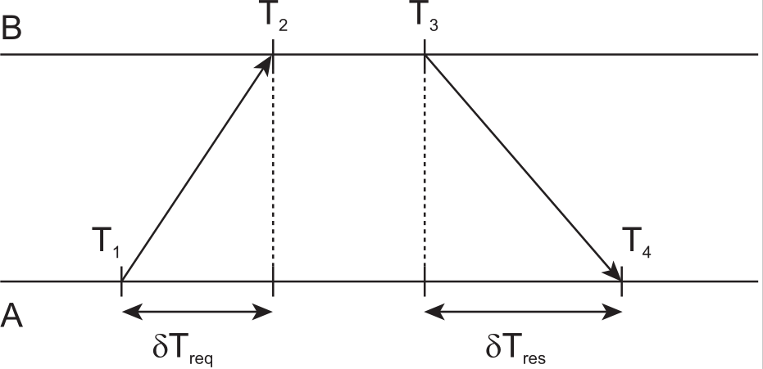
Network Time Protocol (NTP) [1]
Timestamp
Principle I: Every machine asks a time server for the accurate time at least once every δ/(2ρ) seconds.
Note:
It is not possible to determine the one-way delays, unless the actual clock offset is known.
Collect (θ, δ) pairs, choose θ for which associated delay δ was minimal.
request
response
Roundtrip delay time:
2δ = (T₄ – T₁) – (T₃ – T₂)
= (T₂ – T₁) + (T₄ – T₃)
Offset:
θ = [(T₂ – T₁) – (T₄ – T₃)]/2
Useful assumption: the propagation delays are statistically equal in each direction.
δ = [(T₂ – T₁) + (T₄ – T₃)]/2
NOTE: In the Internet of today, network paths and the associated delays can differ significantly.

Slide 16
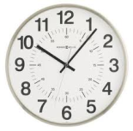


Network Time Protocol (NTP) [2]
Stratum 0: Reference clock
NTP divides servers into strata.
A server with a reference clock (e.g., a UTC receiver or an atomic clock) is a stratum-1 server
Stratum k (k>0) computers normally act as servers for stratum k+1 NTP requests, e.g.,
stratum 2 computers gather the best data sample, dropping obviously wrong references from stratum 1.
stratum 2 computers will peer with each other
1
2
3
Blue arrows indicate a direct connection; red arrows indicate a network connection.

Slide 17
Berkeley Algorithm (1)
In many algorithms such as NTP, the time server is passive.
Other machines periodically ask it for the time. The time server respond to their queries.
In Berkeley UNIX, the time server is active.
Principle II: The time server scan all machines periodically, calculate an average, and inform each machine how it should adjust its time relative to its present time.
Note: You don’t even need to propagate UTC time for synchronization.
Suitable for a system in which no machine has a UTC receiver.
The time daemon’s time must be set manually by the operator periodically.

Slide 18
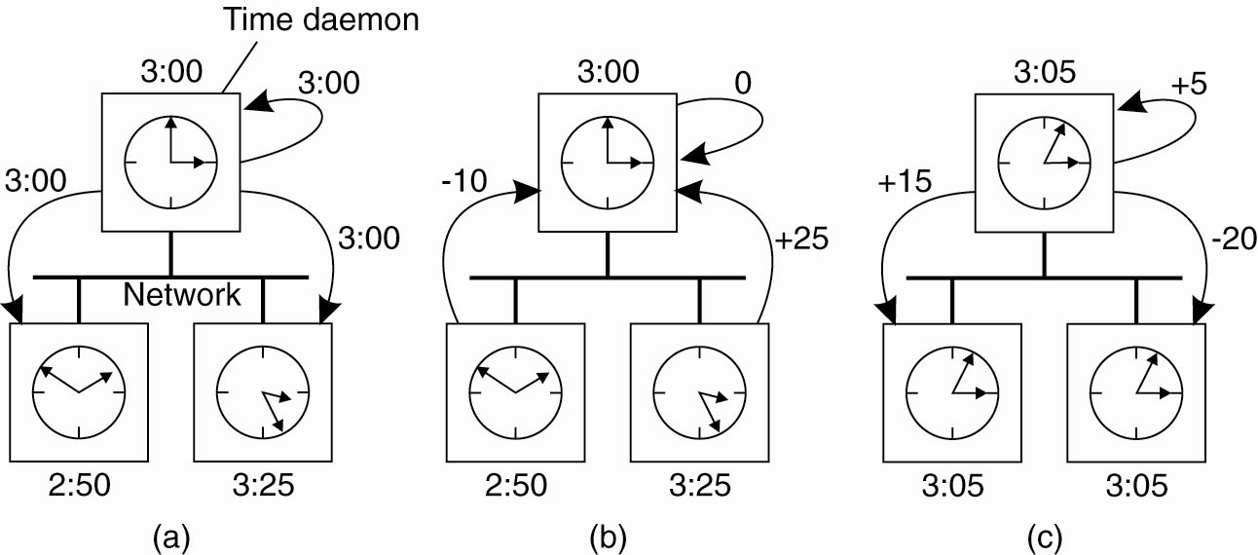
Berkeley Algorithm (2) Keeping time without UTC
NOTE:
For many purposes, it is sufficient that all machines agree on the same time.
It is not essential that this time also agrees with the real time as announce on the radio every hour.
No harm is done provided none of the other nodes communicates with external computers
Smooth adjustments: setting the time back is never allowed
Notes:
(a) The time daemon asks all the other machines for their clock
values. (b) The machines answer. (c) The time daemon tells everyone how to
adjust their clock.

Slide 19
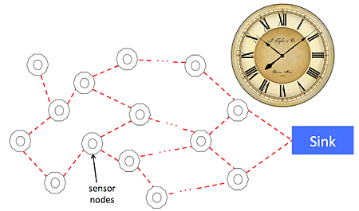
Clock Synchronization in Wireless Networks
Advantage of more traditional DS:
the easy and efficient deployment of time servers
relatively simple dissemination of information.
which are no longer valid in many wireless networks, notably sensor networks
In wireless network
Nodes are resource constrained, and multihop routing is expensive
Optimizing algorithms for energy assumption is more important  Very different clock synchronization algorithm for wireless networks.

Slide 20
Reference broadcast synchronization (RBS)
A wireless clock synchronization protocol.
Goal: merely internally synchronizing the clocks (as the Berkeley algorithm does) instead of providing all nodes UTC time,
RBS lets only the receivers synchronize, keeping the sender out of the loop.
While the previously discussed algorithms (e.g., NTP, Berkeley algorithms) are aiming to bring the sender and receiver into synch, following a two-way protocol.

Slide 21
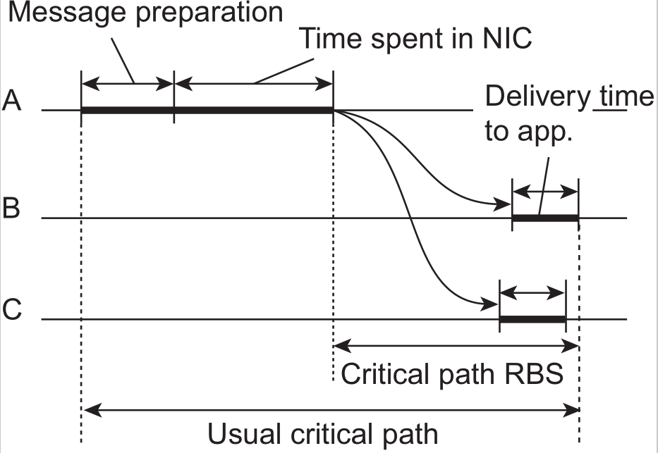
RBS minimize critical path
Observation: in a sensor network the time to propagate a signal to other nodes is roughly constant, provided no multi-hop routing is assumed.
Propagation time in this case is measured from the moment that a message leaves the network interface of the sender.
Two factors of non-determinism are eliminated in estimating delays of message transfer:
the time spent to construct a message
the time spent to access the network
The remaining delivery time at the receiver varies comparably little.
NTP

Slide 22




RBS
Essence
A node broadcasts a reference message m
⇒ each receiving node p records the time T _{p,m} that it received m.
Note: T _{p,m} is read from p’s local clock.
Problem: averaging will not capture drift
Two nodes p and q can exchange each other’s delivery times in order to estimate their mutual, relative offset:
where M is the total number of reference messages sent.
There is no need to adjust its own
clock, which saves energy.
Standard linear regression allow a much more accurate computation
Unfortunately, clocks can drift apart.
α and β are computed from the pairs ( T_{p,k} , T_{q,k} ) .

Slide 23
Unit 6 – Synchronization: Outline
Clock synchronization
Logical clocks
Mutual Exclusion
Election algorithms
Location systems
Summary

Slide 24

Logical Clocks
The time of each node is not necessarily the same as the real time. It is conventional to speak of the clocks as logical clocks.
If two processes do not interact, it is not necessary that their clocks be synchronized
Because the lack of synchronization would not be observable and thus could not cause problem
Observation: What usually matters is not that all processes agree on exactly what time it is, but rather that they agree on the order in which events occur. Requires a notion of ordering.

Slide 25
Lamport’s Logical Clocks The Happens-before relationship
Issue
What usually matters is not that all processes agree on exactly what time it is, but that they agree on the order in which events occur. Requires a notion of ordering.
The happens-before relation (defined by Lamport)
If a and b are two events in the same process, and a comes before b, then a  b. (read “a happens before b”)
If a is the sending of a message, and b is the receipt of that message, then a  b
If a  b and b  c, then a  c (transitive relation)
Note
This introduces a partial ordering of events in a system with concurrently operating processes.
Notes:
transitive
[5trAnsitiv]
adj.
传递的, 可迁[转]移的
有转移力的
中间的;【物】过渡的
【语】及物的
Concurrent: If two events, x and y, happen in different processes that do not exchange messages (not even indirectly via third parties), then neither x  y nor y  x is true.
Means that nothing need to be said about when the events happened or which event happened first.

Slide 26
Lamport’s Logical Clocks
Problem: How do we maintain a global view on the system’s behavior that is consistent with the happens-before relation?
Solution: Attach a timestamp C(e) to each event e, satisfying the following properties:
Prop.1: If a and b are two events in the same process, and a  b, then we demand that C(a) < C(b).
Prop.2: If a corresponds to sending a message m, and b to the receipt of that message, then also C(a) < C(b).
NOTE: the clock time, C, must always go forward (increasing), never backward (decreasing).
Corrections to time can be made by adding a positive value, never by subtracting one.

Slide 27
Lamport’s algorithm
Problem: How to attach a timestamp to an event when there’s no global clock  maintain a consistent set of logical clocks, one per process.
Solution:
Each process P_{i} maintains a local counter C_{i} and adjusts this counter according to the following rules:
For each new event that take place within P_{i} , C_{i} ← C_{i} + 1
Each time a message m is sent by process P_{i} , the message gets a timestamp ts(m) = C_{i} .
Whenever a message m is received by a process P_{j} , P_{j} adjusts its local counter C_{j} to max{C_{j} , ts(m)}; then executes step 1 before passing m to the application.
Notes:
Prop.1 is satisfied by (1); Property Prop.2 by (2) and (3).
It can still occur that two events happen at the same time. Avoid this by breaking ties through unique process IDs.
i.e., sending a message over the network, delivering a message to an application, or some other internal event
Notes:
To achieve this goal, we also use the unique process identifier to break ties and use tuples instead of only the counter’s
values. For example, an event at time 40 at process P i will be timestamped as
h 40,i i . If we also have an event h 40,j i and i < j, then h 40,i i < h 40,j i .

Slide 28
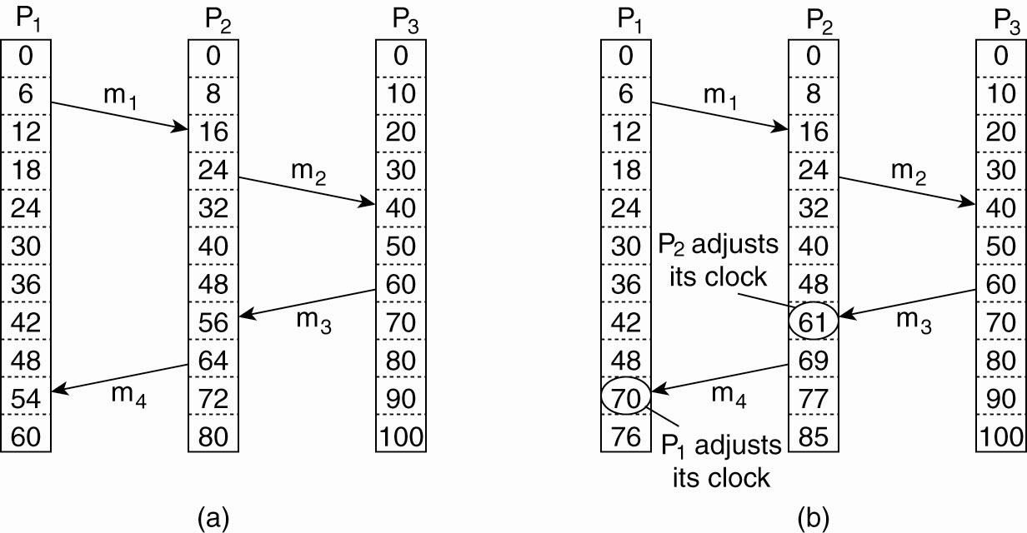
Lamport’s Logical Clocks: Example (1)
When the clock has ticked 6 times in P₁, it has ticked 8 times in P₂ and 10 times in P₃.
Each clock runs at a constant rate, but the rates are different due to differences in the crystals.
16-6=10
possible
40-24=16
possible
61 or later
56<60
impossible
54<64
impossible
Three processes run on different machines, each with its own (logical) clock. The clocks run at different rates
Lamport’s algorithm corrects the clocks follows directly from the happens-before relation.

Slide 29
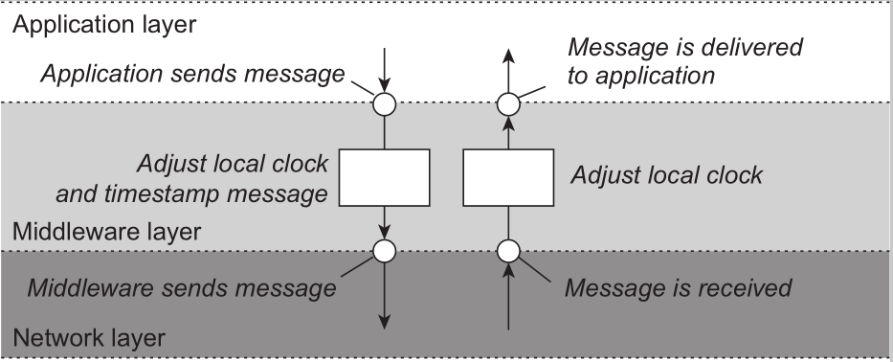
Lamport’s Logical Clocks: Example (2)
NOTE: Adjustments implemented in the middleware layer
The positioning of Lamport’s Logical Clock in DS

Slide 30
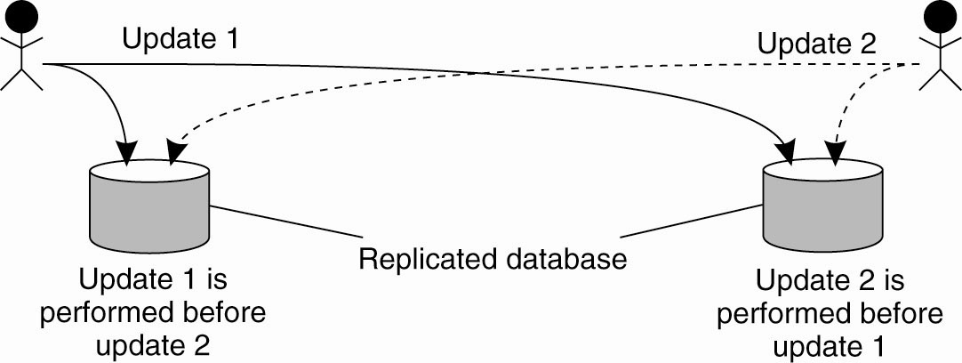
Example: Totally ordered multicast (1)
Problem: We sometimes need to guarantee that concurrent updates on a replicated database are seen in the same order everywhere:
Person 1 adds $100 to an account (initial value: $1000)
Person 2 (a bank employee) increments account by 1% interest
There are two replicas
Person 1
Person 2
replica #1
replica #2
Result
In absence of proper synchronization: replica #1  $1111, while replica #2  $1110.

Slide 31
Example: Totally ordered multicast (2)
Solution:
Process P_{i} sends timestamped message m_{i} to all others. The message itself is put in a local queue queue_{i} .
Any incoming message at P_{j} is ordered in queue_{j} , according to its timestamp, and acknowledged to every other process.
P_{j} delivers a message m_{i} to its application only if:
(1) m_{i} is at the head of queue_{j}
(2) m_{i} has been acknowledged by each other process
Result: Total-ordered multicasting is an important vehicle for replicated services  all messages are delivered in the same order everywhere (a.k.a state machine replication).
Note: We are assuming that communication is reliable and FIFO ordered.
Notes:
acknowledged 搜索网络
英 [ək'nɒlɪdʒd] 美 [ək'nɒlɪdʒd]
adj. 公认的;
v. 承认( acknowledge的过去式和过去分词 ); 鸣谢; 对…打招呼; 告知已收到;

Slide 32
Lamport’s clocks for mutual exclusion
Analogy with total-ordered multicast
With total-ordered multicast, all processes build identical queues, delivering messages in the same order
Mutual exclusion is about agreeing in which order processes are allowed to enter a critical section

Slide 33
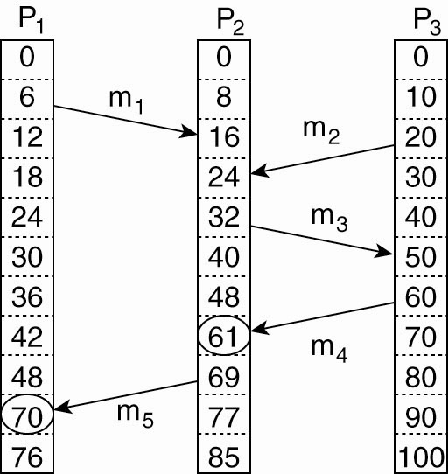
Logical Clocks: Vector Clocks (1)
Observation: Lamport’s clocks do not guarantee that if C(a) < C(b) that a causally preceded b
T_{rcv}(m₁) < T_{snd}(m₂)
Observation
Event a: m₁ is received at T = 16;
Event b: m₂ is sent at T = 20.
We know: for each message T_{snd}(m_{i}) < T_{rcv}(m_{i})
Can we concluded in general from T_{rcv}(m_{i}) < T_{snd}(m_{j}) ?
T_{snd}(m₁) < T_{rcv}(m₁)
T_{snd}(m₂) < T_{rcv}(m₂)
Note: We cannot conclude that a causally precedes b.
Lamport clocks do not capture causality, which can be captured by means of vector clocks.

Slide 34
Logical Clocks: Vector Clocks (2)
A vector clock VC(a) assigned to an event a has the property that if VC(a) <VC(b) for some event b, then event a is known to causally precede event b.
Causality Solution
Each process P_{i} has an array VC_{i} [1..n].
VC_{i}[i] is the number of events that have occurred so far at P_{i}, i.e., VC_{i}[i] is the local logical clock at process P_{i}.
If VC_{i}[j] = k then P_{i} knows that k events have occurred at P_{j} . It is thus P_{i}’s knowledge of the local time at P_{j}.
When P_{i} sends a message m, it adds 1 to VC_{i} [i], and sends VC_{i} along with m as (vector) timestamp ts(m). Result: upon arrival, recipient knows P_{i} ’s timestamp.
When a process P_{j} delivers (to the application) a message m that it received from P_{i} with (vector) timestamp ts(m), it
(1) updates each VC_{j} [k] to max{VC_{j} [k], ts(m)[k]}
(2) increments VC_{j} [j] by 1.
ts(m) tells the receiver how many events in other processes have preceded the sending of m

Slide 35
Enforcing Causal Communication Causally-ordered multicasting
Observation:
We can now ensure that a message is delivered only if all causally preceding messages have already been delivered.
Causally-ordered multicasting is weaker than the totally-ordered multicasting.
Specifically, if two messages are not in any way related to each other, we do not care in which order they are delivered to application. They may even be delivered in different order at different locations.
Assumption: clocks are only adjusted when sending and receiving messages.
P_{j} postpones delivery of m until:
ts(m)[i] = VC_{j} [i]+1.
ts(m)[k] ≤ VC_{j} [k] for all k ≠ i.
m is the next message that P_{j} was expecting from P_{i}.
P_{j} has seen all the messages that have been seen by P_{i} when it sent message m.
There is no need for P_{j} to delay the delivery of its own messages

Slide 36
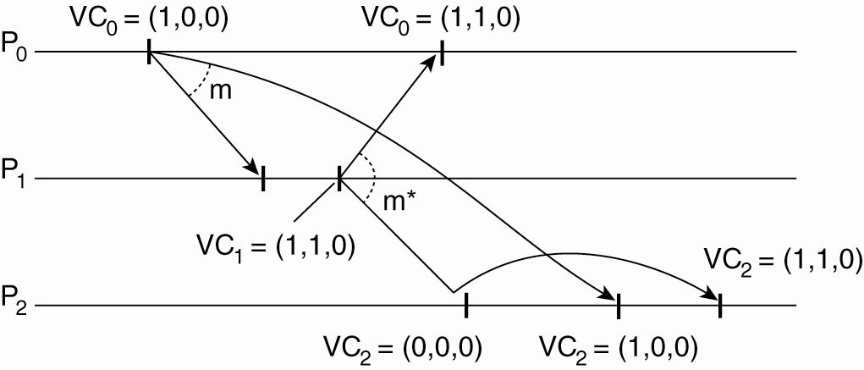
Causally-Ordered Multicasting: Example
Consider three processes P_{o}, P₁, and P₂ :
At local time (1,0,0), P_{o} sends message m to the other two processes.
After its receipt by P₁ , the latter decides to send m*, which arrives at P₂ sooner than m.
At that point, the delivery of m* is delayed by P₂ until m has been received and delivered to P₂’s application layer.
Why?
Answer: The second condition is not fully met. ts(m*)[0] = 1 > VC2[0] = 0
VC₁=(1,0,0)
Question: Take VC₂ = (0,2,2), ts(m) = (1,3,0) from P₀. What information does P₂ have, and what will it do when receiving m (from P₀)?

Slide 37
Causal dependency
Definition
We say that b may causally depend on a if ts(a) < ts(b), with:
for all k, ts(a)[k] ≤ ts(b)[k] and
there exists at least one index k’ 0 for which
ts(a)[k’] < ts(b)[k’]
Precedence vs. dependency
We say that a causally precedes b.
b may causally depend on a, as there may be information from a that is propagated into b.

Slide 38
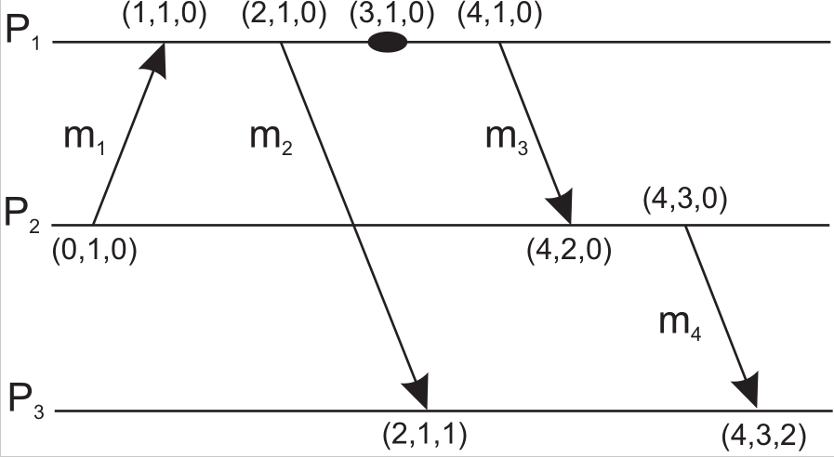
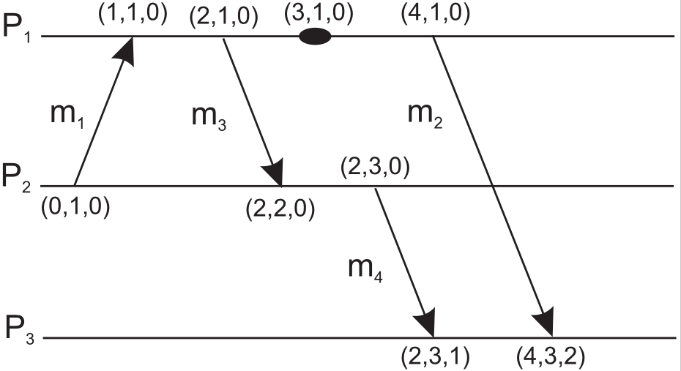
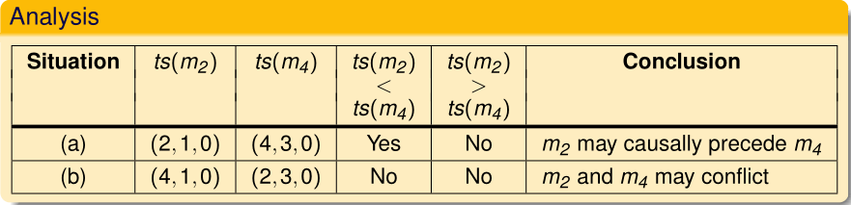
Vector clocks: Example
Capturing potential causality when exchanging messages
(a)
(b)
Note: without knowing the actual information contained in messages, it is not possible to state with certainty.

Slide 39

A Note on Ordered Message Delivery (1)
Some middleware systems provide support for totally-ordered and causally-ordered (reliable) multicasting.
There has been some controversy (until today)
whether such support should be provided as part of the message-communication layer,
or whether applications should handle ordering.
The arguments still hold today

Slide 40


A Note on Ordered Message Delivery (2)
Two main problems with letting the middleware deal with message ordering.
Because middleware cannot tell what a message actually contains, only potential causality is captured.
E.g., two messages from the same sender that are completely independent will always be marked as causally related by the middleware layer.
This approach is overly restrictive and may lead to efficiency problem.
Not all causality may be captured.
Bob
Alice
Alice
Notes:
E.g., an electronic bulletin board. Suppose Alice posts an article. She then phones Bob telling about the article. Bob may post another article as a reaction without having seen Alice’s posting on the board.
There is a causality between Bob’s posting and that of Alice due to external communication. This causality is not captured by the bulletin board system.

Slide 41
A Note on Ordered Message Delivery (3)
End-to-end argument (in systems design): Ordering issues, like many other application-specific communication issues, can be solved by looking at the application for which communication is taking place.
Drawback of having only application-level solution: a developer is forced to concentrate on issues that do not immediately relate to the core functionality of the application.
E.g., ordering may not be the most important problem when developing a messaging system such as an electronic bulletin board.
Conclusion: In this case, having an underlying communication layer handle ordering may be more convenient.

Slide 42
Unit 6 – Synchronization: Outline
Clock synchronization
Logical clocks
Mutual Exclusion
Election algorithms
Location systems
Summary

Slide 43

Mutual Exclusion
Problem: A number of processes in a distributed system want exclusive access to some resource.
To prevent concurrent accesses corrupt the resource, or make it inconsistent, solutions are need to grant mutual exclusive access by processes.
Two different categories of distributed mutual exclusion algorithm:
Permission-based approach
Token-based solutions
Basic solutions
Via a centralized server.
Completely decentralized, using a peer-to-peer system.
Completely distributed, with no topology imposed.
Completely distributed along a (logical) ring.

Slide 44
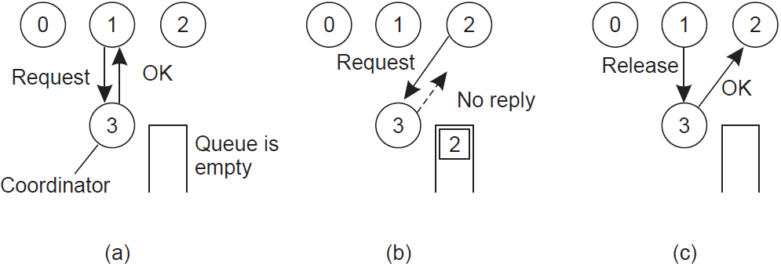
A Centralized Algorithm
One process is elected as the coordinator
Whenever a process wants to access a shared resource, it sends a request message to the coordinator, asking for permission.
The exact method used to deny permission is system dependent
P₁ asks the coordinator for permission to access a shared resource. Permission is granted.
P₂ then asks permission to access the same resource. The coordinator does not reply which blocks P₂. Alternatively replying “permission denied”
When P₁ releases the resource, it tells the coordinator, which then replies to P₂.

Slide 45
A Decentralized Algorithm (1)
Principle: Assume every resource is replicated n times, with each replica having its own coordinator  access requires a majority vote from m > n/2 coordinators. A coordinator always responds immediately to a request.
Assumption: When a coordinator crashes, it will recover quickly, but will have forgotten about permissions it had granted.
Problem: if many nodes want to access the same resource, it turns out that the utilization rapidly drops.
There are so many nodes competing to get access that eventually no one is able to get enough votes leaving the resource unused.

Slide 46
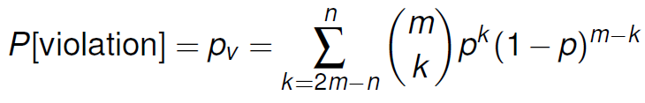
A Decentralized Algorithm (2)
Issue: How robust is this system?
Let p = ∆t/T denote the probability that a coordinator crashes and recovers (i.e., reset) in a period ∆t while having an average lifetime T  probability p[k] that k out of m coordinators reset:
With p = 0.001, n = 32, m = 0.75n, p_{v} < 10⁻⁴⁰
This probability is surely smaller than the availability of any resource.
Notes:
Let p be the probability that a coordinator resets during a time interval ∆t. The
probability P [k] that k out of m coordinators reset during the same interval is then
p[k]=(m,k)p^{k}(1-p)^{m-k}
Given that at least 2m - n coordinators need to reset in order to violate the
correctness of the voting mechanism, the probability that such a violation occurs
is then P[violation]
Unavailable coordinators k out of m
Available coordinators m-k
Correctness of the voting must match m-k > (n-k)/2
2(m - k) > n – k
2m - n > k
Violation condition k >= 2m - n

Slide 47
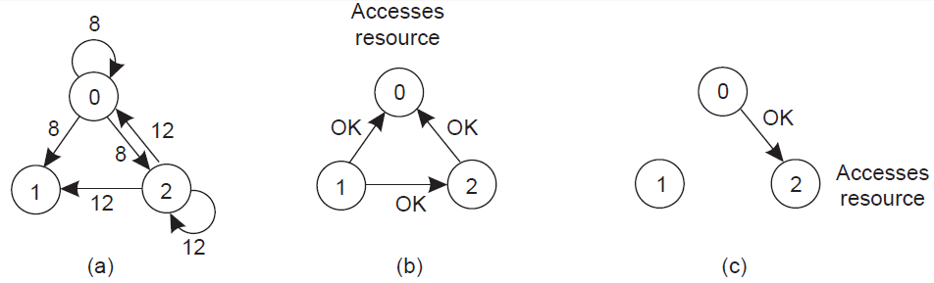
A Distributed Algorithm
Principle: The same as Lamport except that acknowledgments are not sent. Instead, replies (i.e. grants) are sent only when
The receiving process has no interest in the shared resource; or
The receiving process is waiting for the resource, but has lower timestamp.
In all other cases, reply is deferred, implying some more local administration.
Two processes want to access a shared resource at the same moment.
P₀ has the lowest timestamp, so it wins;
P₁ is not interested in the resource.
When P₀ is done, it sends an OK also, so P₂ can now go ahead.
Notes:
Process 0 sends everyone a request with timestamp 8, while at the same time,
process 2 sends everyone a request with timestamp 12. Process 1 is not interested
in the resource, so it sends OK to both senders. Processes 0 and 2 both see the
conflict and compare timestamps. Process 2 sees that it has lost, so it grants permission
to 0 by sending OK. Process 0 now queues the request from 2 for later
processing and access the resource, as shown in Fig. 6-15(b). When it is finished,
it removes the request from 2 from its queue and sends an OK message to process
2, allowing the latter to go ahead, as shown in Fig. 6-15(c).
Nevertheless, this algorithm is slower, more complicated, more expensive,
and less robust that the original centralized one.
The method works best with small groups of processes that never change their
group memberships.
As with the centralized algorithm discussed above, mutual exclusion is
guaranteed without deadlock or starvation. The number of messages required per
entry is now 2(n - 1), where the total number of processes in the system is n. Best
of all, no single point of failure exists.
Unfortunately, the single point of failure has been replaced by n points of
failure.

Slide 48
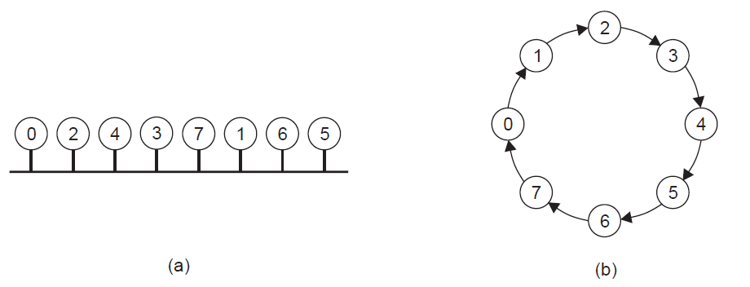
A Token Ring Algorithm
Essence: Organize processes in a logical ring, and let a token be passed between them. The one that holds the token is allowed to enter the critical region (if it wants to).
Properties of token-based solutions
Avoiding starvation
Avoiding deadlocks
An unordered group of processes on a network.
A logical ring constructed in software.
Notes:
Avoiding starvation: depending on the how the processes are organized, they can fairly easily ensure that every process will get a chance at accessing the resource.
Avoiding deadlocks: several processes are waiting for each other to proceed

Slide 49
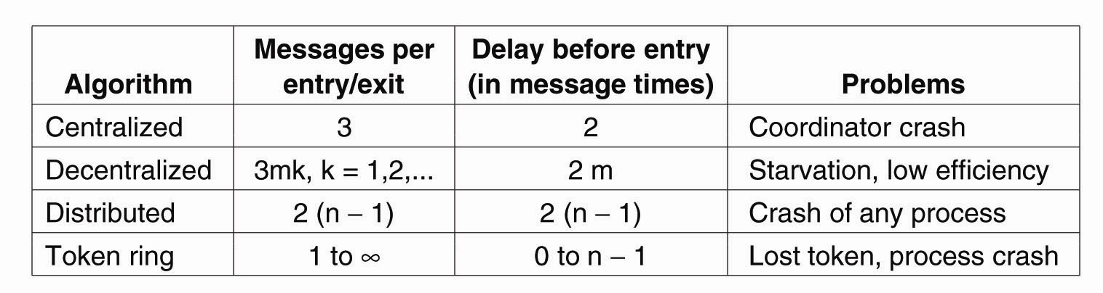
A Comparison of the Four Algorithms
The centralized algorithm is simplest and also most efficient.
All algorithms except the decentralized one suffer badly in the event of crashes.
It is ironic that the distributed algorithms are even more sensitive to crashes than the centralized one.
The decentralized algorithm is less sensitive to crashes, but processes may suffer from starvation and special measures are needed to guarantee efficiency.

Slide 50
Unit 6 – Synchronization: Outline
Clock synchronization
Logical clocks
Mutual Exclusion
Election algorithms
Location systems
Summary

Slide 51
Election Algorithms
Principle: An algorithm requires that some process acts as a coordinator. How to select a coordinator dynamically?
Note: In many systems the coordinator is chosen by hand (e.g. file servers). This leads to centralized solutions → single point of failure.
Question: If a coordinator is chosen dynamically, to what extent can we speak about a centralized or distributed solution?
Question: Is a fully distributed solution, i.e. one without a coordinator, always more robust than any centralized/coordinated solution?
Notes:
teaser
英 [ˈti:zə(r)] 美 [ˈtizɚ]
n. 戏弄者，喜欢戏弄别人的人; 棘手的问题;
变形 复数: teasers

Slide 52

The Bully Algorithm
Principle: Each process has an associated priority (weight). The process with the highest priority should always be elected as the coordinator.
Issue: How do we find the heaviest process?
Any process can just start an election by sending an election message to all other processes (assuming you don’t know the weights of the others).
If a process P_{heavy} receives an election message from a lighter process P_{light}, it sends a take-over message to P_{light}. P_{light} is out of the race.
If a process doesn’t get a take-over message back, it wins, and sends a victory message to all other processes.

Slide 53

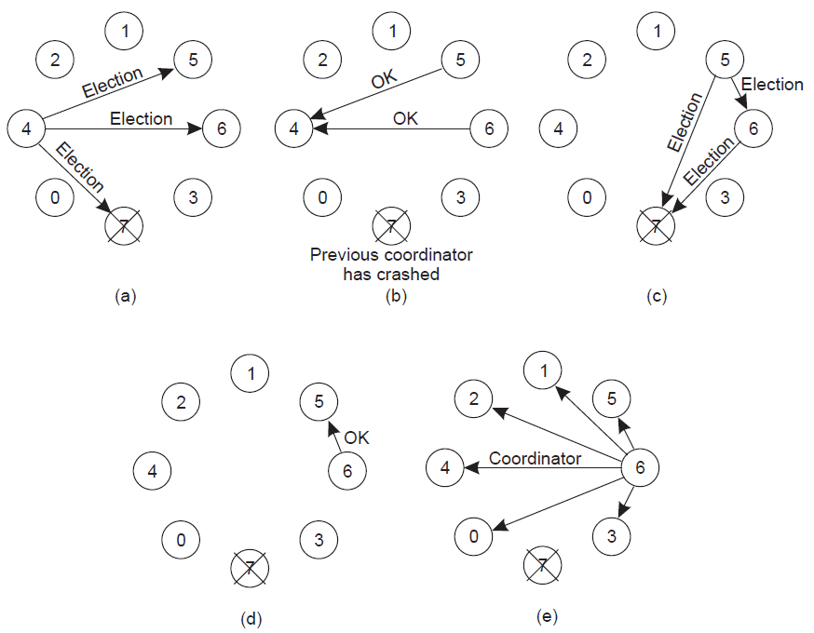
Election by Bullying
(a) Process 4 holds an election. (b) Processes 5 and 6 respond, telling 4 to stop.
(c) Now 5 and 6 each hold an election. (d) Process 6 tells 5 to stop.
(e) Process 6 wins and tells everyone.

Slide 54
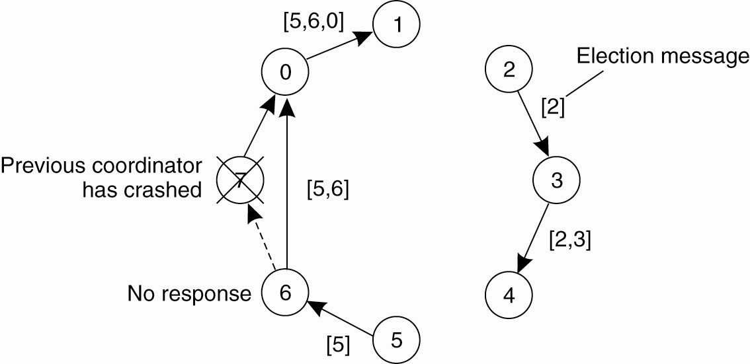
Election in A Ring
Principle: Process priority is obtained by organizing processes into a (logical) ring. Process with the highest priority should be elected as coordinator.
Any process can start an election by sending an election message to its successor. If a successor is down, the message is passed on to the next successor.
If a message is passed on, the sender adds itself to the list. When it gets back to the initiator, everyone had a chance to make its presence known.
The initiator sends a coordinator message around the ring containing a list of all living processes. The one with the highest priority is elected as coordinator.
Notes:
In Fig. 6-21 we see what happens if two processes, 2 and 5, discover simultaneously
that the previous coordinator, process 7, has crashed. Each of these
builds an ELECTION message and each of them starts circulating its message,
independent of the other one. Eventually, both messages will go all the way
around, and both 2 and 5 will convert them into COORDINATOR messages, with
exactly the same members and in the same order. When both have gone around
again, both will be removed. It does no harm to have extra messages circulating;
at worst it consumes a little bandwidth, but this not considered wasteful.

Slide 55
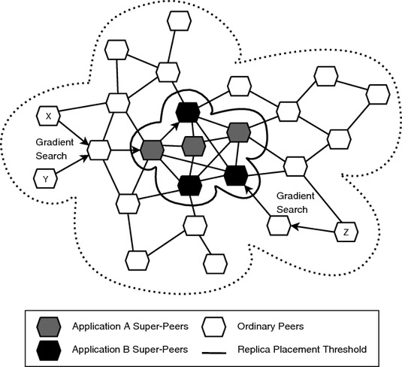
Superpeer Election
Issue: How can we select superpeers such that:
Normal nodes have low-latency access to superpeers
Superpeers are evenly distributed across the overlay network
There is be a predefined fraction of superpeers
Each superpeer should not need to serve more than a fixed number of normal nodes

Slide 56
Unit 6 – Synchronization: Outline
Clock synchronization
Logical clocks
Mutual Exclusion
Election algorithms
Location systems
Summary

Slide 57
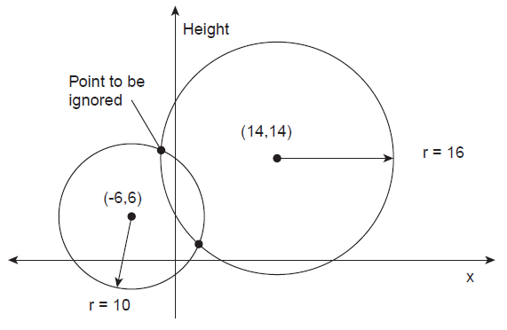
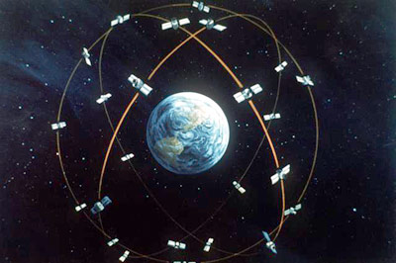
Global Positioning System (GPS) [1]
Basic idea: You can get an accurate account of time as a side-effect of GPS.
GPS uses satellites each circulating in an orbit at a height of approximately 20,000 km.
Each satellite has up to four atomic clocks, regularly calibrated from special stations on Earth. A satellite continuously broadcasts its position, and time stamps each message with its local time.
This broadcasting allows every receiver on Earth to accurately compute its own position
X-axis represents a straight line along the Earth’s surface at sea level
sat1
sat2

Slide 58
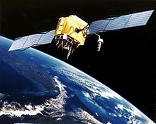
GPS [2]
Problem
Assuming that the clocks of the satellites are accurate and synchronized:
It takes a while before a signal reaches the receiver
The receiver’s clock is definitely out of synch with the satellite

Slide 59

GPS [3]
Principal operation
Δ_{r} : unknown deviation of the receiver’s clock from the actual time.
x_{r} , y_{r} , z_{r} : unknown coordinates of the receiver.
x_{i} , y_{i} , z_{i} : coordinates of satellite i.
T_{i} : timestamp on a message from satellite i
Δ_{i} = (T_{now} − T_{i} ) + Δ_{r} : measured delay by the receiver consists of the actual delay and its own deviation
Measured distance to satellite i: c × Δ_{i} (c is speed of light)
Real distance is
Observation: 4 satellites ⇨ 4 equations in 4 unknowns (with Δ_{r} as one of them)
Notes:
coordinate 1.坐标

Slide 60
GPS[4]: Conclusion
A GPS receiver must be locked on to the signal of at least three satellites to calculate a 2D position (latitude and longitude) and track movement.
With four or more satellites in view, the receiver can determine the user's 3D position (latitude, longitude and altitude).
Once the user's position has been determined, the GPS unit can calculate other information, such as speed, bearing, track, trip distance, distance to destination, sunrise and sunset time and more.

Slide 61
GPS [5]: Discussion
Measurements have been assumed to be perfectly accurate, but they are not.
Sources of error:
GPS does not take leap seconds into account ⇨ There is a systematic deviation from UTC, however, which can be compensated for in software.
Atomic clocks in the satellites are not always in perfect synch
The position of a satellite is not known precisely
The receiver’s clock has a finite accuracy
The signal propagation speed is not constant
The earth is not a perfect sphere
NOTE:
Today's GPS receivers are extremely accurate. Even with relatively cheap GPS receivers, positioning can be precise within a range of 1-5 meters.
Professional receivers have a claimed error of less than 20-35 ns.

Slide 62
Summary (1)
Strongly related to communication between processes is the issue of how processes in distributed systems synchronize. There is no notion of a globally shared clock.
In many cases, knowing the absolute time is not necessary. What counts is that related events at different processes happen in the correct order.
Lamport clocks
Vector clocks (extended Lamport timestamps)
Notes:
Fully distributed algorithms also exist, but have the drawback that they are generally more susceptible to communication and process failures.

Slide 63
Summary (2)
An important class of synchronization algorithms is that of distributed mutual exclusion
can easily be achieved if we make use of a coordinator
Fully distributed algorithms also exist, but have the drawbacks
A decision to fix a coordinator is taken by means of election algorithms, which are primarily used in cases
where the coordinator can crash.
the selection of superpeers in P2P systems.
Related to these synchronization problems is positioning nodes in a geometric overlay
Via side-effect of GPS.
Notes:
Fully distributed algorithms also exist, but have the drawback that they are generally more susceptible to communication and process failures.

Slide 64
Seminar Topics
Network Time Protocol
Time Synchronization in Sensor Networks
Global Positioning System (GPS)
Super Peer Network
A Super-Peer Selection Strategy for Peer-to-Peer
Decentralized implementation of attribute-based naming system (refer to the textbook)
Introduction of election algorithm

