Slide 1
6
函数部分补充
（来自绿皮书）

Slide 2
6.3 Math Library Functions
<cmath> header file
    sqrt( 900.0 )
    All functions in <cmath> are global functions

Slide 3
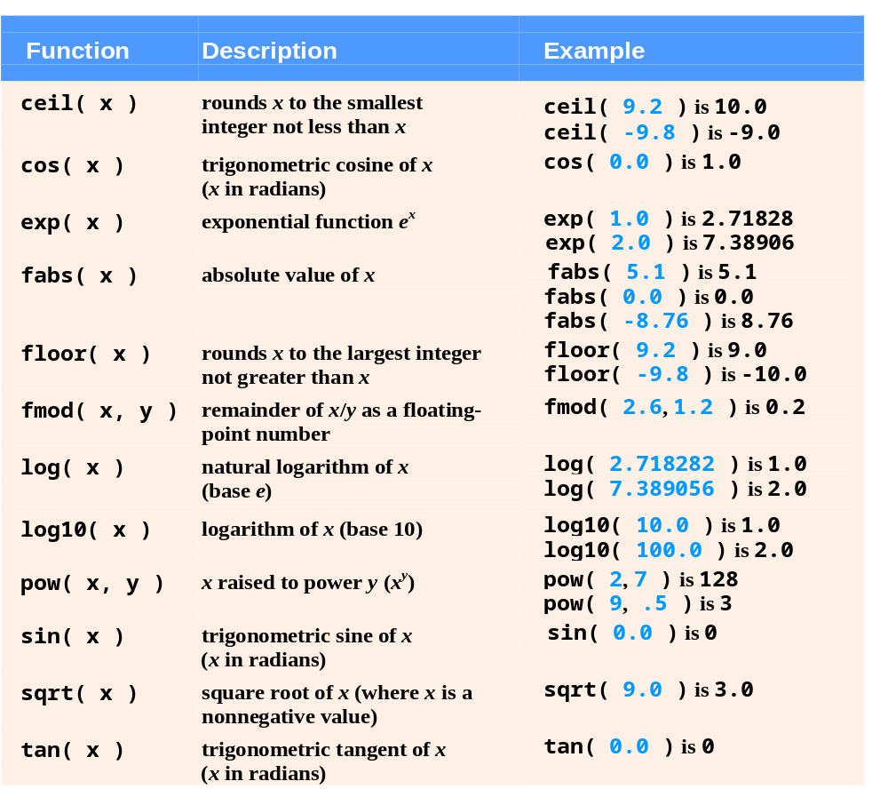
Fig. 6.2 | Math library functions.

Slide 4
6.7 Case Study: Random Number Generation
C++ Standard Library function rand
  Introduces the element of chance into computer applications
  Example
    i = rand();
      Generates an unsigned integer between 0 and RAND_MAX (a symbolic constant defined in header file <cstdlib>)
  Function prototype for the rand function is in <cstdlib>

Slide 5
6.7 Case Study: Random Number Generation (Cont.)
To produce integers in a specific range, use the modulus operator (%) with rand
  Example
    rand() % 6;
      Produces numbers in the range 0 to 5
  This is called scaling, 6 is the scaling factor
  Shifting can move the range to 1 to 6
    1 + rand() % 6;

Slide 6
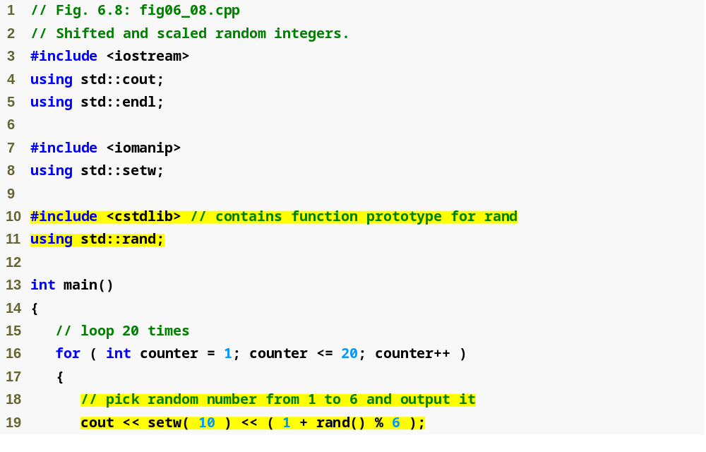
Outline
fig06_08.cpp
(1 of 2)
#include and using for function rand
Calling function rand

Slide 7
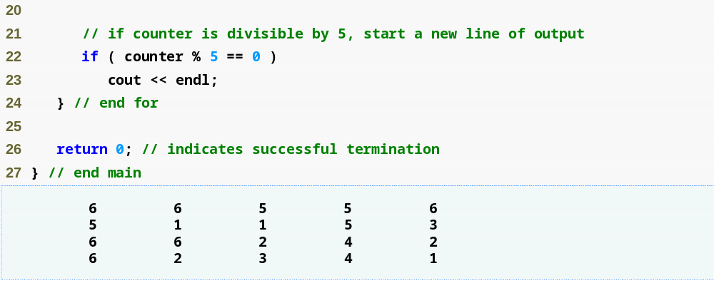
Outline
fig06_08.cpp
(2 of 2)

Slide 8
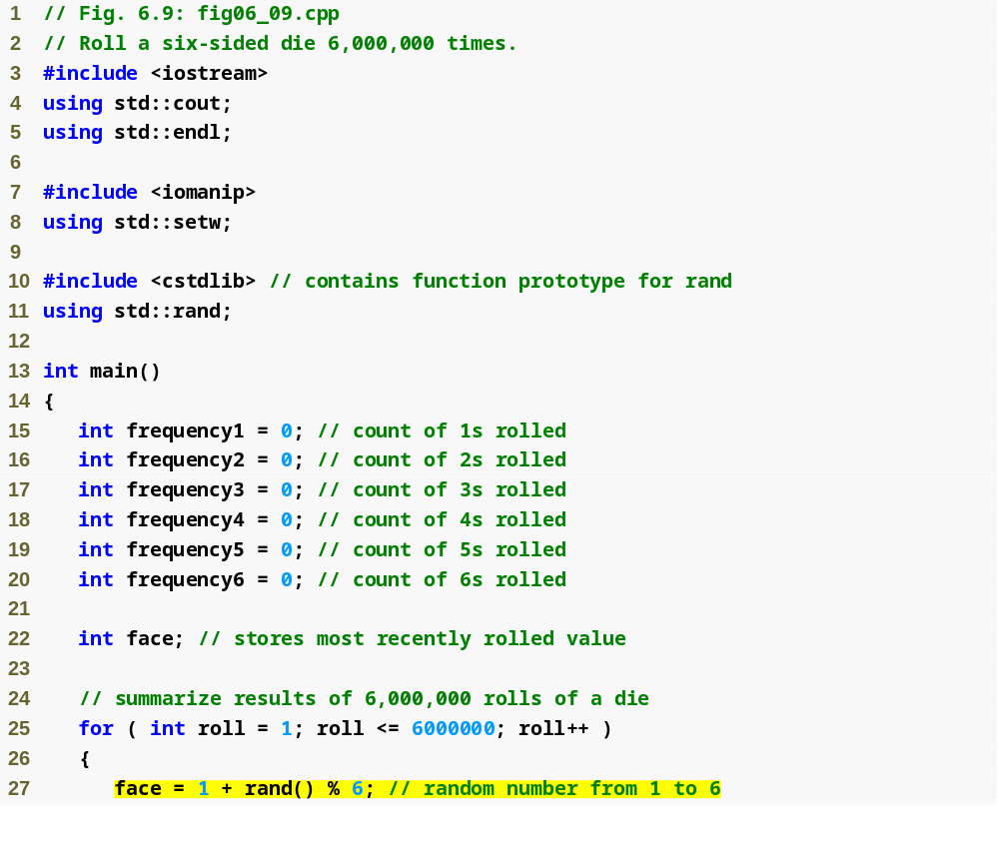
Outline
fig06_09.cpp
(1 of 3)
Scaling and shifting the value produced by function rand

Slide 9
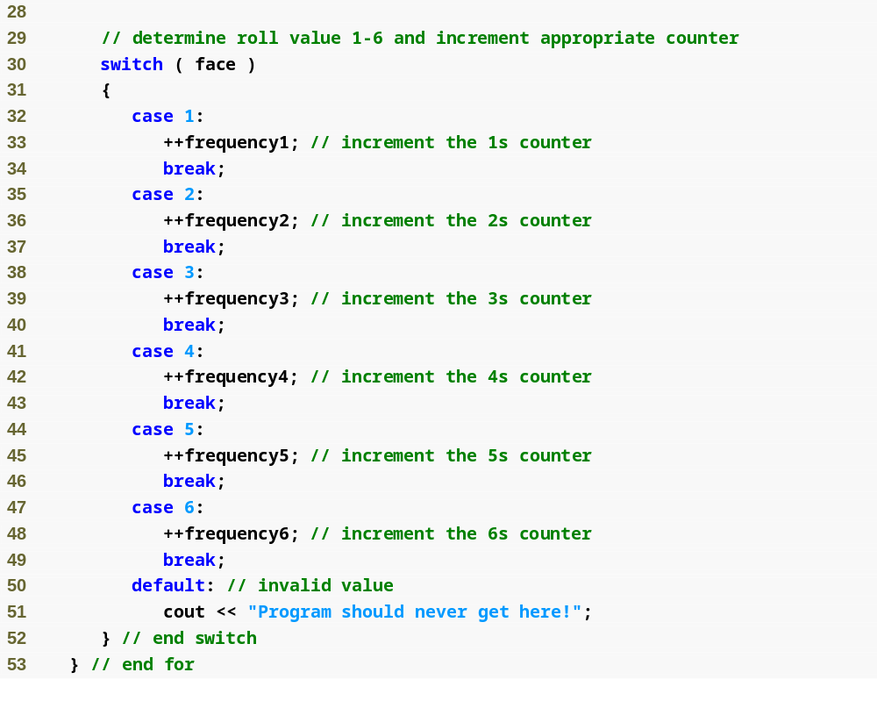
Outline
fig06_09.cpp
(2 of 3)

Slide 10
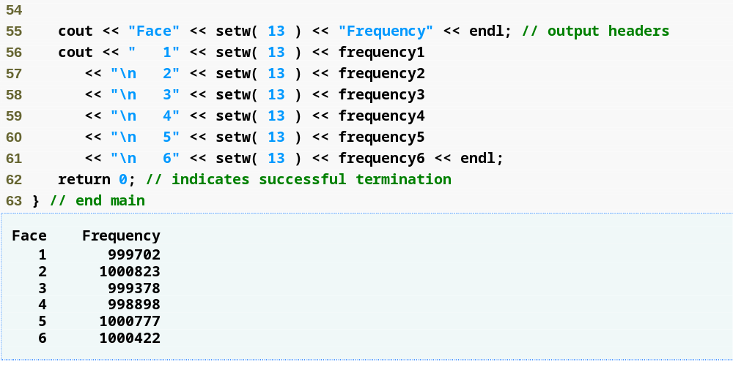
Outline
fig06_09.cpp
(3 of 3)
Each face value appears approximately 1,000,000 times

Slide 11
6.7 Case Study: Random Number Generation (Cont.)
Function rand
  Generates pseudorandom numbers
  The same sequence of numbers repeats itself each time the program executes
Randomizing
  Conditioning a program to produce a different sequence of random numbers for each execution
C++ Standard Library function srand
  Takes an unsigned integer argument
  Seeds the rand function to produce a different sequence of random numbers

Slide 12
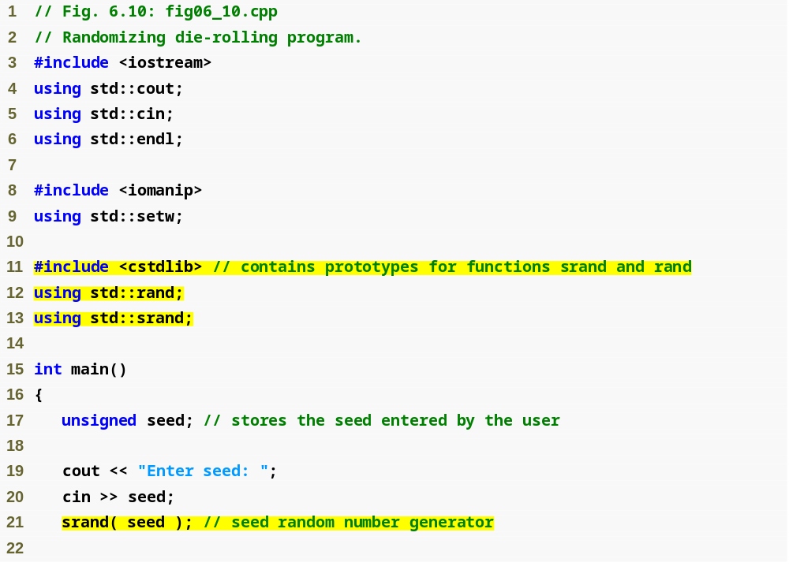
Outline
fig06_10.cpp
(1 of 2)
using statement for function srand
Data type unsigned is short for unsigned int
Passing seed to srand to randomize the program

Slide 13
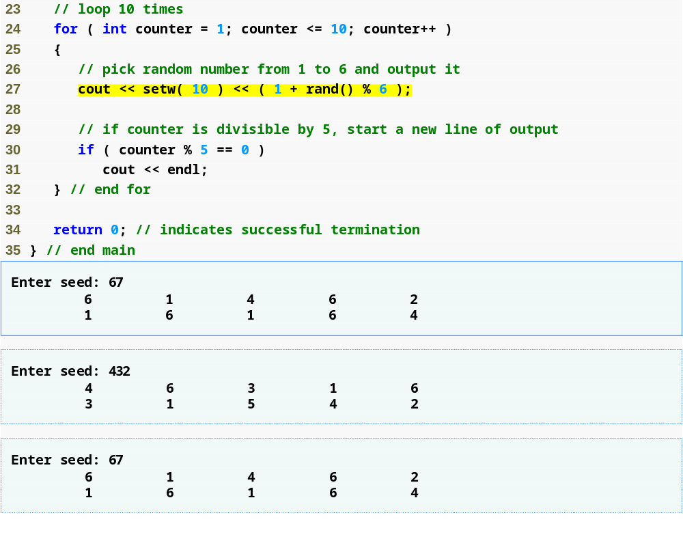
Outline
fig06_10.cpp
(2 of 2)
Program outputs show that each unique seed value produces a different sequence of random numbers

Slide 14
6.7 Case Study: Random Number Generation (Cont.)
To randomize without having to enter a seed each time
  srand( time( 0 ) );
    This causes the computer to read its clock to obtain the seed value
  Function time (with the argument 0)
    Returns the current time as the number of seconds since January 1, 1970 at midnight Greenwich Mean Time (GMT)
    Function prototype for time is in <ctime>

Slide 15
6.7 Case Study: Random Number Generation (Cont.)
Scaling and shifting random numbers
  To obtain random numbers in a desired range, use a statement like
  number = shiftingValue + rand() % scalingFactor;
    shiftingValue is equal to the first number in the desired range of consecutive integers
    scalingFactor is equal to the width of the desired range of consecutive integers
      number of consecutive integers in the range

Slide 16
6.8 Case Study: Game of Chance and Introducing enum
Enumeration
  A set of integer constants represented by identifiers
    The values of enumeration constants start at 0, unless specified otherwise, and increment by 1
    The identifiers in an enum must be unique, but separate enumeration constants can have the same integer value
  Defining an enumeration
    Keyword enum
    A type name
    Comma-separated list of identifier names enclosed in braces
    Example
      enum Months { JAN = 1, FEB, MAR, APR };

Slide 17
Fig 6_11
“双骰”游戏规则：
同时掷两个骰子，点数之和：
7或者11，玩家赢
2、3、12，玩家输
其他：4、5、6、8、9、10，记录为玩家点数，并再投掷一次，直到再次等于玩家点数则赢，如果在此之前掷出了7，则输

Slide 18
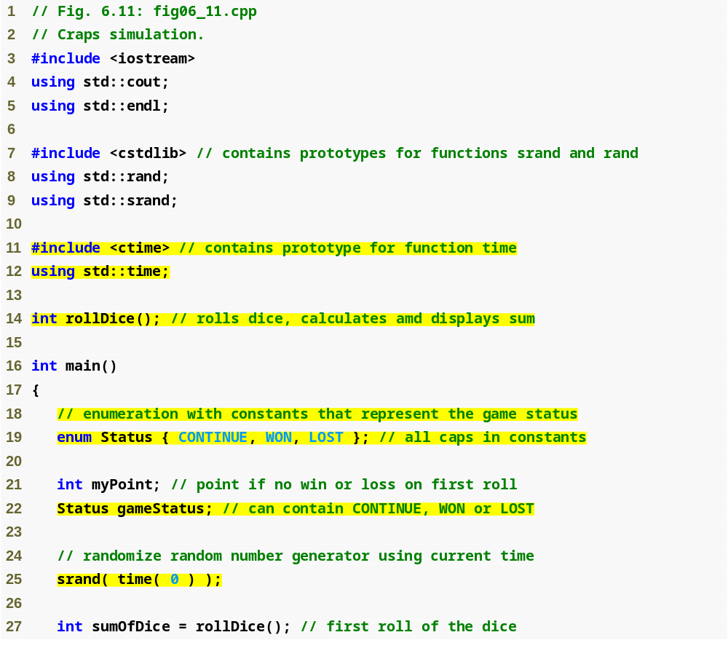
Outline
fig06_11.cpp
(1 of 4)
#include and using for function time
Enumeration to keep track of the game status
Declaring a variable of the user-defined enumeration type
Seeding the random number generator with the current time

Slide 19
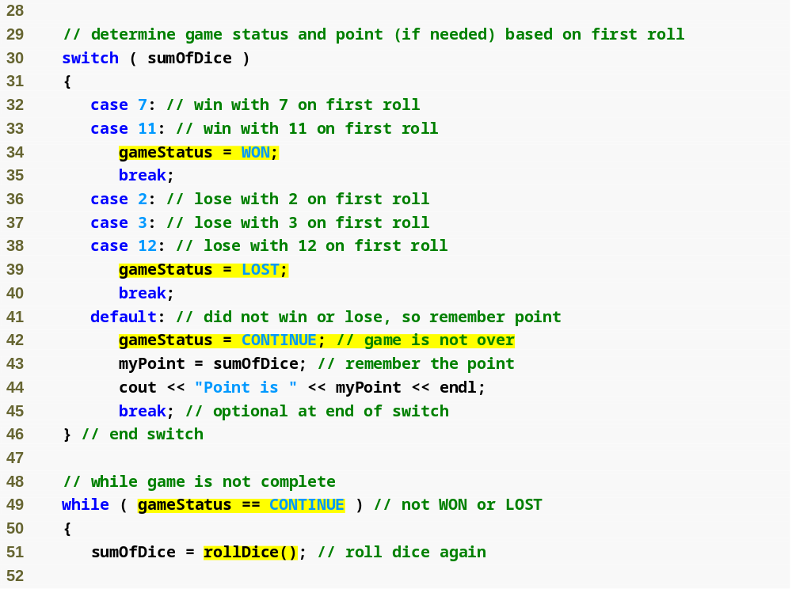
Outline
fig06_11.cpp
(2 of 4)
Assigning an enumeration constant to gameStatus
Comparing a variable of an enumeration type to an enumeration constant

Slide 20
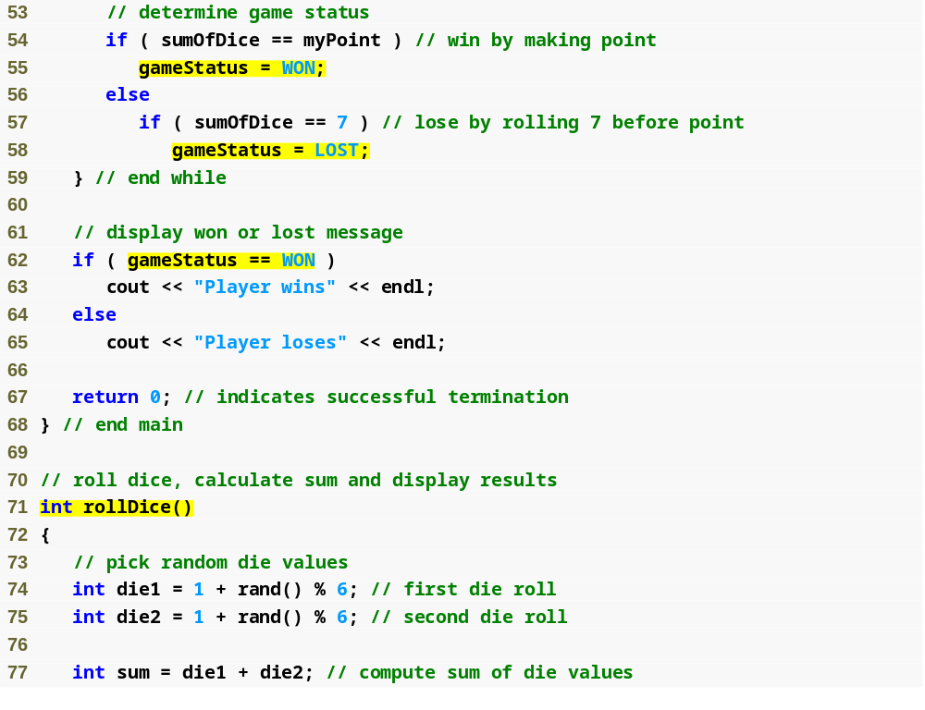
Outline
fig06_11.cpp
(3 of 4)
Function that performs the task of rolling the dice

Slide 21
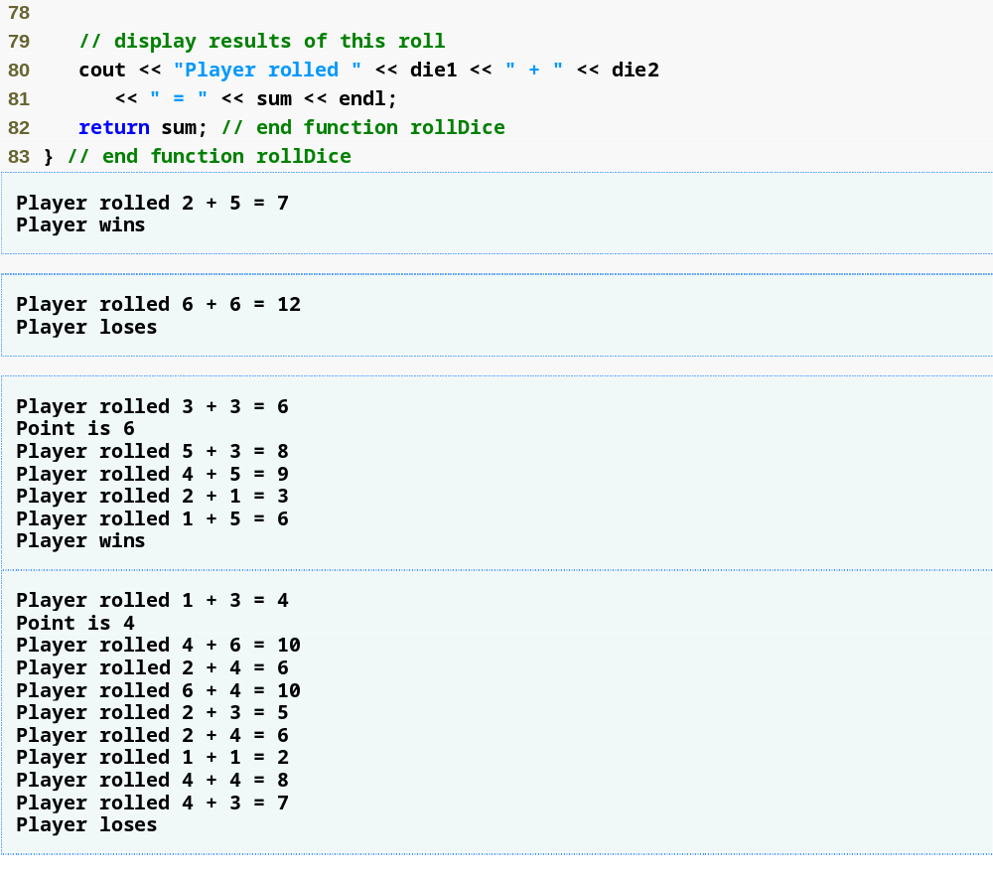
Outline
fig06_11.cpp
(4 of 4)

Slide 22
Good Programming Practice 6.1
Capitalize the first letter of an identifier used as a user-defined type name.
enum Status { CONTINUE, WON, LOST };

Slide 23
Good Programming Practice 6.2
Use only uppercase letters in the names of enumeration constants. This makes these con­stants stand out in a program and reminds the programmer that enumeration constants are not variables.
enum Status { CONTINUE, WON, LOST };

Slide 24
Good Programming Practice 6.3
Using enumerations rather than integer constants can make programs clearer and more maintainable. You can set the value of an enumeration constant once in the enumeration declaration.

Slide 25
Common Programming Error 6.9
Assigning the integer equivalent of an enumeration constant to a variable of the enumeration type is a compilation error.
enum Status { CONTINUE, WON, LOST };
Status gameStatus；
gameStatus=WON;
gameStatus=2;//error;

Slide 26
Common Programming Error 6.10
After an enumeration constant has been defined, attempting to assign another value to the enumeration constant is a compilation error.
enum Status { CONTINUE, WON, LOST };
CONTINUE=1//error;

Slide 27
6.9 Storage Classes
Each identifier has several attributes
  Name, type, size and value
  Also storage class, scope and linkage
Identifier’s storage class
  Determines the period during which that identifier exists in memory
Identifier’s scope
  Determines where the identifier can be referenced in a program

Slide 28
6.9 Storage Classes (Cont.)
Identifier’s linkage
  Determines whether an identifier is known only in the source file where it is declared or across multiple files that are compiled, then linked together
An identifier’s storage-class specifier helps determine its storage class and linkage
C++ provides five storage-class specifiers:
  auto, register, extern, mutable and static
  mutable（突破const限制）以后介绍

Slide 29
6.9 Storage Classes (Cont.)
Automatic storage class
  Declared with keywords auto and register
  Automatic variables
    Created when program execution enters block in which they are defined
    Exist while the block is active
    Destroyed when the program exits the block
  Only local variables and parameters can be of automatic storage class
    Such variables normally are of automatic storage class

Slide 30
6.9 Storage Classes (Cont.)
Storage-class specifier auto
  Explicitly declares variables of automatic storage class
    auto int x,y;
  Local variables are of automatic storage class by default
    So keyword auto rarely is used
Storage-class specifier register
  Suggest that the compiler maintain the variable in one of the computer’s high-speed hardware registers rather than in memory , such as counters or totals
    register int counter=1;
  The compiler might ignore register declarations
    May not be sufficient registers for the compiler to use
  Often, register is unnecessary

Slide 31
extern 用法
在多个程序文件组成的程序中共享数据
// item1.cpp
#include<iostream>
using namespace std ;
int n = 8 ; // define
void f ( ) ;
int main ( ){
cout<<n<<”\n”;
f ( ) ;
cout<<n<<”\n”;
return 0;
}
// item2.cpp
#include<iostream>
using namespace std ;
extern int n ; // declare
void f ( ){
cout<<n++<<”\n”;
}

Slide 32
6.9 Storage Classes (Cont.)
Local variables declared with keyword static
  Known only in the function in which they are declared
  Retain their values when the function returns to its caller
    Next time the function is called, the static local variables contain the values they had when the function last completed
  If numeric variables of the static storage class are not explicitly initialized by the programmer
    They are initialized to zero

Slide 33
void f ( )
{
static int n=1; //static int n;
cout<<n++<<endl;
}
int main ( )
{
f ( ) ;
f ( );
return 0;
}

Slide 34
void f ( )
{
static int n=1;
cout<<n++<<endl;
}
int main ( )
{
int n=3;
f ( ) ;
f ( );
cout<<n<< endl;
return 0;
}

Slide 35
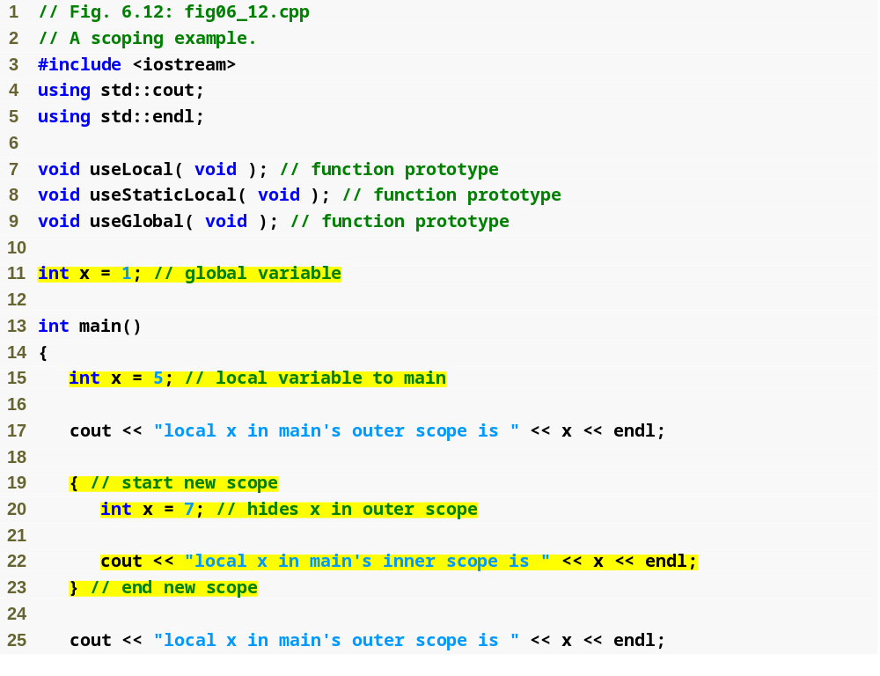
Outline
关于变量的作用域
fig06_12.cpp
(1 of 4)
Declaring a global variable outside any class or function definition
Local variable x that hides global variable x
Local variable x in a block that hides local variable x in outer scope

Slide 36
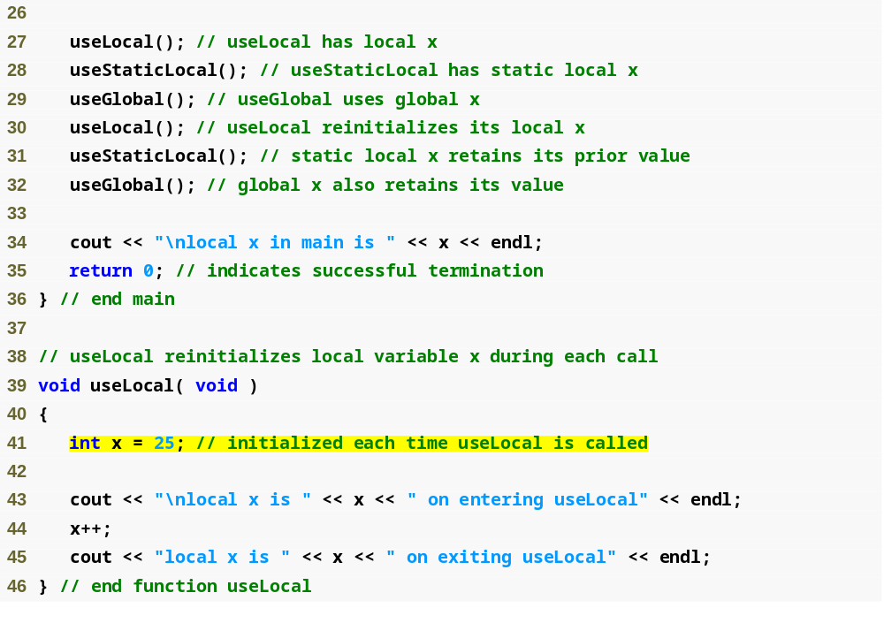
Outline
fig06_12.cpp
(2 of 4)
Local variable that gets recreated and reinitialized each time useLocal is called

Slide 37
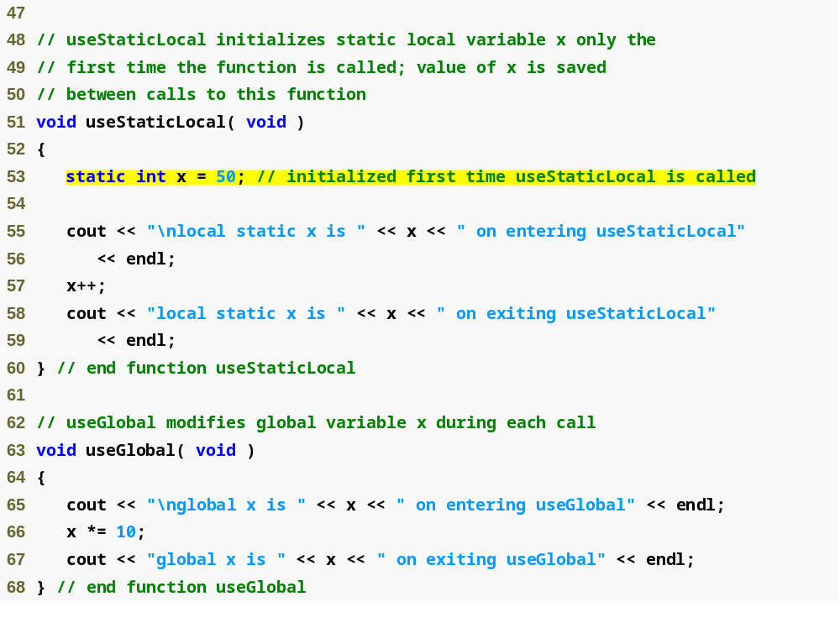
Outline
static local variable that gets initialized only once
fig06_12.cpp
(3 of 4)
Statement refers to global variable x because no local variable named x exists

Slide 38
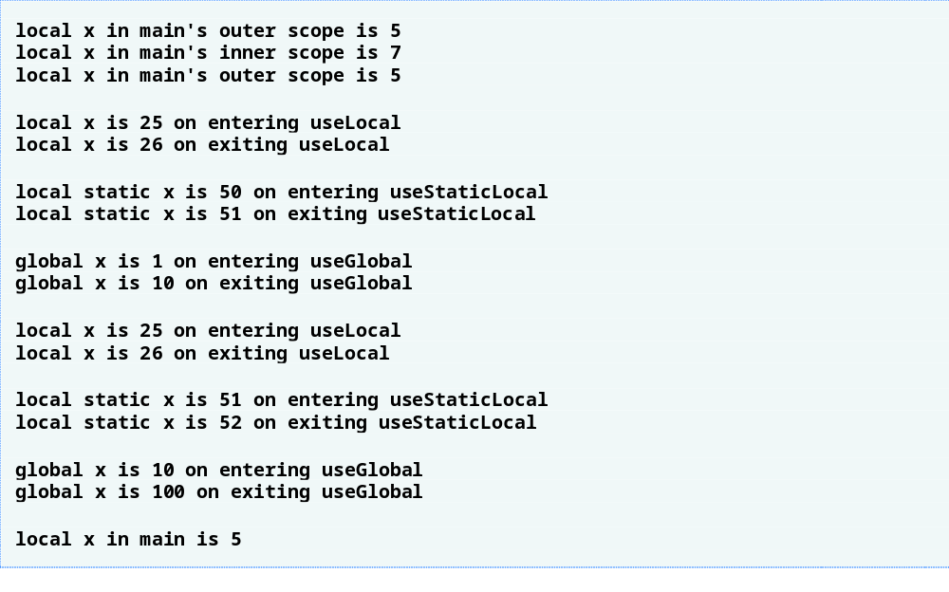
Outline
fig06_12.cpp
(4 of 4)

Slide 39
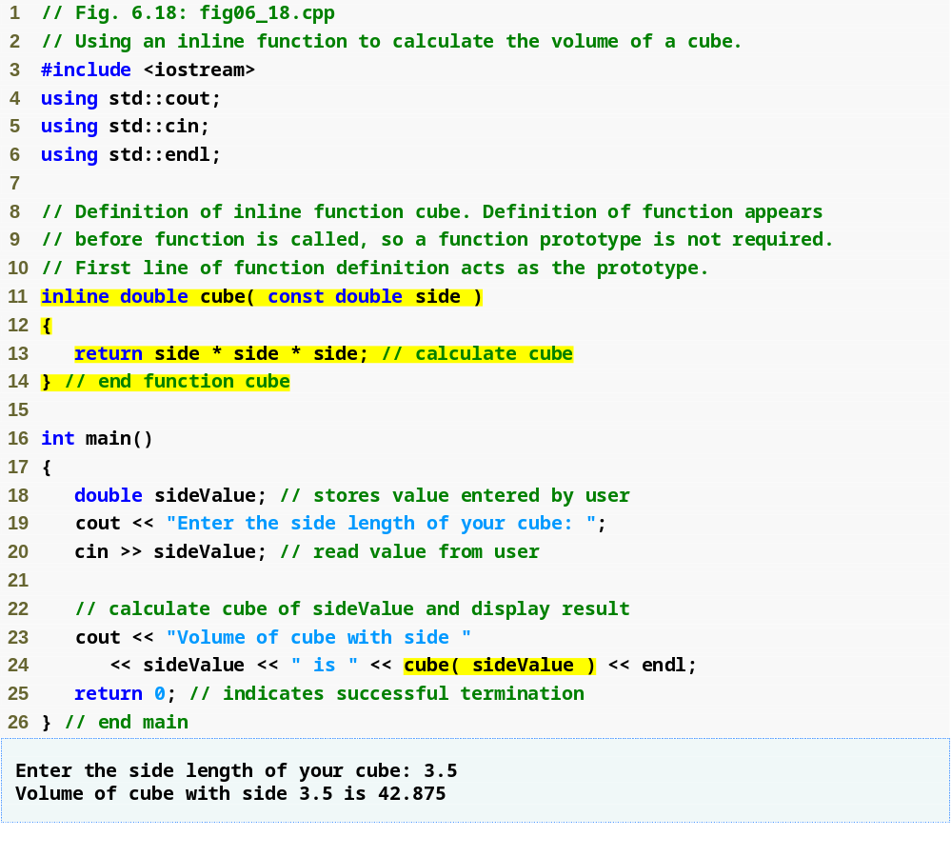
Outline
Inline 函数
fig06_18.cpp
(1 of 1)
Complete function definition so the compiler knows how to expand a cube function call into its inlined code.
inline qualifier
cube function call that could be inlined

Slide 40
6.14 References and Reference Parameters (Cont.)
Returning a reference from a function
  Functions can return references to variables
    Should only be used when the variable is static
  Dangling reference
    Returning a reference to an automatic variable
      That variable no longer exists after the function ends

Slide 41
#include <iostream>
using namespace std;
double & GetWeeklyHours()
{
double h = 46.50; // static OK
return h;
}
//--------------------------------------------------------------
int main()
{
double hours = GetWeeklyHours();
cout << "Weekly Hours: " << hours << endl;
return 0;
}
warning C4172: 返回局部变量或临时变量的地址

Slide 42
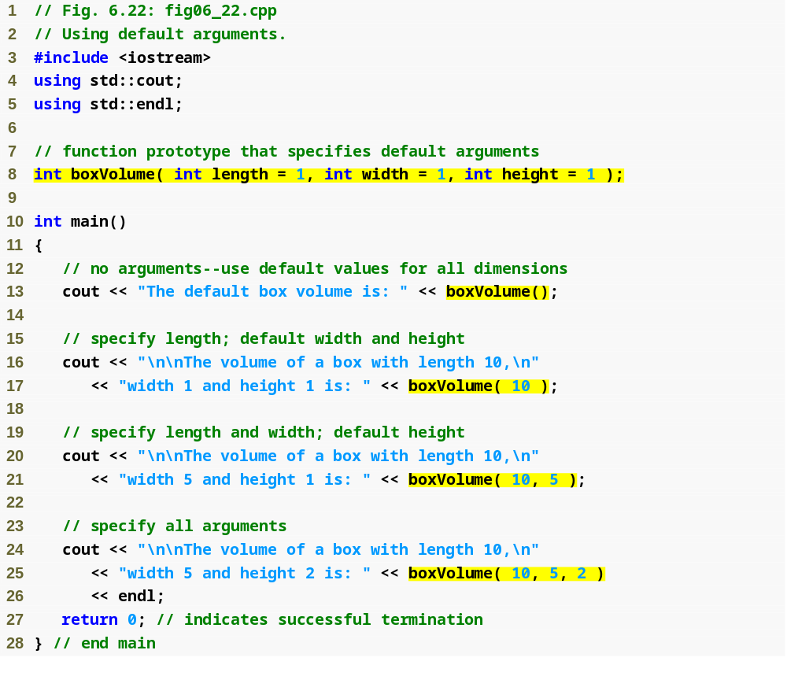
Outline
缺省参数
fig06_22.cpp
(1 of 2)
Default arguments
Calling function with no arguments; uses three defaults
Calling function with one argument; uses two defaults
Calling function with two arguments; uses one default
Calling function with three arguments; uses no defaults

Slide 43
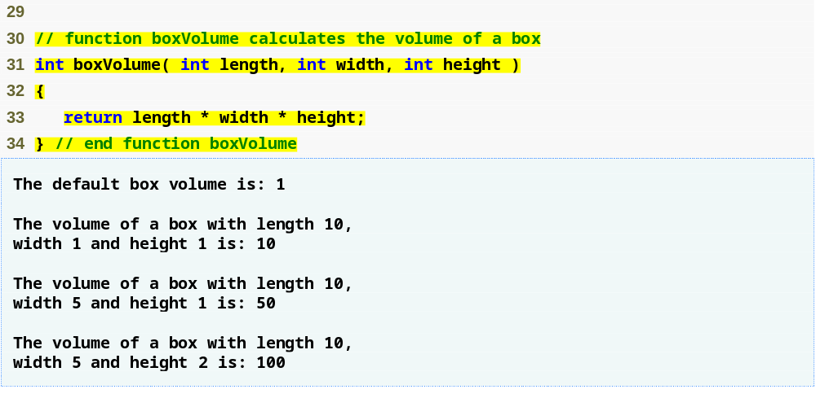
Outline
fig06_22.cpp
(2 of 2)
Note that default arguments were specified in the function prototype, so they are not specified in the function header

Slide 44
说明：
默认参数的说明必须出现在函数调用之前。若一个函数说明已给出参数的默认值，则在函数定义中不允许再设置。
要求赋予默认值的参数必须放在形参表列中的最右端。
分析下面各例：
void fun(int i, int j, int k, int m=3,int n=4);
假设函数调用语句为：
fun(1,2); //错误，至少应有三个实参
fun(10,20,30); //正确，m、n取默认值
fun(10,20,30,40); //正确，m取40 、n取默认值4
fun(10,20,30, ,50); //错误，只能从左至右匹配

Slide 45
关于“::”
int count = 0;
int main(void) {
int count = 0;
{
int count=3;
::count = 1; // set global count to 1
}
cout<<count<<" "<<::count;
return 0;
}

Slide 46
一. 参数类型不同的重载函数
int abs(int x)
{return x>0?x:-x; }
double abs(double x)
{return x>0?x:-x; }
long abs(long x)
{return x>0?x:-x; }
void main()
{int x1=1;
double x2=2.5;
long x3=3;
cout<<abs(x1)<<endl;
cout<<abs(x2)<<endl;
cout<<abs(x3)<<endl;
}
编译器根据调用语句中实参的类型来确定应该调用哪个函数

Slide 47
二. 参数个数不同的重载函数
int min(int a,int b)
{return a<b?a:b; }
int min(int a,int b,int c)
{int t=min(a,b);
return min(t,c);}
int min(int a,int b,int c,int d)
{int t1=min(a,b);
int t2=min(c,d);
return min(t1,t2);}
void main()
{ cout<<min(13,5,4,9)<<endl;
cout<<min(-2,8,0)<<endl;
}
注意：不要同时使用重载函数和缺省参数函数。
编译器根据调用语句中实参的个数来确定应该调用哪个函数
可见：重载使得函数的使用更加灵活、方便。 它体现了c++对多态性的支持———一个名字，多个入口 。

Slide 48

6.18 Function Templates
使用函数重载需编写多个函数，而利用函数模板只需定义一个通用函数即可。
利用函数模板定义的函数称为模板函数，形式：
template <class 类型参数表 >
类型 函数名( 参数表)
{……}
template <typename 类型参数表 >
类型 函数名( 参数表)
{……}
定义一个数据类型T
使用模板函数时,模板中的类型参数T用实参的类型替换
template <class T>
T min(T a,T b)
{return a<b?a:b; }
void main()
{ cout<<min(3,5)<<endl;
cout<<min(8.5,5.6)<<endl;
}

Slide 49
template <class T>
T abs (T x)
{return x>0?x:-x; }
void main(){
int x1=1;
double x2=2.5;
long x3=3;
cout<<abs(x1)<<endl;
cout<<abs(x2)<<endl;
cout<<abs(x3)<<endl;
}

Slide 50
分析以下几种模板函数：
✓
template <class T>
T fun1(T a, int b) //可含有模板参数表中未给出的数据类型
{…… }
✓
template <class T1,class T2> //模板中可带有多个参数
T2 fun1(T1 a,T2 b)
{…… }
×
template <class T>
T fun1(int a,int b) //必须至少有一个参数的类型为模板的类型参数
{…… }
×
template <class T>
void fun1(int a, int b)
{T i,j;
……
}

Slide 51
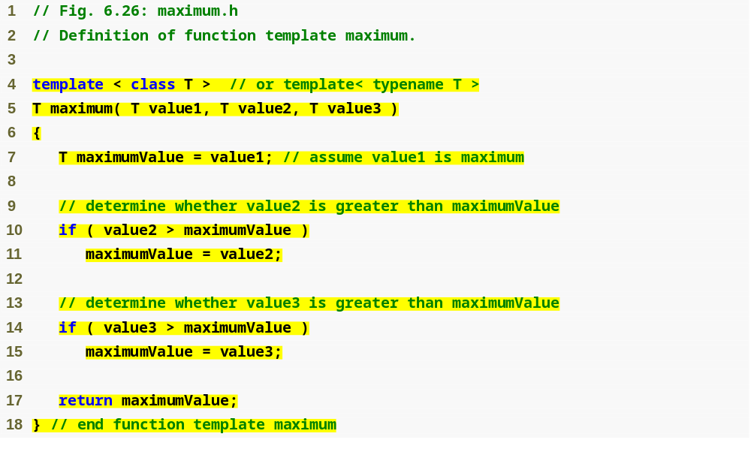
Outline
Using formal type parameter T in place of data type
fig06_26.cpp
(1 of 1)

Slide 52
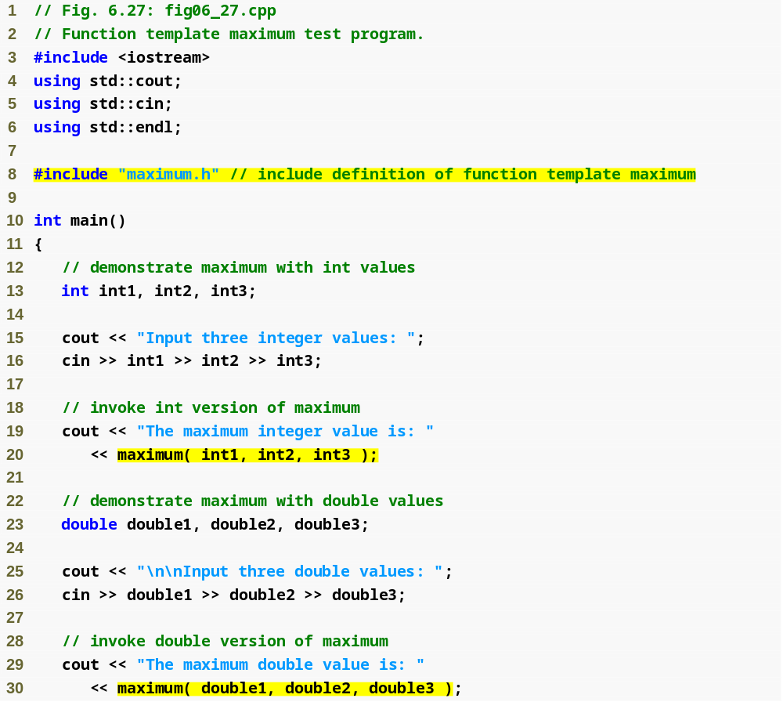
Outline
fig06_27.cpp
(1 of 2)
Invoking maximum with int arguments
Invoking maximum with double arguments

Slide 53
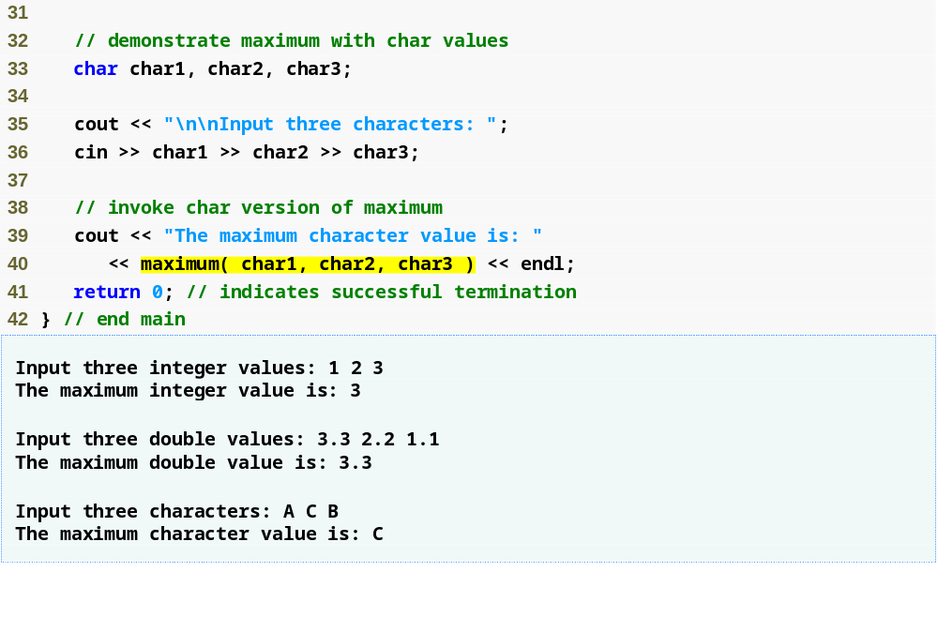
Outline
fig06_27.cpp
(2 of 2)
Invoking maximum with char arguments

Slide 54

6.19 Recursion(递归函数)
用自身的结构来描述自身就称为递归。
最典型的例子是对阶乘运算：
特点：
① 原始问题可转化为解决方法相同的新问题；
② 新问题的规模比原始问题小；
③ 新问题又可转化为解决方法相同的规模更小的新问题，直至终结条件为止。

Slide 55
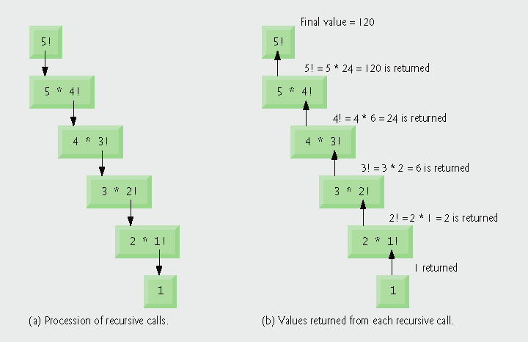
Fig. 6.28 | Recursive evaluation of 5!.

Slide 56
编fac(n)=n! 的递归函数
long fac(long n)
{
if(n==1)
return 1;
return n*fac(n-1);
}
递推
回归
fac(4)=4*fac(3)
fac(3)=3*fac(2)
fac(2)=2*fac(1)
fac(1)=1
fac(4)=4*6
fac(3)=3*2
fac(2)=2*1
递推过程
每调用自身，当前参数压栈，直到达到递归结束条件。
回归过程
不断从栈中弹出当前的参数，直到栈空。

Slide 57
任何有意义的递归必须具有：
  递归结束条件及结束时的值；
能用递归形式表示，并且递归向终止条件发展。
递归算法设计简单，程序代码简洁易读，但它消耗的时间和占据的内存空间比非递归大。

Slide 58
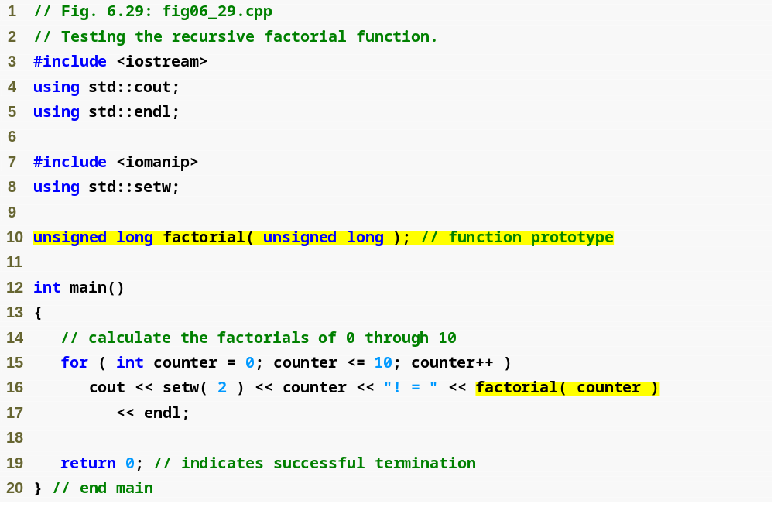
Outline
fig06_29.cpp
(1 of 2)
First call to factorial function

Slide 59
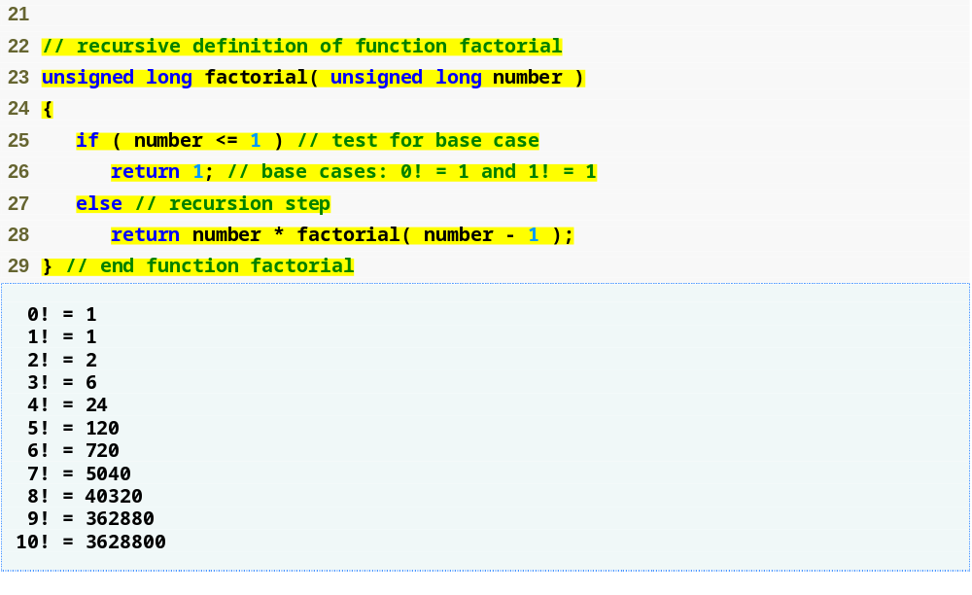
Outline
Base cases simply return 1
fig06_29.cpp
(2 of 2)
Recursive call to factorial function with a slightly smaller problem

Slide 60
6.20 Example Using Recursion: Fibonacci Series
The Fibonacci series
  0, 1, 1, 2, 3, 5, 8, 13, 21, …
  Begins with 0 and 1
  Each subsequent Fibonacci number is the sum of the previous two Fibonacci numbers
  can be defined recursively as follows:
    fibonacci(0) = 0
    fibonacci(1) = 1
    fibonacci(n) = fibonacci(n – 1) + fibonacci(n – 2)

Slide 61
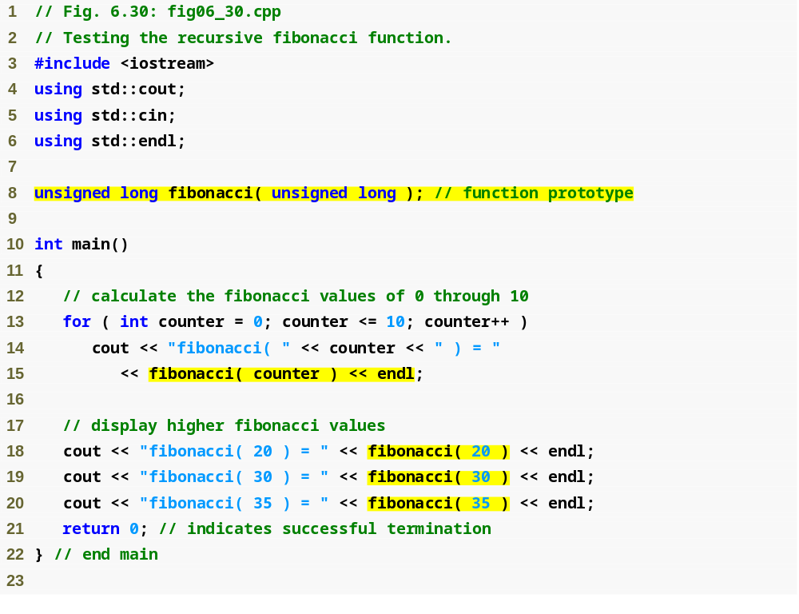
Outline
fig06_30.cpp
(1 of 2)

Slide 62
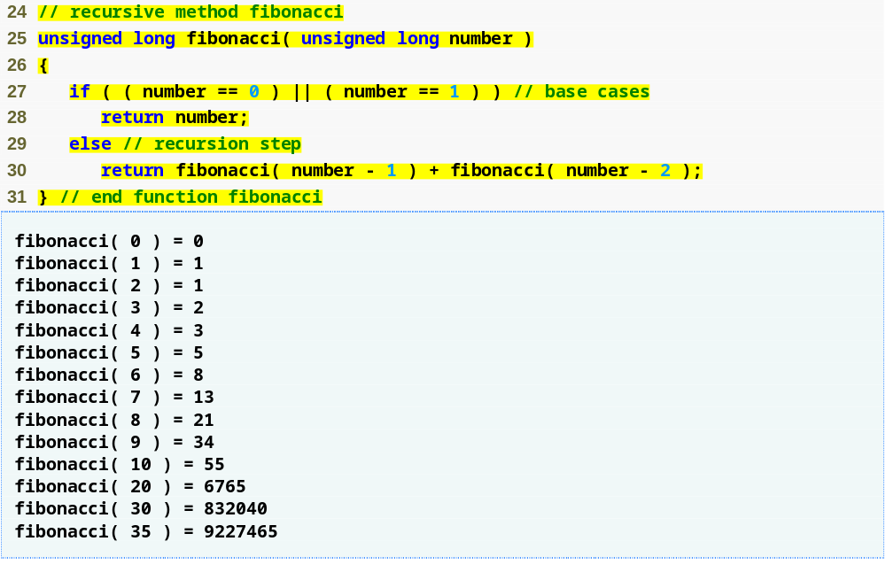
Outline
Base cases
fig06_30.cpp
(2 of 2)
Recursive calls to fibonacci function

Slide 63
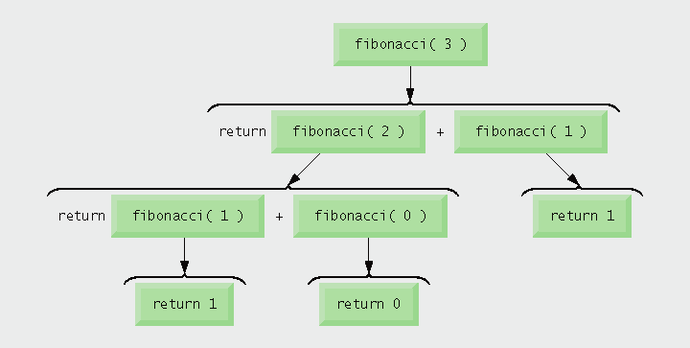
Fig. 6.31 | Set of recursive calls to function fibonacci.

Slide 64
6.21 Recursion(递归) vs.
Iteration(迭代)
Both are based on a control statement
  Iteration – repetition structure
  Recursion – selection structure
Both involve repetition
  Iteration – explicitly uses repetition structure
  Recursion – repeated function calls
Both involve a termination test
  Iteration – loop-termination test
  Recursion – base case

Slide 65
6.21 Recursion vs. Iteration (Cont.)
Both gradually approach termination
  Iteration modifies counter until loop-termination test fails
  Recursion produces progressively simpler versions of problem
Both can occur infinitely
  Iteration – if loop-continuation condition never fails
  Recursion – if recursion step does not simplify the problem

Slide 66
6.21 Recursion vs. Iteration (Cont.)
Negatives of recursion
  Overhead of repeated function calls
    Can be expensive in both processor time and memory space
  Each recursive call causes another copy of the function (actually only the function’s variables) to be created
    Can consume considerable memory
Iteration
  Normally occurs within a function
  Overhead of repeated function calls and extra memory assignment is omitted

Slide 67
4.9 Formulating Algorithms: Sentinel-Controlled Repetition (Cont.)
<iomanip> setw
cin >> setw( 20 ) >> word;//cout
Formatting floating-point numbers
  Parameterized stream manipulator setprecision
    Specifies number of digits of precision to display to the right of the decimal point
    Default precision is six digits
  Nonparameterized stream manipulator fixed
    Indicates that floating-point values should be output in fixed-point format
      As opposed to scientific notation (3.1 × 10³)
  Stream manipulator showpoint
    Forces decimal point to display

Slide 68
Cout <<setprecision(2)<<fixed<<average;

Slide 69
8.6 Selection Sort Using Pass-by-Reference
Implement selectionSort using pointers
  Selection sort algorithm
    Swap smallest element with the first element
    Swap second-smallest element with the second element
    Etc.
  Want function swap to access array elements
    Individual array elements: scalars
      Passed by value by default
    Pass by reference via pointers using address operator &

Slide 70
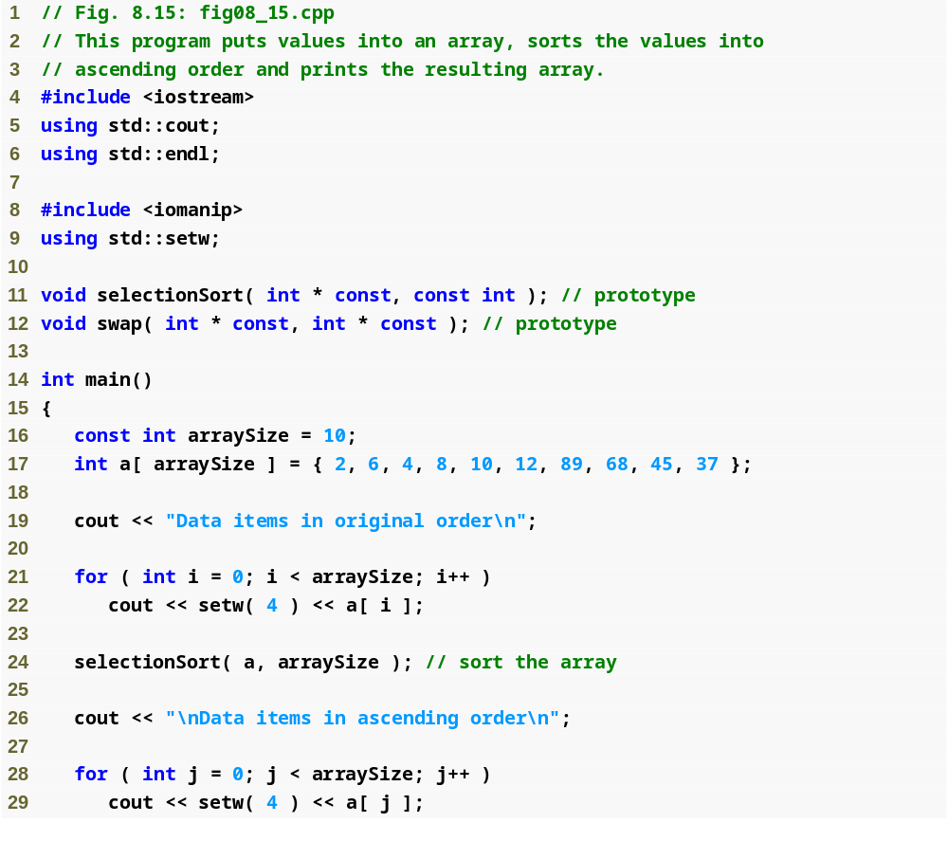
Outline
fig08_15.cpp
(1 of 3)

Slide 71
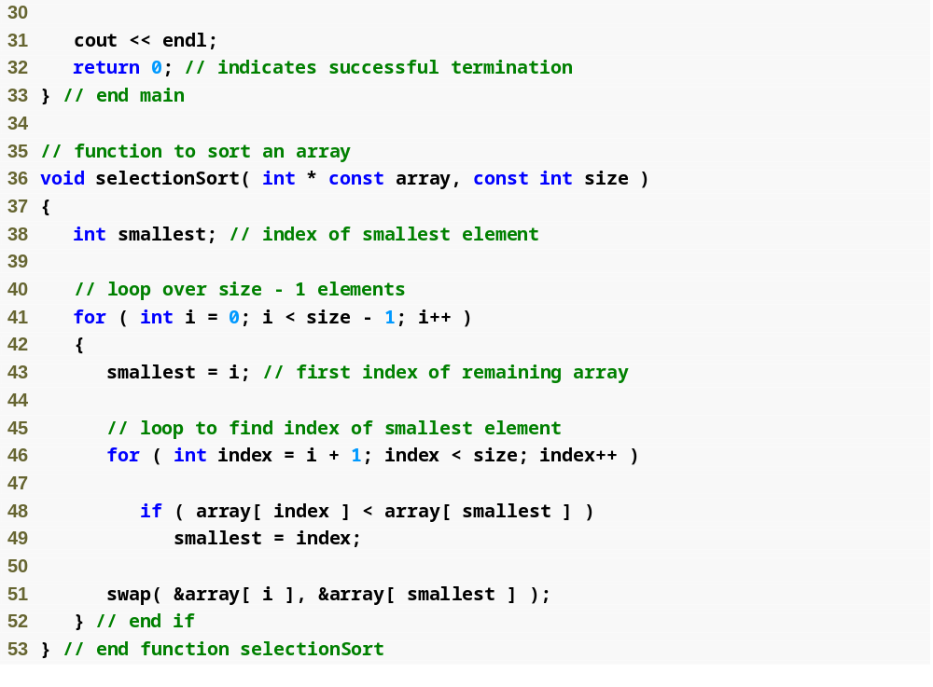
Outline
Declare array as int *array (rather than int array[]) to indicate function selectionSort receives single-subscripted array
fig08_15.cpp
(2 of 3)
Receives the size of the array as an argument; declared const to ensure that size is not modified

Slide 72
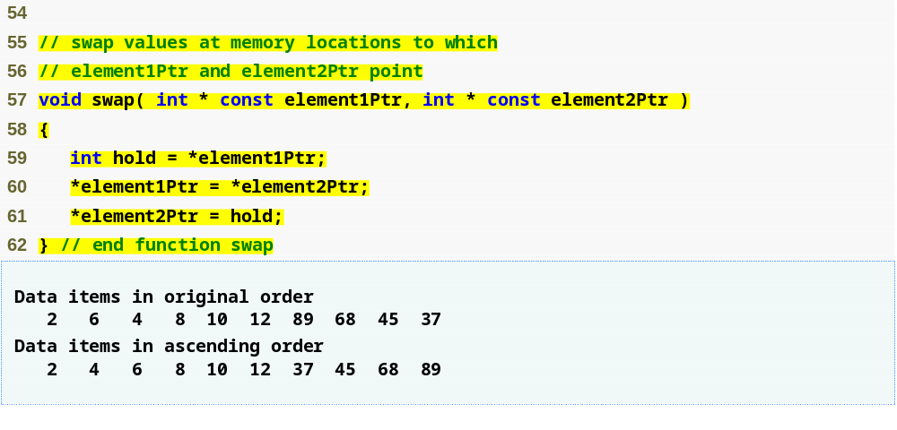
Outline
fig08_15.cpp
(3 of 3)
Arguments are passed by reference, allowing the function to swap values at the original memory locations

Slide 73
函数指针Function Pointers ：
void(*fp)( );
void(*fp2)(int);
void f1() {
cout << "call f " <<endl;
}
void f2(int a) {
cout << "call f2( " << a << " )" <<endl;
}
fp = &f1; // 也可以用：fp = f1;
fp2= &f2; // 也可以用：fp2= f2;
void (*fp3)() = &f1; // 也可以用：void (*fp3)() = f1;
//调用时如下：
fp(); // 或 (*fp)();
fp2(1); // 或 (*fp2)(1);
fp3(); // 或 (*fp3)();

Slide 74
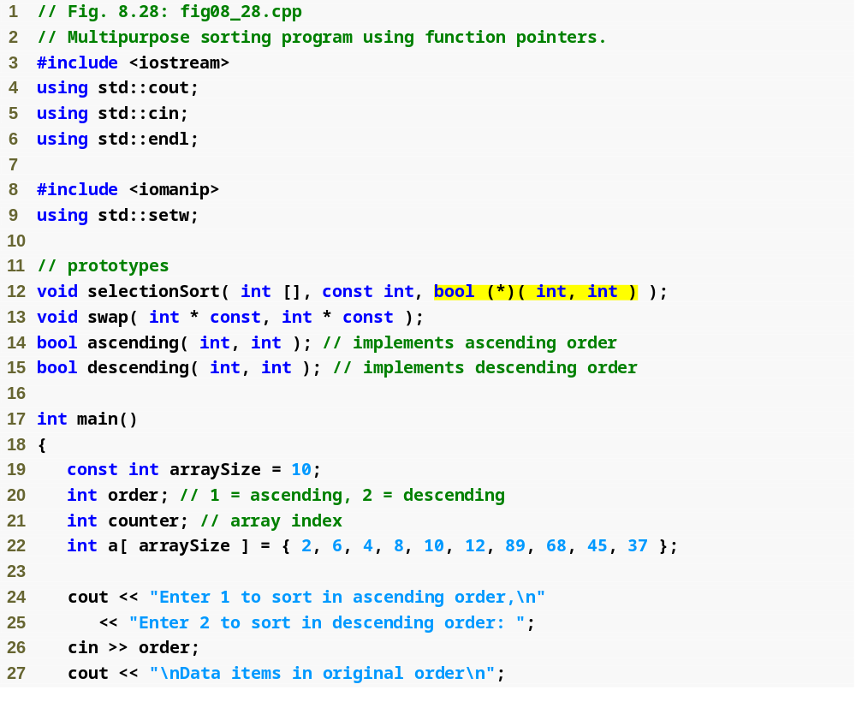
Outline
fig08_28.cpp
(1 of 4)
Parameter is pointer to function that receives two integer parameters and returns bool result

Slide 75
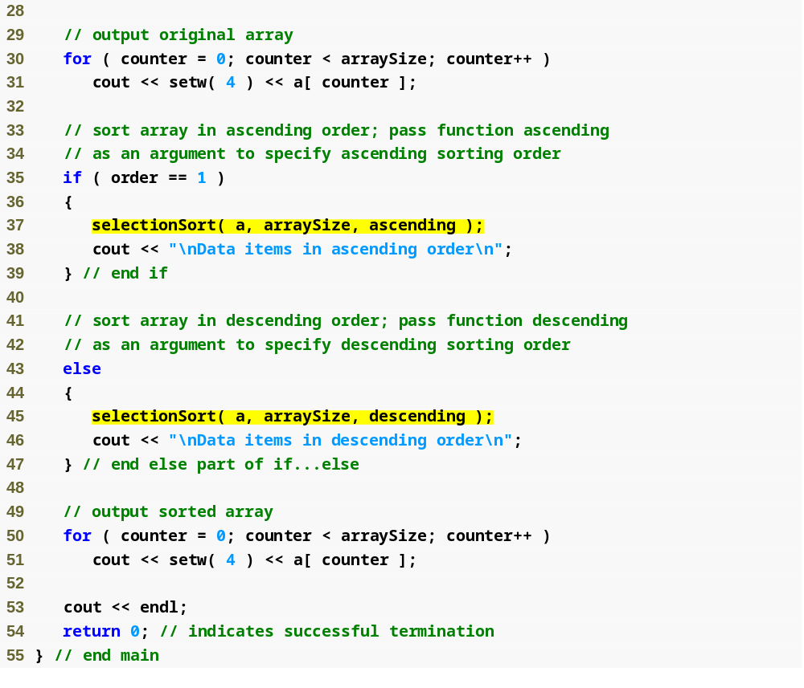
Outline
fig08_28.cpp
(2 of 4)
Pass pointers to functions ascending and descending as parameters to function selectionSort

Slide 76
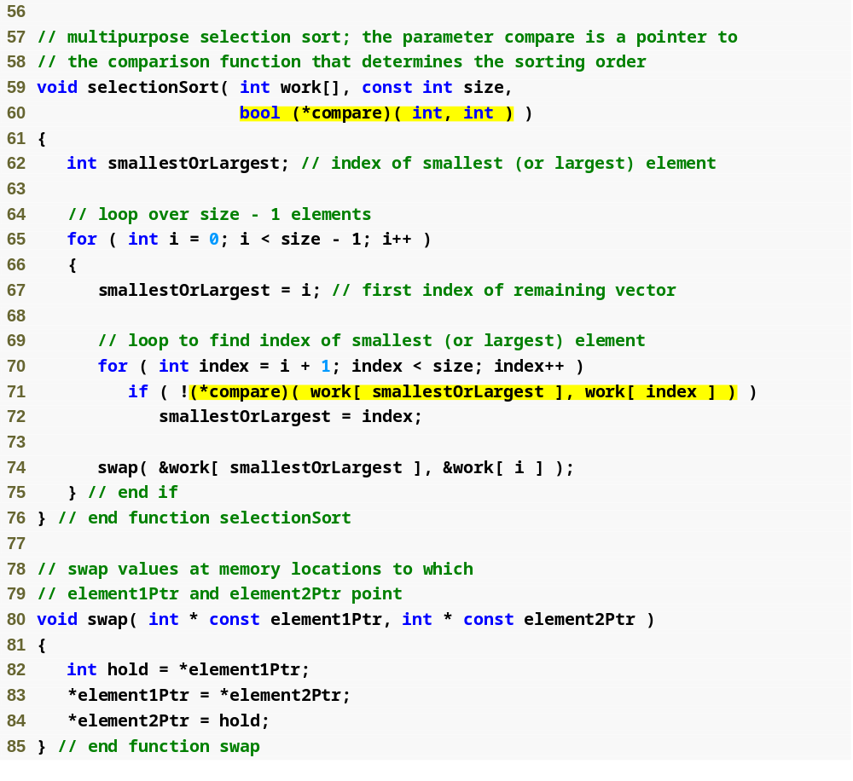
Outline
compare is a pointer to a function that receives two integer parameters and returns a bool result
fig08_28.cpp
(3 of 4)
Parentheses necessary to indicate pointer to function
Dereference pointer compare to execute the function

Slide 77
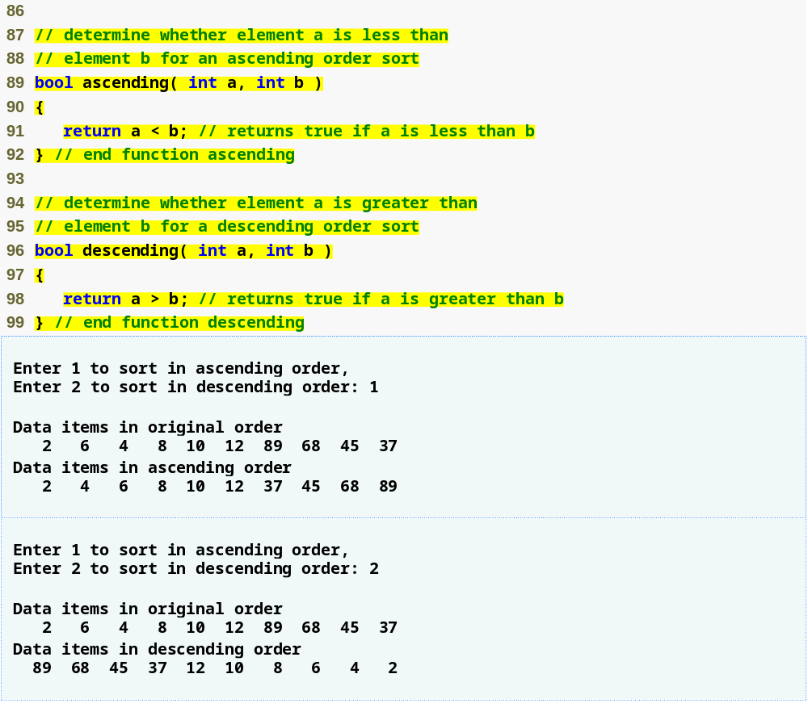
Outline
fig08_28.cpp
(4 of 4)

Slide 78
8.12 Function Pointers (Cont.)
Arrays of pointers to functions
  Menu-driven systems
    Pointers to each function stored in array of pointers to functions
      All functions must have same return type and same parameter types
    Menu choice determines subscript into array of function pointers

Slide 79
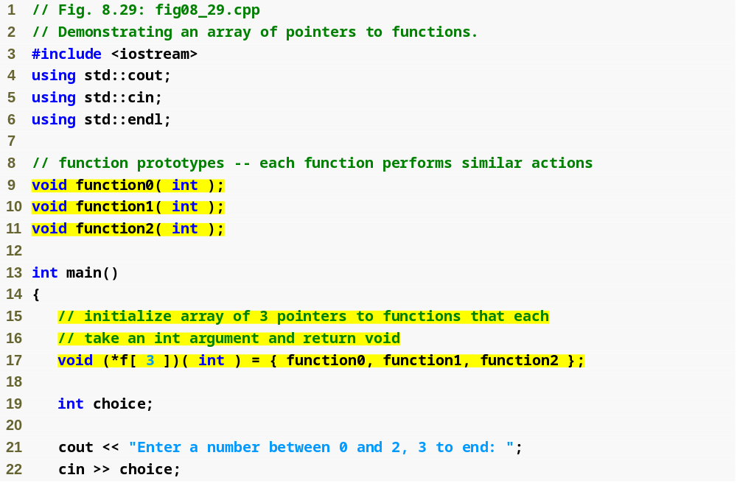
Outline
fig08_29.cpp
(1 of 3)
Array initialized with names of three functions

Slide 80
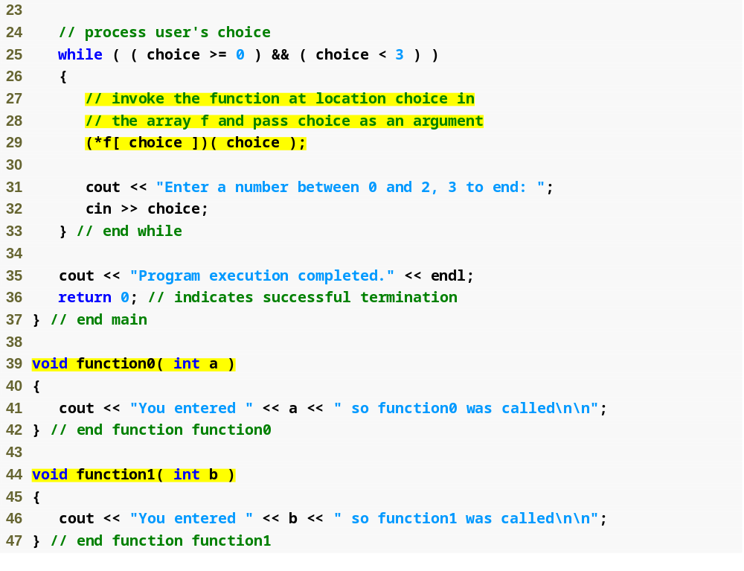
Outline
fig08_29.cpp
(2 of 3)
Call chosen function by dereferencing corresponding element in array

Slide 81
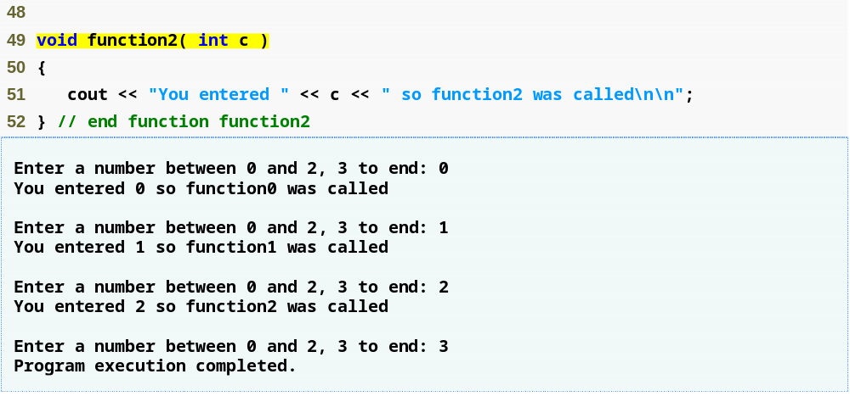
Outline
fig08_29.cpp
(3 of 3)

