Slide 1



Learning Equality - Curriculum Recommendations
X+Y+Z^3
Notes:
Recommending picking out he most interesting and important parts from your documentation.

Slide 2
Agenda

Slide 3
Agenda
Background
Summary
Training pipeline
Training methods
Important findings
Simple model

Slide 4
Background

Slide 5

Background
ZONG SHENGYA: NLP algorithm engineer, Kaggle competition master.
XIA MAOJIN: NLP algorithm engineer, Kaggle competition master.
ZHOU YANG: NLP algorithm engineer, Kaggle competition expert.
ZHENG YUE: Recommend system algorithm engineer, Kaggle competition master.
ZHENG HENG: SRE engineer, Kaggle competition & notebook master.
All members of the team have participated in and won awards in previous NLP competitions, including Kaggle and domestic competitions in China.

Slide 6
Summary
Random sampling non-source topics as holdout set for validation.
Training divided into two stages: stage1 for Retriever, stage2 for Reranker.
SimCSE method for training retriever models of stage1
Text binary classification model for training reranker models of stage2
Weighted blending reranker models for ensembling
Finding best threshold and post-processing

Slide 7
Train pipeline

Slide 8
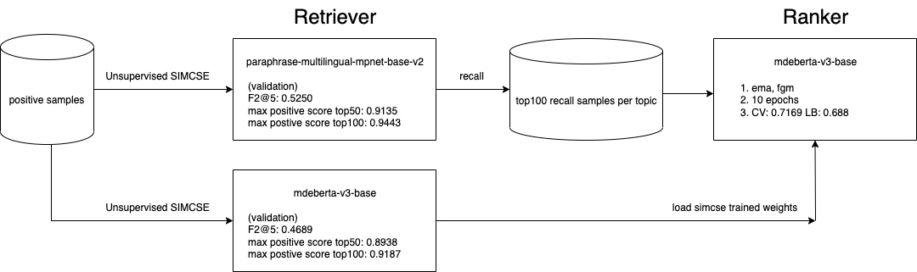
Train pipeline

Slide 9
Training Methods

Slide 10
Training Methods
CV strategy
1,000 random topics which category != 'source' as hold out data.
Kaggle Winner Presentation Template

Slide 11
Training Methods
Retriever
only used positive samples from correlations.csv for unsupervised simcse training
random choice 100 negative samples per validation topic from same language, for validation set
content text format: title [SEP] kind [SEP] description [SEP] text (maxlen 256, string level)
topic text format: title [SEP] channel [SEP] category [SEP] level [SEP] language [SEP] description [SEP] context [SEP] parent_description [SEP] children_description (maxlen 256, string level)
Kaggle Winner Presentation Template

Slide 12
Training Methods
simcse loss
topic embedding
content embedding
Transformers
topic text
content text
Kaggle Winner Presentation Template

Slide 13
Training Methods
simcse_unsup_loss
def simcse_unsup_loss(feature_topic, feature_content) -> 'tensor':
y_true = torch.arange(0, feature_topic.size(0), device=device)
sim = F.cosine_similarity(feature_topic.unsqueeze(1), feature_content.unsqueeze(0), dim=2)
sim = sim / 0.05
loss = F.cross_entropy(sim, y_true)
loss = torch.mean(loss)
return loss
Kaggle Winner Presentation Template

Slide 14
Training Methods
Choosing models
Performance on 1,000 topics validation data
model | F2@5 | max positive score top50 | max positive score top100
paraphrase-multilingual-mpnet-base-v2 | 0.5250 | 0.9135 | 0.9443
all-MiniLM-L6-v2 | 0.4879 | 0.9045 | 0.9353
mdeberta-v3-base | 0.4689 | 0.8938 | 0.9187
Kaggle Winner Presentation Template

Slide 15
Training Methods
Making rerank dataset
We used our best simcse finetuned model (paraphrase-multilingual-mpnet-base-v2) to infer on train set topics, calculate cosine similarity for each topic and all content samples of the topic's language and then choose top100 samples. We also added all positive samples from correlations.csv.
Texts were prepared as same as stage1.
Concatenate to text pairs: topic [SEP] content.
Kaggle Winner Presentation Template

Slide 16
Training Methods
Reranker
The reranker in stage2 basically is a binary classification model.
score/prob
Transformers
topic text
SEP
content text
Kaggle Winner Presentation Template

Slide 17
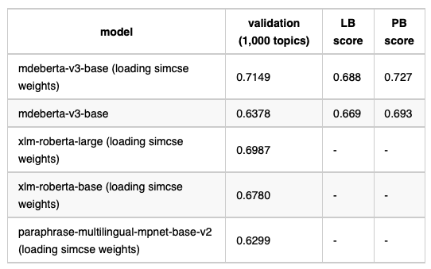
Training Methods
Choosing models
We tested on 4 models:
mdeberta-v3-base
xlm-roberta-large
xlm-roberta-base
paraphrase-multilingual-mpnet-base-v2
We have used two model initialization methods.
One is to directly load the model weight from huggingface, and the other is to load the model weight after simse finetuning. The performance of the two methods is basically the same, while the latter is slightly higher and can converge faster.
Kaggle Winner Presentation Template

Slide 18
Training Methods
Training tricks
We used FGM (Fast Gradient Method), EMA (Exponential Moving Average) on training.
FGM+EMA can impove score by 0.01.
Kaggle Winner Presentation Template

Slide 19
Training Methods
Finding threshold
We set the threshold in loop to calculate the f2 metric on the 1,000 topics validation data, codes like:
best_thres = 0.
best_score = 0.
best_n_rec = 10
for thres in tqdm(np.arange(0.01, 0.2, 0.005)):
for n_rec in range(30, 50):
test_sub = test_data[test_data['score'] >= thres].reset_index(drop=True)
sub_df = test_sub.groupby('topic_id').apply(lambda g: g.head(n_rec)).reset_index(drop=True)
score = calc_f2(sub_df, label_df)
if score > best_score:
best_score = score
best_thres = thres
best_n_rec = n_rec
When submitting a single model, this method basically CV-LB consistency (CV is about 0.02-0.03 higher than LB).
But When it came to the last two weeks of the competition, when started to ensemble, we lost the CV-LB consistency, and I think the reason may be that 1,000 topics validation data is not big enough.
Kaggle Winner Presentation Template

Slide 20
Training Methods
Post-processing
When dividing the threshold, we will have a small number of topics that do not match any contents. We just simply using top4 contents ranked by the original scores.
We tried recalling more contents for this part of topics, but LB score didn't improve.
We also tried different languages using different threshold, both CV and LB score dropped a little.
Kaggle Winner Presentation Template

Slide 21
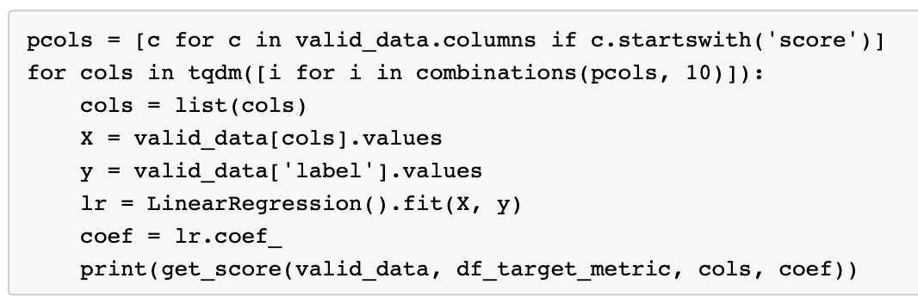
Training Methods
Ensemble
We had trained 20+ ranker models, trained on different number of recall samples per topic, like 50, 70, 100.
mdeberta (simcse weights, 4,000 validate topics)
mdeberta (simcse weights, 4,000 validate topics, with FGM,EMA)
mdeberta (simcse weights, 1,000 validate topics)
mdeberta (simcse weights, 1,000 validate topics, with FGM,EMA)
mdeberta (1,000 validate topics, with FGM,EMA)
xlm-roberta-large (simcse weights, 1,000 validate topics, with FGM,EMA)
xlm-roberta-base (simcse weights, 1,000 validate topics, with FGM,EMA)
......
We used LinearRegression to fit on 1,000 topics validation model output score to get coef_ array, and then used as blending weights:
Kaggle Winner Presentation Template

Slide 22
Training Methods
Ensemble
We started with 100 recall samples per topic, but due to time limits, we can only use up to 6 models. So we tried 70 and 50 recall samples in the later stage of the competition.
number of recall candidates per topic | number of models | validation (1,000 topics) | LB score | PB score
100 | 6 | 0.725 | 0.705 | 0.738
70 | 10 | 0.738 | 0.715 | 0.751
50 | 12 | 0.743 | 0.715 | 0.751
Kaggle Winner Presentation Template

Slide 23
Important and Interesting Findings

Slide 24
Important and Interesting Findings
The most important trick we used is training Retriever model with the SimCSE method.
The hard negative samples from retriever model can greatly improve the performance of ranker models.
retriever (max positive score top100) | LB score
0.80 | 0.585
0.94 | 0.688
Kaggle Winner Presentation Template

Slide 25
Simple Model

Slide 26
Simple Model
Our solution looks relatively heavy compared to others, so we provide a simplier but less effective solution here:
retriever model training epochs reduce to 50.
rerank model training epochs reduce to 5.
In this solution, we should get a PB score of about 0.67.

Slide 27
Question and Answer

