Slide 1
Amorphorization Skill
Generating amorphous structures via melt-quench MD
AtomisticSkills

Slide 2
What is Amorphorization?
Goal: Generate disordered, amorphous structures from crystalline inputs
Method: Melt-quench molecular dynamics protocol using MLIPs
Use case: Study properties of glasses, amorphous electrolytes, coatings
Tools: MACE / CHGNet foundation potentials + MCP run_md tool

Slide 3
Melt-Quench Protocol

Slide 4
3-Stage Melt-Quench Protocol
Stage | Temperature | Duration | Thermostat | Purpose
1. Melting | 3000 K | 10 ps (5000 steps) | NVT Langevin | Destroy crystalline order
2. Quenching | 3000 K -> 300 K | 10 ps (5000 steps) | NVT Langevin | Freeze disordered state
3. Equilibration | 300 K | 5 ps (2500 steps) | NVT Bussi | Relax to equilibrium

Slide 5
Key Parameters
Supercell: >100 atoms to avoid periodicity artifacts
Melt temperature: ~1000 K above experimental melting point
Cooling rate: 1-10 K/ps (typical MD quench rate)
Final step: Static relaxation (0 K) to find local energy minimum
Timestep: 2 fs throughout all stages

Slide 6
Example: LiCl Amorphorization

Slide 7
LiCl Example — Setup
Parameter | Value
Material | LiCl (Lithium Chloride)
Starting structure | Crystalline rocksalt (Fm-3m)
Supercell | 3 x 3 x 2 expansion (~108 atoms)
MLIP Model | MACE-OMAT-0-small
Crystalline density | 2.07 g/cm3

Slide 8
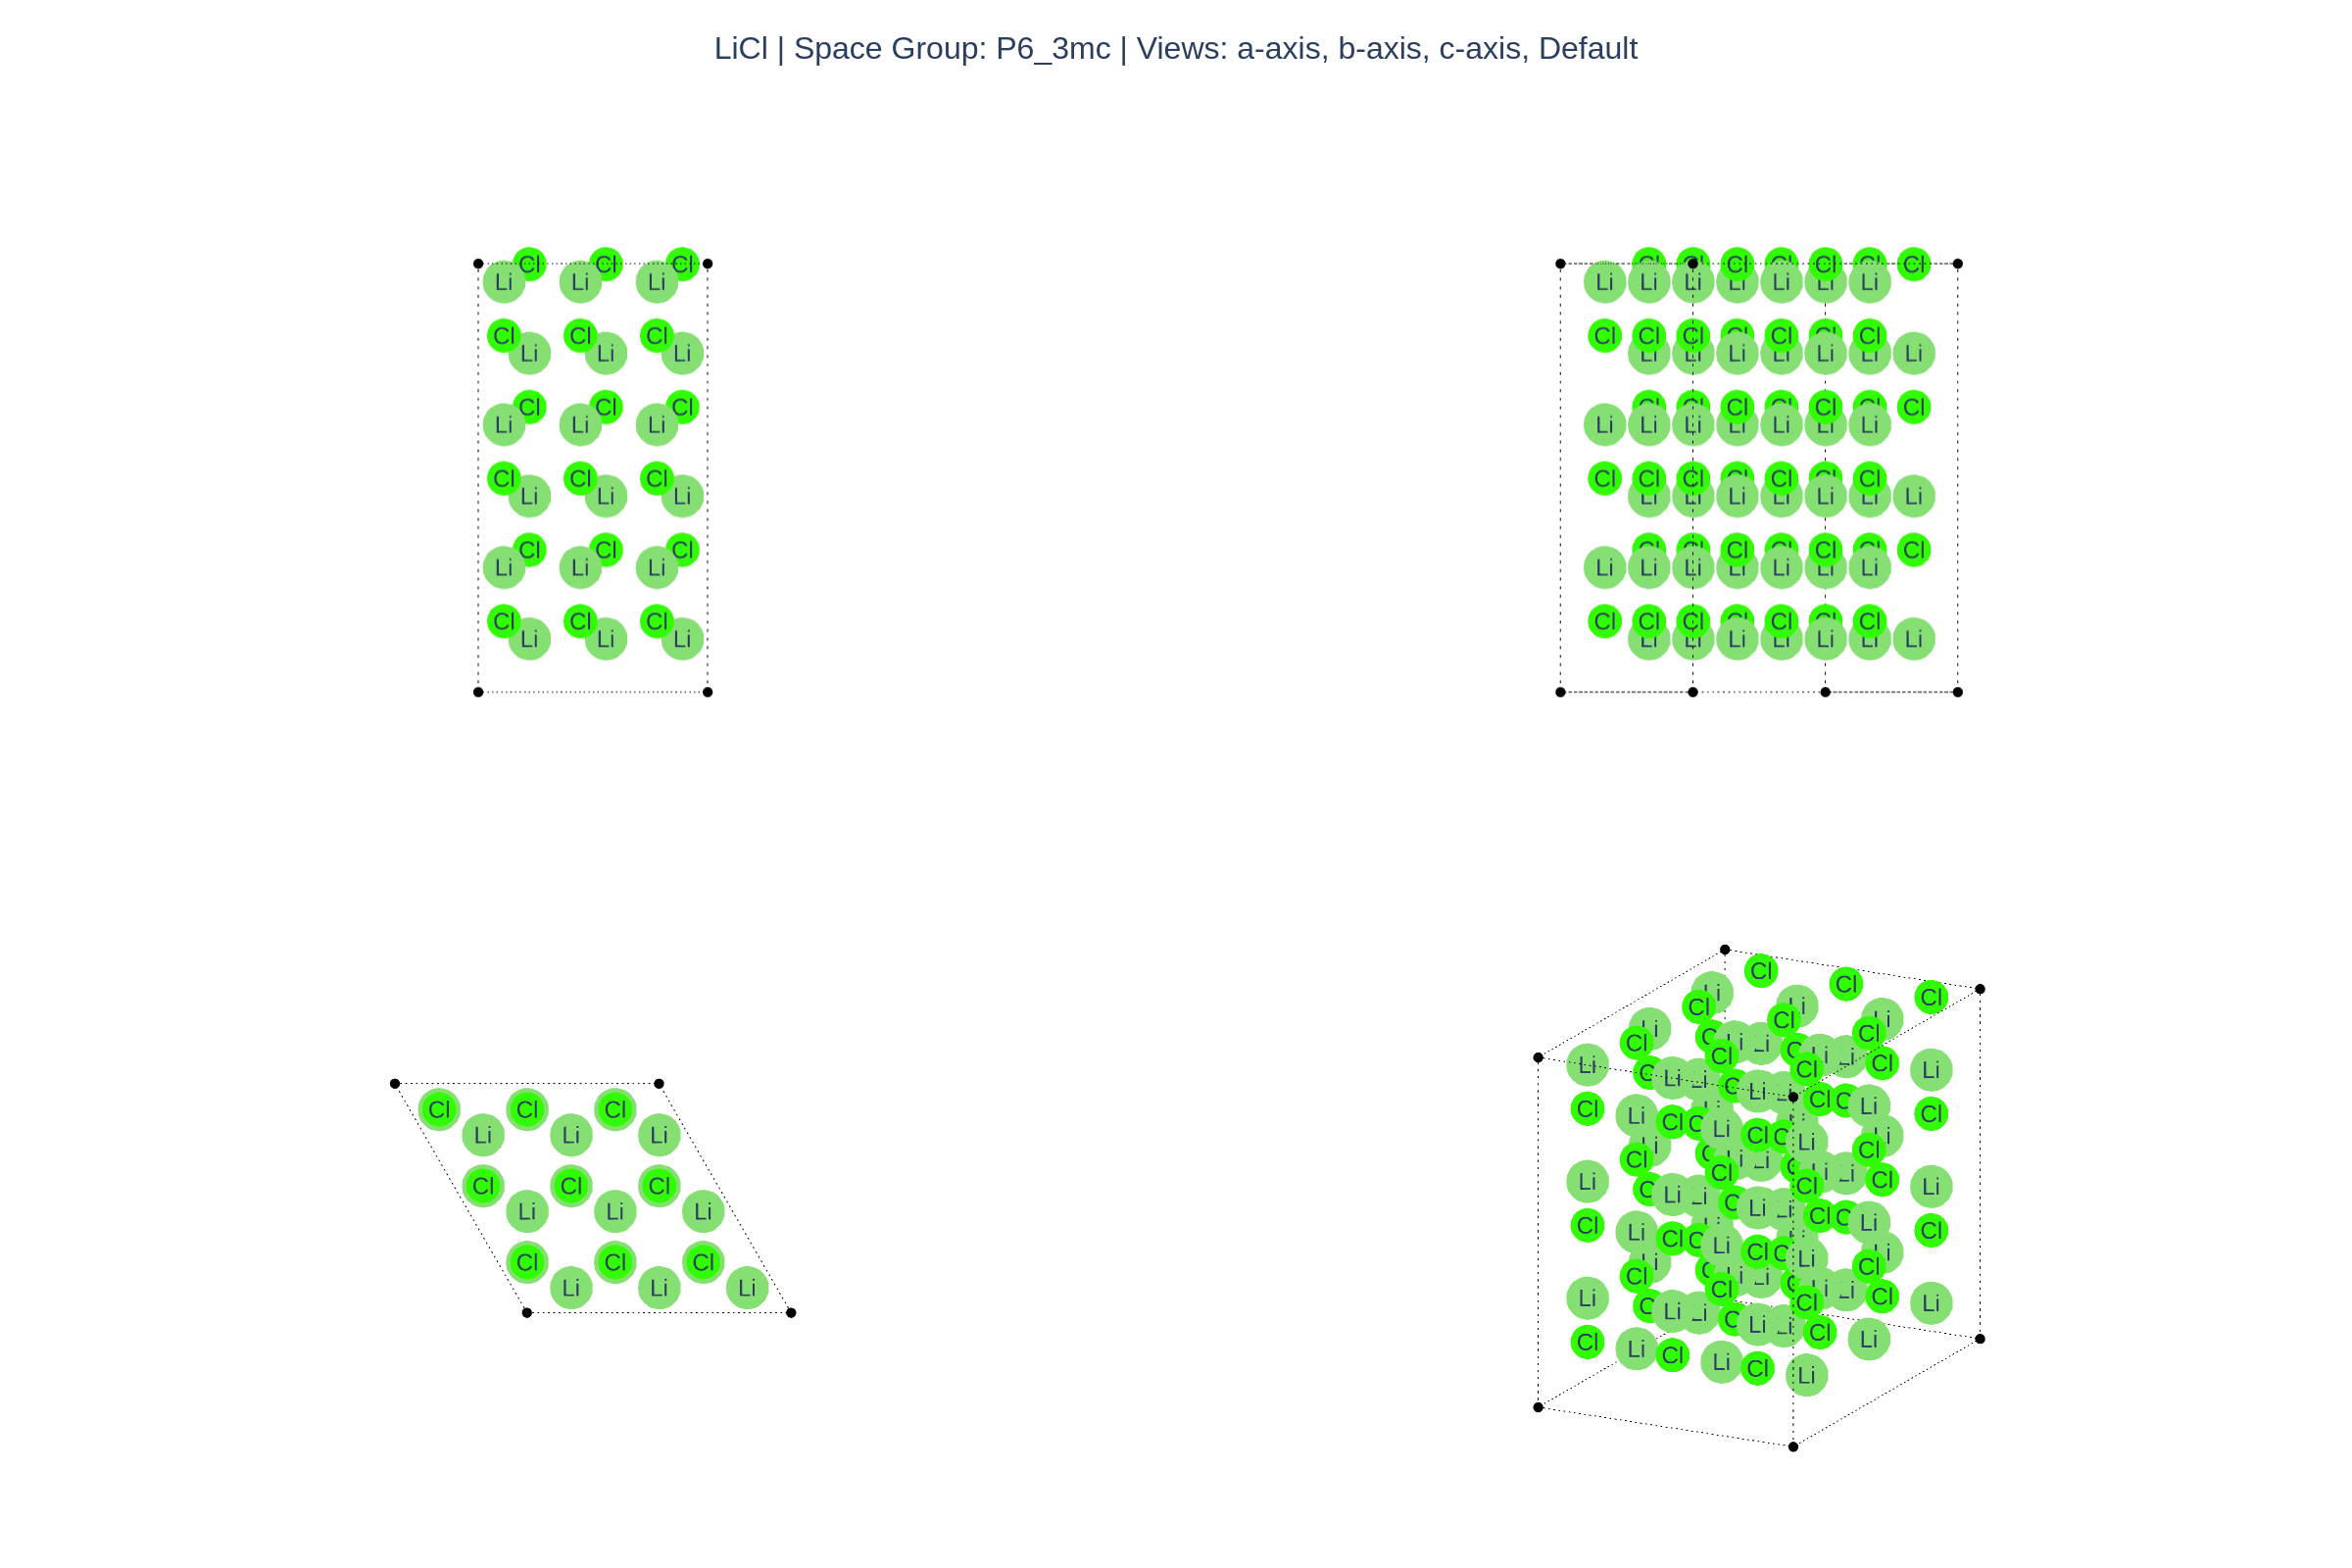
Crystalline LiCl — Rocksalt Structure
3x3x2 supercell (~108 atoms), Fm-3m space group

Slide 9
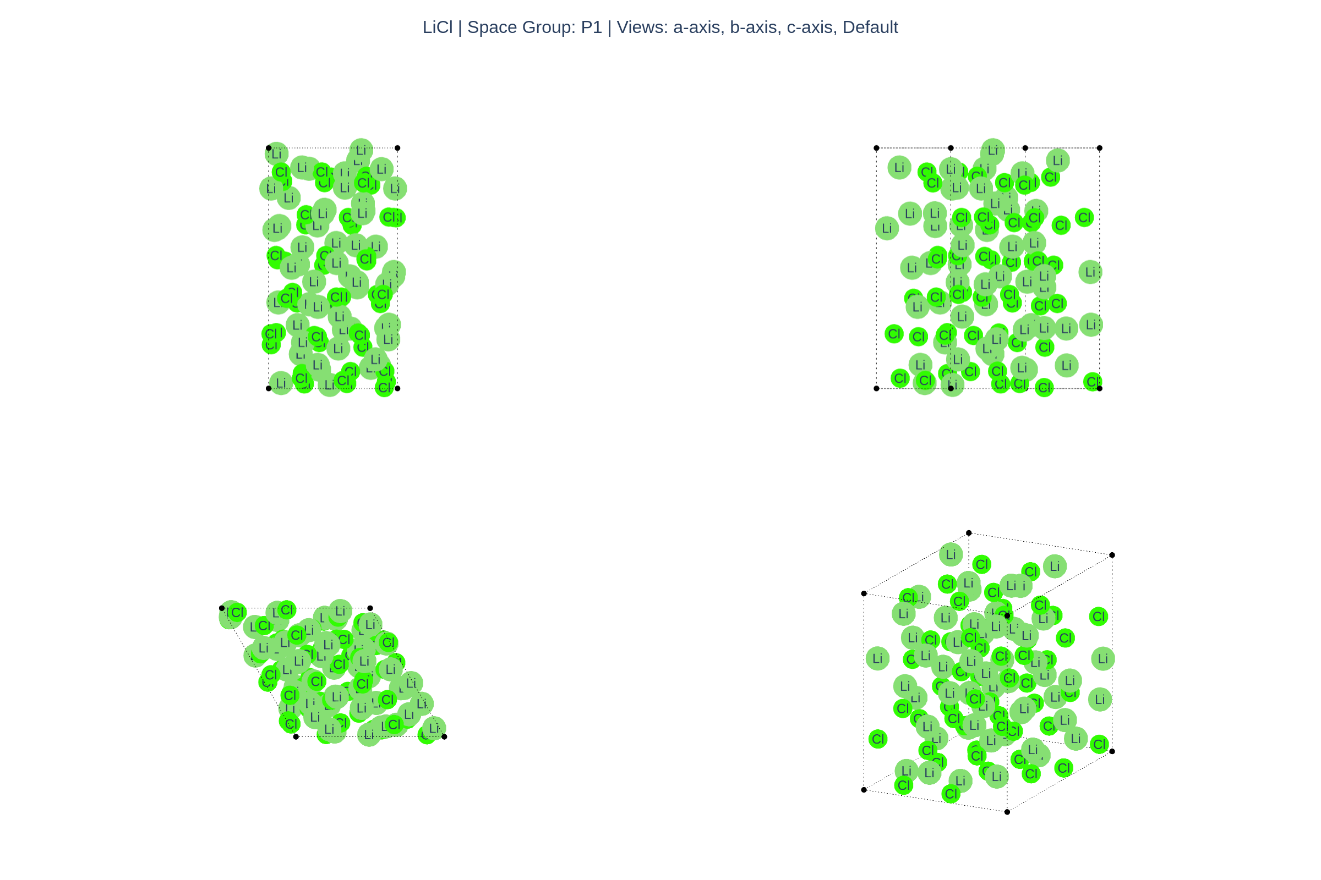
Amorphous LiCl — After Melt-Quench
Disordered structure after 3-stage melt-quench protocol

Slide 10
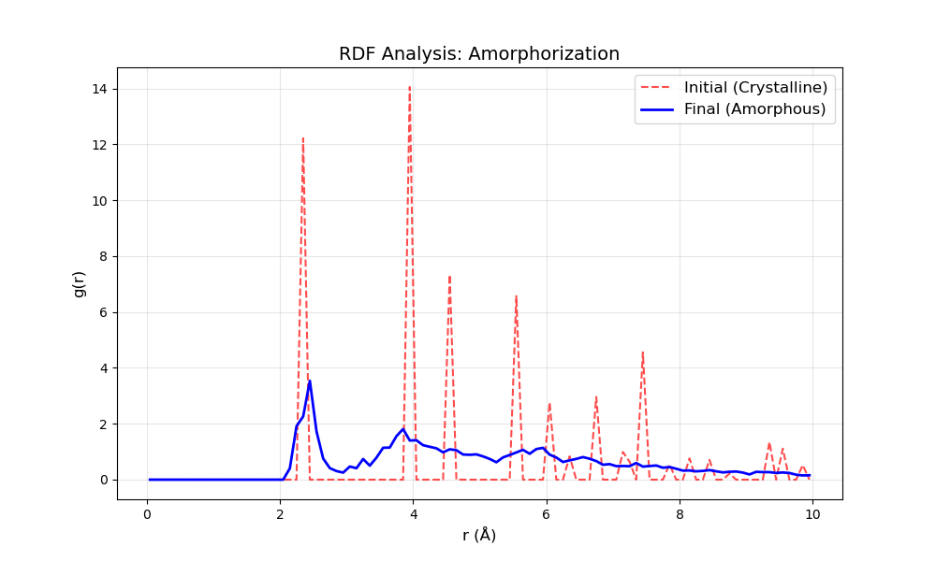
Radial Distribution Function (RDF) — Confirms Amorphous State
Sharp first peak (Li-Cl at ~2.4 A) with no long-range periodicity
Notes:
The RDF confirms amorphous nature: first peak preserves local bonding, but peaks decay to 1.0 beyond second neighbor shell.

Slide 11
LiCl Results — Crystalline vs. Amorphous
Property | Crystalline | Amorphous
Density | 2.07 g/cm3 | 1.66 g/cm3
Coordination Number | 6 (rocksalt) | ~4 (open network)
Long-range order | Yes (sharp RDF peaks) | No (peaks decay to 1)
Structure type | Periodic lattice | Disordered network

Slide 12
Summary & Takeaways
Melt-quench protocol successfully generates amorphous LiCl
20% density reduction from crystalline to amorphous state
Coordination number drops from 6 to ~4, reflecting open network
RDF analysis confirms complete loss of long-range order
Protocol generalizes to other materials (oxides, sulfides, etc.)
Analysis tools: RDF + coordination number via analyze_amorphous.py

