Slide 1
Real-time Traffic Tracking Sensor Web System
Presented By: Prakash Chourasia

Slide 2
Contents
Introduction
Analysis And Simulation
Conclusion Related Work

Slide 3
Introduction
To develop an smart phone program that tracks the speed of your car when you are driving and report periodically to a database of your location and speed.
And visualize the city traffic map with an overlay on google maps.
The system can leverage smart phone platform and its sensors GPS to track real-time traffic situations and report to a sensor web database.
Phone tracks car location with GPS and calculate speed (every 10 seconds)
If GPS signal is blocked, then discard data.

Slide 4
Contt..
Phone periodically uploads location and speed records with timestamp to SQLite database.
Database manages merging similar records, removing outdated records and store the route speed
Phone downloads speed records from database and visualize them on map view as colored dots.

Slide 5
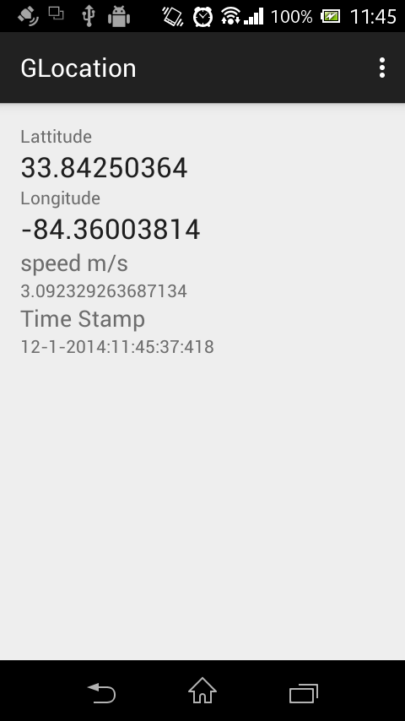

Slide 6
Was Unable to change timestamp.
Then implemented alarm manager for monitoring the change location activity.
Then thought of binding data in spinner.

Slide 7
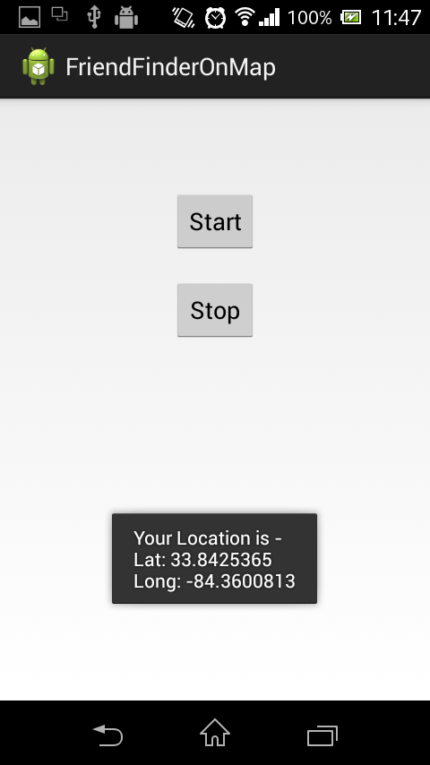

Slide 8
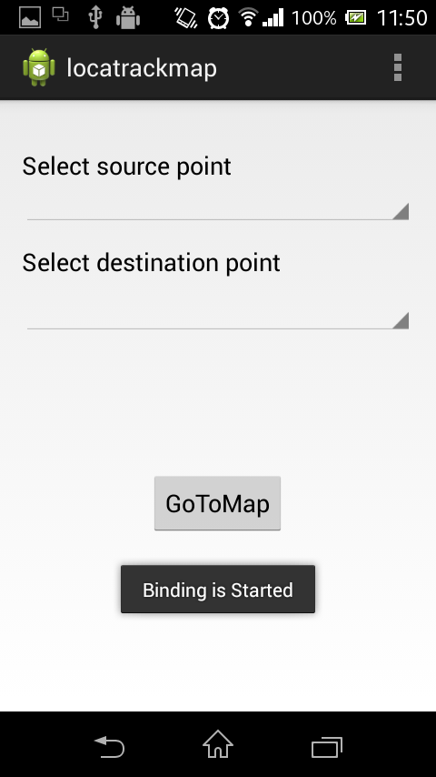
Main Activity

Slide 9
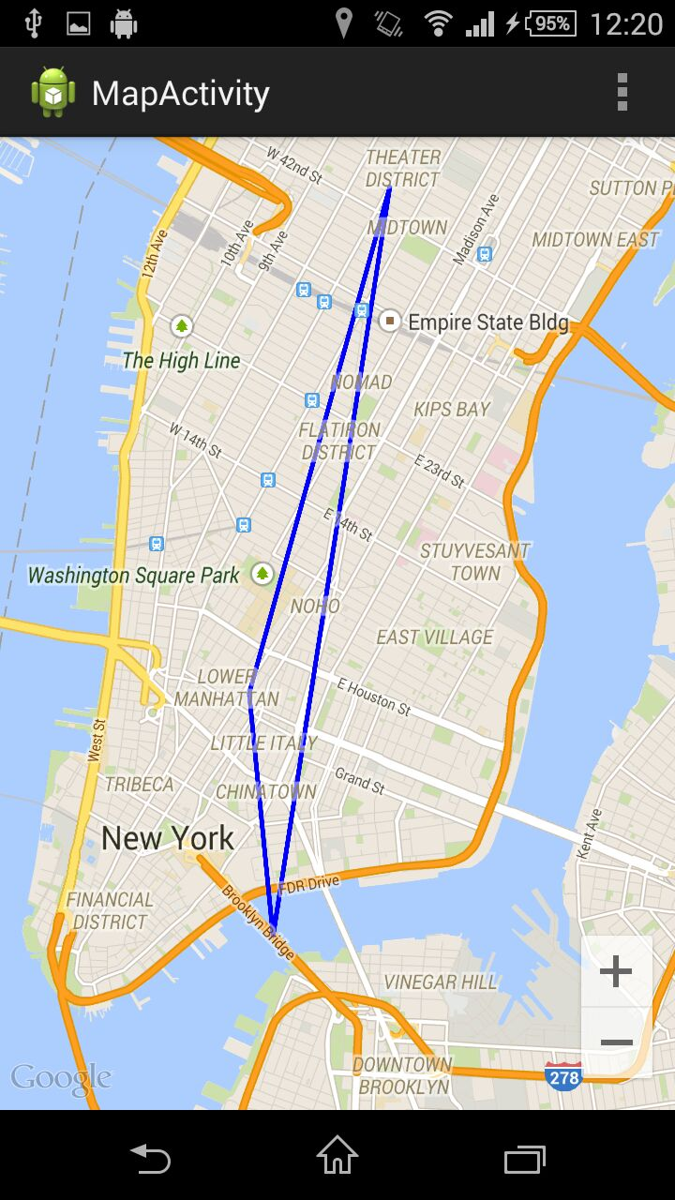

Slide 10
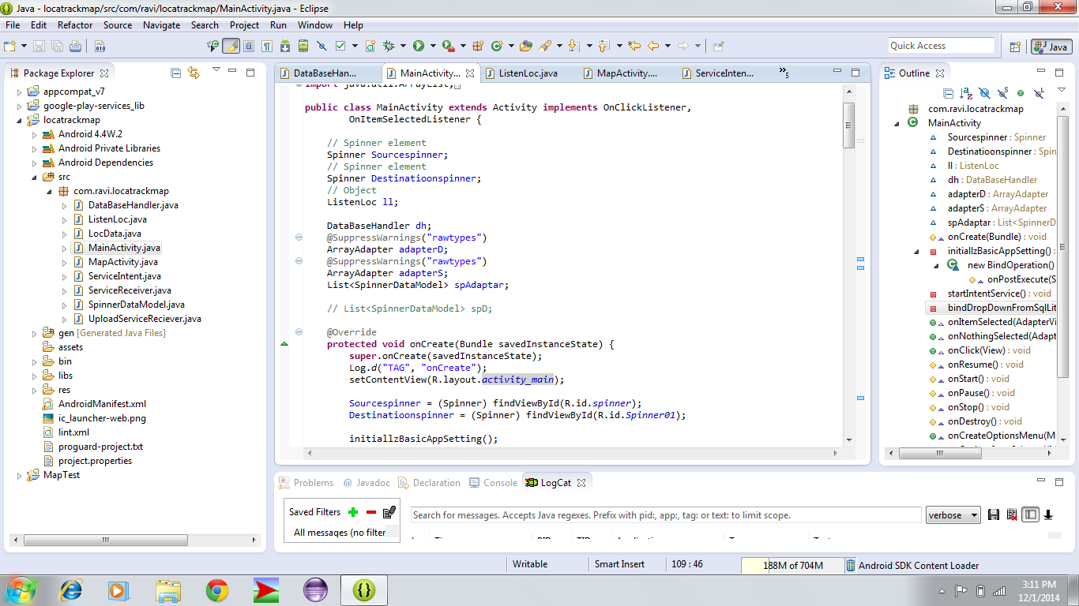

Slide 11
Thank You !!

