Slide 1
Implementing web security using Parallel Key Encryption
Submitted By: Prakash Chourasia

Slide 2
Objective
Study of encryption decryption methods
(Parallel key encryption for ICBC)
Implementation of this technology through a web site.

Slide 3
Current Senario
In current day scenario, the need to protect information has become very important and hence the need for cryptographic algorithms is high.
It is implemented in USA, Japan, Mexico( previous versions).

Slide 4
Cryptography
Cryptography has got a niche of its own in the world of computer security and there have been several cryptographic algorithms that are being proposed in order to protect the systems and there confidential data.
Types
Symmetric cryptography(secret-key, single-key, shared-key, one-key, and private-key encryption.)
Asymmetric cryptography ( Pair of keys 2 encrypt and decrypt)
.

Slide 5
Asymmetric Cryptography
Asymmetric cryptography or public-key cryptography is cryptography in which a pair of keys is used to encrypt and decrypt a message so that it arrives securely.
Initially, a network user receives a public and private key pair from a certificate authority. Any other user who wants to send an encrypted message can get the intended recipient's public key from a public directory. They use this key to encrypt the message, and they send it to the recipient. When the recipient gets the message, they decrypt it with their private key, which no one else should have access to.

Slide 6
Parallel key cryptography
Parallel Key encryption is classified under the Asymmetric type as it makes use of two separate keys for encryption and decryption. The limitations of asymmetric key cryptography have been overcome by parallel key encryption algorithm.

Slide 7
PROPOSED ALGORITHM
1. Parallel key generation process
2. Cipher block chaining
3. Interleaved cipher block chaining.
Key Generating process: This a method of generating the two pairs of key used for encryption and decryption. The key size chosen for minor key is 1024 bit and for major key is 2048 bit.

Slide 8
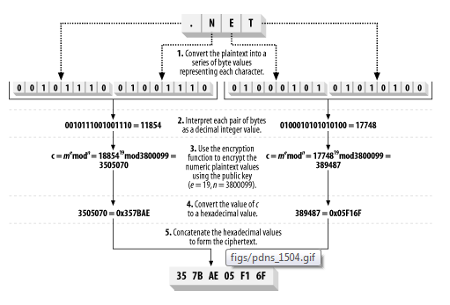
Working of Encryption Function

Slide 9
Parallel Cryptography algorithm
Key Generating process:
This is a method of generating the two pairs of key used for encryption and decryption. The key size chosen for minor key is 1024 bit and for major key is 2048 bit. Here, we have made use of the concept of Big Integer in java for the key generation process.

Slide 10
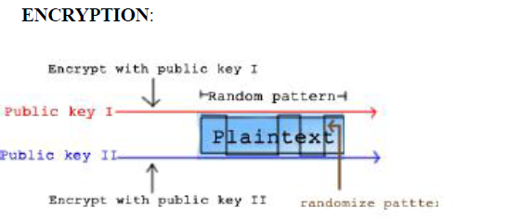

Slide 11
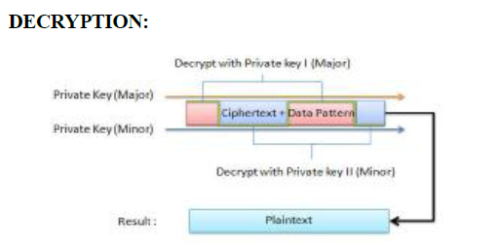

Slide 12
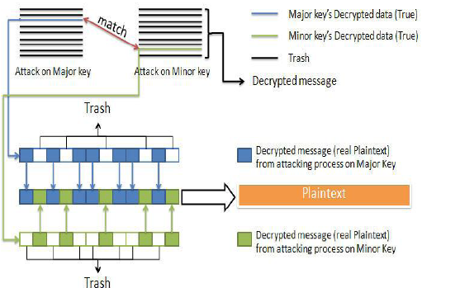

Slide 13
Key generation
Choose two large random prime numbers, p and q, of equal length and multiply them together to create n, the RSA key modulus.
Select p as 23 and q as 31, so that the modulus, n, is:
n = p x q = 23 x 31 = 713
Randomly choose e, the public exponent, so that e and (p - 1)(q - 1) are relatively prime.
Numbers are "relatively" prime when they share no common factors except 1. For these test values select a value for e that has no common factors with 660. Select e as 19.
Compute the private exponent, d, where d = e⁻¹mod((p - 1)(q - 1)).
For our example, we calculate d as follows:
d = 19⁻¹mod(22 x 30) = 139
The public key consists of e and n. The private key is d. Discard p and q, but do not reveal their values.

Slide 14
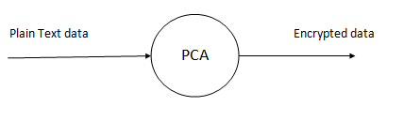
DATA FLOW DIAGRAM level 0

Slide 15
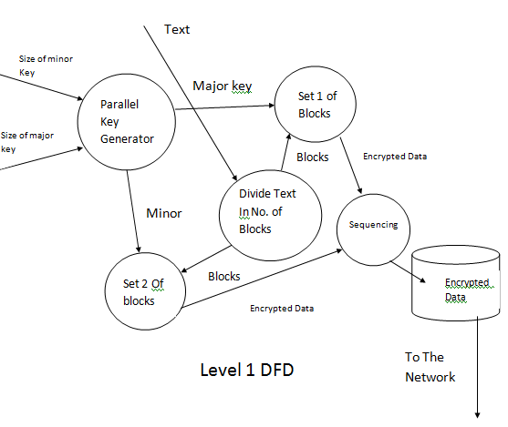
Sender side level 1

Slide 16
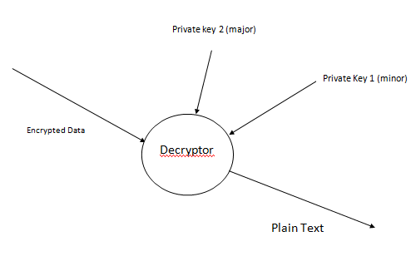
Receiver side level 1

Slide 17
Attacks
factorization attack
brute force attacks
Time for Brute force attack
Algorithm | Time of brute force (yrs)
PCA 512 bits (minor) | (1.224*10^63) -3.596*10^24)+ 1.497*10^126)
RSA | 1.224 *10^63

Slide 18
CONCLUSIONS AND FURTHER WORK
It has also been proven that PCA can substantially reduce the encryption and decryption time taken in the above cryptographic modes with higher speed and efficiency.
From the theoretical results, it can be known that PCA can encrypt and decrypt messages faster than RSA.
In attack analysis, it can be verified that the time taken in brute force attack is comparatively high than the other algorithms and hence enhanced protection of data.
This algorithm is more flexible in transferring of data through communication networks or insecure channels without key limitations and key agreements.
Implementation of Algo in web site.

Slide 19


