Slide 1

Slide 1
Power Point Presentation
SMARTER-BOOKS
By: Divina Arpino

Slide 2
Introduction
Kevin Smart has always dreamed of owning his own little bookstore, the local type of place that brings in community and promotes local reading clubs. He finally has the opportunity, but he has a tiny problem…tiny as in, he has a very tiny space in which to establish “Smarter-Books” as well as a tiny starting budget. Kevin’s plans include an open mid-space with a couple of tables, two comfy couches, and several floor cushions. That center space will be surrounded on all walls with bookshelves. He also has room for some standing shelves where he plans to have books and toys for his younger audiences…and maybe even a train, puzzle, or Lego table.
Kevin would like to know the titles that will be absolute staples – ‘the must invest in titles’ in his inventory. Specifically considering:
What titles have made top-50 rankings in past years
Who the most popular authors making the top-50 rankings are
The top 5-10 books in Fiction and Non-Fiction Genres
Influence of cost and number of pages in people’s ratings
Kevin believes that this data will not only be helpful to him in his initial inventory acquisitions, but also that he can use the information to raise community book club interest that will in turn help him promote his local store and turn his dream into a reality.

Slide 3
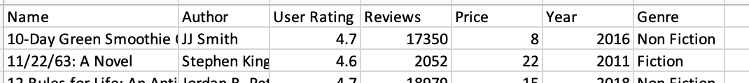
Methodology
1. Clean up data structure (Excel)
2. Clean column names (remove spaces, rename second data set to be consistent with first)
4. Make data condusive to analysis (eg. change publication date to display year only)
3. Remove non-relevant columns (eg. ISBNs)
6. Get the answers needed
5. Spend time on analysis and learning the data
7. Produce Visuals
Two Datasets used – Book reviews/ratings from Kaggle:
Amazon Top 50 Bestselling Books 2009 - 2019
Goodreads-books
Other tools used:
Excel – Initial peek at the data and some column shift adjustments
Python 3 through Jupyter Notebooks
Libraries used: pandas, seaborn, matplotlib
ChatGPT’s quick guidance / Google searches
Other MS-Office applications such as Word and PowerPoint

Slide 4
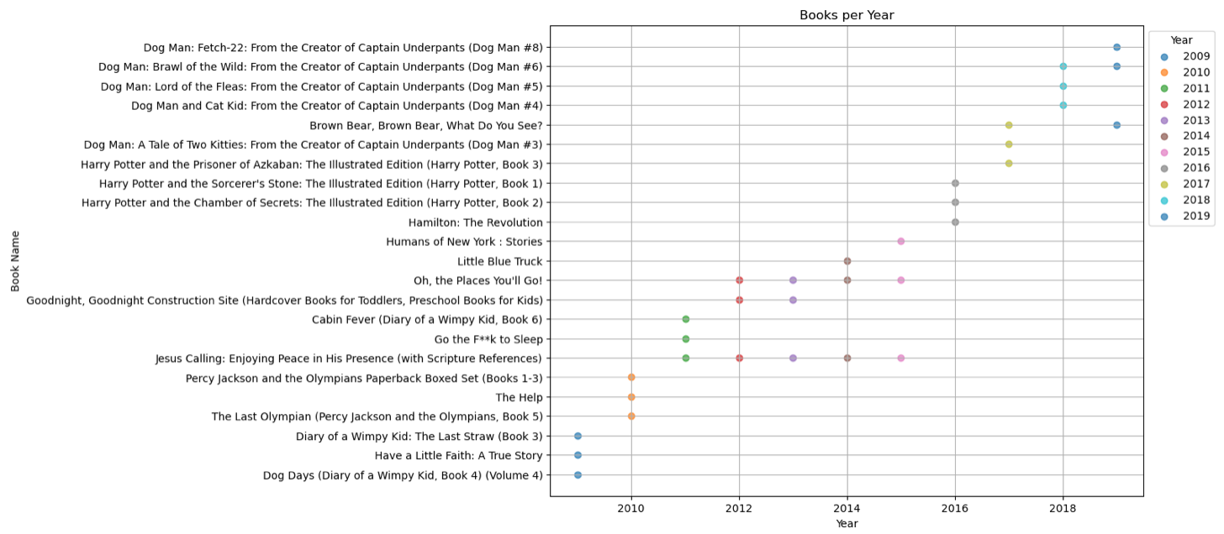
Results
Titles making top-50 rankings in past years based on count of ratings
Note: I selected top 3 instead of top 5 due to space in this presentation format

Slide 5
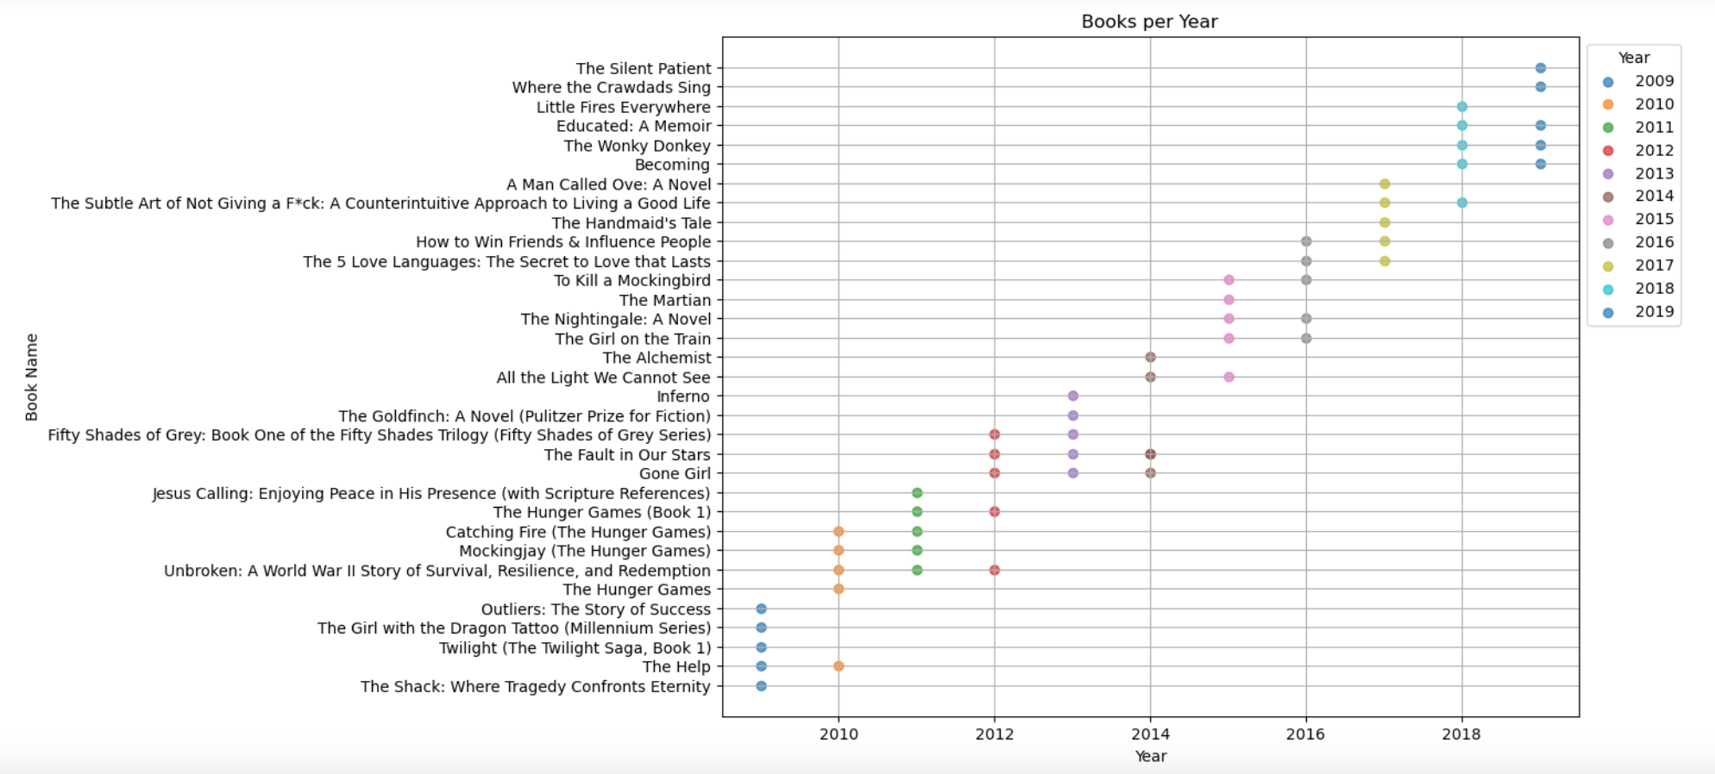
Results
Titles making top-50 rankings in past years based on count of reviews

Slide 6
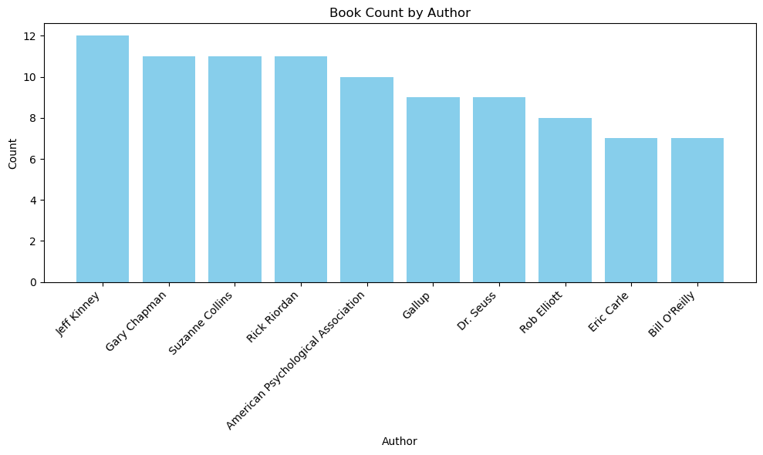
Results
Most popular authors making the top-50 rankings based on book counts

Slide 7
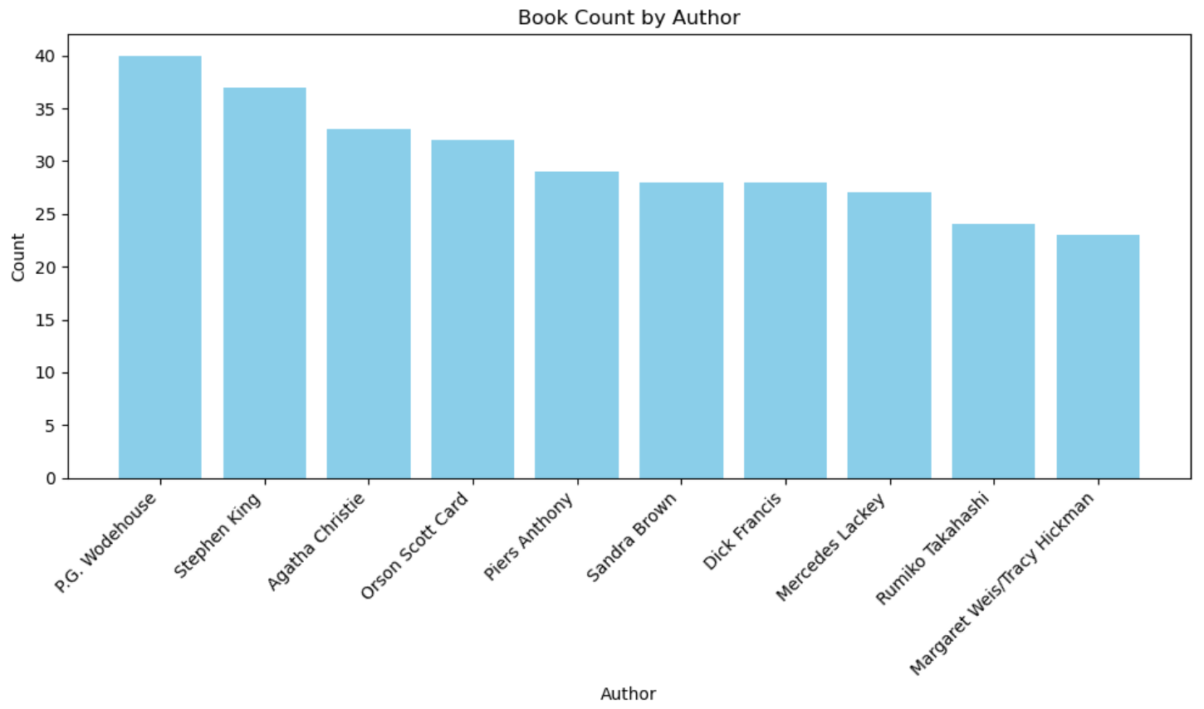
Results
Most popular authors based on goodreads counts

Slide 8
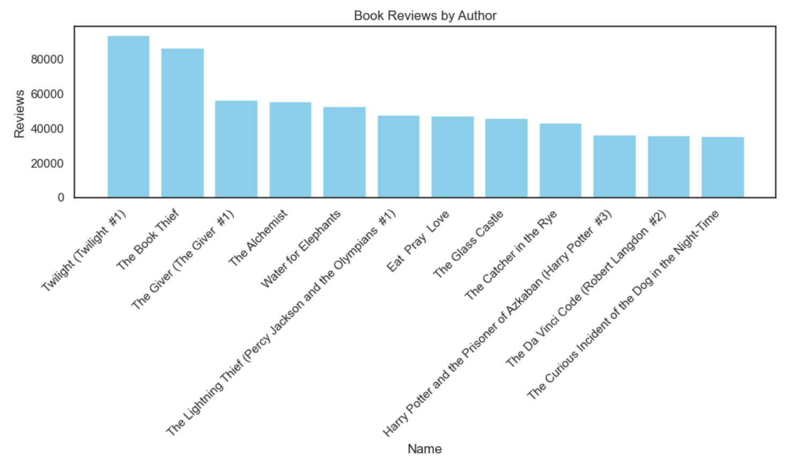
Results
Most popular books based on book review counts

Slide 9
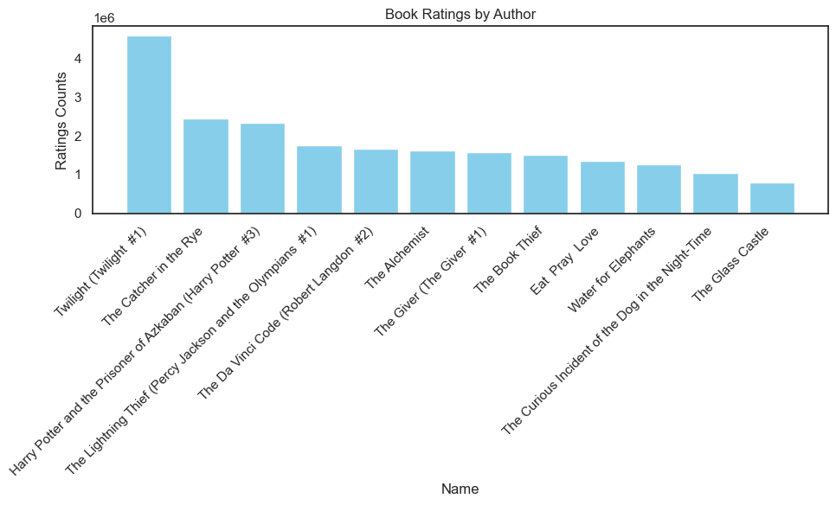
Results
Most popular books based on rating counts

Slide 10
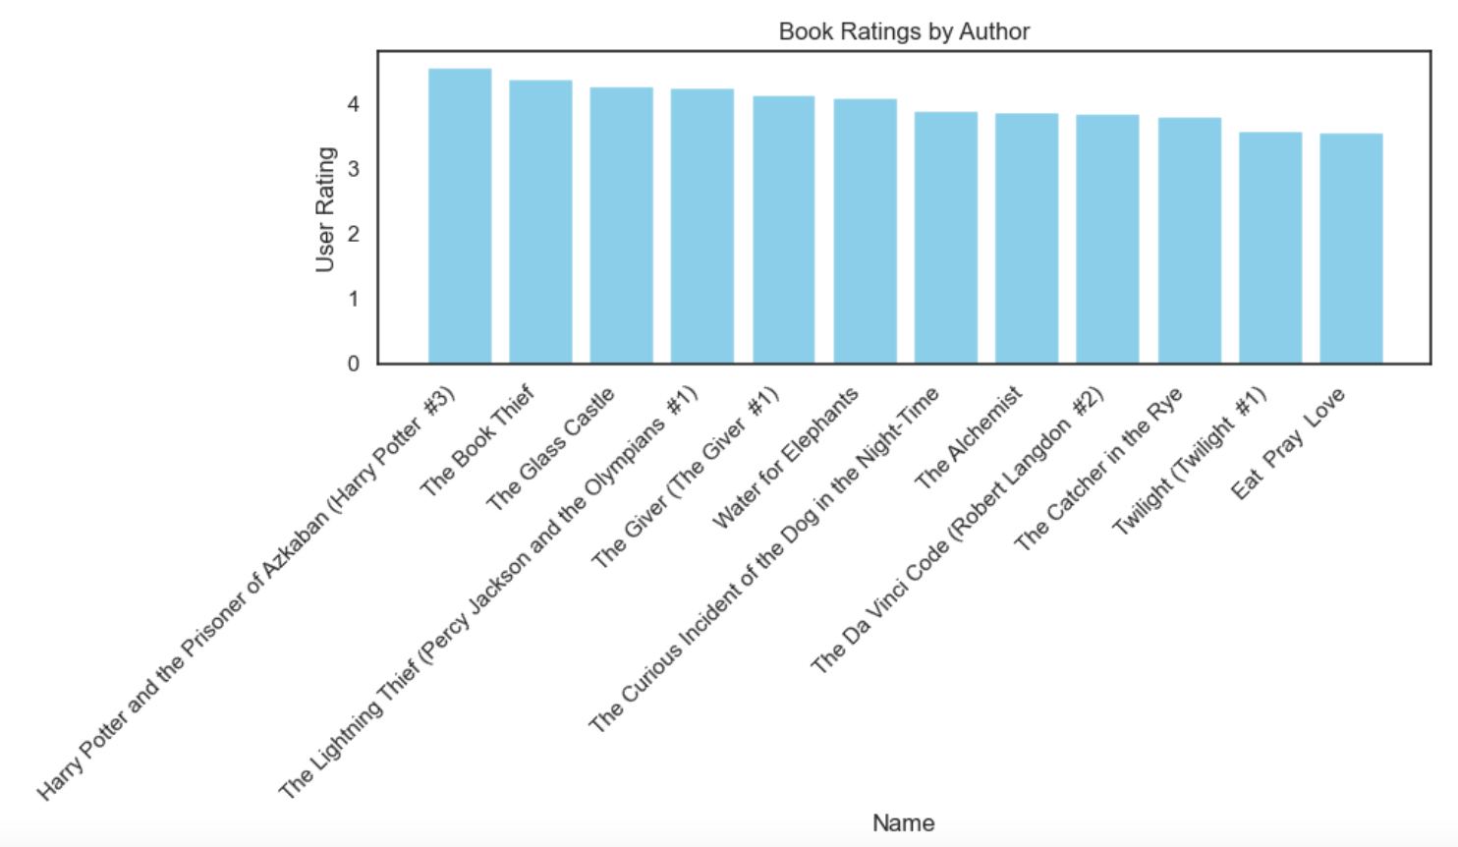
Results
Most popular books based on book ratings

Slide 11
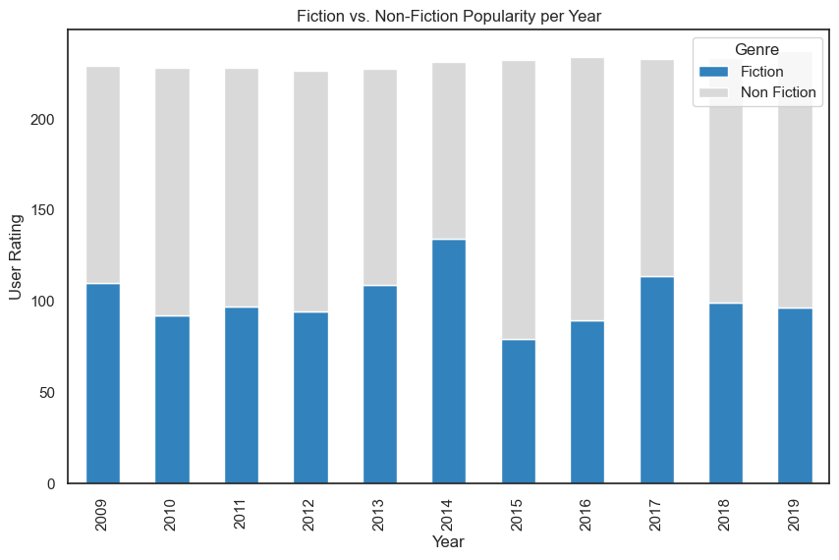
Results
Genre popularity over the years

Slide 12
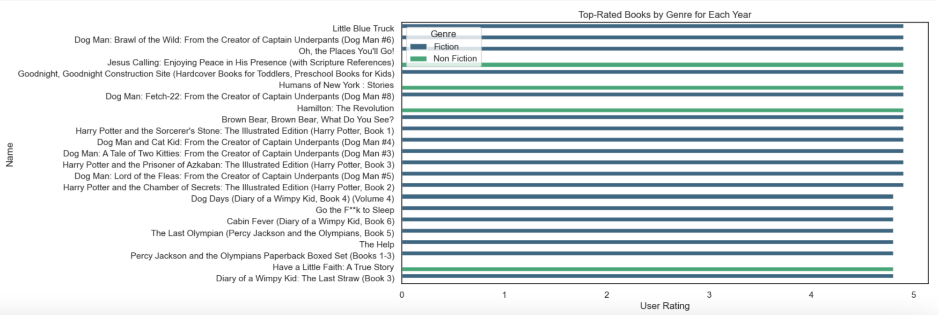
Results
The top 3 books each year showing Genres (based on rating)
Note: I selected top 3 instead of top 5 due to space in this presentation format

Slide 13
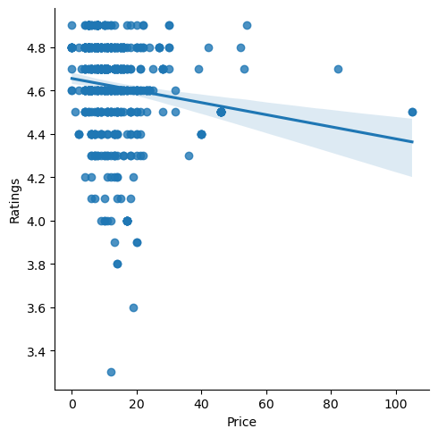
Results
Diagnostic and Statistical Manual of Mental Disorders, 5th Edition: DSM-5
The Twilight Saga Collection
Most of the books that have highest user ratings fall in the lower price range, however, the expensive 'need' books are still receiving reasonably high reviews, so people are not
totally dissatisfied with them
The Casual Vacancy | / J.K. Rowling
Cost as a factor in people’s book selections

Slide 14
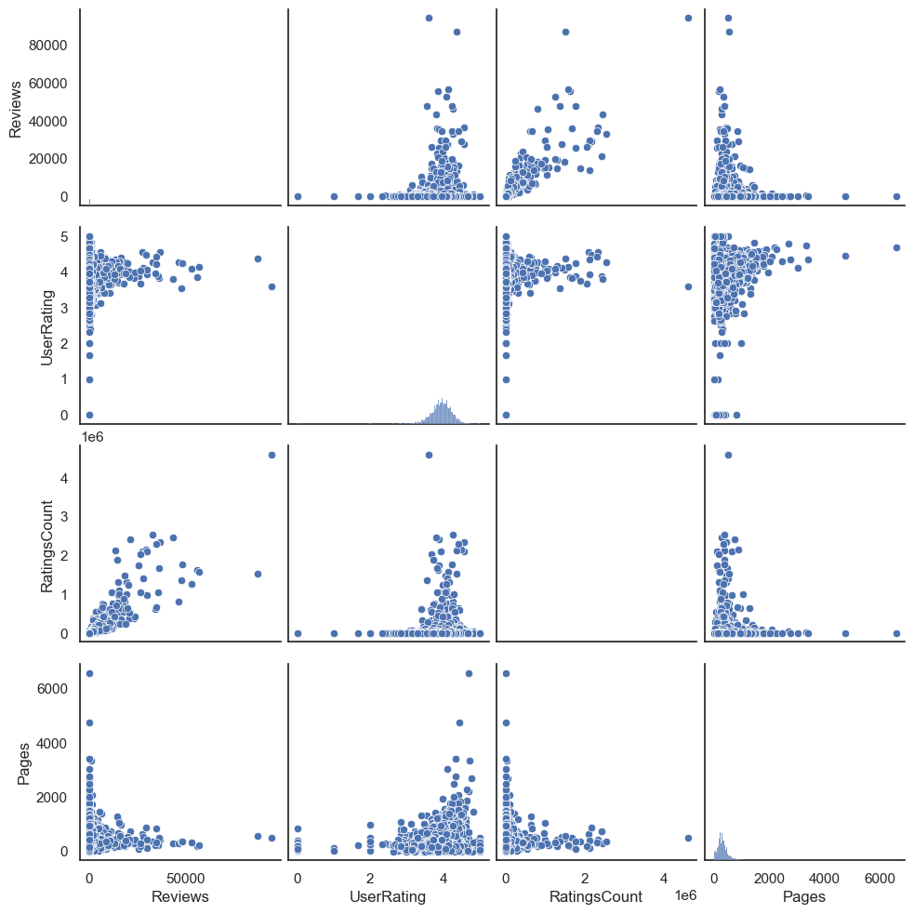
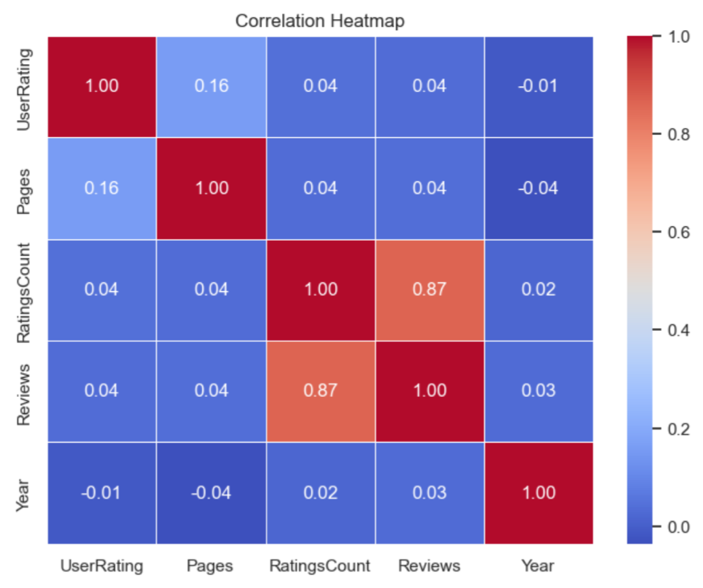
Results
Cost of books as a factor
Book length as a factor

Slide 15
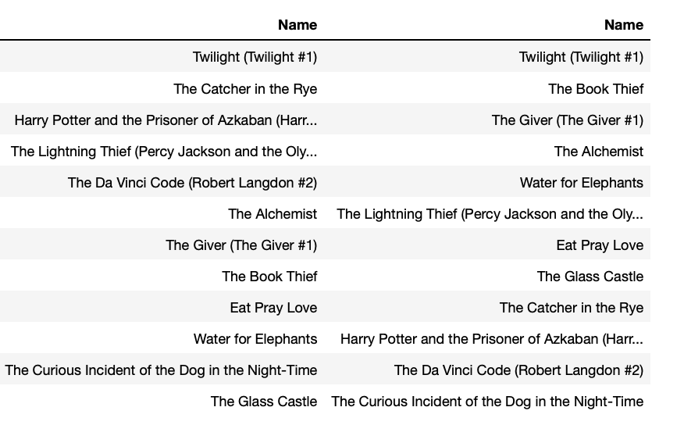
Results
Top 10 most rated books vs. top most reviewed books side by side

Slide 16
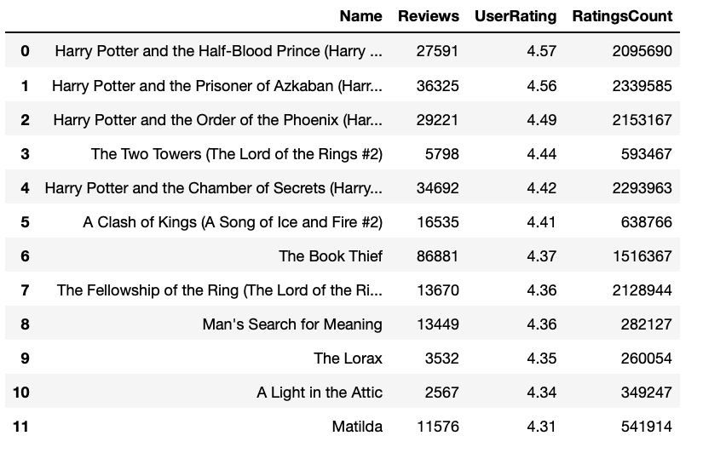
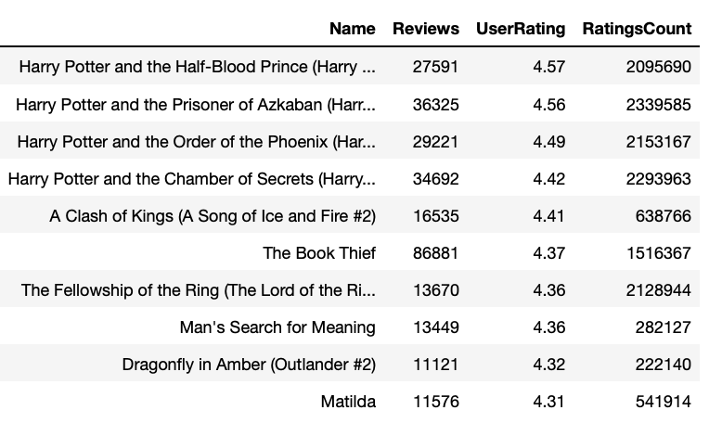
Results
Top highest # ratings (> 250000) and highest rating score
Top highest # reviews (> 10000) and highest rating score

Slide 17
Recommendations
My recommendations for the client are as follows:
Purchase all of the series of books that are in the top 50, most reviewed or most rated results, ie. If three Harry Potter books are listed, purchase more of the three making the list, but have some of all in hand of all others in that series.
Purchase books from the most reviewed / rated authors, starting with those that are higher rated
Fiction is a bit more popular than non-fiction, but non-fiction titles that are highly reviewed or rated should be kept on hand.
Purchase titles that received top 50% or review and rating counts
Purchase all titles that are in the top 50 of previews 10 years

Slide 18
Final Thoughts
The data is not ideal for this analysis, some additional insight is needed, such as:
Categorization for age applicability (eg. Little Blue Truck)
Further breakdown of genre (eg. Diagnostic and Statistical Manual of Mental Disorders)
Box sets vs. individual included titles should be noted
Reviews and Ratings counts are just that, counts. A book could have 1M reviews, but a 2.0 rating. However, a highly reviewed book or one with high counts in ratings is likely a good candidate for being read, regardless of rating – they cannot be discounted.
If I had further time for analysis:
Identify additional datasets to perform same analysis
Refine my current analysis to exclude additional data, less focus on counts without factoring in ratings
Further explore Pages to User Rating relationship
Call out the least popular books
Figure out why Harry Potter is only popular in late years in this dataset (data integrity?)

Slide 19
Slide 11
THANK YOU

