Slide 1
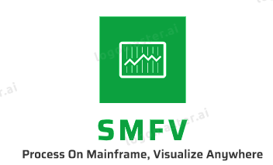
Smart MainFrame Visualizer
A project for MTM 2020
By Sameer Joshi (learningsam20@gmail.com)

Slide 2
What is SMFV?
Context
SMF holds wealth of info for various mainframe subsystems, including SDSF. Analyzing this may help in identifying anomalies, taking proactive actions, detecting issues early, monitor system KPIs and so on.
Challenges
Users cannot access this information in raw or processed form readily. Also, it cannot be leveraged easily by the other systems for downstream processing like ML based analytics, automation, forecasting, etc.
Solution
SMFV attempts to analyze & visualize a part of SDSF job information. It analyzes the data captured on DA job queue of SDSF at a pre-defined interval and shows tableau dashboard with top resource consuming jobs/users, frequently executed jobs, class & priority wise job distribution, execution trend & more. While this is a representative analysis, it could be extended to additional SDSF attributes and SMF data.
All of this is done leveraging best in class solutions. E.g. It leverages mainframe for data processing, Python for data formatting, MySQL for cloud-based data storage, and Tableau for cloud-based dashboards. It leverages shell scripts to do SDSF monitoring automation

Slide 3


How does SMFV work?
Scheduler, 5 Mins
Shell Script
Async Process
SDSF Extractor Job
Last Updated Records
ZOAU
Python Script
SORT
SORT
User
Jobs
SDSF
SDSF Batch
Processed Records
Modified Records
SMFA DB
GCP Based MySQL
Web based dashboards
Tableau Dashboards
User
Legend: Execution Environment
Mainframe, USS
Google Cloud
Tableau Cloud
Mainframe, ZOS
SSH, Win/Lin

Slide 4
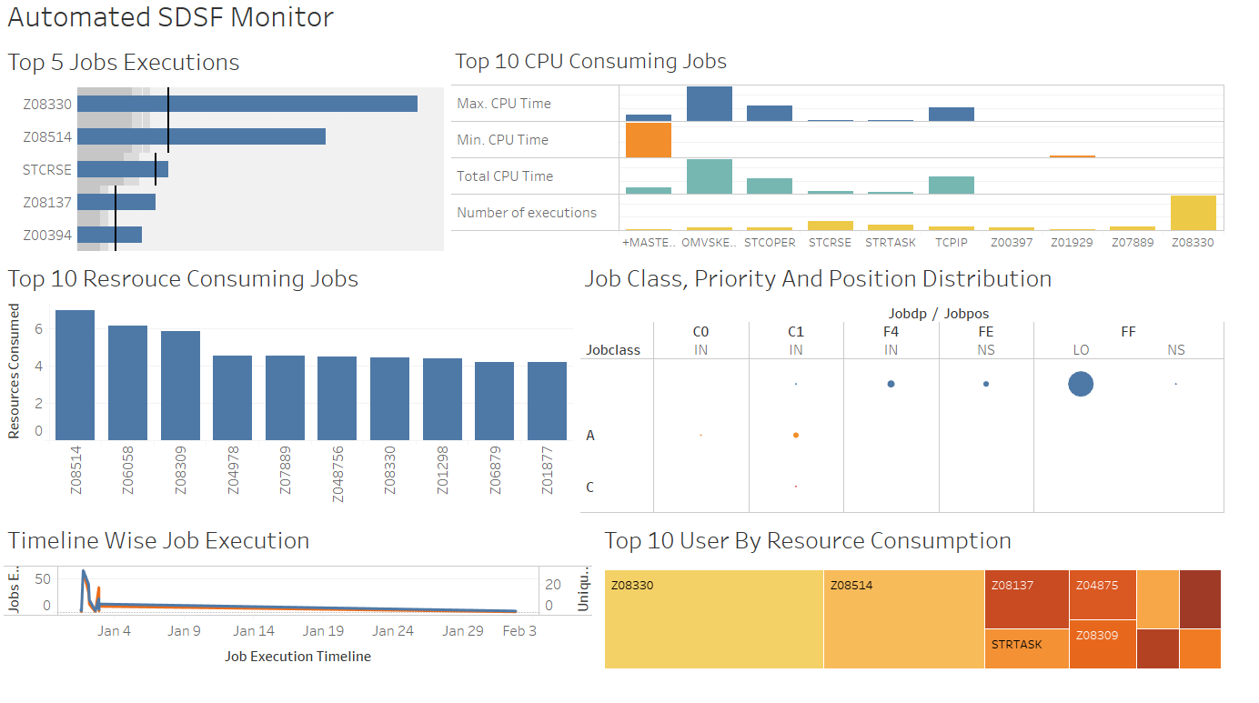
What is SMFV?
Demo Link
Know More

Slide 5
What do I need to install SMFV?
The following pre-requisites must be met in order to successfully use SMFV
A Mainframe host with accessible SSH port and a user credentials
Access to Mainframe Unix subsystem (USS)
Access to cloud/native MySQL installation
Access to Tableau online server
Availability of necessary Python, ZOAU packages on Mainframes
A system to schedule the script that would invoke SDSF monitoring job every 5 minutes (configurable)

Slide 6
How do I get going?
Follow these steps to get your first responsive dashboard up and running:
Copy the necessary files from git clone https://github.com/learningsam20/smfv
Copy SDSFJCL in a mainframe JCL PDS and change/add params if any to the job card
Connect to any MySQL server and execute the mtm.sql. Provide necessary firewall exception to the IP of MF host and Tableau host
Copy mtmlog.py in mainframe USS and change database connection info as above (line 35, defaults to GCP based instance created)
Copy trig.sh in any linux machine, modify user, password, host info for Mainframe (default MTM MF) and job prefix to analyze (default Z*). and execute the following.
chmod 777 trig.sh
while true; do ‘./trig.sh'; sleep 300; done
Copy MTMProject.twb and modify connection info if needed (default above connection). Publish it to server.
Currently hosted instance available at https://prod-apnortheast-a.online.tableau.com/#/site/testsam/workbooks/118064

Slide 7
Benefits and roadmap
Benefits
Due to leverage of best of the modern technologies, SMFV can deliver the rich, interactive dashboards in near real time manner. These are responsive and can be accessed across devices. This provides a quick view into the SDSF related KPIs that could be configured to be shown on the dashboard.
Roadmap
To further the SMFV solution, following are some possibilities:
Integrate with entire SMF records, including SDSF. This will broaden the scope of SMFV. This could not be accomplished due to lack of resources and time
Apply machine learning to perform advanced analytics to auto detect patterns, correlations, resource forecasting, etc.
Integrate downstream automation, either through Ansible or other playbooks, post generating triggers using AI/ML

Slide 8
Thank You

