Slide 1
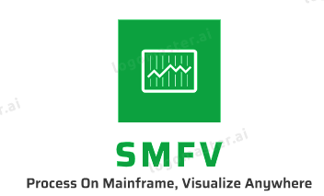
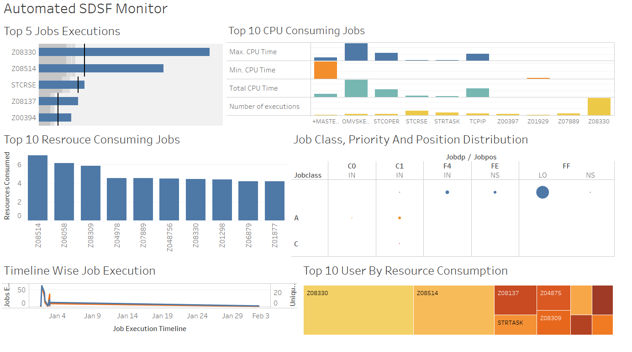
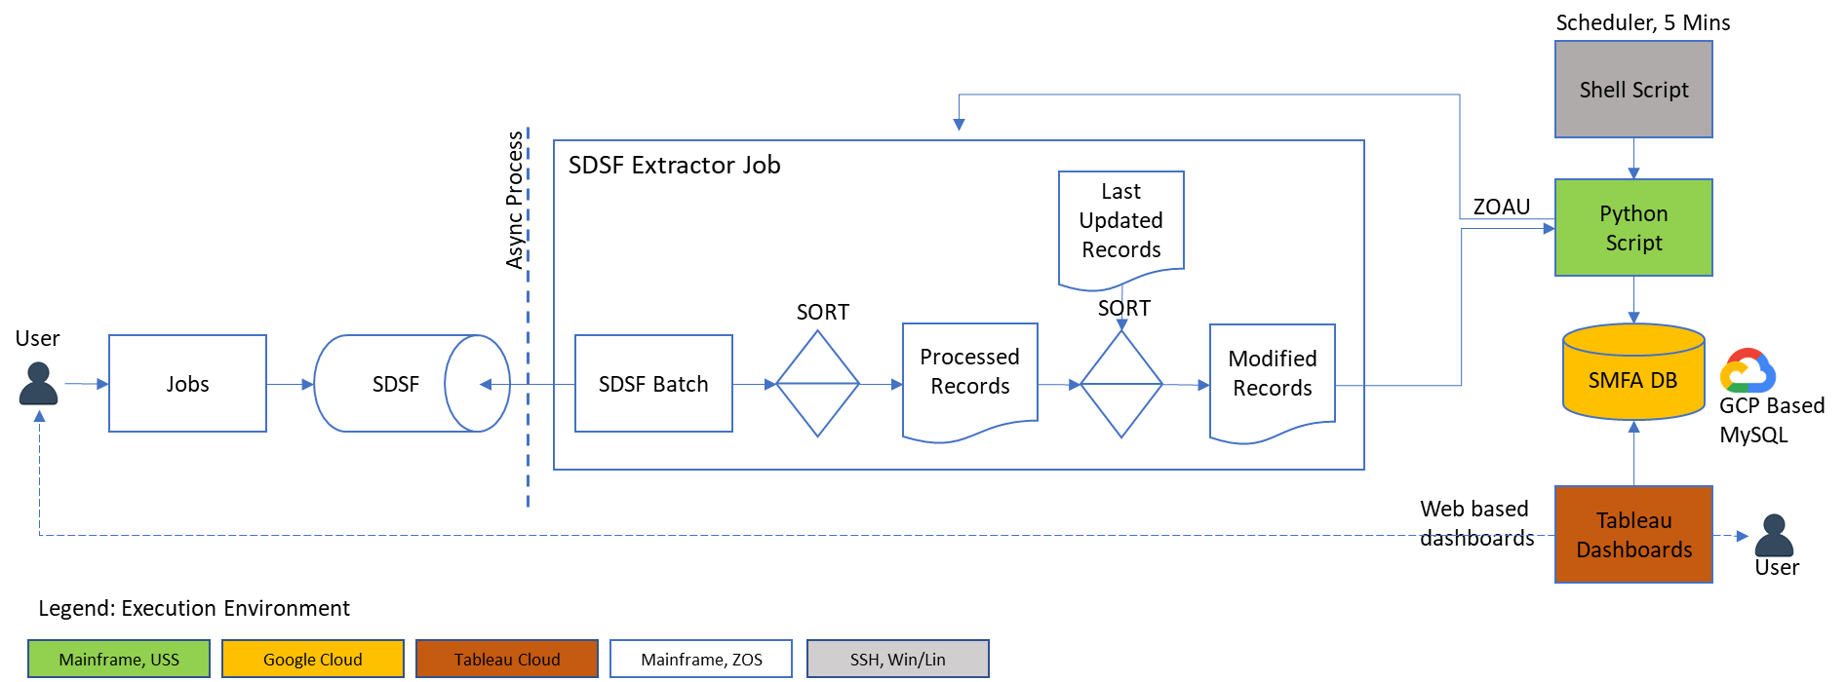
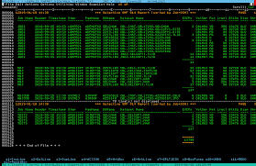
Smart MainFrame Visualizer (SMFV)
Demo Link
Know More
SMFV helps analyze SDSF data on Mainframe and visualize it on responsive, web dashboards on cloud
Responsive, Web based dashboard
Context: Mainframes batch processes huge amounts of data. SDSF has wealth of such batch information. Analyzing this may help in identifying anomalies, taking proactive actions, detecting issues early, monitor system KPIs and so on.
Challenge: Analyze and visualize this data in more user-friendly manner near real time
Solution: Integrate mainframe with the modern technologies.
Mainframe: Z/OS for heavy processing, capture of SDSF data
Mainframe USS: Python to interact with Mainframe, perform analysis, update stats DB
Cloud DB: MySQL on Google cloud
Cloud, responsive dashboard: Tableau based multi-device dashboard depicting various KPIs
Benefits: Rich UI, easy programmability and extensibility, efficient processing
Roadmap: Integrate with entire SMF data, beyond SDSF. Apply ML to
provide intelligent analytics. Use trigger above to do automation.
Mainframe User View
High Level SMFV Architecture

