Slide 1
Linear Regression

Slide 2
Linear Regression in Machine Learning
Linear regression is one of the easiest and most popular Machine Learning algorithms.
It is a statistical method that is used for predictive analysis.
Linear regression makes predictions for continuous/real or numeric variables such as sales, salary, age, product price, etc.
It is a method of Supervised Learning in Machine Learning.

Slide 3
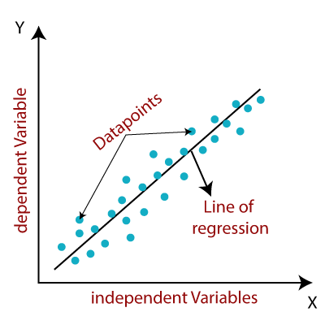
Linear Regression

Slide 4
Linear Regression
y= a₀+a₁x+ ε
Mathematically, we can represent a linear regression as:
Y=a0+a1x+E
Y= Dependent Variable (Target Variable) X= Independent Variable (predictor Variable) a0= intercept of the line (Gives an additional degree of freedom) a1 = Linear regression coefficient (scale factor to each input value). ε = random error

Slide 5
Types of Linear Regression
Simple Linear Regression
Single independent variable or single predictor variable
Multiple Linear Regression
Multiple Independent variables or multiple predictor variables

Slide 6
Linear Regression Line
A linear line showing the relationship between the dependent and independent variables is called a regression line.
A regression line can show two types of relationship:

Slide 7
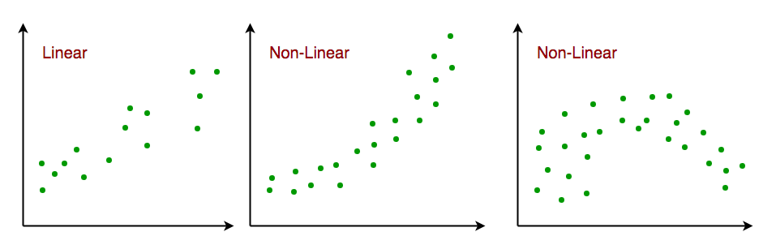
Linear Regression

Slide 8
Logistic Regression
Logistic regression is a supervised learning classification algorithm used to predict the probability of a target variable. The nature of target or dependent variable is dichotomous, which means there would be only two possible classes.

Slide 9
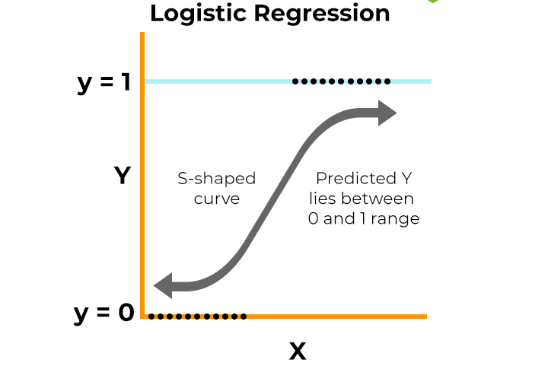
Logistic Regression

Slide 10
Decision Tree
A decision tree in machine learning is a supervised learning algorithm used for both classification and regression tasks.
It operates by constructing a model that predicts the value of a target variable by learning simple decision rules inferred from the data features.

Slide 11
Decision Tree
A common example of a decision tree in machine learning is predicting whether a customer will purchase a new product based on their demographics and past behavior.

Slide 12
Decision Tree
Consider a dataset with features like:
Age: (e.g., <30, 30-50, >50)
Income: (e.g., Low, Medium, High)
Previous Purchases: (e.g., Yes/No)
Target Variable: Purchase New Product (Yes/No)

Slide 13
Decision Tree
A decision tree would be constructed as follows:
Root Node: The algorithm identifies the feature that best splits the data into distinct groups regarding the target variable. For instance, "Age" might be chosen as the root node if it provides the most information gain.
Split 1: Age < 30: This branch leads to a subset of customers under 30.
Split 2: Age 30-50: This branch leads to a subset of customers between 30 and 50.
Split 3: Age > 50: This branch leads to a subset of customers over 50.

Slide 14
Decision Tree
Subsequent Nodes: Within each branch, the algorithm continues to identify the next best splitting feature.
For "Age < 30" branch: "Income" might be the next splitting feature.
Split 1a: Income Low: This leads to a leaf node predicting "No" purchase.
Split 1b: Income Medium: This leads to another split based on "Previous Purchases."
Split 1bi: Previous Purchases Yes: Leads to a leaf node predicting "Yes" purchase.
Split 1bii: Previous Purchases No: Leads to a leaf node predicting "No" purchase.
Split 1c: Income High: Leads to a leaf node predicting "Yes" purchase.

Slide 15
Decision Tree
Leaf Nodes: The tree continues to branch until it reaches leaf nodes, which represent the final predicted outcome (e.g., "Yes" or "No" for purchasing the new product).
Each path from the root to a leaf node represents a set of conditions that lead to a specific prediction.

Slide 16
Decision Tree
Leaf Nodes: The tree continues to branch until it reaches leaf nodes, which represent the final predicted outcome (e.g., "Yes" or "No" for purchasing the new product).
Each path from the root to a leaf node represents a set of conditions that lead to a specific prediction.

Slide 17
Decision Tree
Decision Tree:
Root Node: Outlook (Sunny, Overcast, Rainy)
If Outlook is Sunny:
Node: Humidity (High, Normal)
If Humidity is High: Leaf Node: No Play
If Humidity is Normal: Leaf Node: Play
If Outlook is Overcast: Leaf Node: Play
If Outlook is Rainy:
Node: Wind (Strong, Weak)
If Wind is Strong: Leaf Node: No Play
If Wind is Weak: Leaf Node: Play

Slide 18
Decision Tree
Decision Rules Derived from the Tree:
IF Outlook = Sunny AND Humidity = High THEN Play = No
IF Outlook = Sunny AND Humidity = Normal THEN Play = Yes
IF Outlook = Overcast THEN Play = Yes
IF Outlook = Rainy AND Wind = Strong THEN Play = No
IF Outlook = Rainy AND Wind = Weak THEN Play = Yes

Slide 19
Decision Tree
Decision Rules Derived from the Tree:
IF Outlook = Sunny AND Humidity = High THEN Play = No
IF Outlook = Sunny AND Humidity = Normal THEN Play = Yes
IF Outlook = Overcast THEN Play = Yes
IF Outlook = Rainy AND Wind = Strong THEN Play = No
IF Outlook = Rainy AND Wind = Weak THEN Play = Yes

Slide 20
Decision Tree (infogain)
Information Gain (S, A) = Entropy (S) - Σ [ (|Sv| / |S|) * Entropy (Sv) ]
Where:
S is the parent dataset.
A is the attribute (feature) being considered for the split.
Sv is the subset of S for which attribute A has value v.
|S| and |Sv| represent the number of instances in S and Sv, respectively.
Entropy(S) and Entropy(Sv) represent the entropy of the parent dataset and the subset Sv, respectively.

Slide 21
Decision Tree (gini index)
Where:
p_j is the proportion of instances belonging to class j within that node.
The summation Σ is performed over all classes present in the node.
Gini Index = 1 - Σ (p_j)^2
Where:
p_j is the proportion of instances belonging to class j within that node.
The summation Σ is performed over all classes present in the node.

Slide 22
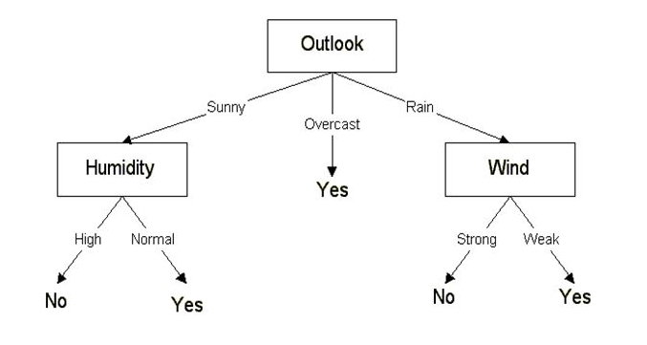
Decision Tree

Slide 23
Classification Measures
Where:
p_j is the proportion of instances belonging to class j within that node.
The summation Σ is performed over all classes present in the node.
Confusion Matrix:
A table that visualizes the performance of a classification model by summarizing the counts of true positives, false positives, true negatives, and false negatives.

Slide 24
Classification Measures (confusion Matrix)
True Positives (TP): Correctly predicted positive outcomes.
True Negatives (TN): Correctly predicted negative outcomes.
False Positives (FP): Incorrectly predicted positive outcomes (Type I error).
False Negatives (FN): Incorrectly predicted negative outcomes (Type II error).

Slide 25
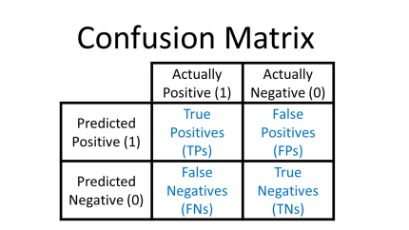
Classification Measures (confusion Matrix)

Slide 26
Classification measures
Accuracy:
The ratio of total correct predictions (TP + TN) to the total number of predictions.
Precision:
The proportion of correctly predicted positive instances out of all instances predicted as positive (TP / (TP + FP)).
Recall (Sensitivity):
The proportion of correctly predicted positive instances out of all actual positive instances (TP / (TP + FN)).
F1-Score:
A harmonic mean of precision and recall, providing a single metric that balances both (2 * (Precision * Recall) / (Precision + Recall)).
Specificity:
The proportion of correctly predicted negative instances out of all actual negative instances (TN / (TN + FP)).

Slide 27
Classification measures
Accuracy:
The ratio of total correct predictions (TP + TN) to the total number of predictions.
Precision:
The proportion of correctly predicted positive instances out of all instances predicted as positive (TP / (TP + FP)).
Recall (Sensitivity):
The proportion of correctly predicted positive instances out of all actual positive instances (TP / (TP + FN)).
F1-Score:
A harmonic mean of precision and recall, providing a single metric that balances both (2 * (Precision * Recall) / (Precision + Recall)).
Specificity:
The proportion of correctly predicted negative instances out of all actual negative instances (TN / (TN + FP)).

Slide 28
Classification measures
Accuracy:
The ratio of total correct predictions (TP + TN) to the total number of predictions.
Precision:
The proportion of correctly predicted positive instances out of all instances predicted as positive (TP / (TP + FP)).
Recall (Sensitivity):
The proportion of correctly predicted positive instances out of all actual positive instances (TP / (TP + FN)).
F1-Score:
A harmonic mean of precision and recall, providing a single metric that balances both (2 * (Precision * Recall) / (Precision + Recall)).
Specificity:
The proportion of correctly predicted negative instances out of all actual negative instances (TN / (TN + FP)).

Slide 29
Classification measures
Accuracy:
The ratio of total correct predictions (TP + TN) to the total number of predictions.
Precision:
The proportion of correctly predicted positive instances out of all instances predicted as positive (TP / (TP + FP)).
Recall (Sensitivity):
The proportion of correctly predicted positive instances out of all actual positive instances (TP / (TP + FN)).
F1-Score:
A harmonic mean of precision and recall, providing a single metric that balances both (2 * (Precision * Recall) / (Precision + Recall)).
Specificity:
The proportion of correctly predicted negative instances out of all actual negative instances (TN / (TN + FP)).

Slide 30
Clustering
Where:
p_j is the proportion of instances belonging to class j within that node.
The summation Σ is performed over all classes present in the node.
Cluster is a group of objects that belongs to the same class. In other words, similar objects are grouped in one cluster and dissimilar objects are grouped in another cluster.
Clustering is the process of making a group of abstract objects into classes of similar objects.
A cluster of data objects can be treated as one group.
While doing cluster analysis, we first partition the set of data into groups based on data similarity and then assign the labels to the groups.
The main advantage of clustering over classification is that, it is adaptable to changes and helps single out useful features that distinguish different groups.

Slide 31
K-Means clustering
Where:
p_j is the proportion of instances belonging to class j within that node.
The summation Σ is performed over all classes present in the node.
K-Means Clustering is an unsupervised machine learning algorithm that helps group data points into clusters based on their inherent similarity.
Unlike supervised learning, where we train models using labeled data, K-Means is used when we have data that is not labeled and the goal is to uncover hidden patterns or structures.
For example, an online store can use K-Means to segment customers into groups like "Budget Shoppers," "Frequent Buyers," and "Big Spenders" based on their purchase history.

Slide 32
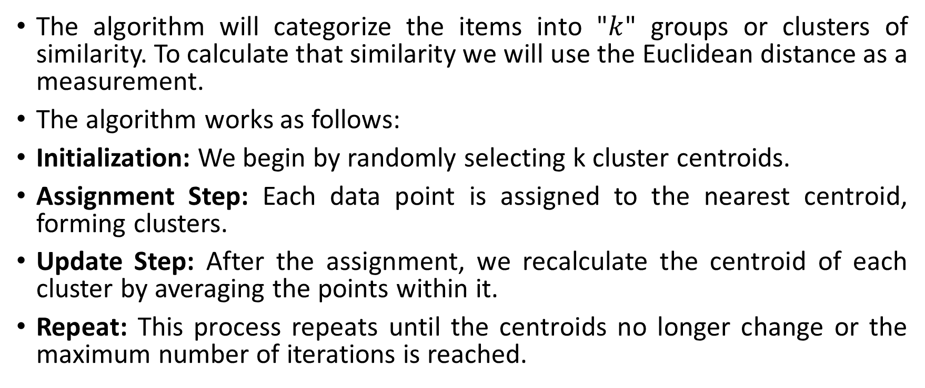
K-Means clustering Algorithm
Where:
p_j is the proportion of instances belonging to class j within that node.
The summation Σ is performed over all classes present in the node.
The algorithm will categorize the items into "$k$" groups or clusters of similarity. To calculate that similarity we will use the Euclidean distance as a measurement.
The algorithm works as follows:
Initialization: We begin by randomly selecting k cluster centroids.
Assignment Step: Each data point is assigned to the nearest centroid, forming clusters.
Update Step: After the assignment, we recalculate the centroid of each cluster by averaging the points within it.
Repeat: This process repeats until the centroids no longer change or the maximum number of iterations is reached.

Slide 33
K-Means clustering Algorithm Elbow Method
Where:
p_j is the proportion of instances belonging to class j within that node.
The summation Σ is performed over all classes present in the node.
WCSS (Within-Cluster Sum of Squares) is a metric used in the elbow method to find the optimal number of clusters (K) in a K-means clustering algorithm.
It measures the total variance within each cluster by summing the squared distances between each data point and its cluster's centroid.

