Slide 1
Dev-Communities; A Ruby on Rails Social Networking App for Developers
Written for FredDev
by Brian Monaccio

Slide 2
My Introduction
Studied Biochemistry at VT; planned CS Minor
  Learned C++, Java, ultimately discontinued the minor to focus on my lab work
Specialized in bacterial genetics

Slide 3

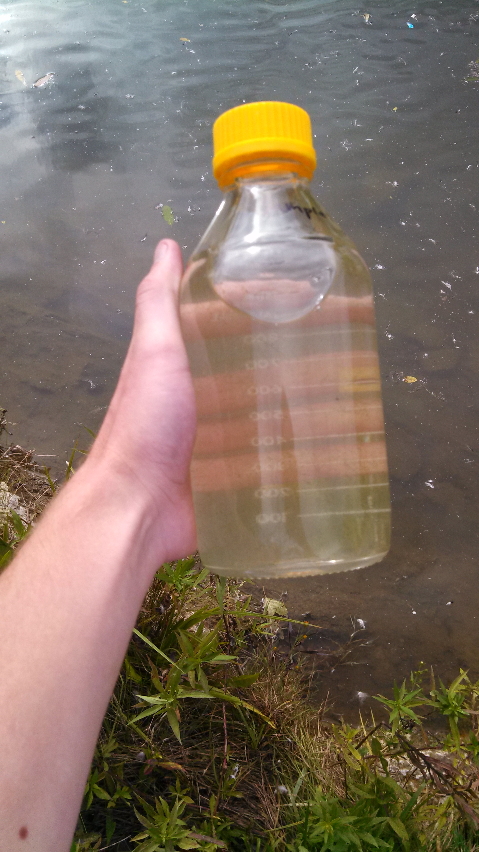
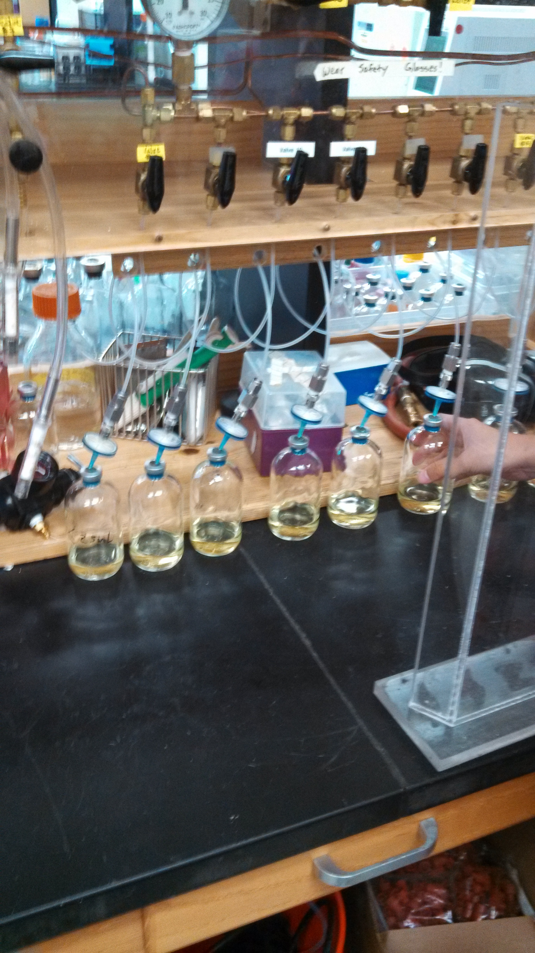
Archaea Lab Work Spring 2013

Slide 4
Summer 2014
Realized I disliked my research
Took a Summer Job in the VA Wine Industry

Slide 5
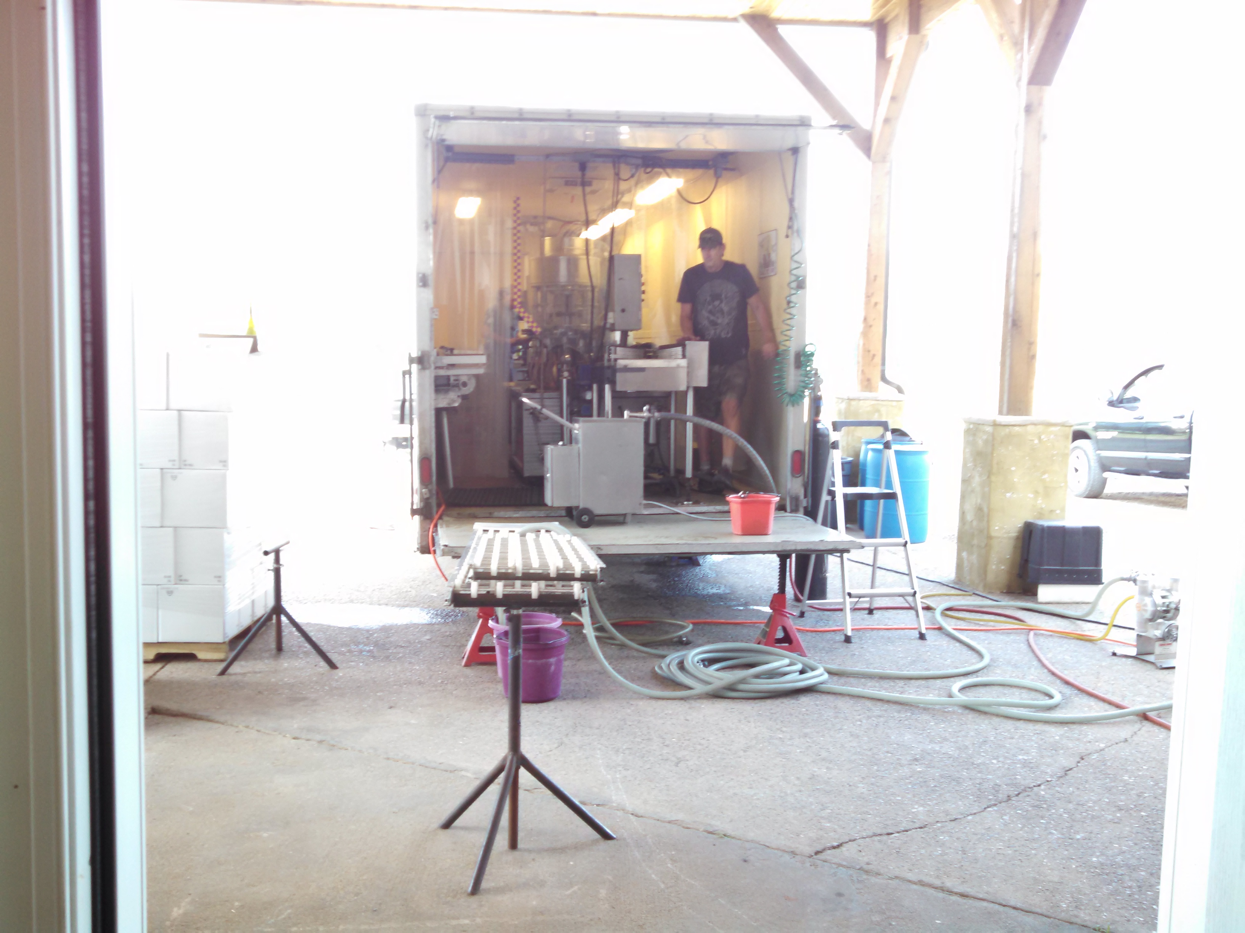
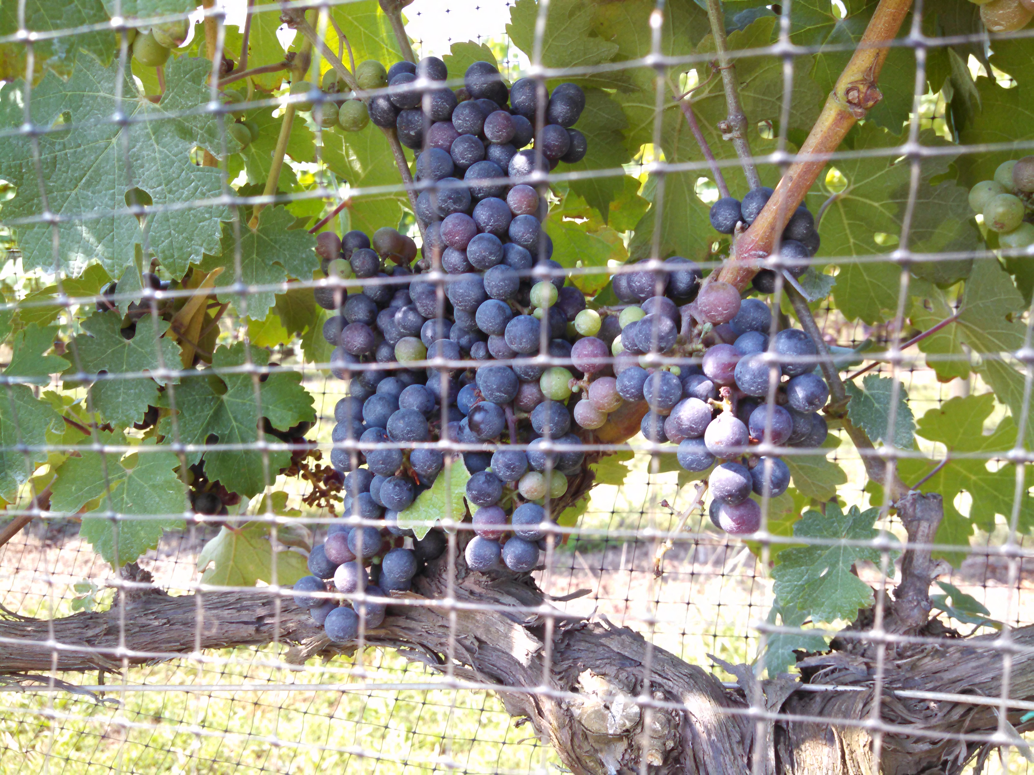
Wine Industry Summer 2014

Slide 6
Winter 2017
VA Wine Industry Round 2 @ Sunset Hills Vineyard
Assistant Winemaker

Slide 7
Summer 2018
Knew I wanted to leave the wine industry
Started learning python to see if I was still interested in CS

Slide 8
Fall 2018
Discovered The Odin Project in Sept 2018 – Harvest begins
Working long days with no time to spend on TOP

Slide 9
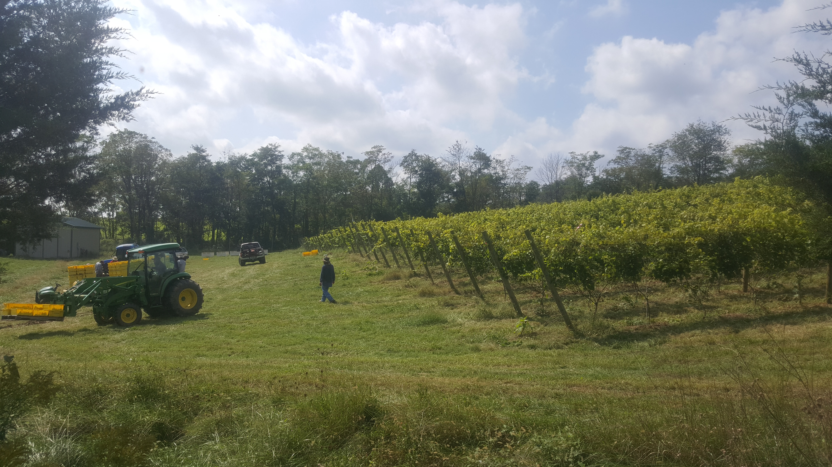
Harvest 2018

Slide 10
Post Harvest 2018
Harvest ends early – wet weather in ‘17 and ‘18 made for a miserable crop
Decide to commit to changing careers after spending time on TOP and after seeing some friends succeed in Bootcamps
Leave Job in Jan 2019

Slide 11
Jan 2019 - Present
The Odin Project
Working full time on TOP
Finishing Ruby on Rails Curriculum

Slide 12
What is Ruby on Rails (Rails)?
Rails is a web development framework created by David Heinemeier Hansson (DHH) and released in Dec. 2005
Written in Ruby
~4000 contributors to date

Slide 13
The Rails Way
Rails is opinionated
Assumes there is a ‘best’ way to do things
Two major guiding principles:
  DRY – most developers are familiar with this concept
  Convention > configuration
    Hope to spend less time writing config files and getting straight to development

Slide 14
Rails builds on MVC Architecture
M – domain model with logic specific to the app
  Uses Active Record pattern to implement its ORM
V – templates that represent app resources
  Ususally HTML with Embedded Ruby (ERB)
C – controllers that handle incoming HTTP requests
  manage the manipulation of models and generate responses to received HTTP requests
  Rendering an HTML/ERB template or JSON are common responses
    Response can also take the form of XML, PDF, etc.

Slide 15
Inspiration for Dev-Communities
Rails Final Project

Slide 16
Purpose of Dev-Communities
A platform for developers to connect with each other
Allow developers to
  Discover one another
  Communicate, share ideas, collaborate
  Meet in real life

Slide 17
Features and links
Full list at github
Dev Communities project repo
Relevant github repos
  Devise
  CarrierWave
  acts-as-taggable-on
  mailboxer

Slide 18
Future
2 remaining courses at TOP
  HTML & CSS
  JavaScript
Profit?

