Slide 1
Exploratory Analysis of causes of Wildfires in US
SANTHOSHI PISUPATI

Slide 2
Abstract
The analysis predicts the causes of wildfires using supervised machine learning methods Decision Tree and Random Forest Classifiers with an accuracy of 40% and 56% respectively.
The data set used for the analysis is “1.88 Million US Wildfires” taken from: https://www.kaggle.com/rtatman/188-million-us-wildfires

Slide 3
Motivation
Can we predict the causes of wildfires based on given attributes using machine learning techniques.
Predicting the causes can help local fire organizations in better resource allocation and increase supervision in remote zones.

Slide 4
Dataset(s)
The dataset used is 1.88Million US Wildfires. A SQLite database of wildfires that occurred in the United States from 1992-2015.
The table used is:
Fires (1880465 rows x 39 columns) – Table including wildfire data for the period of 1992-2015 compiled from US federal, state and local reporting systems.
Got the dataset from the website : https://www.kaggle.com/rtatman/188-million-us-wildfires.

Slide 5
Data Preparation and Cleaning
The table has 39 columns, of which only 10 columns are selected for this analysis.
The data contains lots of missing values for a date column, so they need to be removed. But the problem with dropping the NaN values is it is dropping lots of rows with significant data that is needed for the analysis.
In order to use Decision Tree method, we also need to convert categorical values to numeric values. So, all the missing values for the column are filled with zeros.

Slide 6
Research Question(s)
What are the main causes of wildfires, which states are more prone to wildfires, Have the frequency increased or decreased over time, Can we use supervised machine learning methods to predict the attributes that describe the causes of wildfires.

Slide 7
Methods
Supervised Decision Tree Classifier method is used to analyze the data because we already had the label of cause from the current dataset.
Random Forest Classifier method is also used to see whether that can improve the accuracy of the model build.

Slide 8
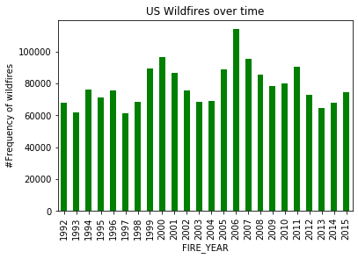
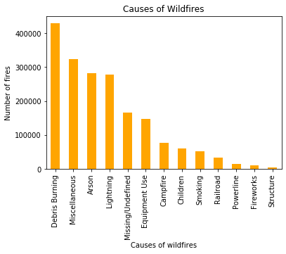
Findings (contd..)
The main causes of wildfires are Debris Burning, Miscellaneous, Arson, Lightening. And the frequency of wildfires seems less after 2006.

Slide 9
Findings
DecisionTreeClassifier(class_weight=None, criterion='gini', max_depth=None, max_features=None, max_leaf_nodes=20……)
Accuracy: 0.4054522249473857
RandomForestClassifier(bootstrap=True, class_weight=None, criterion='gini', max_depth=None, max_features='auto', max_leaf_nodes=None, n_estimators=50…..)
Accuracy: 0.556678387376441
Decision Tree model is built and trained with attributes fire size, longitude, latitude, burn time, month, discovery day of year to predict the causes of wildfires with the accuracy of 40%.
Random Forest model is built and trained with the same attributes to see if its accuracy of prediction is better. And got an accuracy of 56%.
Because there are 13 classes or causes the prediction is fifty-fifty.

Slide 10
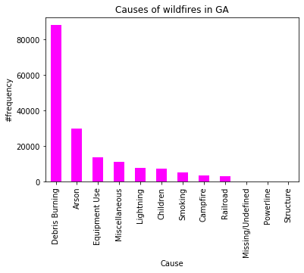
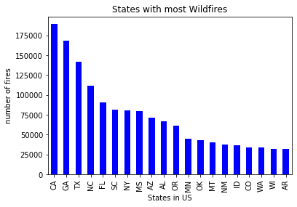
Findings
Random Forest model is built and trained with attributes fire size, latitude, longitude, month, discovery date, day of week to predict a selected cause, Debris Burning for state Georgia with an accuracy of 65%.

Slide 11
Limitations
The NaN values in the data are filled with 0’s.
There are a total of 39 columns in the Fires table. But only 10 columns are selected for the analysis.

Slide 12
Conclusions
1. Main causes of wildfires in US are Debris Burning, Miscellaneous, Arson, Lightening.
2. States prone to wildfires are mainly California, Georgia, Texas, North Carolina.
3. The frequency of wildfires has decreased from 110k in 2006(highest number of fires) to 70k in 2015.
4. Given information like location, fire size, month, discovery time, contained/controlled time we can predict the cause of wildfire by an accuracy of 56%.
Lastly, When selected the state GA and given the information like fire size, location, month, day of week we can predict the cause to be Debris Burning by an accuracy of 65%.

Slide 13
Acknowledgements
The data set is from https://www.kaggle.com/rtatman/188-million-us-wildfires.
Citation:
Short, Karen C. 2017. Spatial wildfire occurrence data for the United States, 1992-2015 [FPA_FOD_20170508]. 4th Edition. Fort Collins, CO: Forest Service Research Data Archive. https://doi.org/10.2737/RDS-2013-0009.4
My friend has given a positive feedback about this analysis.

Slide 14
References
https://www.forbes.com/sites/brendarichardson/2019/09/12/top-states-with-the-most-homes-at-risk-of-wildfire-damage/#29317d014c50
https://www.nps.gov/articles/wildfire-causes-and-evaluation.htm

