Slide 1


© Digivate Labs | Proprietary and Confidential

Slide 2
SCOPE OF DEMO
To showcase the catalog Digitization solution in action, as it automatically evaluates the input video and create the catalog based on the information available in input video.
Following videos have been considered for the demo:
Sample_Video1_Bengali
Sample_Video2_English
Sample_Video3_Hindi
Access Videos: Link
Demo Application Link :https://devbox.digivatelabs.com:8443/catalog-digitalization/#/login
© Digivate Labs | Proprietary and Confidential

Slide 3
USER MANUAL FOR CATALOG DIGITIZATION
Description: Upload the video which is containing the product information.
Steps:
Navigate to the Log-in Page:
Open browser and login to the application.
Click on '+' to upload the video.
Select and upload the video:
Click on 'Upload Video' button.
Browse and select the video from local system.
Save the catalog:
1. Validate the catalog after processing.
2. Click "Save" to store the catalog.
Result: Your catalog is now created and saved within the DigivAI platform.
© Digivate Labs | Proprietary and Confidential

Slide 4
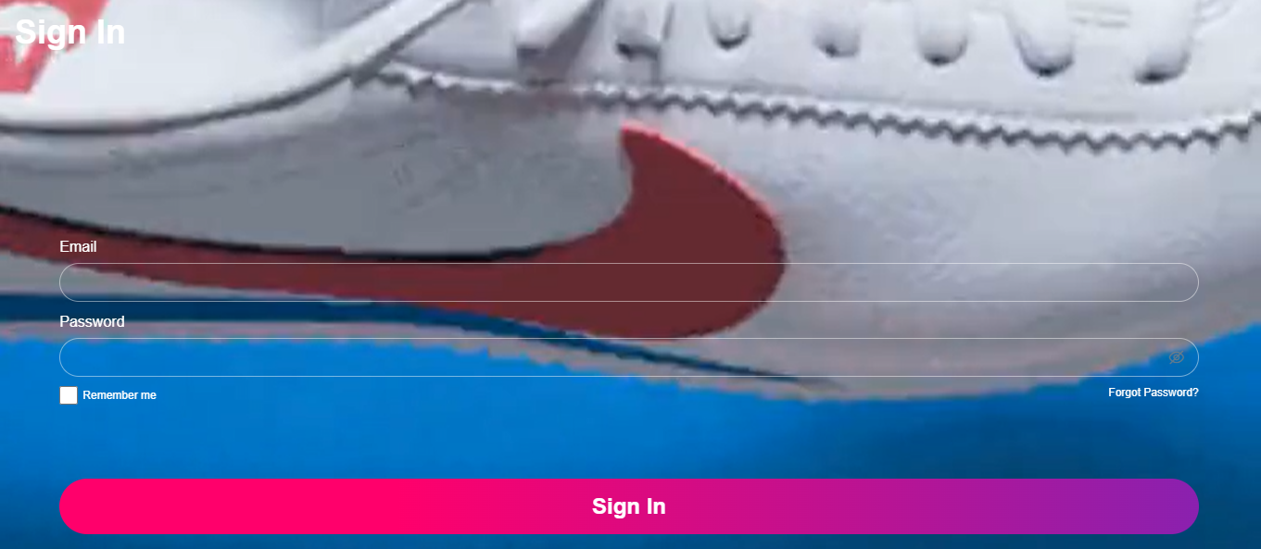

Slide 5
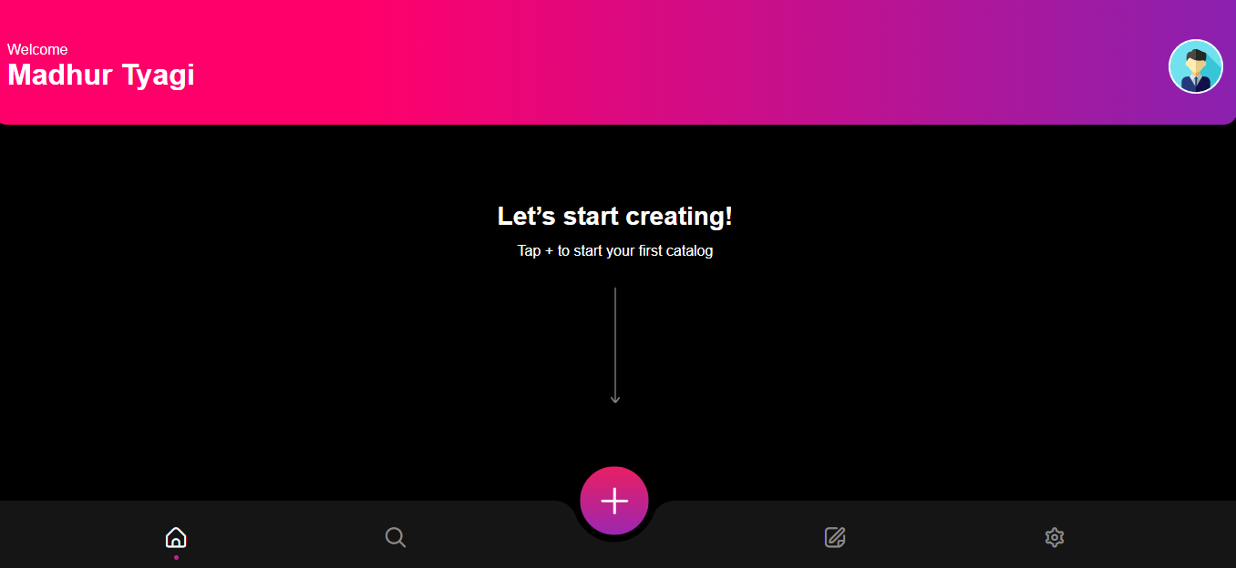

Slide 6
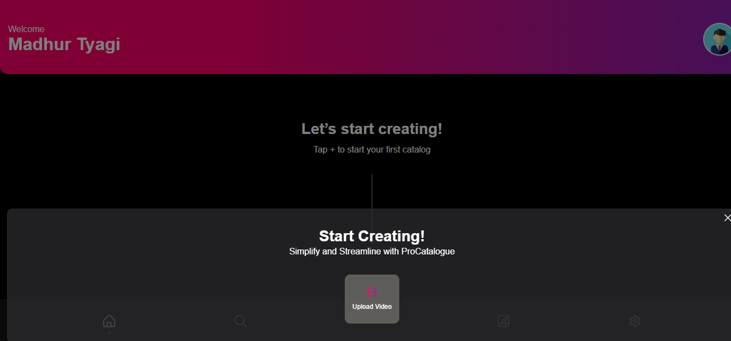

Slide 7
ADDITIONAL USEFUL INFORMATION
Supported File Formats: .MP4
Video Length Support: 50 minutes.
Technology used: Gemini, Vertex AI, google-cloud-storage, Firestore, Python Libraries - (Werkzeug, OpenCV).
OpenCV – To open the video and analyze the frame and saving the images
Approximate Time taken for evaluation:
Evaluation time can vary based on factors like:
Length and Size of the Video.
Network speed
No of products covered in the video.
Gemini Responsiveness
Metric | Time (approx.)
Upload time (Video size: 30 MB) | 1-1.2 min
Processing Time (Video Length: 01:10 min, Video Size: 30 MB) | 3 -3.5 min
© Digivate Labs | Proprietary and Confidential

Slide 8
