Slide 1
Agenda
What is Application Gateway
Pre-requisite of Application Gateway
How Application Gateway works
Creation of Application Gateway in Azure.

Slide 2
Azure Application Gateway
In Azure , there are 4 Load balancing Services available
Load Balancers - Regional
Application Gateway - Regional
Traffic Manager - Global
Front Door - Global
Azure Application Gateway is a web traffic (OSI layer 7) load balancer that enables you to manage traffic to your web applications. It makes the routing decision based on attributes of Http requests, for example URI path or host headers.

Slide 3
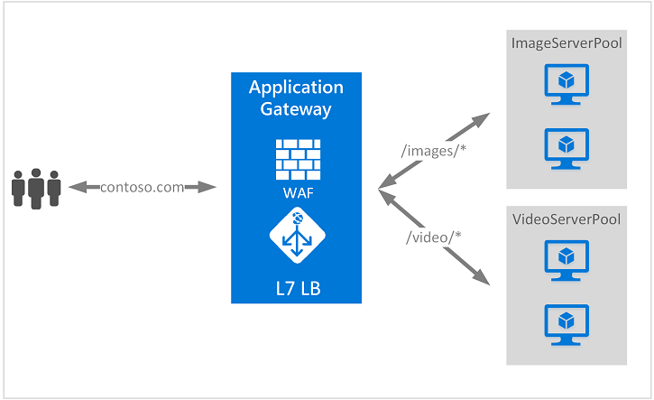
Azure Application Gateway

Slide 4
Pre-requisite of Application Gateway
A dedicated Subnet
To deploy application gateway, we need a dedicated subnet where no other resources should be deployed other than application gateway.
Public IP
This is not mandatory; however, the App gateways are more suitable load balancing service to route the traffic coming from internet to applications hosted inside azure.
Backend Pool
It is a group of actual resources which hosts the applications. Currently , VMs, VMSS, App Services and OnPrem Servers can be used as backend pool

Slide 5
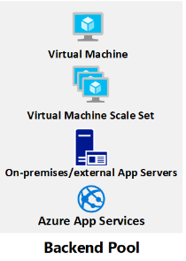


How Application Gateway works
Http/Backend Settings
Users/Clients
Frontend IP
Listener
Routing
Rule
Application
Gateway
Users/Clients

Slide 6
Key Points to remember
Application Gateway has 4 Tiers. Namely Standard, StandardV2, WAF, and WAFV2.
Standard V2 and WAF V2 provides the option for Autoscaling.
Application Gateways with a tier of Standard_v2 and WAF_v2 don’t support only private IP addresses as the frontend. Supported SKU tiers are standard and WAF.
WAF or Web Application Firewall provides extra layer of security to applications.
Application Gateway supports HTTP, HTTPS, HTTP/2 protocols
An application gateway supports only one public IP address.
Inside one Subnet, we can deploy more than One Application Gateway.

