Slide 1
Azure Fundamentals

Slide 2
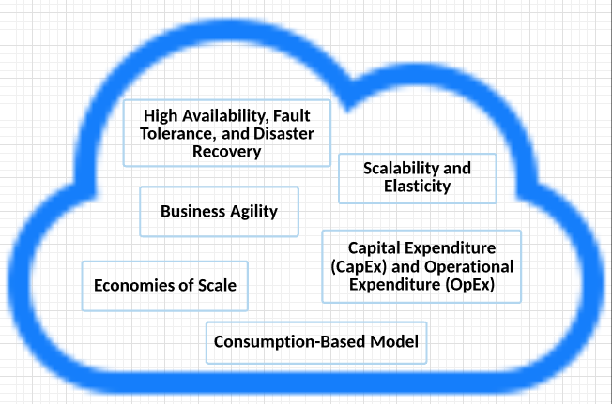
Cloud Concepts: Benefits and considerations of using Cloud Services

Slide 3
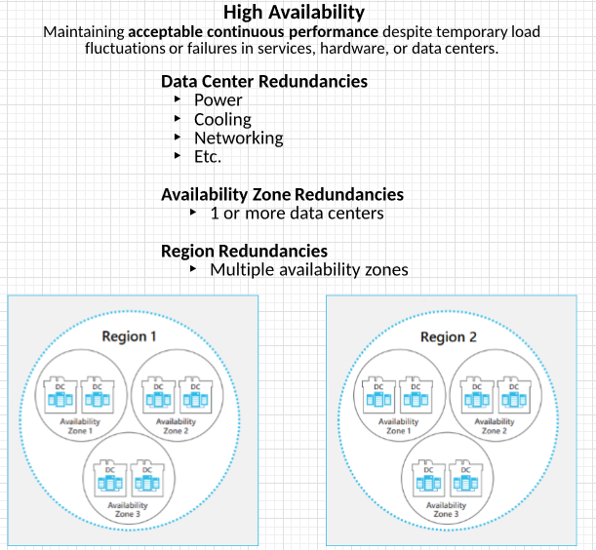
High availability, Fault tolerance, and Disaster Recovery
https://azure.microsoft.com/en-us/global-infrastructure/regions/

Slide 4
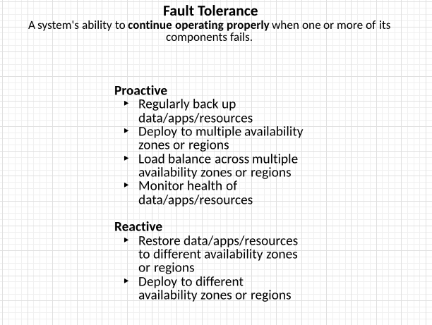
High availability, Fault tolerance, and Disaster Recovery

Slide 5
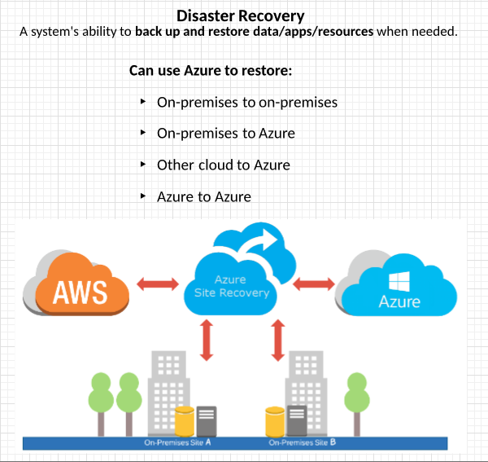
High availability, Fault tolerance, and Disaster Recovery
https://azure.microsoft.com/en-us/global-infrastructure/

Slide 6
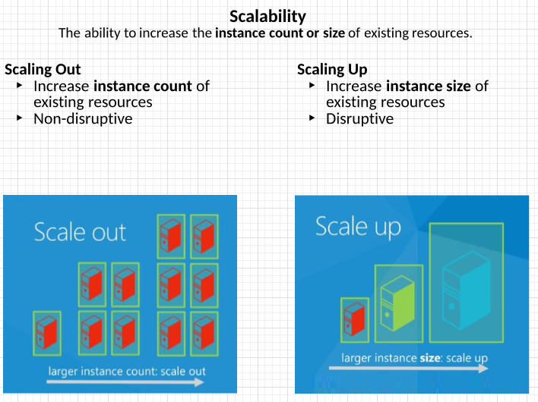
Scalability & Elasticity
https://docs.microsoft.com/en-us/azure/azure-monitor/platform/autoscale-overview
https://docs.microsoft.com/en-us/azure/architecture/best-practices/auto-scaling

Slide 7
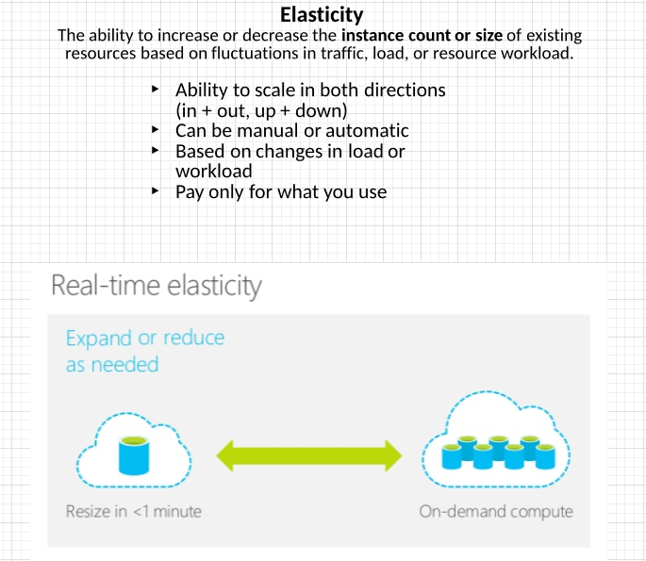
Scalability & Elasticity

Slide 8
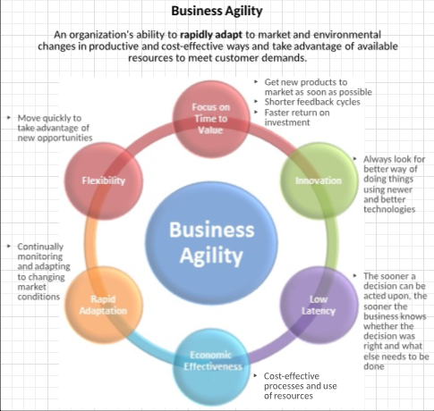
Business Agility

Slide 9
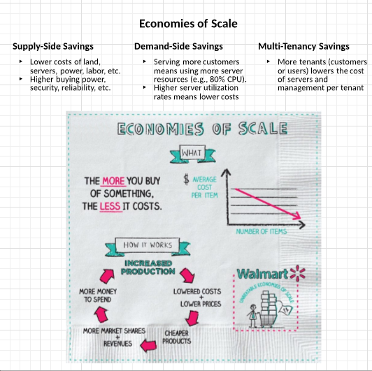
Economies of Scale
https://news.microsoft.com/download/archived/presskits/cloud/docs/The-Economics-of-the-Cloud.pdf

Slide 10
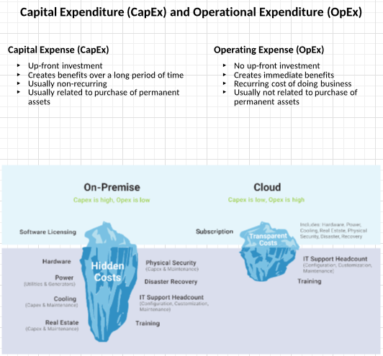
Capital expenditure versus Operational expenditures

Slide 11
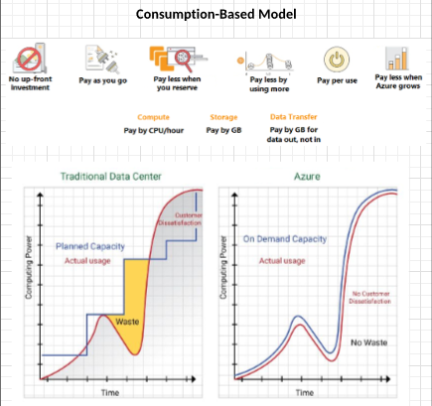
consumption based model

Slide 12
Cloud Concepts
IAAS - infrastructure as a service
PASS - platform as a service
SAAS - software as a service

Slide 13
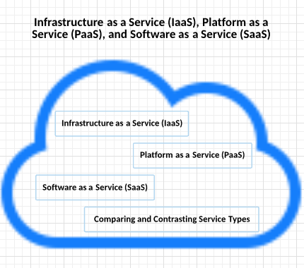
Cloud Concepts: Overview: IAAS, PAAS, SAAS

Slide 14
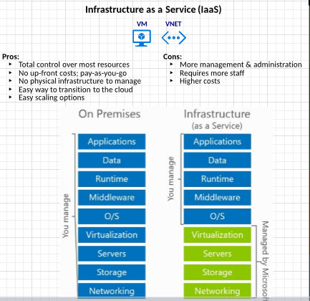
IaaS
https://azure.microsoft.com/en-us/overview/what-is-iaas/

Slide 15
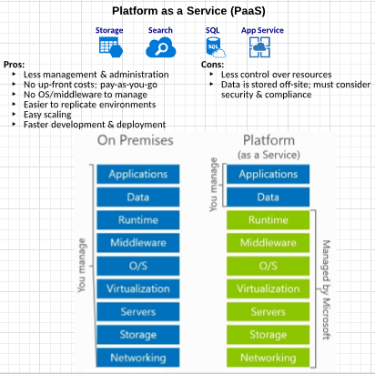
PaaS
https://azure.microsoft.com/en-us/overview/what-is-paas/

Slide 16
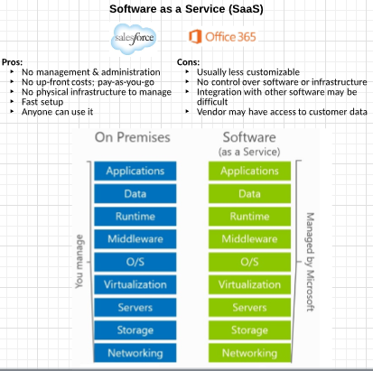
SaaS
https://azure.microsoft.com/en-us/overview/what-is-saas

Slide 17
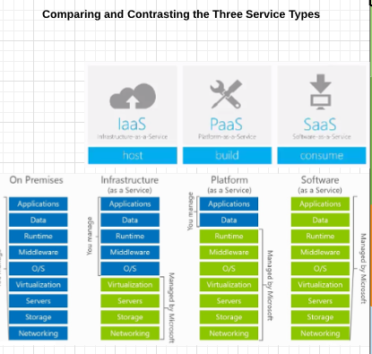
Comparing and Contrasting IaaS as vs PaaS vs SaaS.

Slide 18
Azure Services
The overall architecture of Azure

Slide 19
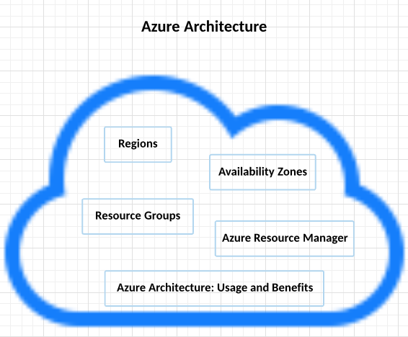
Azure Architecture

Slide 20
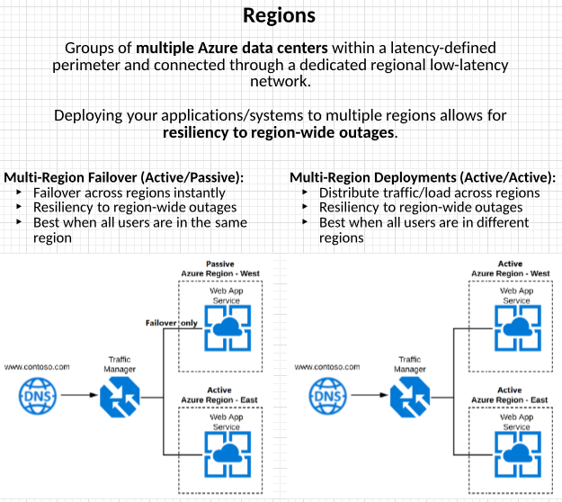
Azure Architecture: Regions

Slide 21
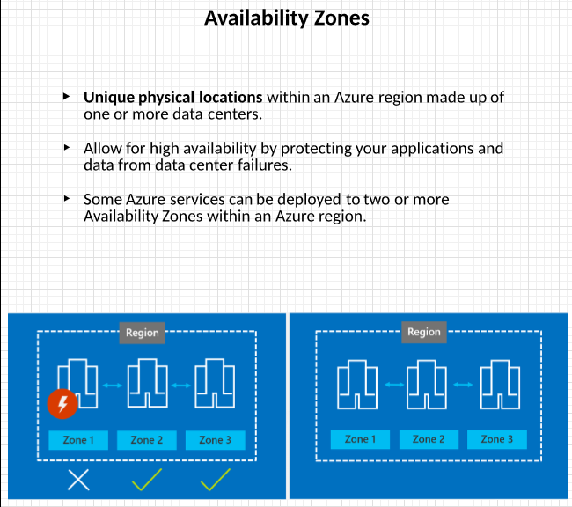
Azure Architecture: Availability Zones

Slide 22
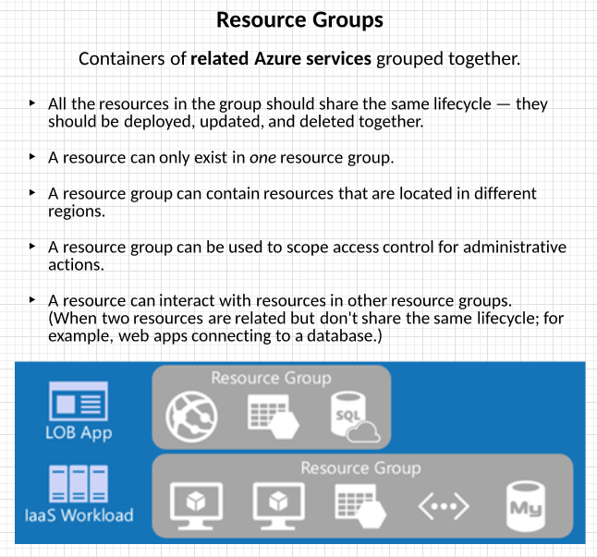
Azure Architecture: Resource Group

Slide 23
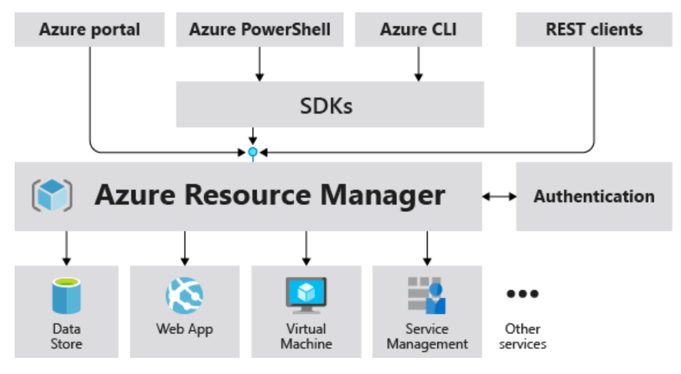
Azure Architecture: Azure Resource Manager – Part1

Slide 24
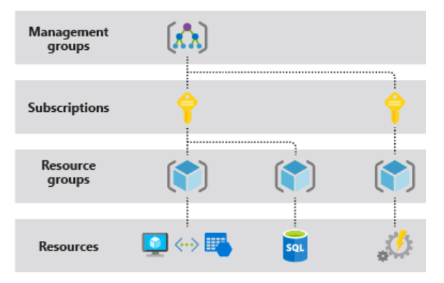
Azure Architecture: Azure Resource Manager – Part 2
Scope

Slide 25
Azure Pricing and Support: Azure Support Options
Azure Support Plans: https://azure.microsoft.com/en-us/support/plans/
Azure Support Ticket How-To: https://docs.microsoft.com/en-us/azure/azure-supportability/how-to-create-azure-support-request
Additional Azure Support Channels
Azure Support FAQs: https://azure.microsoft.com/en-us/support/faq/
MSDN Forums: https://social.msdn.microsoft.com/Forums/en-US/home
Stack Overflow Forums: https://stackoverflow.com/questions/tagged/azure
Azure Knowledge Center: https://azure.microsoft.com/en-us/resources/knowledge-center/

Slide 26
The END

