Slide 1


Data Governance @ SneakerPark
Prepared by: Leandro Roncoroni
Submitted on: May 6, 2025

Slide 2
Background
SneakerPark is an online shoe reseller that allows people to buy and sell used and new shoes. Buyers can bid for shoes or buy them outright, and sellers can set a price or sell to the highest bidder.
Each buyer and seller must have an active account in order to sell, bid, or purchase sneakers using SneakerPark’s website.
SneakerPark authenticates the shoes before shipping them to the buyer, so before listing an item, the seller must ship it to SneakerPark’s warehouse. Upon receipt, SneakerPark assigns an item number to each pair of sneakers and notifies the seller that they are now free to list their item. If the item is not listed within 45 days, SneakerPark returns it to the seller and sends an invoice to the seller for the shipping cost.
If the item is found to be inauthentic or in an unacceptable condition, it is also returned back to the seller in a similar fashion.
When the item sells, the buyer’s account is credited with the purchase price minus the SneakerPark service fee and shipping fees to deliver the item to the buyer.
Currently, SneakerPark only supports sales within the United States.

Slide 3
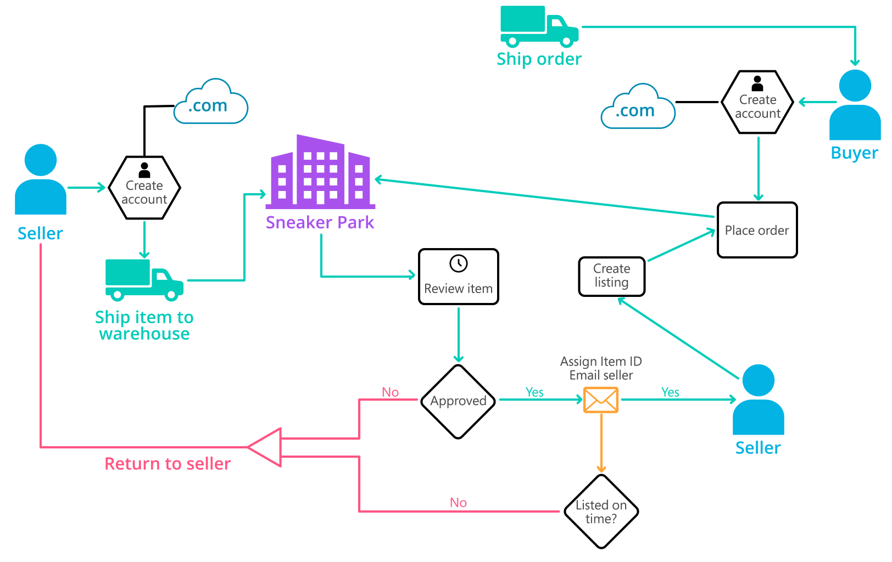
Background (cont’d)
Below you can see a diagram that will hopefully help you visualize some of SneakerPark's business processes. Keep in mind that it does not capture ALL processes and every nuance, but simply serves as another artifact to use in your project.

Slide 4
Step 1
Enterprise Data Catalog Part 1: Enterprise Data Model

Slide 5
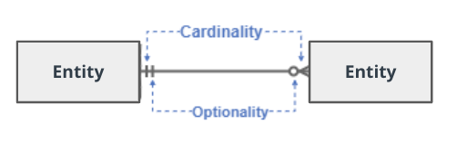
Create a conceptual data model that will provide SneakerPark with a holistic view of its data systems and help you grasp the organization's important entities and relationships, which will be instrumental as you move further in the project. You can use Lucidchart or any other diagramming tool of your choice, but please use the Crow’s Foot/IE Notation and please be sure to indicate both cardinality (the type of a relationship such as 1:N or N:N) and optionality (whether the relationship is optional or mandatory).

Slide 6
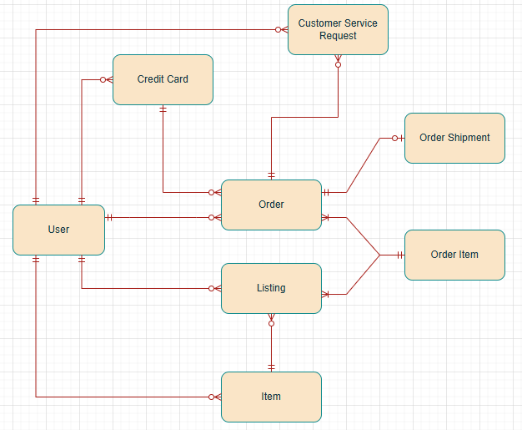
Replace the example below with your own solutions (obviously feel free to take more space):

Slide 7
Step 2
Enterprise Data Catalog Part 2: Metadata

Slide 8
Create the first version of the Metadata Catalog by documenting the metadata from all systems in the "Data Dictionary" and the “Enterprise Data Catalog” tabs of the provided Sheets template.
Please note that you are required to fill out all fields in both tabs.

Slide 9
Step 3
Data Quality
Part 1: Profiling and Cleansing

Slide 10
Profile the data to identify at least 3 data quality issues you see in the data. Also provide at least 1 data quality issue that you haven’t yet seen in the data, but can foresee occurring in the future. Based on the issues you’ve identified, come up with the data quality rule for each data quality issue, including for the one that you foresee.
Make sure you fill out all columns in the "Data Quality Issues" tab with your answers in the provided Sheets template.

Slide 11
Step 4
Data Quality
Part 2: Monitoring

Slide 12
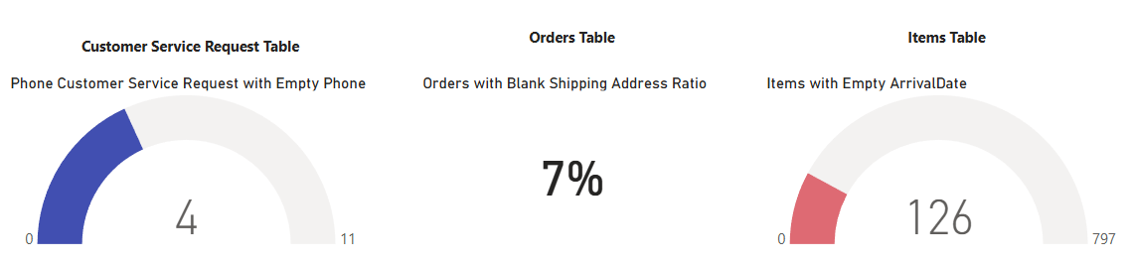
Using the metrics you've created in the last step, please create a mock-up of a data quality monitoring dashboard that will be used to monitor the data to ensure compliance with your data quality rules.
Please make sure to label your metrics clearly on your mock-up.

Slide 13
Step 5
Master Data Management
Part 1: MDM Architecture

Slide 14
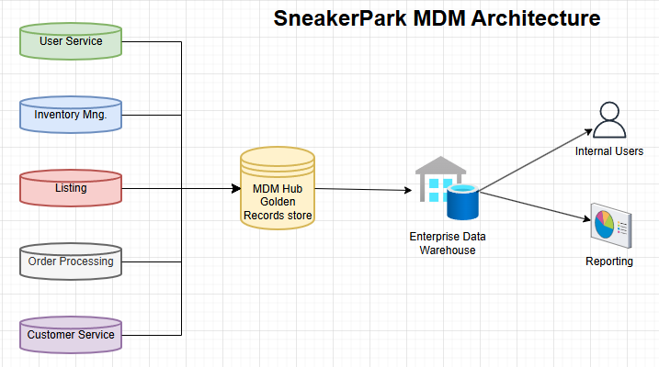
Based on what you’ve read about SneakerPark’s systems and business model, sketch out a proposed MDM implementation architecture, and write a detailed explanation of why you chose this specific approach.
Tip: Think about how your plan and its implementation might affect existing systems.

Slide 15
Explanation:
My proposal is to go with a Consolidated/Analytical MDM.
It is not intrusive to the existing transactional systems, which are five different in the company, being User Service, Order Processing Service, and Customer Service Application the most critical ones.
The cost is medium, so it is suitable for starting implementing master data management practices.
It stablishes a MDM Hub to store the Golden records, while keeping the operational systems running. Having Golden records will enable a consistent and single view of entities across the company and enable reporting Enterprise-wide.
There are people knowledgable on the Business that could help create and maintain the Golden records. Addionally as they are incorporataning a new person to handle the data platform, targeting a medium maturity solution is a good fit.

Slide 16
Step 6
Master Data Management
Part 2: Master Record

Slide 17
In this step, you will define a set of matching rules that will be used by the SneakerPark's MDM Hub to match item and customer entities between the company's different systems.
Please come up with 4 rules - 2 for Items and 2 for Customers and list them below.
Items
Match SellerID with UserID from usr.users table.
Match ItemID with ProductID from li.listings table.
Customers
Match UserID from usr.users table with UserID from cs.CustomerServiceRequests.
Match UserID from usr.users with BuyerID from op.Orders table.
Match FirstName from usr.users table with FirstName from cs.CustomerServiceRequests.
Match LastName from usr.users table with LastName from cs.CustomerServiceRequests.

Slide 18
Step 7
Data Governance:
Roles and Responsibilities

Slide 19
Write 1-2 paragraphs discussing what data governance roles and responsibilities will be necessary to oversee this new Data Management initiative. Please be sure to discuss the responsibilities in the context of at least 3 different aspects of Data Governance (such as Data Quality Management, Metadata Management, MDM, etc). Based on what you know, do SneakerPark's current employees have the necessary skills for these roles or should the company make new hires?
To oversee the new Data Management initiative at SneakerPark, several key data governance roles and responsibilities will be necessary.
SME from the Business to define data quality rules to ensure data is complete, accurate and consistent with company expectations.
Data stewards, responsible to review and approve metadata keeping the metadata governed and managed to be usable and consumable for the company.
Data Architect, to lead the Enterprise Data Management Program and build the MDM Hub.
Based on the current employees at SneakerPark, new hires will be required with experience in Data Management. Jake has IT and DBA experience that contributes with technical and operational processes. Jessica, a senior business analyst and subject-matter expert on SneakerPark's data, has been instrumental in diagnosing data issues but may be overwhelmed by the additional task of metadata management and data governance. Therefore, it might be beneficial to hire new people with specialized skills in data governance to effectively oversee the new Data Management initiative.

Slide 20
Standout Suggestions

Slide 21
Create a Business Glossary for SneakerPark and define common terms such as Item, Buyer, etc. Think and discuss how SneakerPark can improve on the consistency of the terms that its systems currently use. (You can use the “Business Glossary” tab of the same Sheets template you’ve been using for the other parts of this project to get you started.)
Document SneakerPark’s current naming conventions. Can you think of any improvements? (You can use the “Standard Naming Conventions” tab of the same Sheets template you’ve been using for the other parts of this project to get you started.) Some examples of Naming Conventions include;
Do not use spaces or special characters.
Use only LOWERCASE.
All identifier fields should end in “_id”.
Avoid acronyms and abbreviations.
Write SQL scripts for the matching rules that you’ve created in Step 6.

