Slide 1
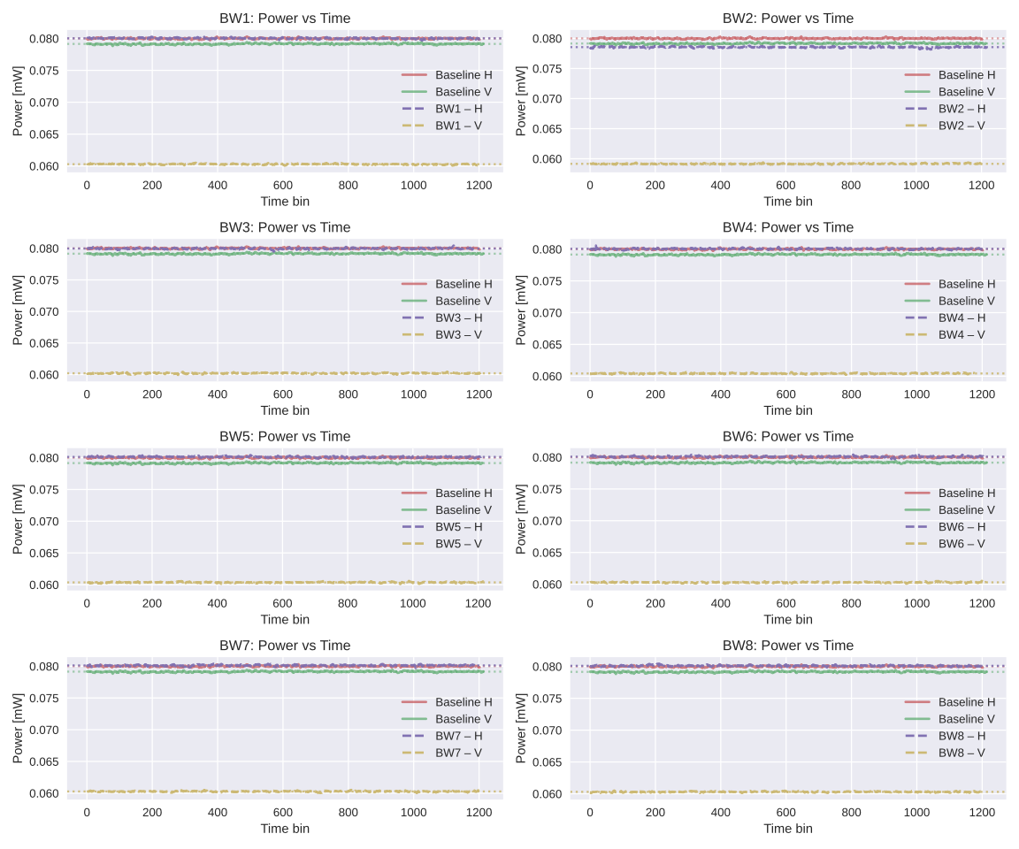
Transmission for each Pol for each BW:
BW1:
H-Pol: $$100.0\%± 0.2\%$$
V-Pol: $$76.2\%± 0.1\%$$
BW2:
H-Pol: $$98.2\%± 0.2\%$$
V-Pol: $$74.7\%± 0.1\%$$
BW3:
H-Pol: $$100.0\%± 0.2\%$$
V-Pol: $$76.1\%± 0.1\%$$
BW4:
H-Pol: $$100.2\%± 0.2\%$$
V-Pol: $$76.3\%± 0.1\%$$
BW5:
H-Pol: $$100.1\%± 0.2\%$$
V-Pol: $$76.3\%± 0.1\%$$
BW6:
H-Pol: $$100.1\%± 0.2\%$$
V-Pol: $$76.2\%± 0.1\%$$
BW7:
H-Pol: $$100.2\%± 0.2\%$$
V-Pol: $$76.1\%± 0.1\%$$
BW8:
H-Pol: $$100.1\%± 0.2\%$$
V-Pol: $$76.2\%± 0.1\%$$

Slide 2
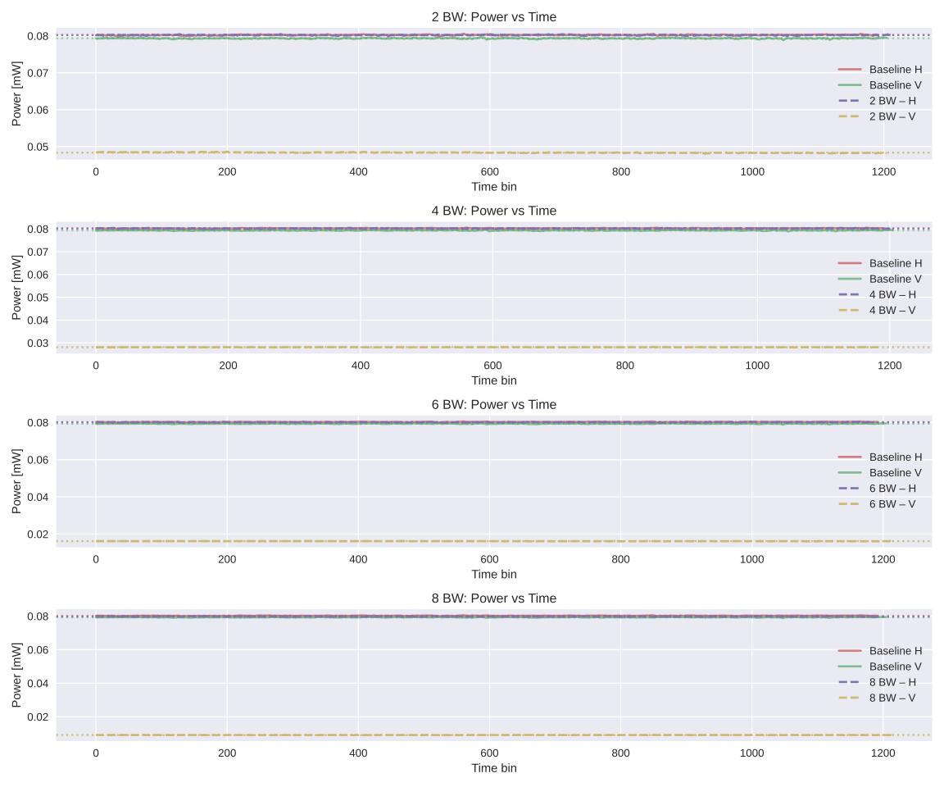
Transmission for each Pol for each
configuration:
2 Brewster Windows:
H-Pol: $$100.0\%± 0.2\%$$
V-Pol: $$61.0± 0.1\%$$
4 Brewster Windows:
H-Pol: $$99.9± 0.2\%$$
V-Pol: $$35.4± 0.1\%$$
6 Brewster Windows:
H-Pol: $$99.8± 0.2\%$$
V-Pol: $$20.4\%± 0.0\%$$
8 Brewster Windows:
H-Pol: $$99.4± 0.2\%$$
V-Pol: $$11.5\%± 0.0\%$$

