Slide 1
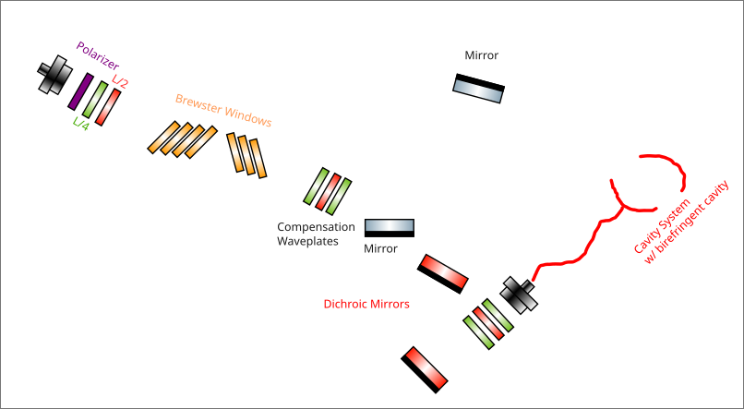

Slide 2
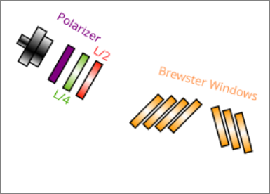
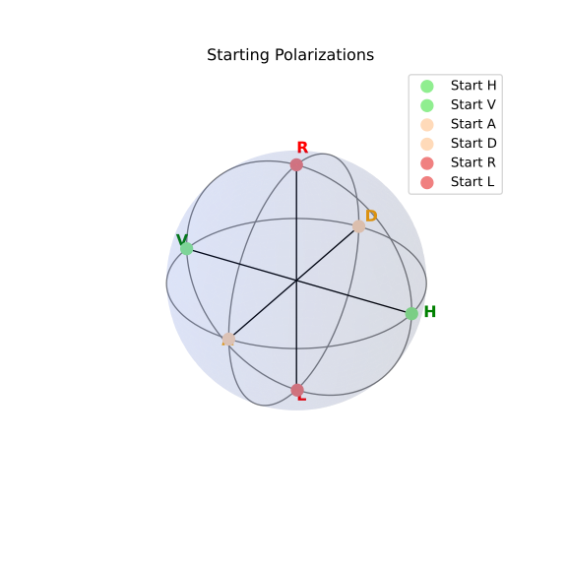

Slide 3
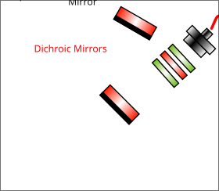
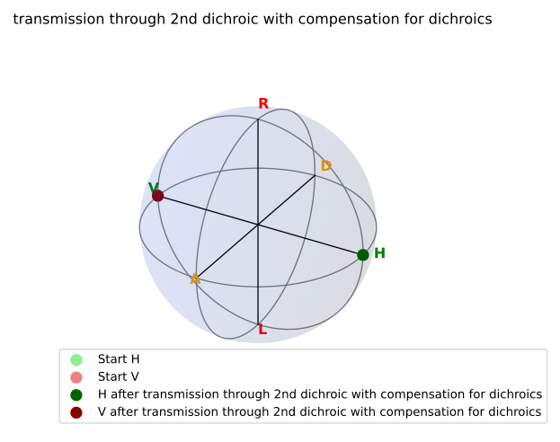

Slide 4
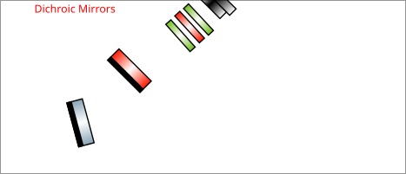
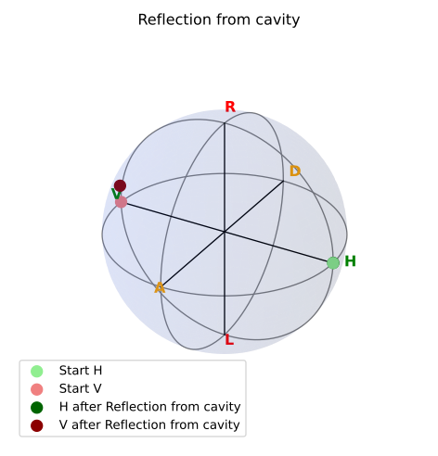

Slide 5
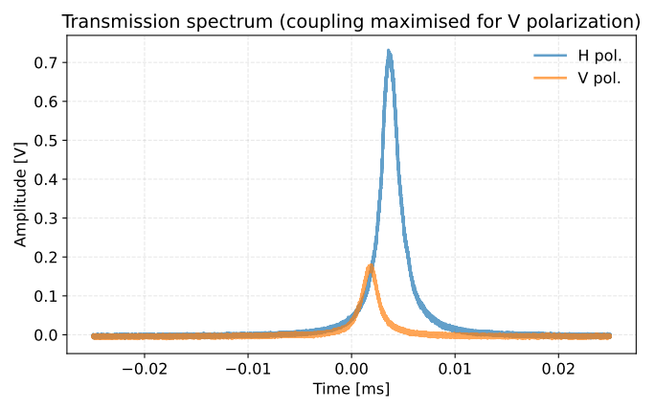
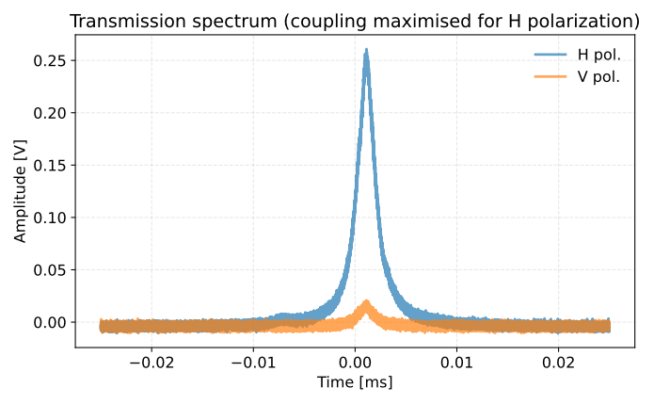
Light towards cavity:
for H : 200.7 +/- 0.4 nW
for V : 25.67 +/- 0.04 nW
Light reflected from cavity:
for H : 96.61 +/- 0.15 nW (48.13 %)
for V : 8.00 +/- 0.01 nW (31.16 %)
Light towards cavity:
for H : 206.5 +/- 0.5 nW
for V : 55.47 +/- 0.13 nW
Light reflected from cavity:
for H : 66.25 +/- 0.21 nW (32.08 %)
for V : 16.57 +/- 0.02 nW (29.87 %)

Slide 6
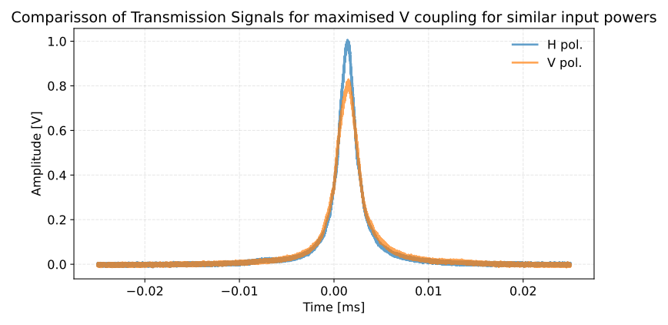
~ 20%

