Slide 1
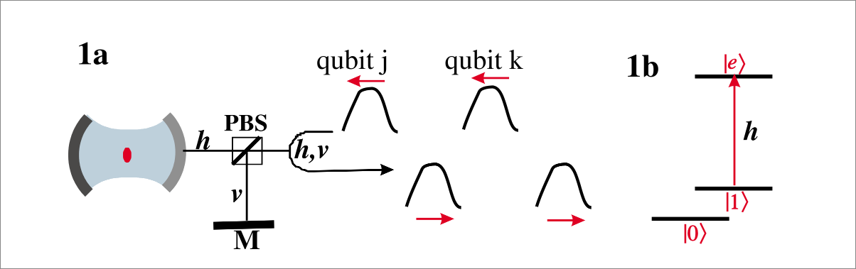
Leart Lab Report 22.10.2025
Duan, Kimble 2004

Slide 2


Theoretical Setup:
KC
KC- V
KC-

Slide 3

Possible Scenarios:
Atom in 0 and photon is π polarized:
  → Photon enters cavity, doesn’t interact with atom, exits cavity with π phase shift
Atom in 1 and photon is π polarized:
  → Photon doesn’t enter cavity due to normal mode splitting, gets reflected without π phase shift
Atom in 0 or 1 and photon is V polarized:
  → V mode of KC is detuned, photon gets reflected without π phase shift

Slide 4
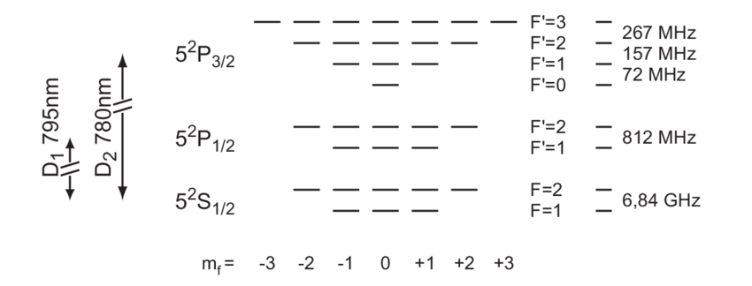

Vrana 2004
2-3’@ mf = 0 | 2-2’ @ mf =±1 | 2-1’ @ mf = 0

Slide 5
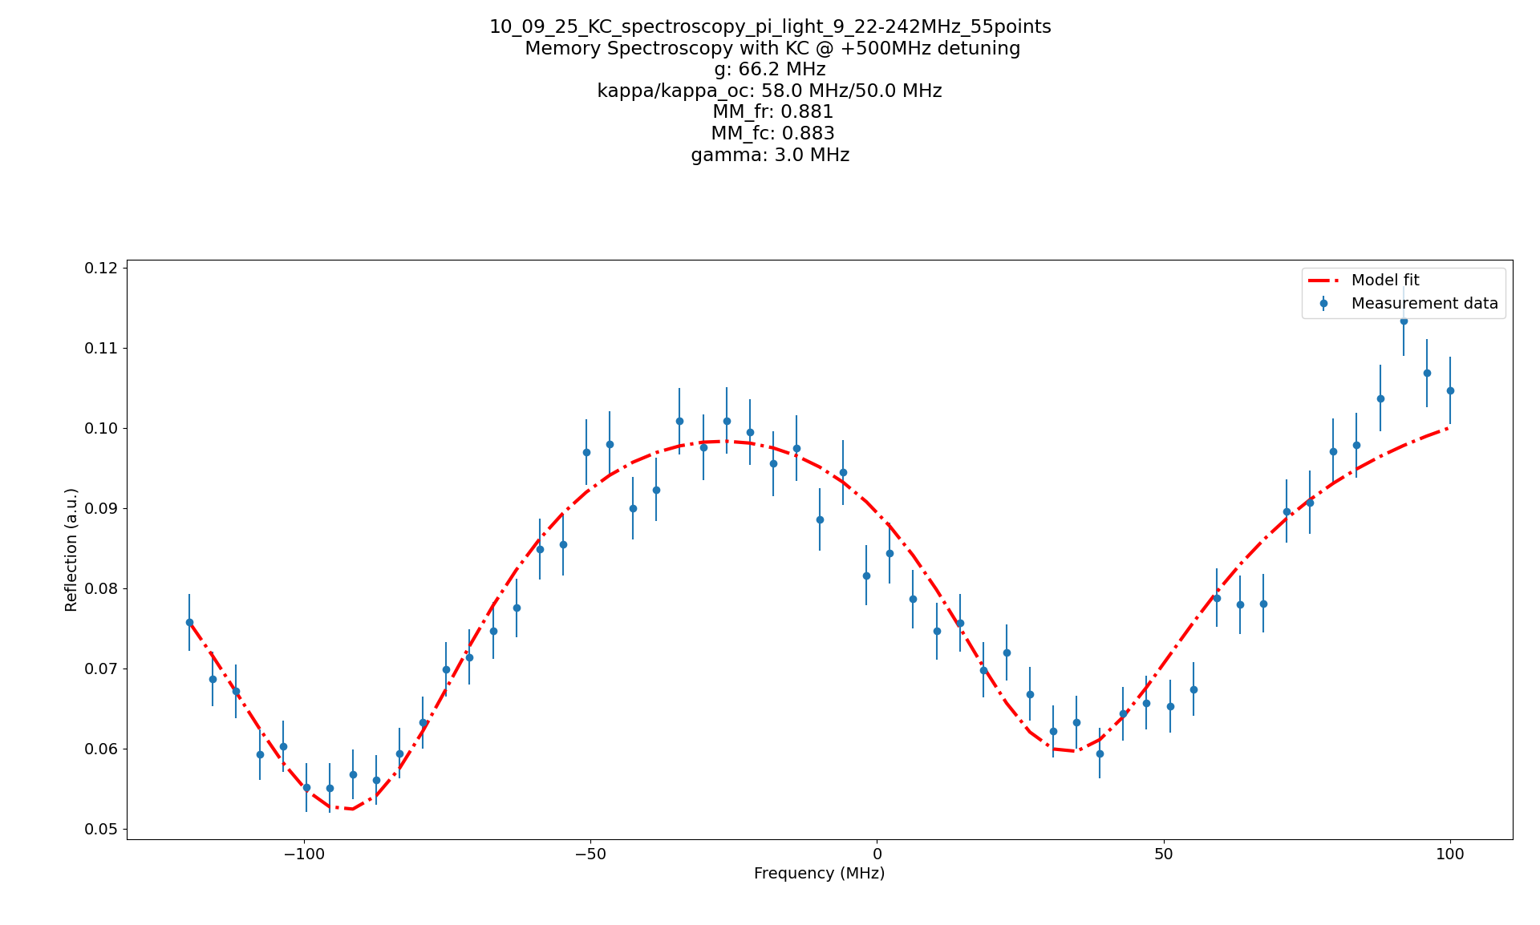

Normal Mode Spectroscopy @ 2-2’
g=66.2MHz

Slide 6
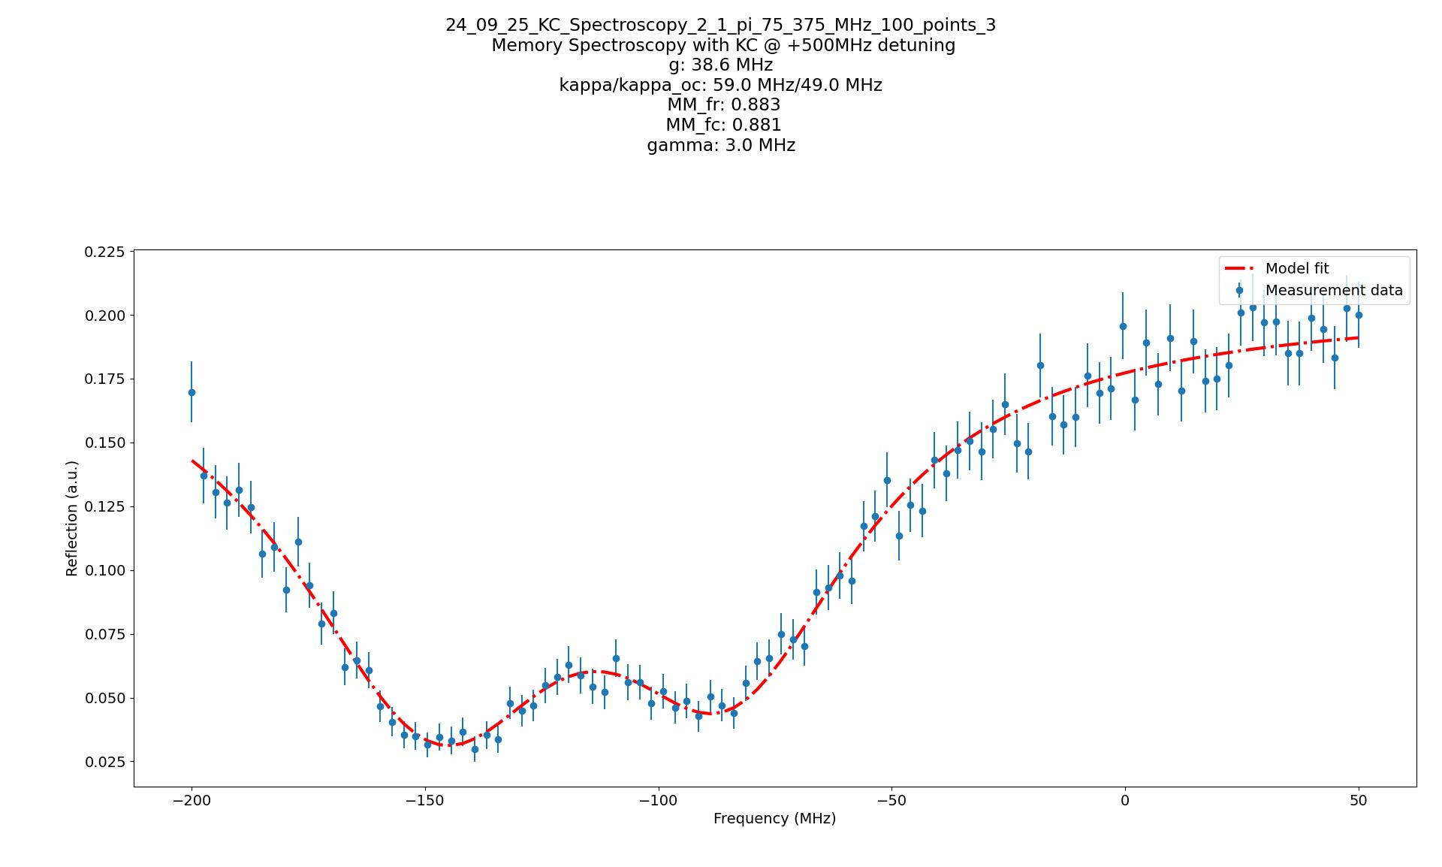

Normal Mode Spectroscopy @ 2-1’
g=38.6MHz

Slide 7
Steps moving forward:
Insert Brewster windows to reduce amplitude of V reflection and allow for similar amplitudes between V and π
→ Run the experiment

