Slide 1
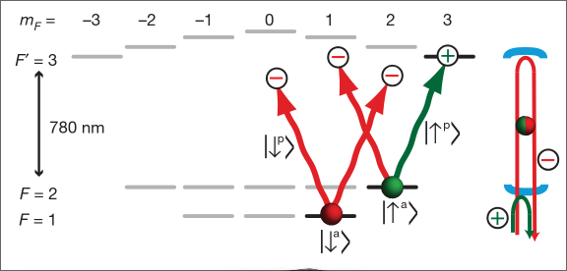
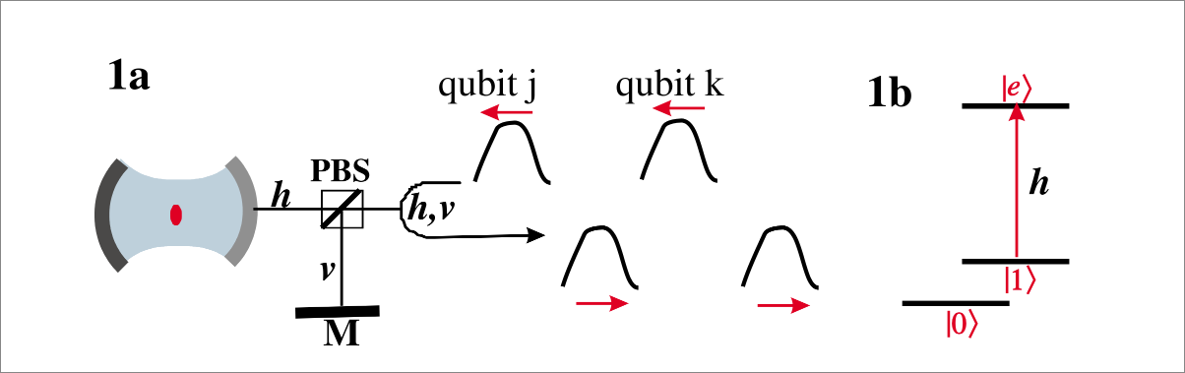


An atom-photon quantum gate using an atomic clock qubit and a birrefringent cavity
Duan, Kimble 2004
Reiserer, Kalb, Rempe, Ritter 2014
}
KC

Slide 2

Brekenfeld 2023

Slide 3
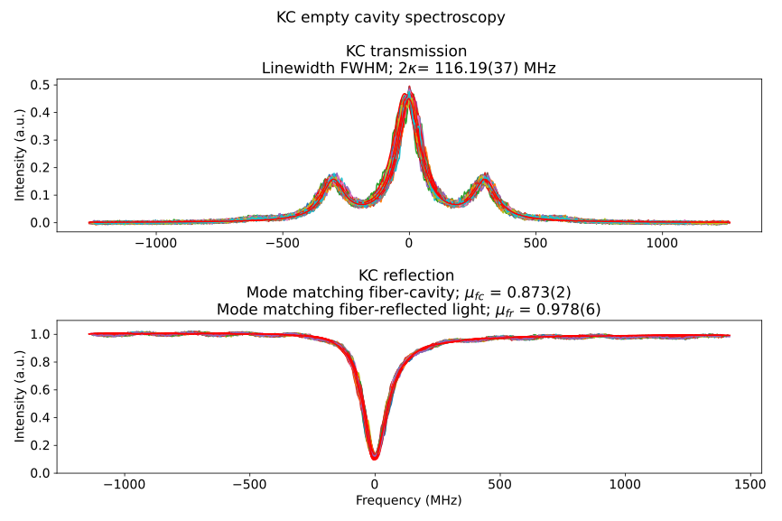
Brekenfeld 2023

Slide 4
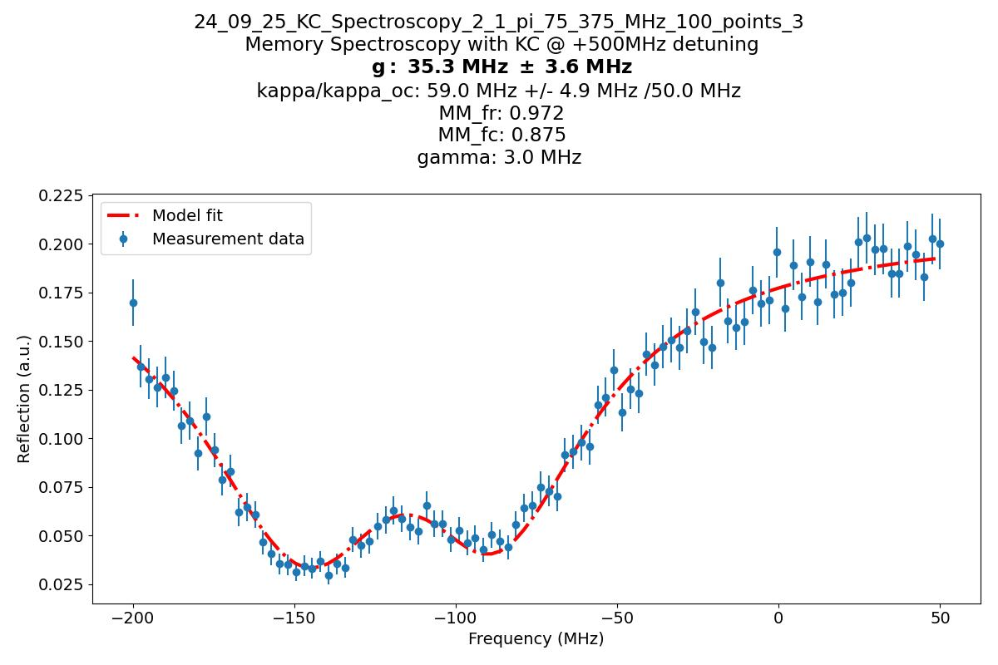
Brekenfeld 2023

Slide 5
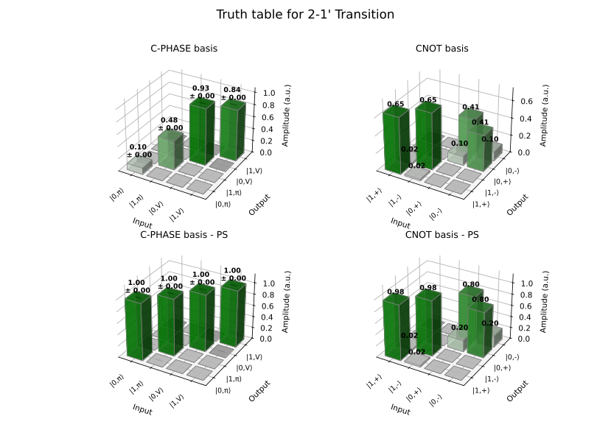

Slide 6
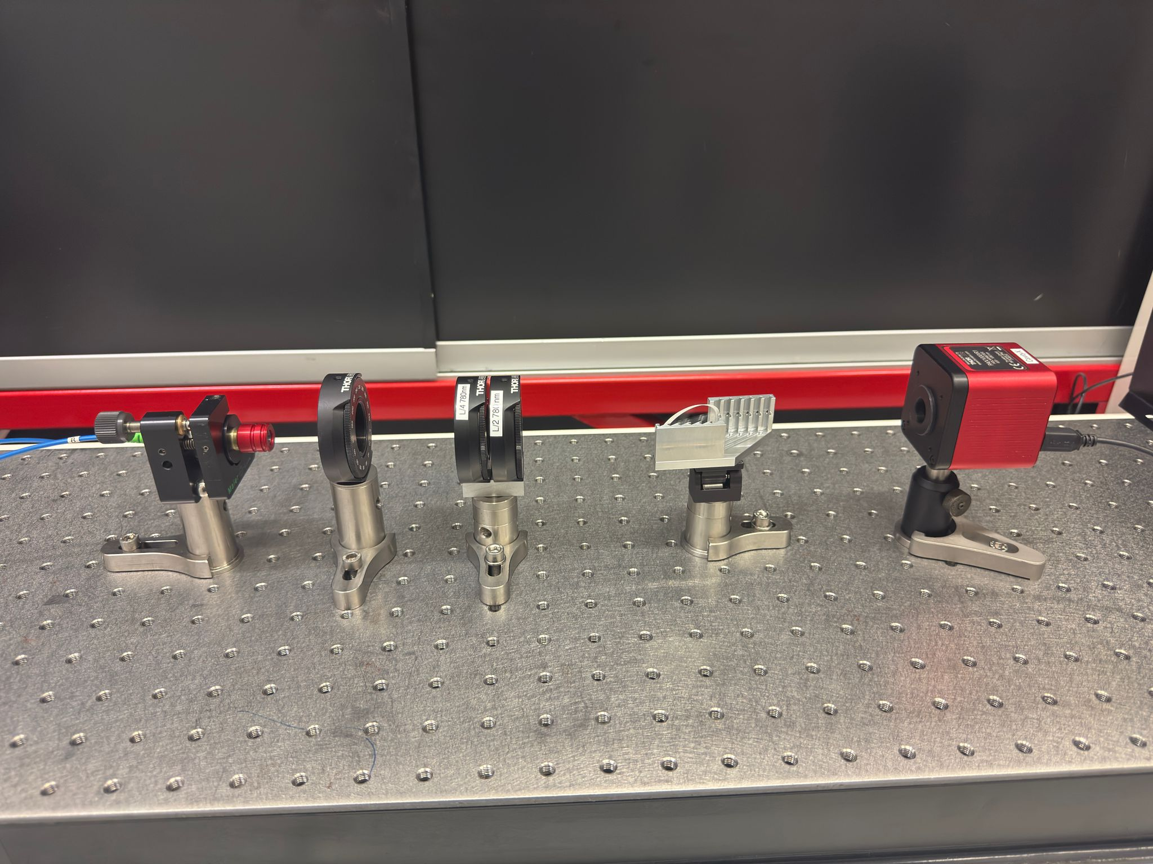
4 Brewster Windows:
BW 1:
  Transmittance V - Pol = 77.73(1)%
  Transmittance π − pol. = 98.98(1)%
BW 2:
  Transmittance V - Pol = 77.68(1)%
  Transmittance π − pol. = 98.98(1)%
BW 3:
  Transmittance V - Pol = 77.44(1)%
  Transmittance π − pol. = 98.85(1)%
BW 4:
  Transmittance V - Pol = 77.31(1)%
  Transmittance π − pol. = 98.95(1)%

Slide 7
