Slide 1
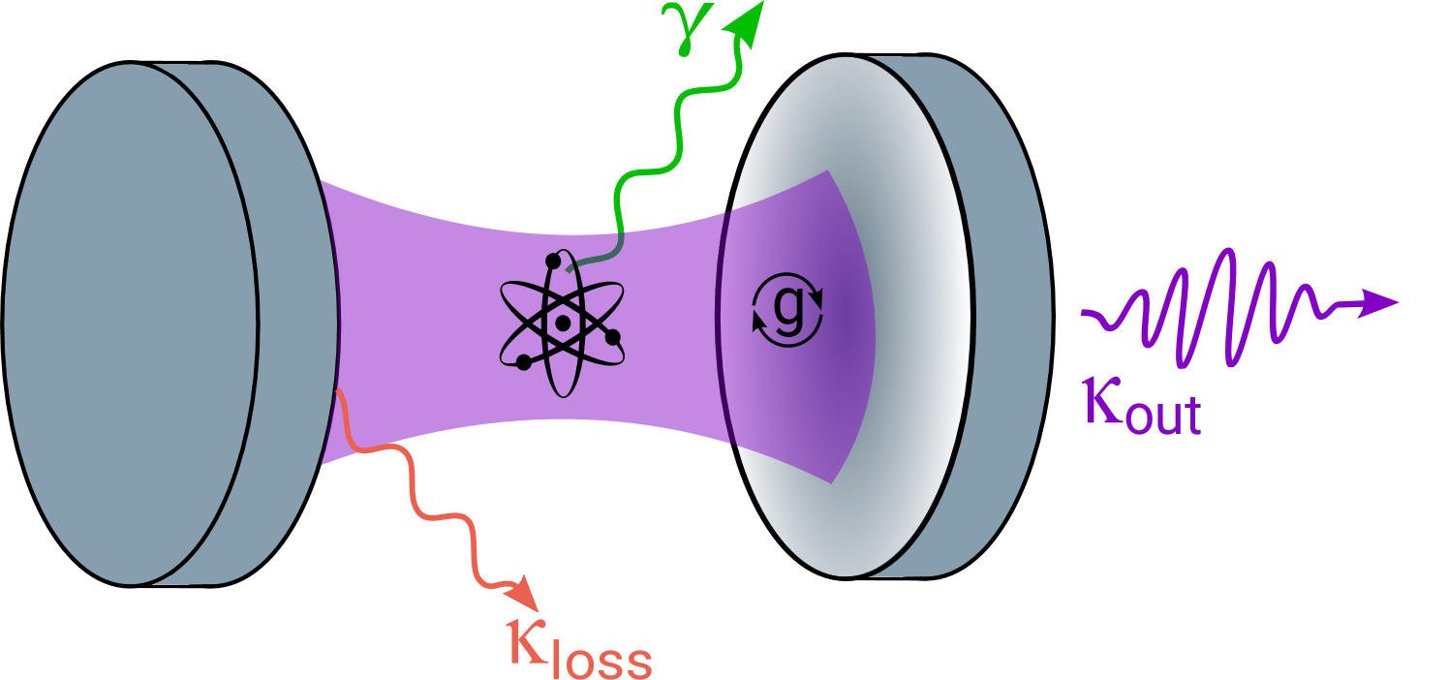
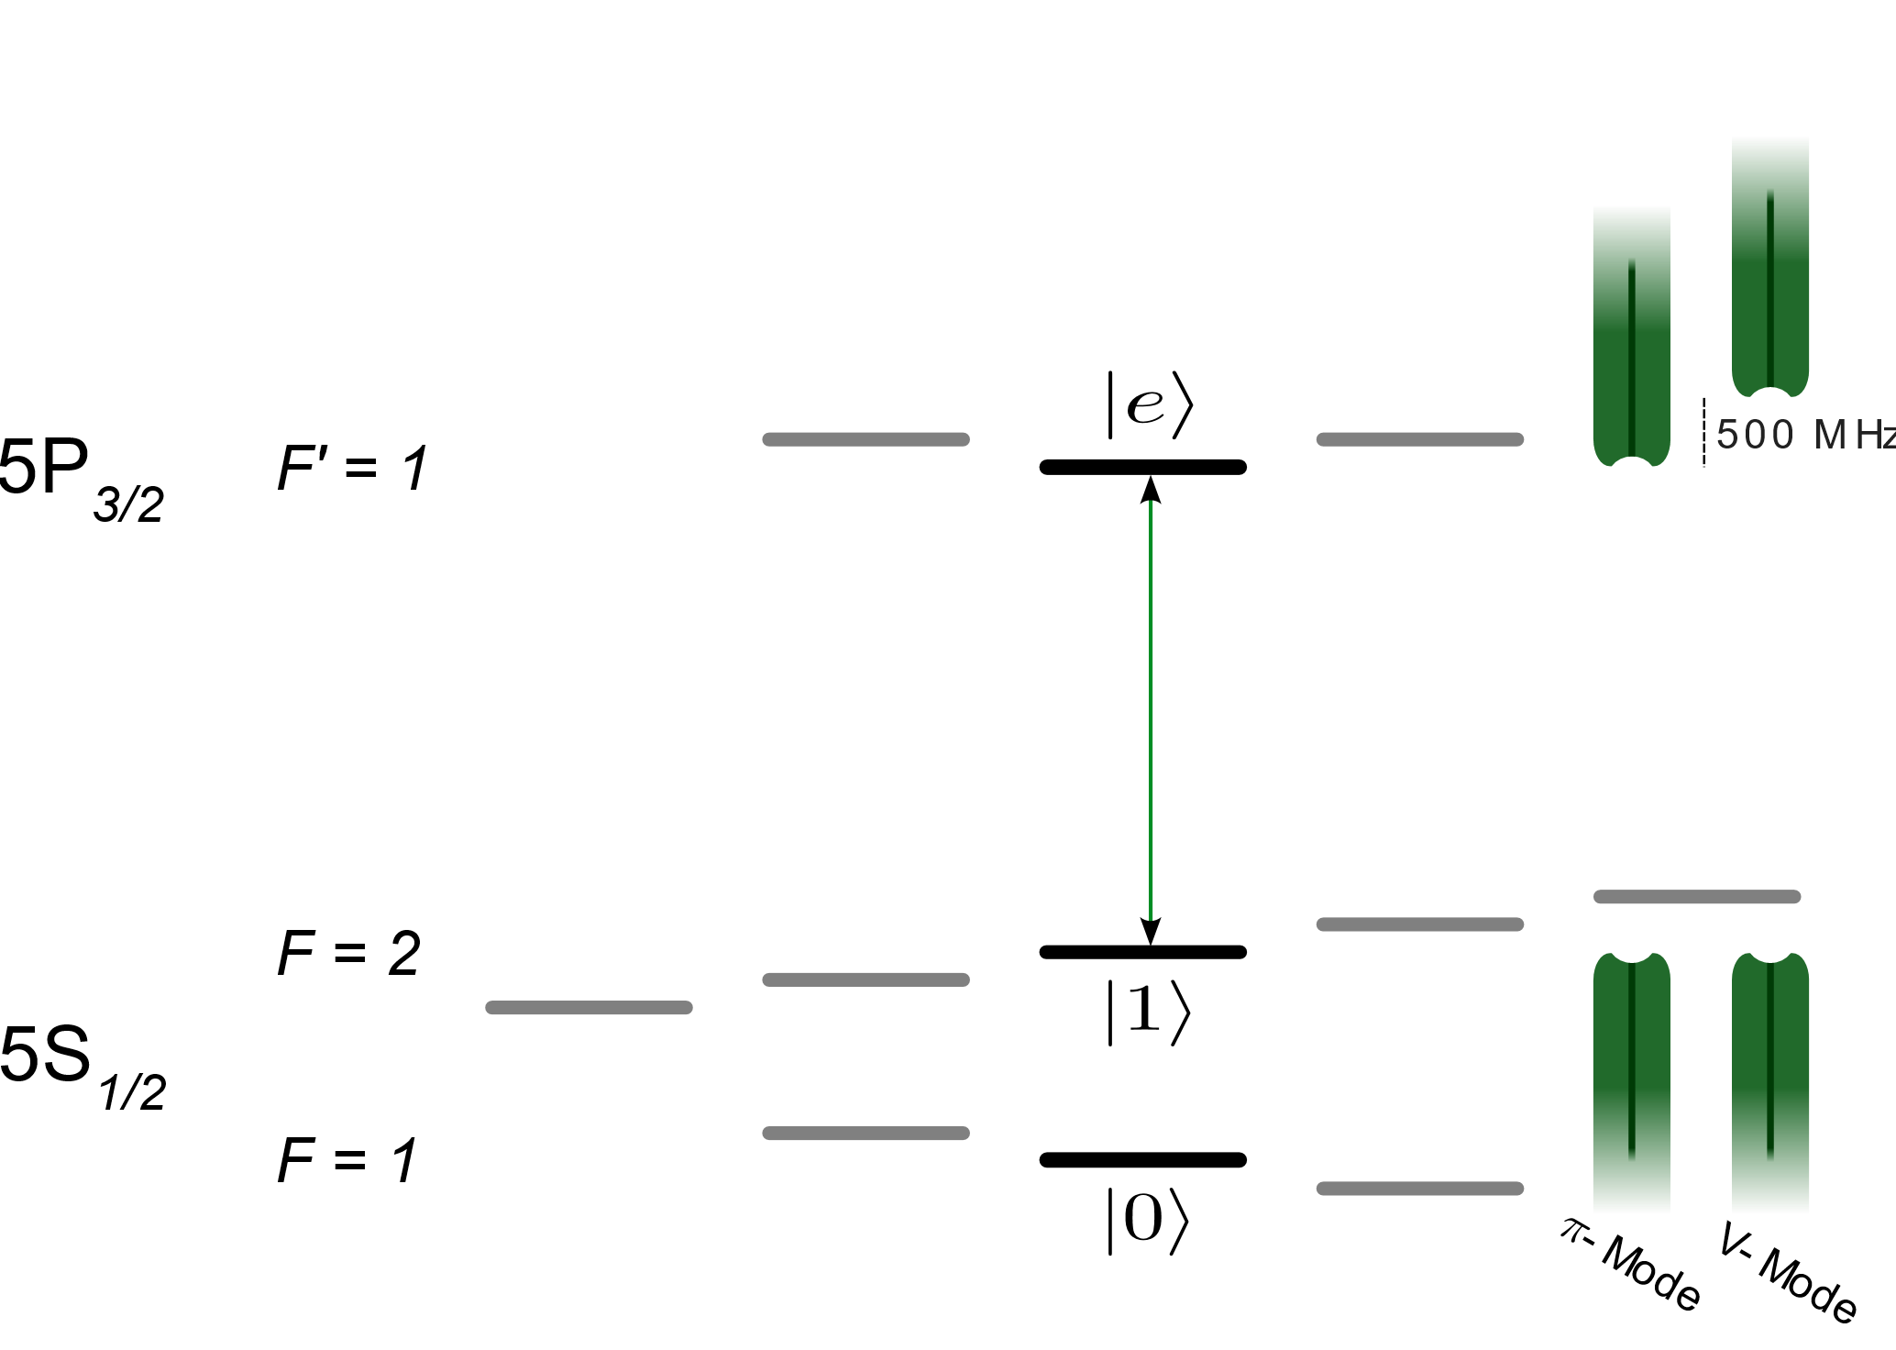
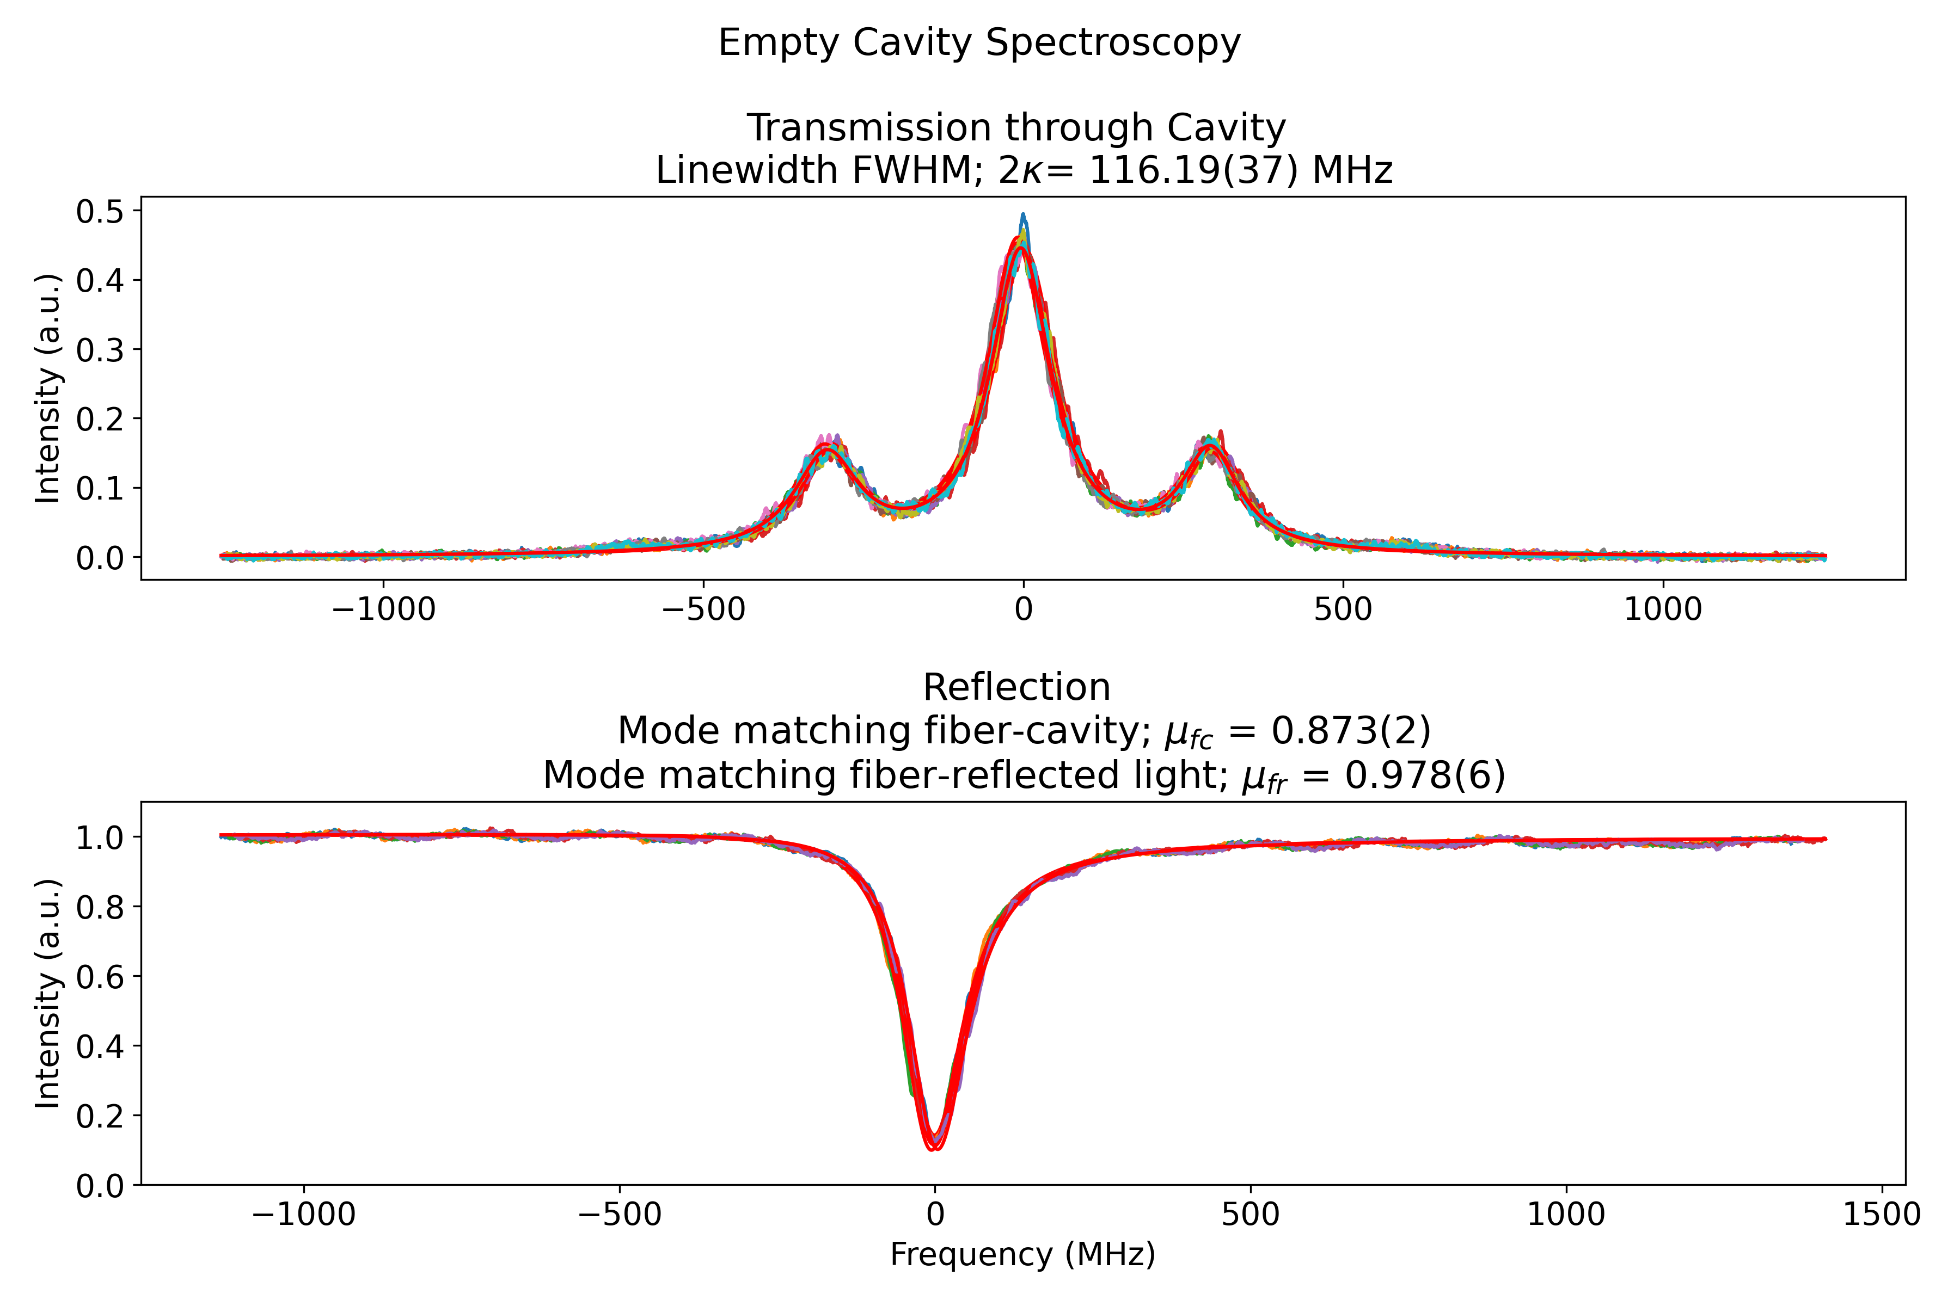
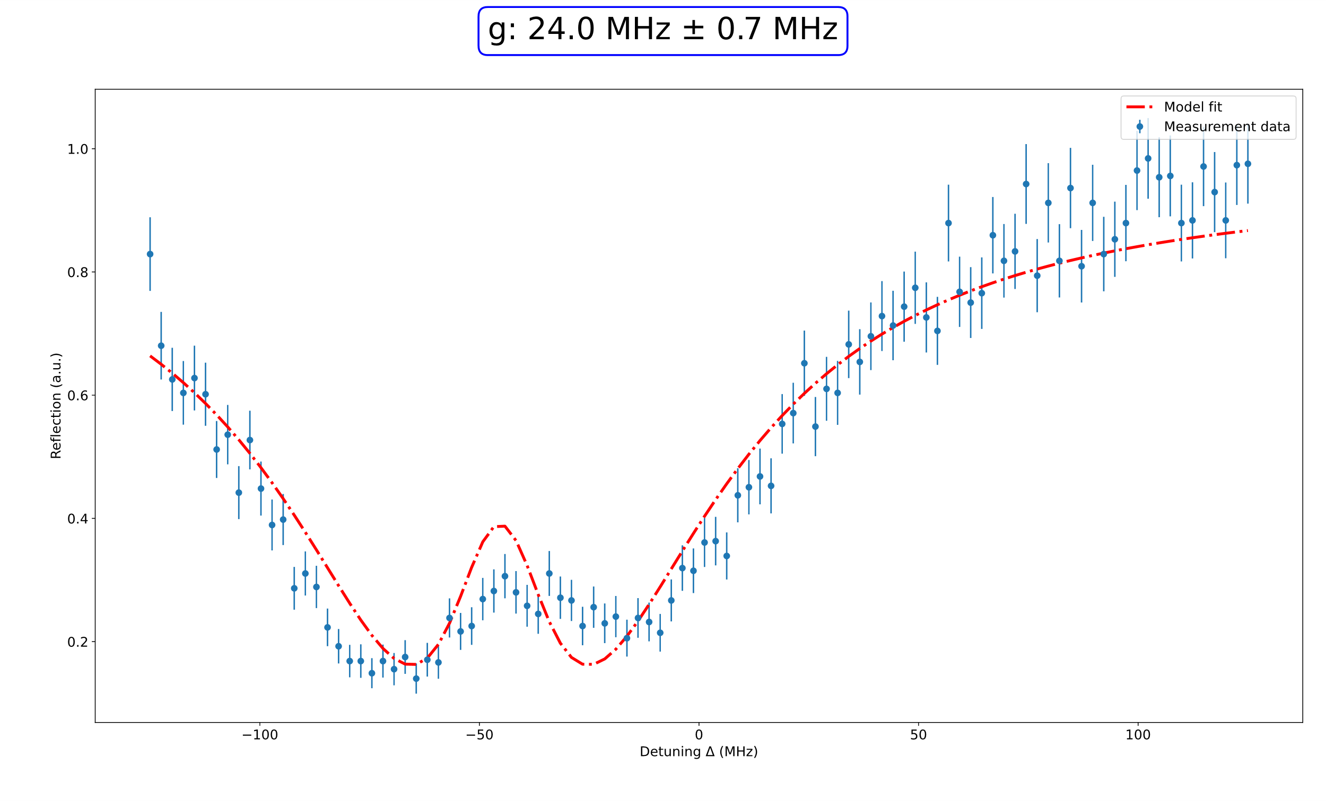
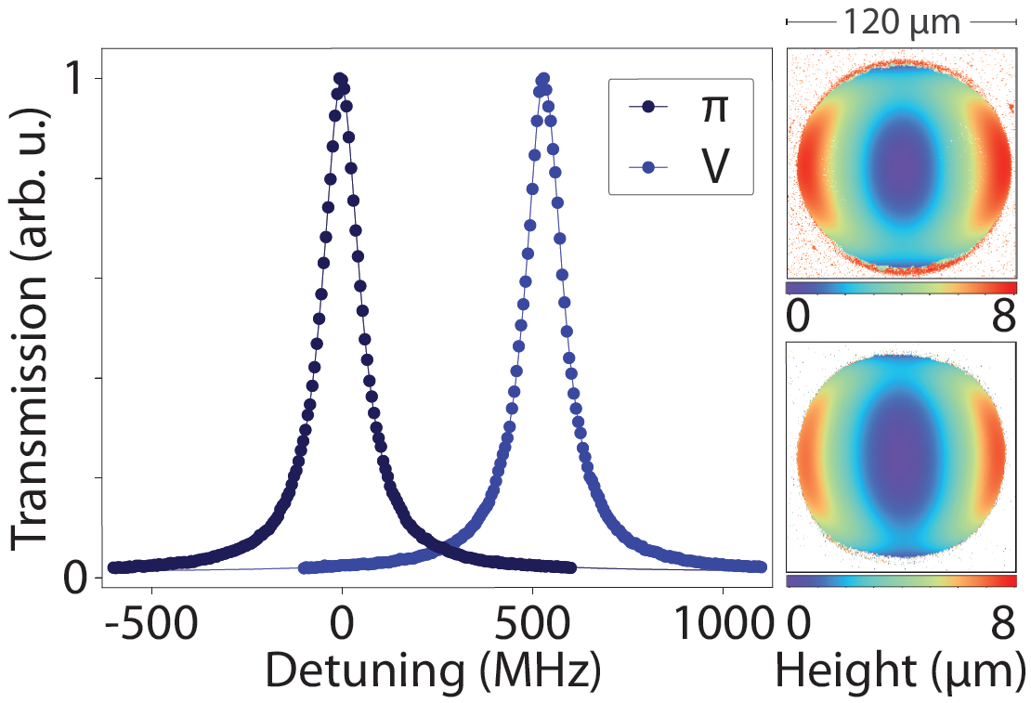
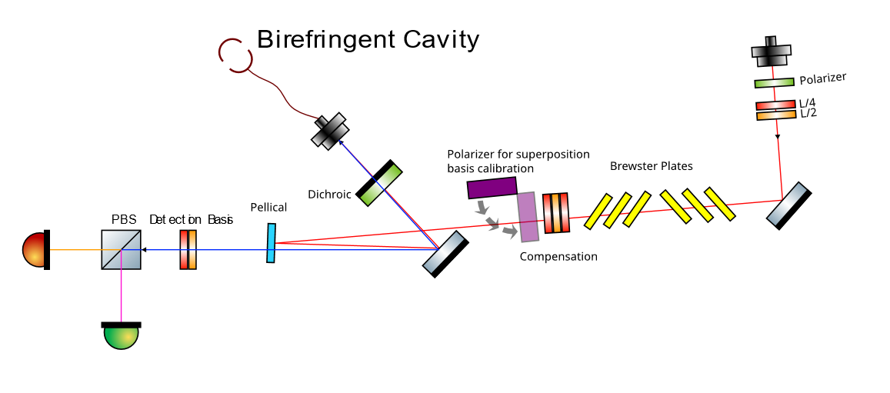
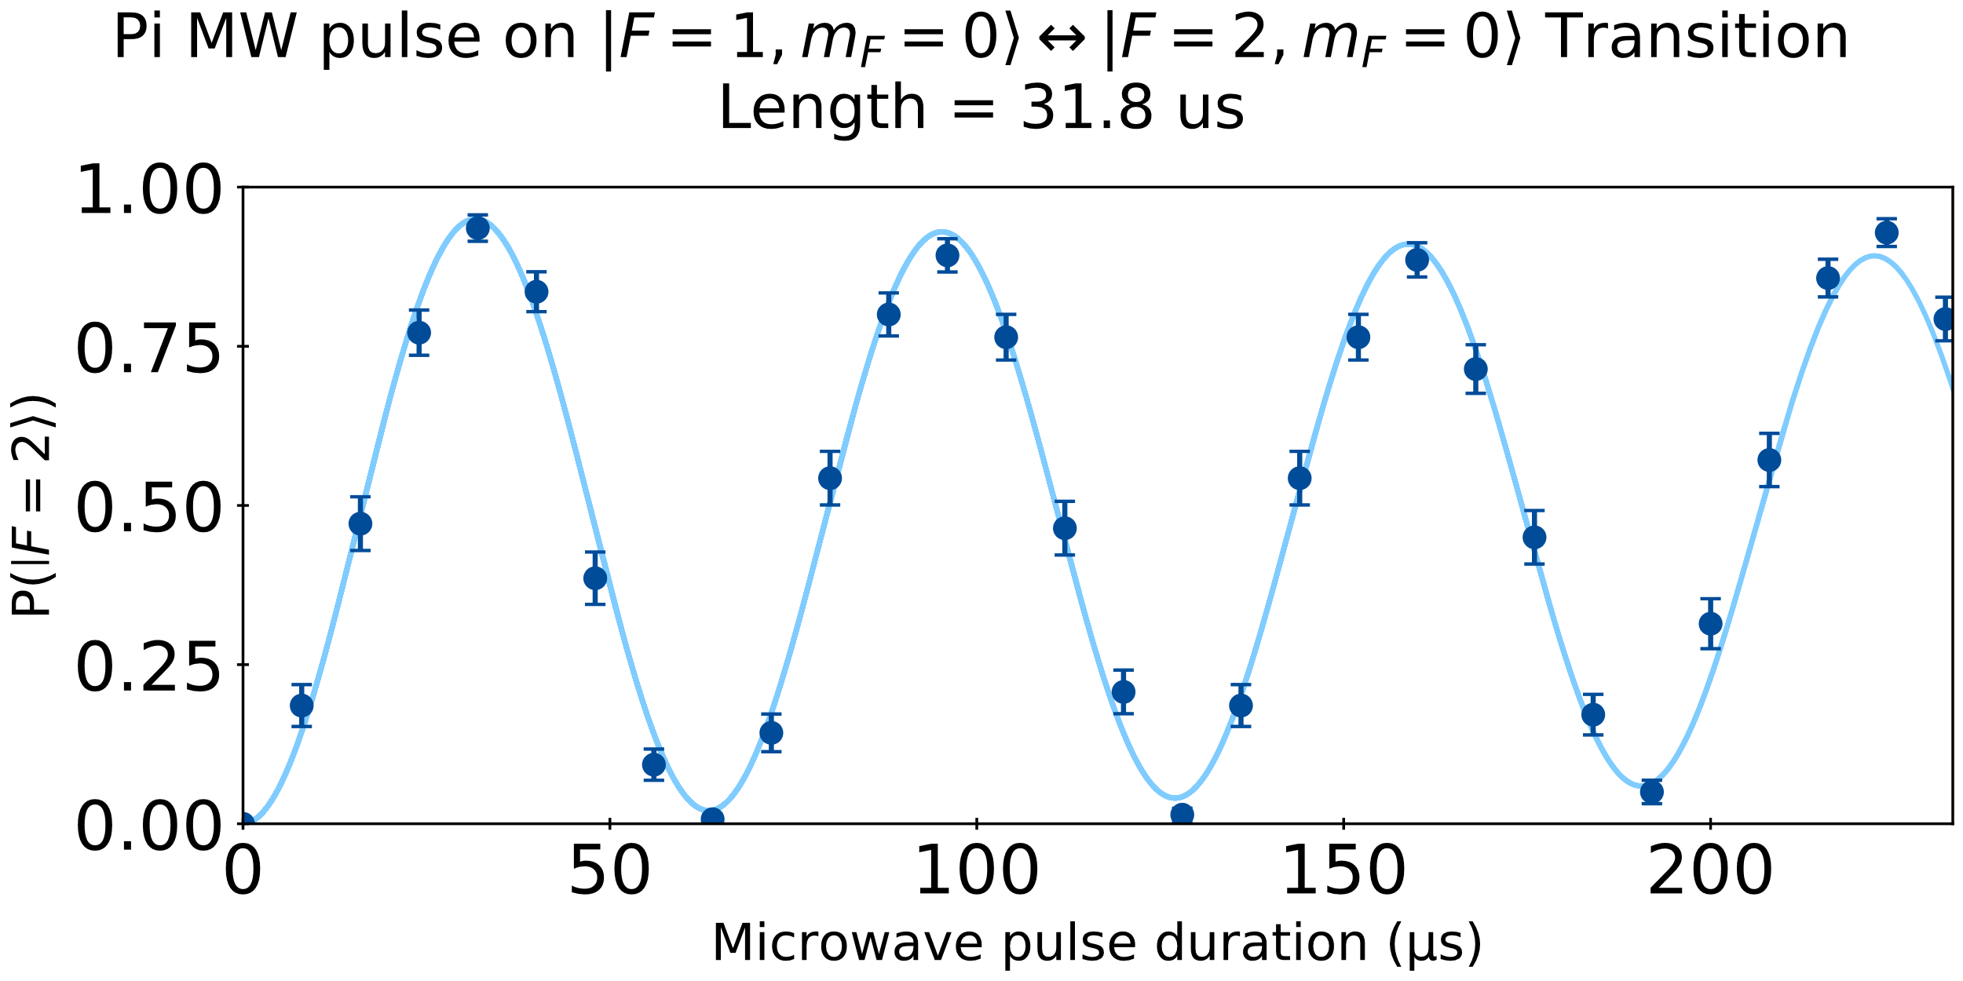
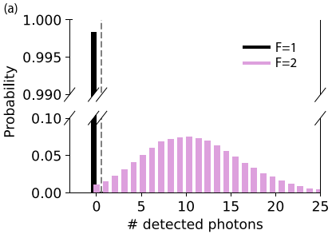
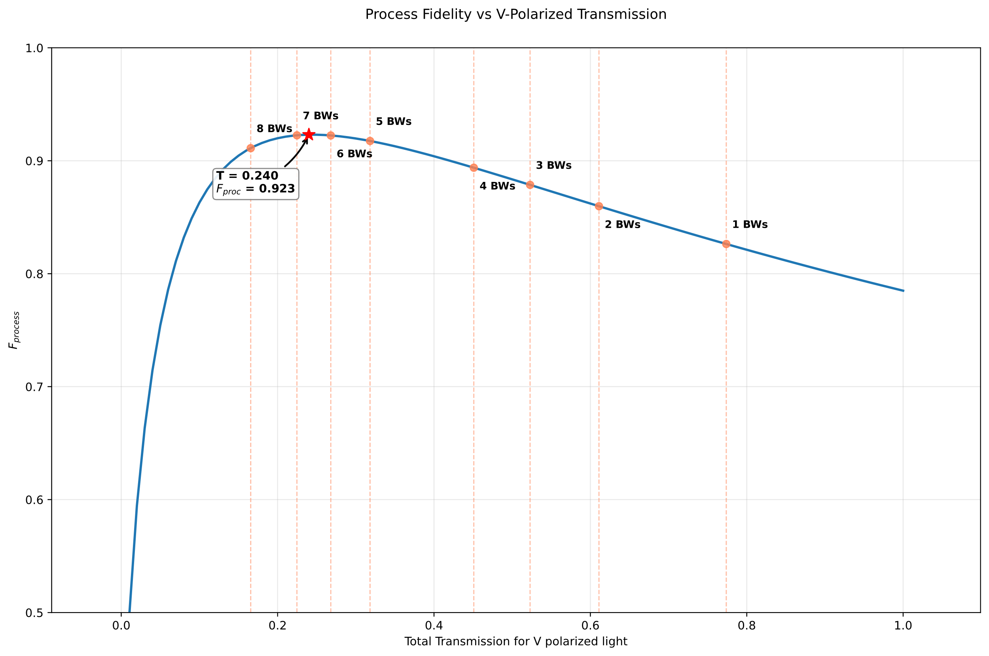
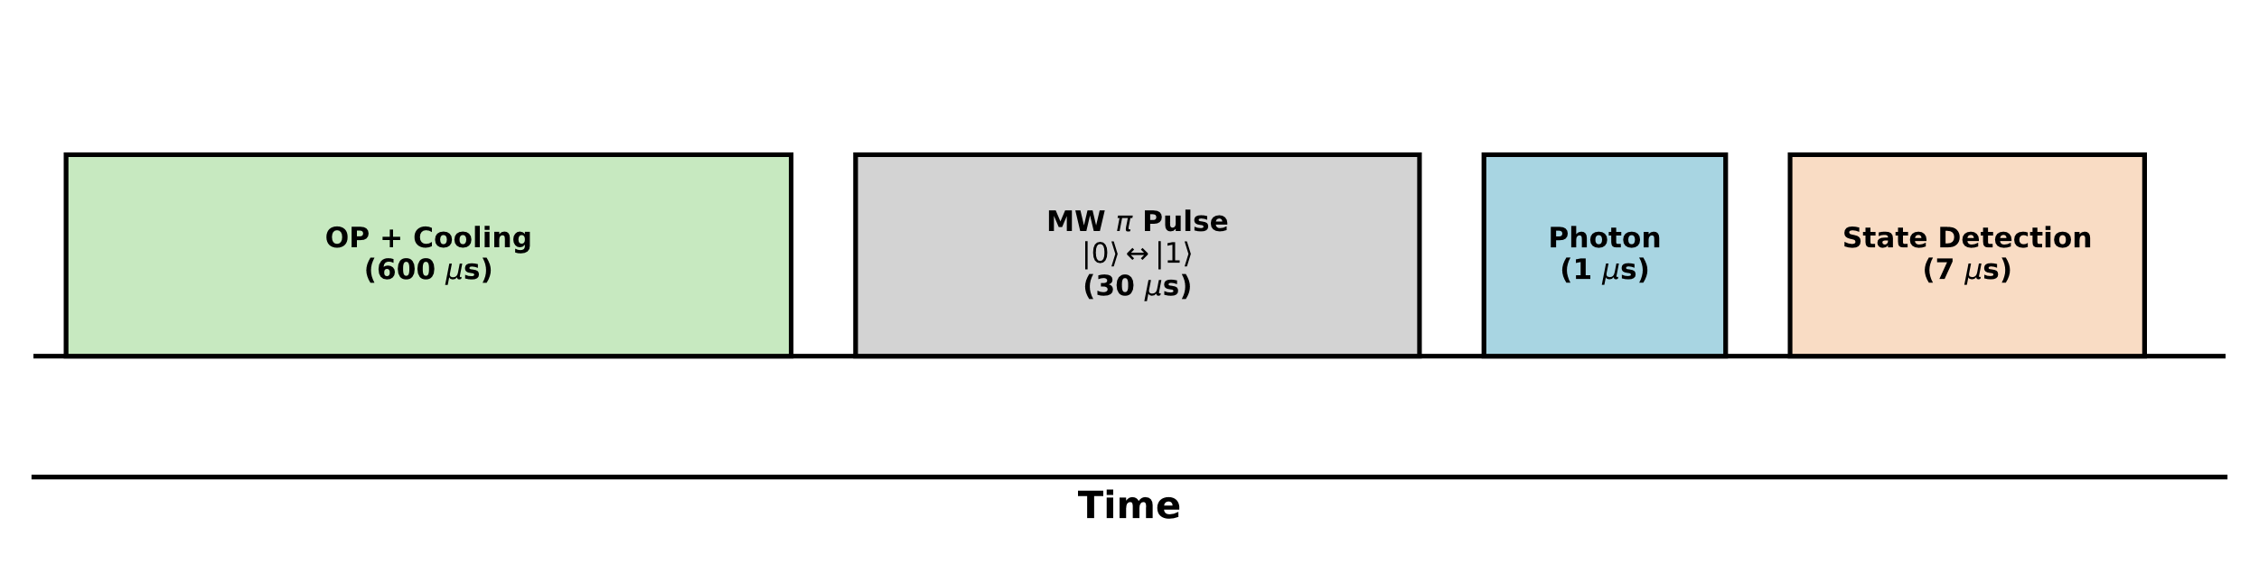
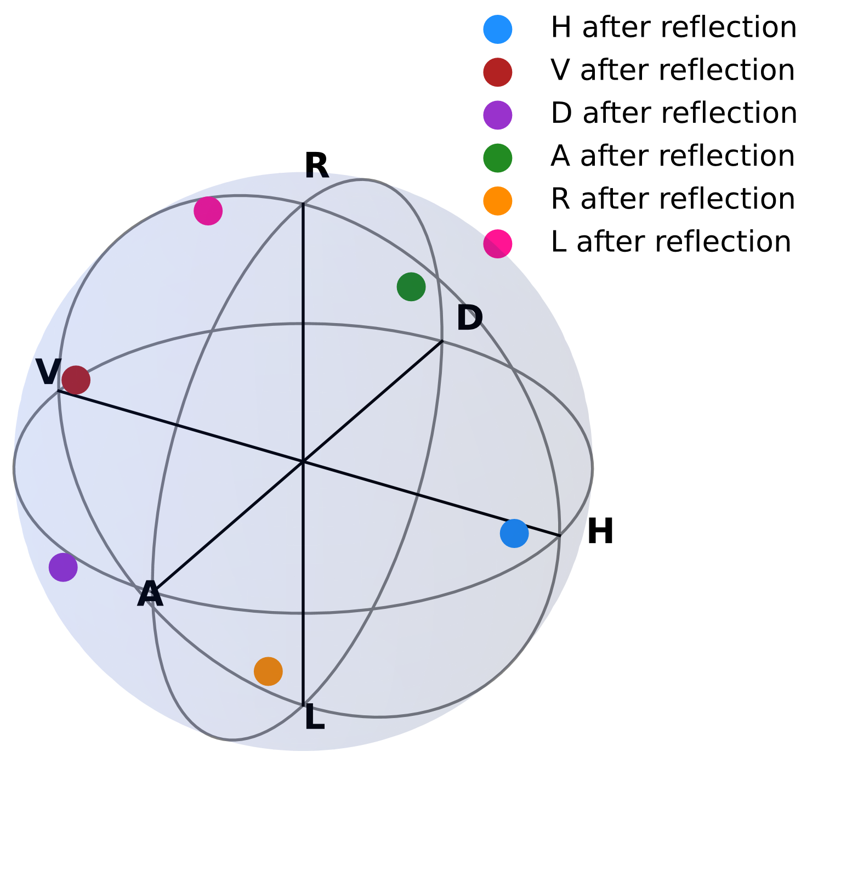
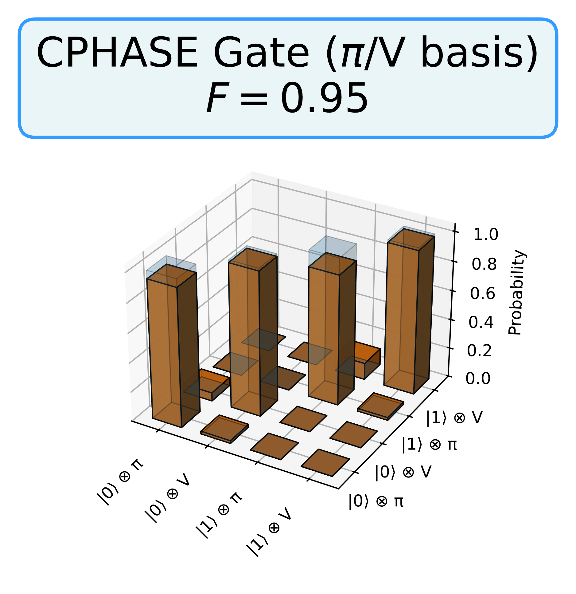
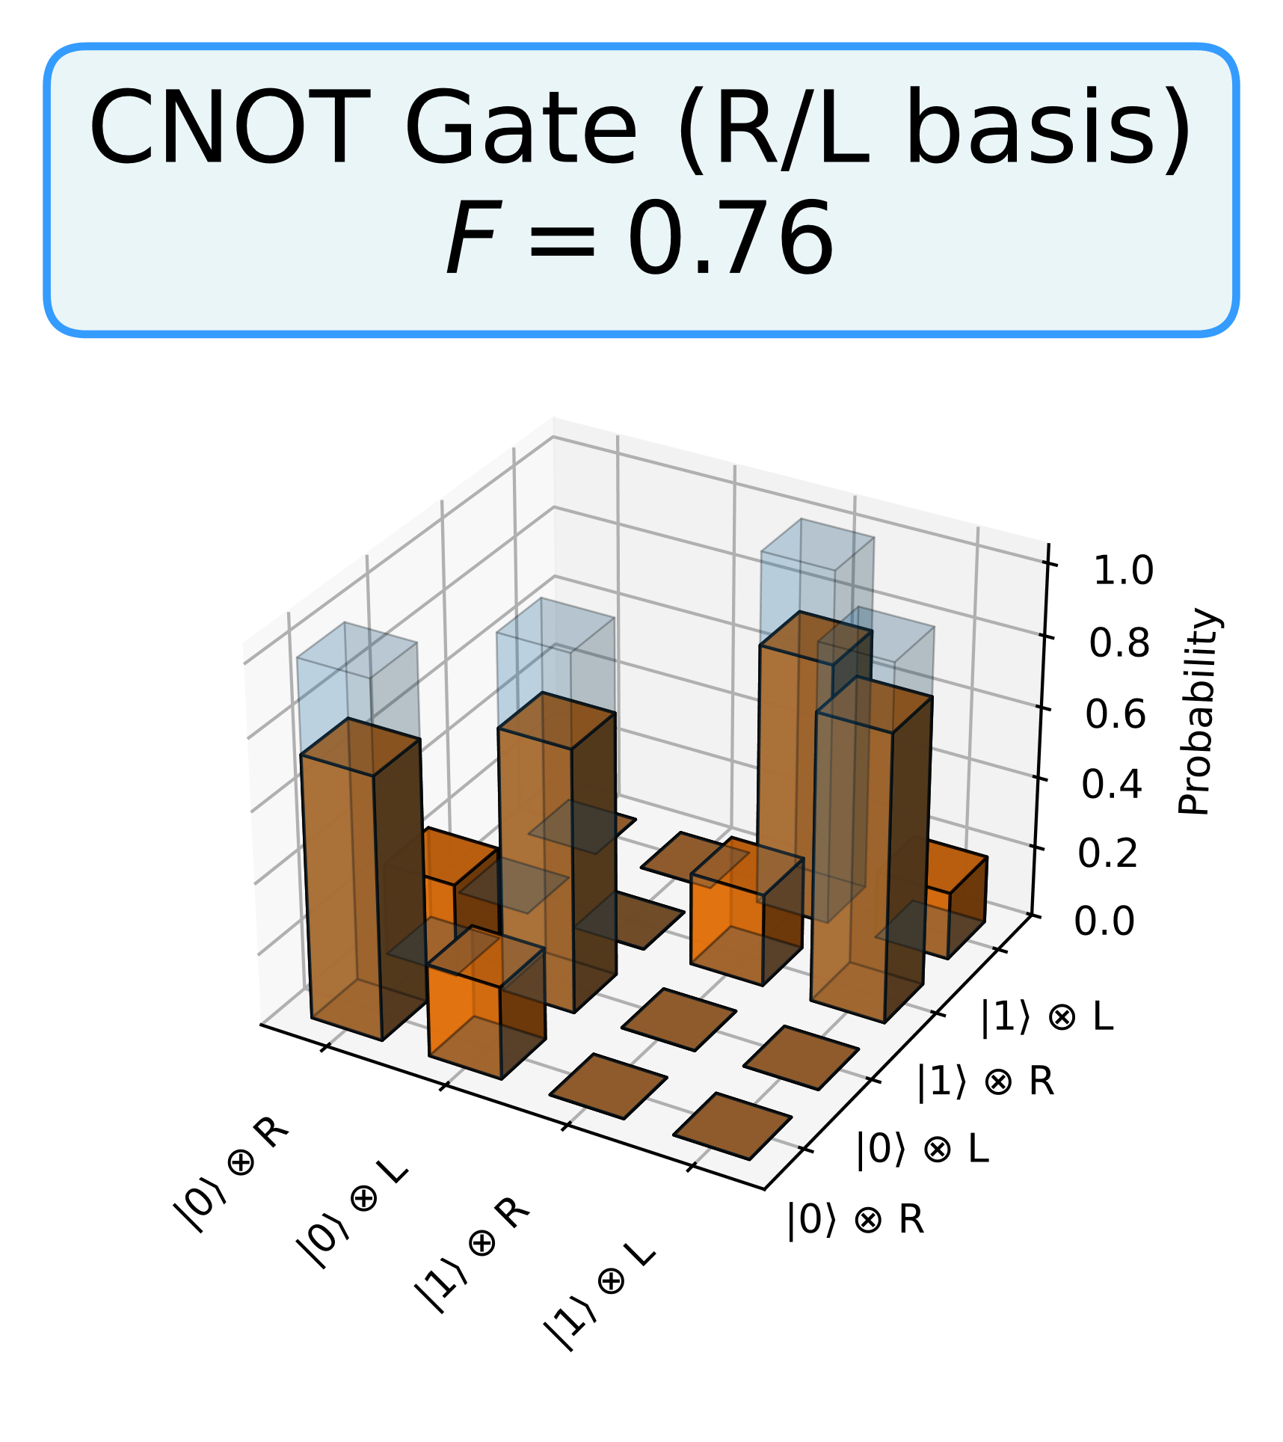
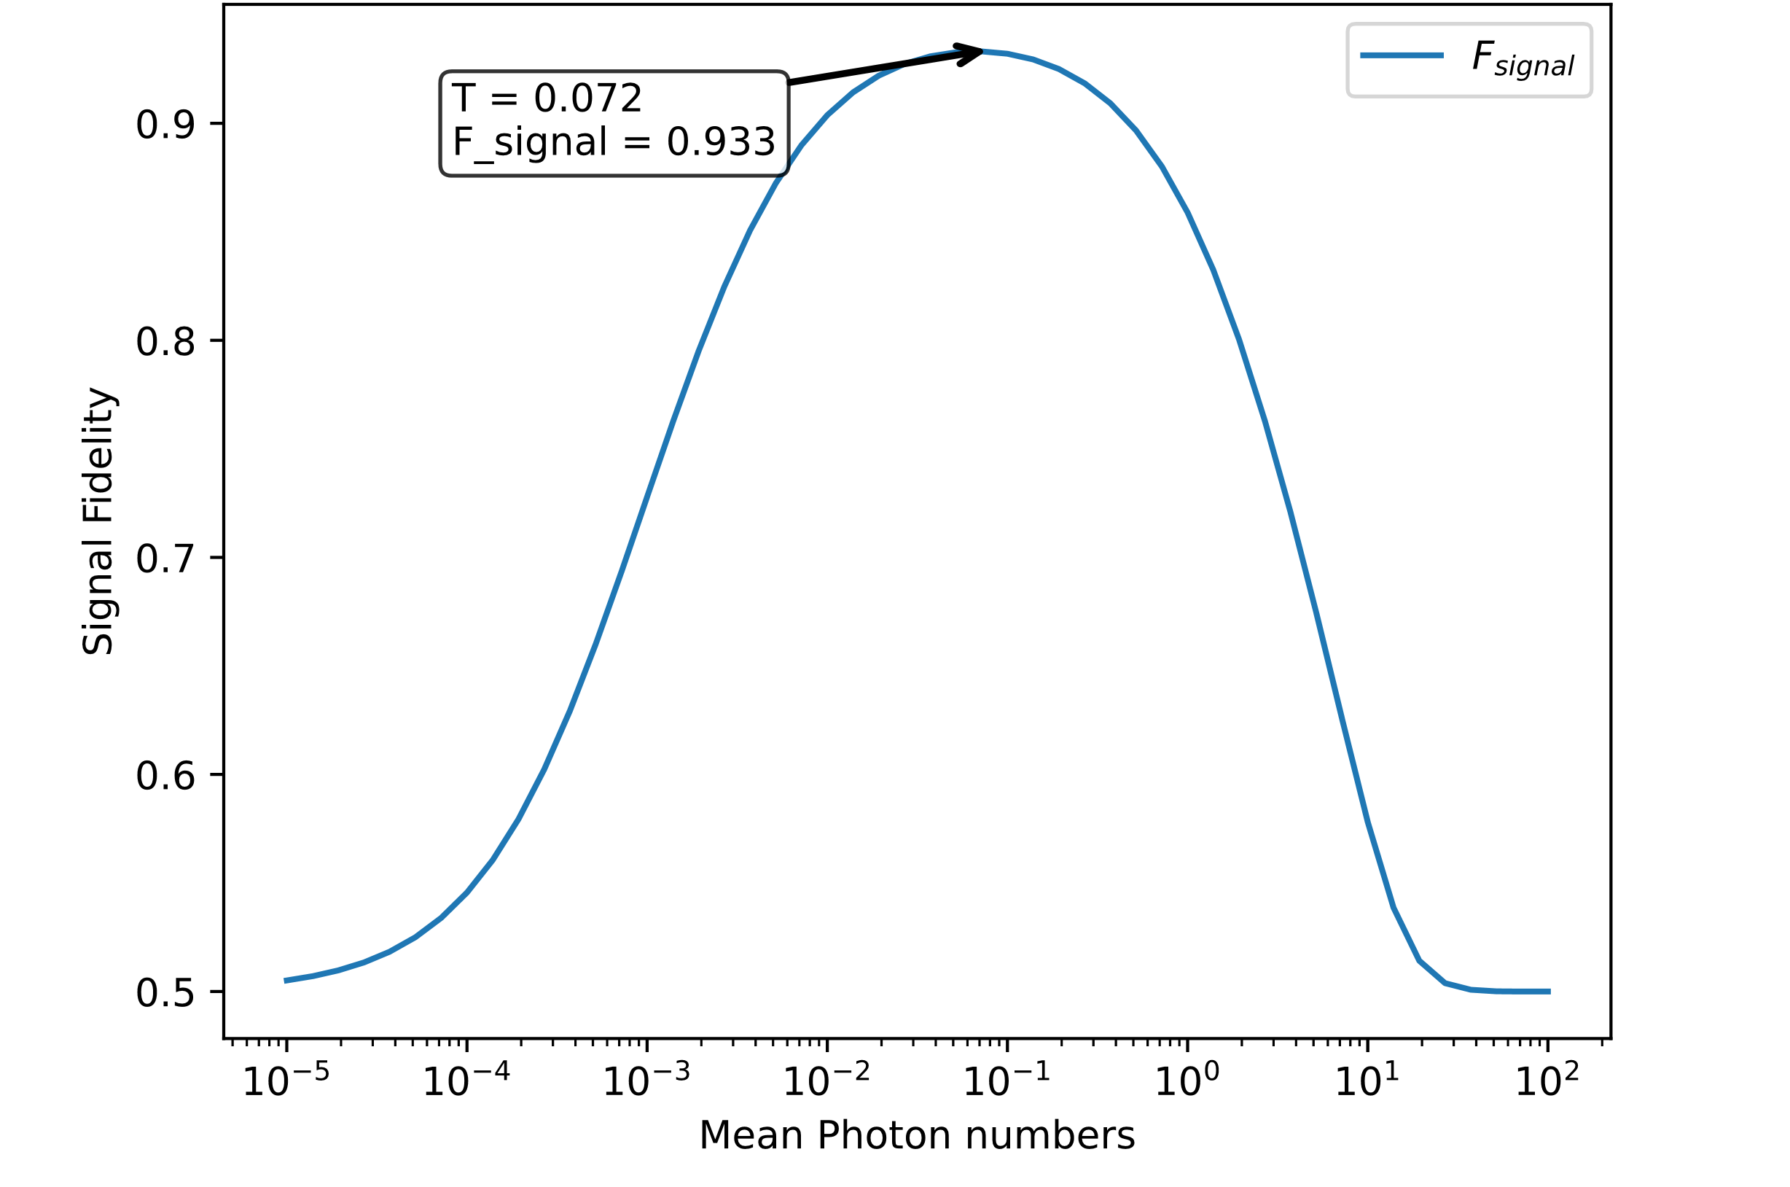
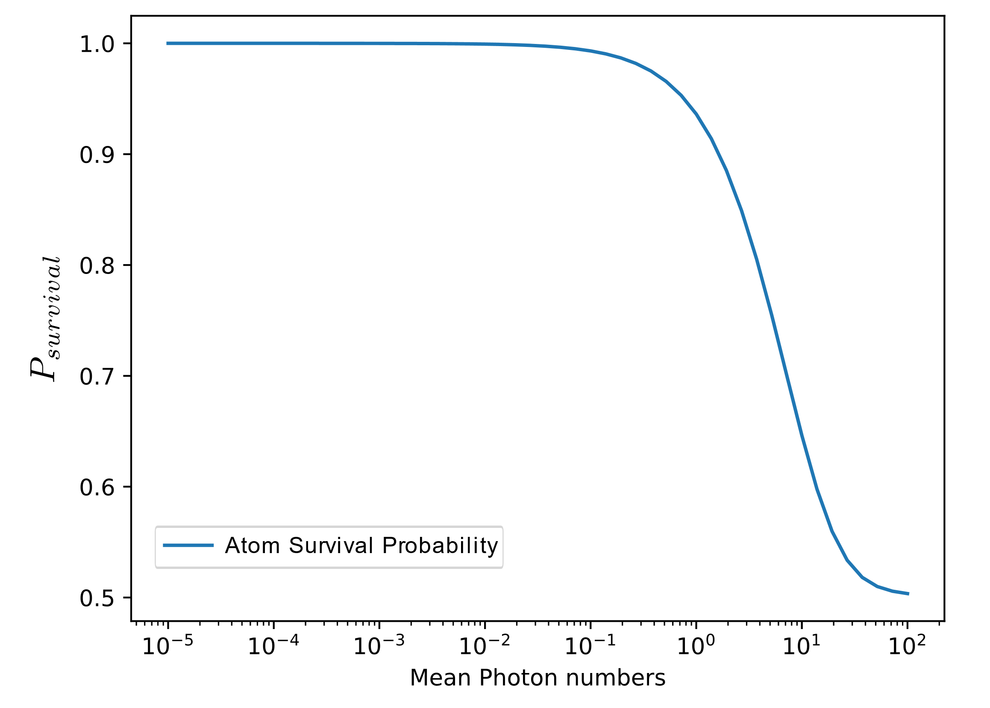





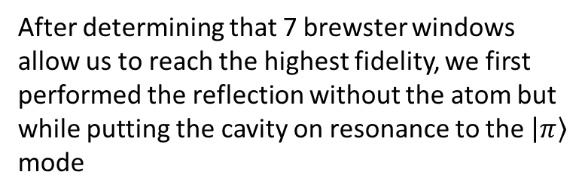
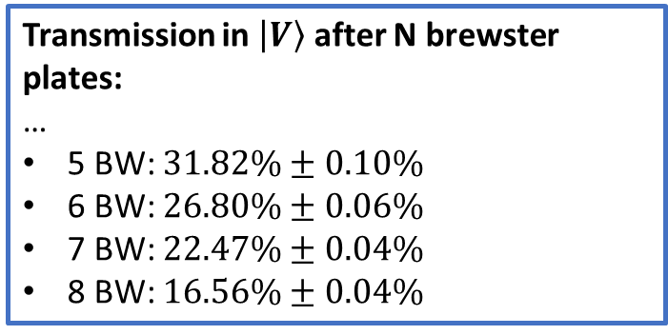

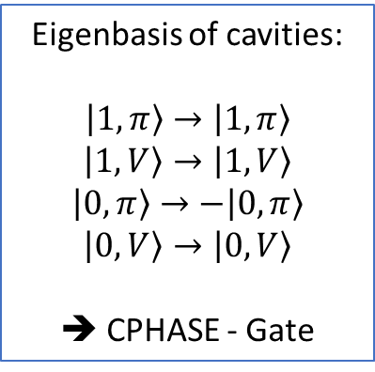


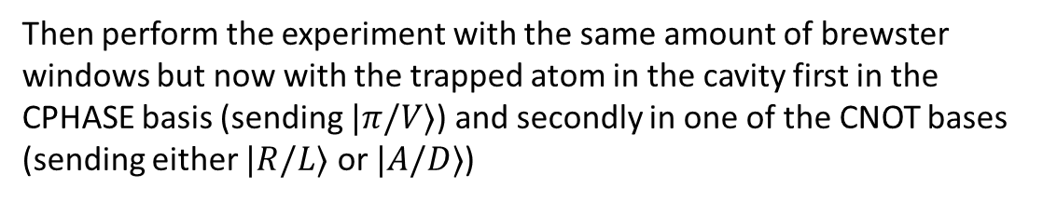
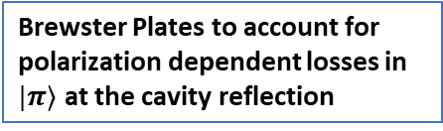
Atom-Photon Quantum Gate using an Atomic Clock Qubit
Leart Zuka^{1,2} , Tobias Frank^{1,2} , Gianvito Chiarella^{1,2} , Pau Farrera^{1,2}, Gerhard Rempe^{1,2}
1 Max-Planck-Institut für Quantenoptik, Hans-Kopfermann-Straße 1, 85748 Garching 2 Munich Center for Quantum Science and Technology (MCQST), Schellingstr. 4, 80799 München
Single atoms coupled to optical cavities provide a powerful platform for photonic quantum information processing.
Using photonic qubits has the obvious advantage that scaling is very easily achieved by simply sending more single-photon pulses. However, for these photons to serve as effective carriers of information, one must ensure that the interface between the atoms and the photons via gates has high fidelities and low errors.
In this work, we investigate a novel gate protocol that employs a single Rb⁸⁷ atom prepared in a magnetic-field-insensitive clock qubit and coupled to a high-finesse birefringent Fabry-Perot cavity. The cavity‘s high birefringence creates two well-separated polarization eigenmodes, enabling the polarization-selective reflectivity that depends on the atomic qubit state. This allows the use of clock states while maintaining strong polarization separation. We present ongoing experimental progress towards implementing the gate as well as simulations based on input-output theory.
Rb atoms (in cavities) as building blocks for quantum networks
Single atoms can be used…
… for the generation of atom-photon-entanglement [1]
… as quantum memories [2]
… as quantum repeaters [3]
… for quantum gates [4]
… for remote atom-atom entanglement [5]
… for teleportation between quantum memories [6]
…
$$κ=κ_{loss}+κ_{out}$$
Experiment
$$\left|1,π\right\rangle →\left|1,π\right\rangle$$
We use the D₂ –line of Rb⁸⁷ to perform a conditional photon reflection based on the state of the atom and the polarization to which we’re resonantly coupled to:
Truth tables for different bases
Changing to the following basis:
$$\left|+\right\rangle =\frac{\left|V\right\rangle +|π⟩}{\sqrt{2}}$$
$$\left|−\right\rangle =\frac{\left|V\right\rangle −|π⟩}{\sqrt{2}}$$
$$\left|1,+\right\rangle →\left|1,+\right\rangle$$
$$\left|1,−\right\rangle →\left|1,−\right\rangle$$
$$\left|0,+\right\rangle →\left|0,−\right\rangle$$
$$\left|0,−\right\rangle →|0,+⟩$$
➔ CNOT - Gate
System Characterization & Control
Eigenbasis of cavities:
$$\left|1,π\right\rangle →|1,π〉$$
$$\left|1,V\right\rangle →|1,V〉$$
$$\left|0,π\right\rangle →−\left|0,π\right\rangle$$
$$\left|0,V\right\rangle →\left|0,V\right\rangle$$
➔ CPHASE - Gate
Determining of cavity field decay rate and outcoupling efficiency, as well as mode matching parameters
Determining coupling constant of $\left|F=2,m_{f}=0\right\rangle ↔\left|F^{′}=1,m_{f}=0\right\rangle$:
Brewster Plates to account for polarization dependent losses in $|π⟩$ at the cavity reflection
Determine ideal attenuation of V polarized light to balance output polarization in $\left|±\right\rangle$ basis
Experimental Sequence for the Gate:
Transmission in $\left|V\right\rangle$ after N brewster plates:
…
5 BW: $31.82\%±0.10\%$
6 BW: $26.80\%±0.06\%$
7 BW: $22.47\%±0.04\%$
8 BW: $16.56\%±0.04\%$
Resonant Reflection with and w/o Atom
Optimal Pulse Intensity (Preliminary)
After determining that 7 brewster windows allow us to reach the highest fidelity, we first performed the reflection without the atom but while putting the cavity on resonance to the $\left|π\right\rangle$
mode
Then perform the experiment with the same amount of brewster windows but now with the trapped atom in the cavity first in the CPHASE basis (sending $|π/V⟩$) and secondly in one of the CNOT bases (sending either $|R/L⟩$ or $|A/D⟩$)
To identify the optimal operating regime for our gate, we model the gate fidelity at different mean input photon numbers $\overline{n}$. The motivation behind this, is that at very high and very low photon numbers certain sources lead to infidelity ($\overline{n}≪1$: detector dark counts; $\overline{n}≫1$: increased atomic scattering and multi-photon contributions). Thus finding the ideal pulse intensity allows us to keep these infidelities at bay, while ensuring a high enough rate of our gate.
Overlap = 97.43(3) %
Outlook
Finish ongoing simulations
Boost fidelity by improving current experimental parameters (e.g mean photon number, attenuation of V-pol. light)
Generate atom-photon entanglement
Preparation of a GHZ state
Achieve successful quantum gate operation between two single-photon pulses.
References
Fundings
[1] P. Thomas et al., Nature 608, 677-681 (2022)
[2] M. Brekenfeld et al., Nat. Phys. 16, 647–651 (2020)
[3] M. Uphoff et al., Applied Physics B: Lasers and Optics 122 (3), 46 (2016)
[4] Duan & Kimble, Phys. Rev. 92(12), 127902 (2004)
[5] S. Welte et al., Phys. Rev. X 8 (1), 011018 (2018)
[6] S. Langenfeld, Phys. Rev. Lett. 126, 130502 (2021)

