Slide 1

An atom-photon quantum gate
using an atomic clock qubit
and a birefringent cavity
Leart Zuka
26.6.2026

Slide 2


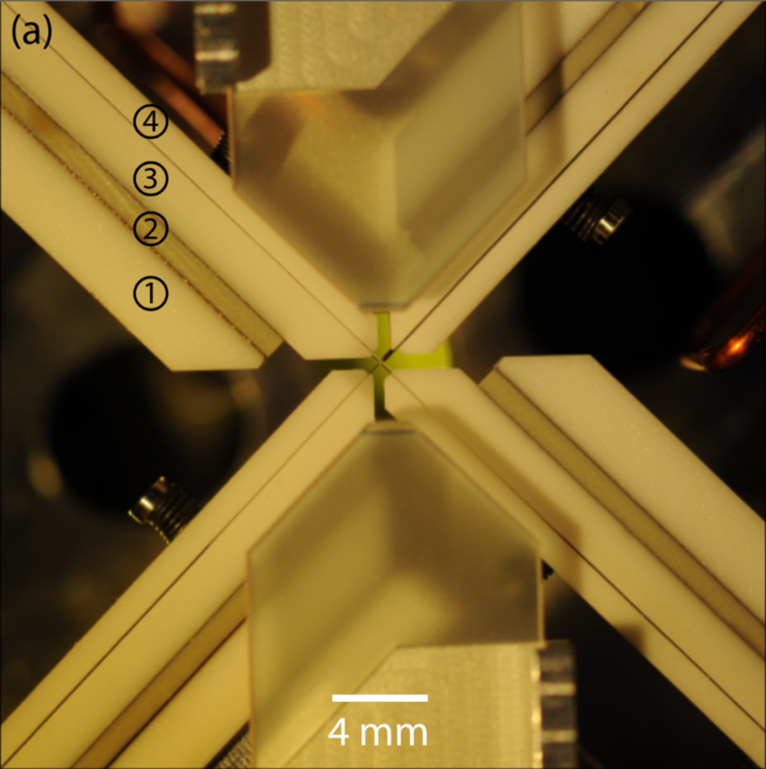
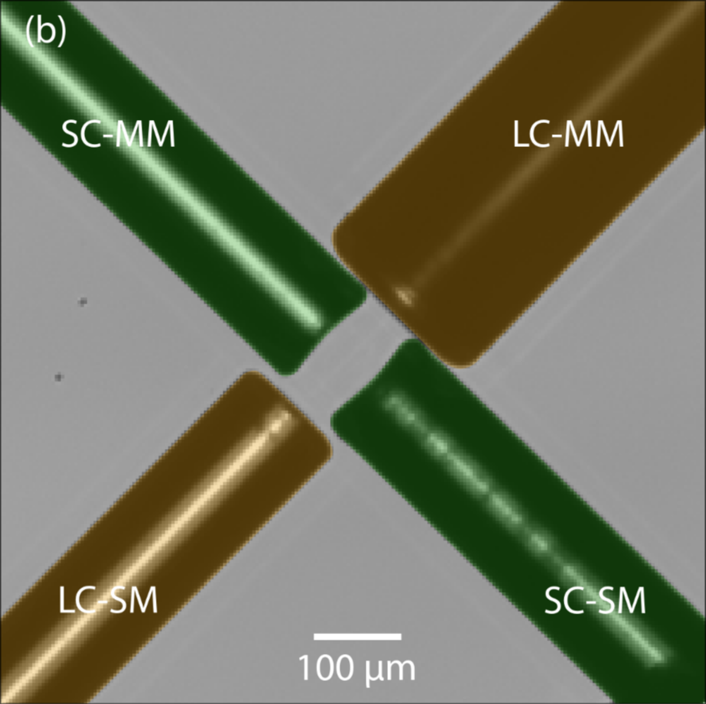
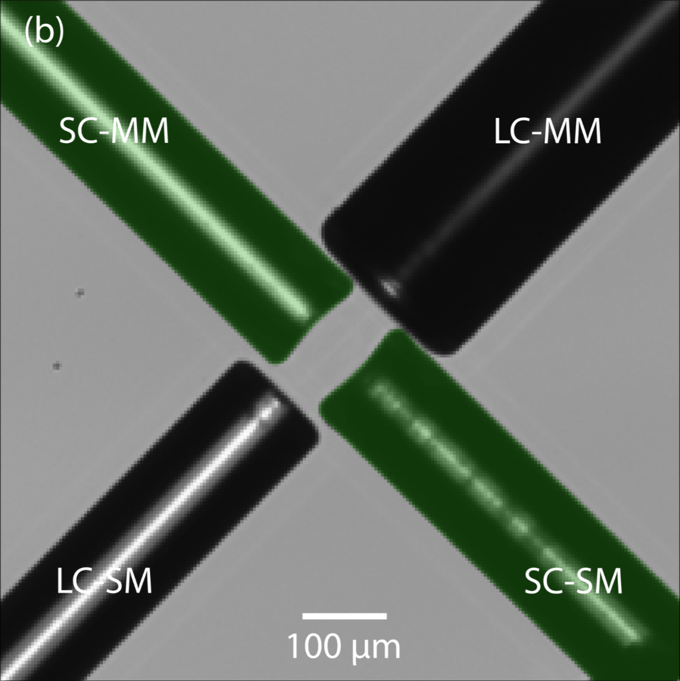
Motivation
Chiarella, 2026
Leart Zuka
Notes:
The experiment at the center of this thesis is a single rubidium-87 atom, trapped inside a high-finesse birefringent fiber cavity. What you see here is the physical heart of that system — two fiber Fabry-Pérot cavities arranged in an X formation, where a single atom sits at their crossing point.
---------------------------------------------------------
Let’s zoom in. Here we can see the two crossed fiber cavities up close. Although the long cavity, here highlighted in orange, won’t be used for this project, I still wanted to showcase it as it is a core part of the CavityX setup.
-----------------------------------------------------------
The short cavity however, here highlighted in green, is roughly 76 micrometers long, and crucially, its mirror surfaces have been machined with an elliptical profile. This ellipticity makes the cavity very birefringent, causing its polarization eigenmodes to be separated by about 500 megahertz. This will be very crucial for realizing our atom photon gate
-------------------------------------------------------------
The regime in which we operate in is the strong coupling one — where a single photon is able to bounce around the cavity many times, thus interacting with the atom many times, before being lost. In this regime, the internal state of the atom, will have an effect on how the photon will be reflected from the cavity system, thus giving us the main physical mechanism behind the gate

Slide 3
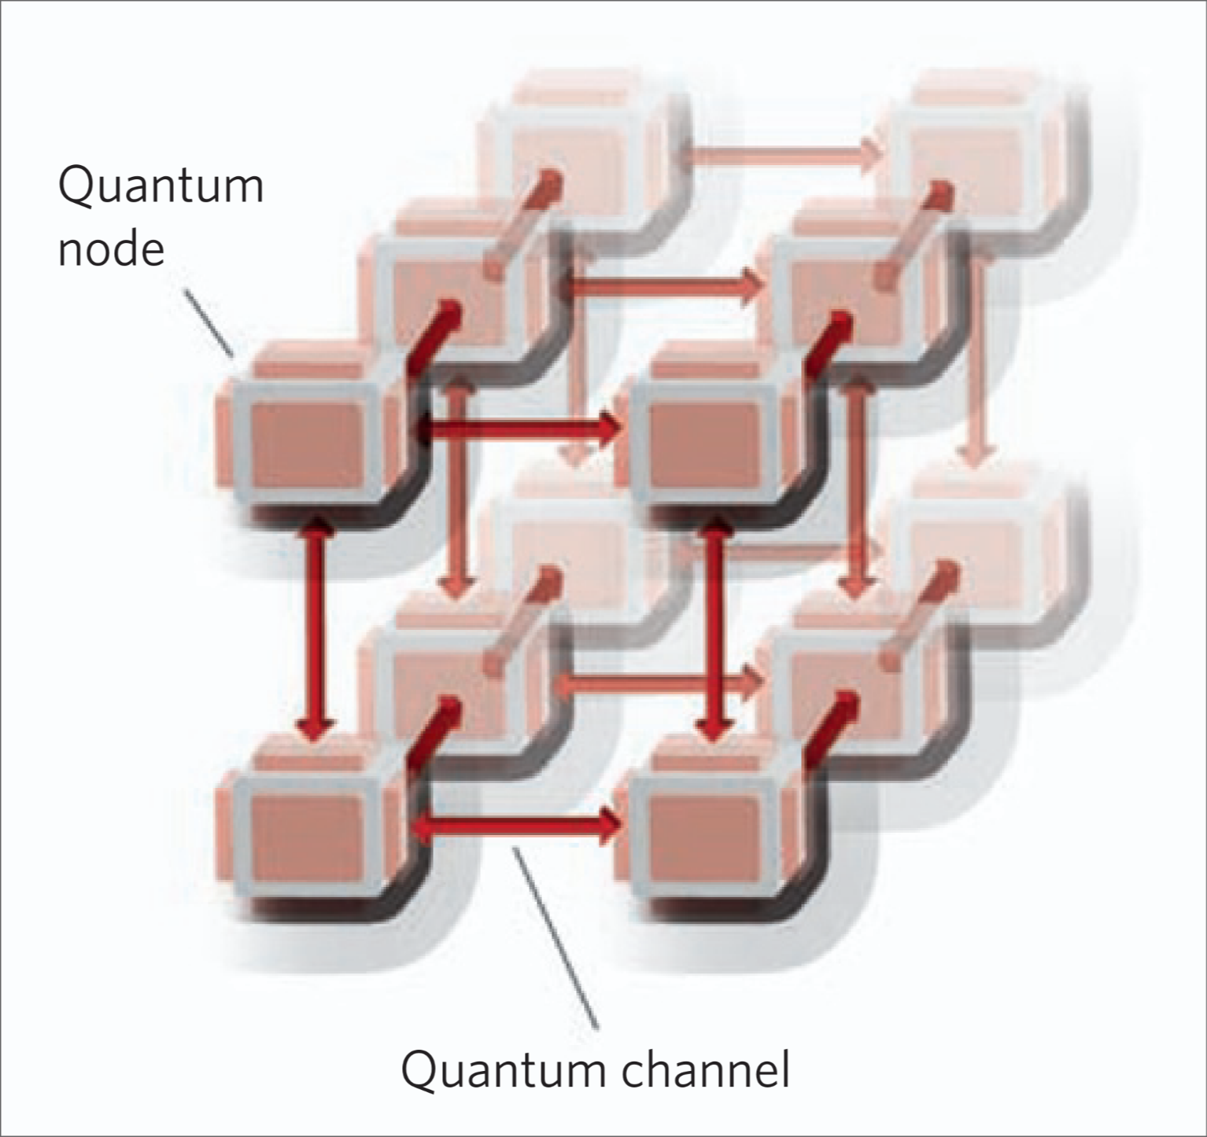
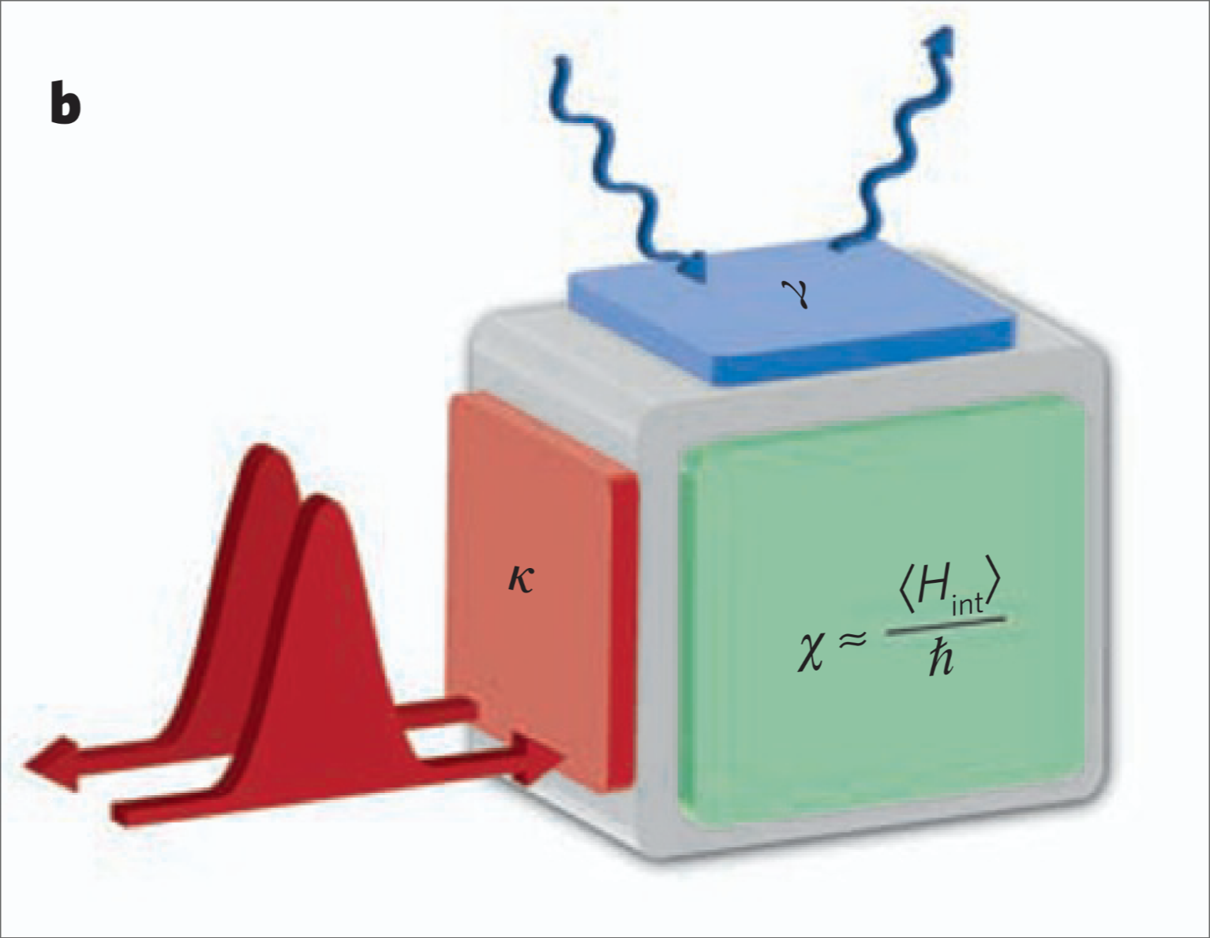

Motivation
Three preliminaries each quantum node must fulfill:
  Storage of quantum information
  Processing quantum information via quantum logic gates
  Generation of entanglement
~94.7% Brekenfeld et. al.; Nature; 647–651 (2020)
~87% Chiarella et. al.; Phys. Rev. Letter 135, 240802 (2025)
Kimble, H., Nature 453, 1023–1030 (2008)
Leart Zuka
Notes:
Now, why do we care about an atom talking to a photon in a fiber cavity? The answer is quantum networks.
---------------------------------------------------------
Idea is, instead of building one large quantum computer that is very susceptible to external noise sources, and cannot be scaled that easily, how about you build a network of them as proposed by Jeff Kimble
---------------------------------------------------------
Can be seen here on the left, where the network is made up of multiple smaller quantum nodes, which each are a small quantum computer in themselves, and are interlinked with one another via quantum channels
---------------------------------------------------------
This gives us a much easier time to achieve the advantages of quantum computers
---------------------------------------------------------
In order for a node to be genuinely useful, it needs to be able to do three things: generate entanglement between the local atom and a photon, store incoming photonic quantum information onto the atom, and process that information locally through quantum logic gates.
---------------------------------------------------------
Our system has already demonstrated the first two. Chiarella et al. demonstrated heralded atom-photon entanglement with 87% fidelity. And Brekenfeld et al. demonstrated quantum memory — storing a photonic qubit onto the atom — with 94.7% fidelity. These are published results from this very platform.
---------------------------------------------------------
What was missing — and what this thesis addresses — is the third capability: the quantum logic gate. Without it, the node can receive and store quantum information, but it cannot act on it. The gate is the missing piece that completes the picture.

Slide 4
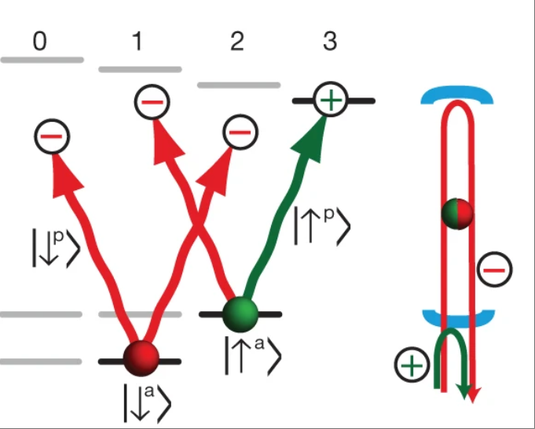
Motivation
Reiserer, A., et al., Nature 508, 237–240 (2014)
Leart Zuka
Notes:
Atom photon gates are not entirely new
Reiserer has demonstrated one on a similar platform, where a flying photon is interacting with the stationary atom
The “problem” with this setup is, that the atomic qubit is encoded in magnetically sensitive Zeeman sublevels
Ergo you need an external magnetic fields in order to get the controlling gate behavior to work
This works, but the qubit is sensitive to magnetic field fluctuatians that can cause dephasing and limit coherence
So the setup I want to realize is one where I use my strong birefringence of the cavity in order to remove this constraint
We will be using the d2 line of rb87 with the red mode being resonant to the f=2 to f=1 transition and the v mode will be far blue detuned
The red cavity mode will be resonantly coupled to the atom, the blue one not, thus allowing us to encode the qubit in the magnetic insensitive clock states
The birefringence is what makes the clock state qubit possible, and the clock state qubit is what then makes the implementation more robust than the previous one

Slide 5
Motivation
Three preliminaries each quantum node must fulfill:
  Storage of quantum information
  Processing quantum information via quantum logic gates
  Generation of entanglement
~94.7% Brekenfeld et. al.; Nature; 647–651 (2020)
~87% Chiarella et. al.; Phys. Rev. Letter 135, 240802 (2025)
+ Clock States
+ Birefringent Cavity
Leart Zuka
Notes:
Notes:
Goal: atom-photon gate on birefringent cavity platform with clock state qubit

Slide 6
Contents
Theory: Cavity QED & Janes Cummings Model
Atomic Qubit Preperation
Photonic Qubit Path
Results
Limitations & Imperfections
Leart Zuka
Notes:
Notes:
One of such quantum nodes is cavityX:
The reason for the name is because there are two crossed fiber cavities in there forming an x formation
The difference between the two fiber cavities are in the length and in the fact that the longer one was designed with minimum birefringence in mind and the shorter one with maximum birefringence in mind
For the experiment we will however only be using the shorter cavity
As for the quantum node two preliminaries are already given in this setup: quantum memory with a fidelity of 94.7% and generate atom-photon entanglement with a fidelity of 89%
Last prelimenary to operate cavityX as quantum node would be the processing via logic gates
But in order for us get into that we first need to understand the interaction between the mediating qubits (aka photons), and our stationary qubits in our system (aka the neutral atoms)

Slide 7

Cavity QED & Jaynes Cummings Model
Leart Zuka
Notes:
Notes:
CQED describes the interaction between a resonator (here: Fabry-Perot-cavity) and the electronic states within a matter system (here: D2 -transition of Rb87)
System is described by three parameters: g=strength of the coupling of the atom to the cavity; kappa=decay rate of cavity field, gamma=spontaneous decay rate of d2 transition of rb87
What ends happening if a photon enters the cavity system
Since the atom is between two highly reflective mirrors the photonic field inside of the system gets reflected back and forth thus enhancing the interaction cross-section
However, at each round trip a little bit of the field gets lost at a rate of kappa, or sometimes the atom spontaneously decays at a rate of gamma
A theory which captures this interaction and its losses is the jaynes-cummings model
In order to understand it let’s look at the energy scheme of this example here
Here we would have three distinct levels:
One uncoupled one that is far detuned from the cavity resonance
And two levels c and e which are which have a resonance frequency of omega_a
On the other hand the one cavity mode here itself has a resonance frequency of omega_c
The difference between these two frequencies is described as delta_ac
In our case though we want to be resonant to the c←→e transition, meaning that this difference is ideally 0

Slide 8

Cavity QED & Jaynes Cummings Model
Atom in the uncoupled state & cavity on resonance:
Atom in the coupled state
& cavity on resonance:
Leart Zuka
Notes:
Notes:
It’s now also very important how the system reacts when the atom is in a specific state
When the atom state is in the uncoupled state:
The atom is not sitting on the level where it would be resonant with the cavity, therefor nothing changes about the energy levels
If the atom state is in the coupled state however and we’re resonant to the c-e transition:
The eigenenergies of our system split by 2*hbar*g giving rise to the so called vacuum rabi splitting
What this means for our photon that has a frequency of omega_c, is that it isn’t resonant anymore as the energy levels of the atom have now shifted by +/- hbar*g

Slide 9
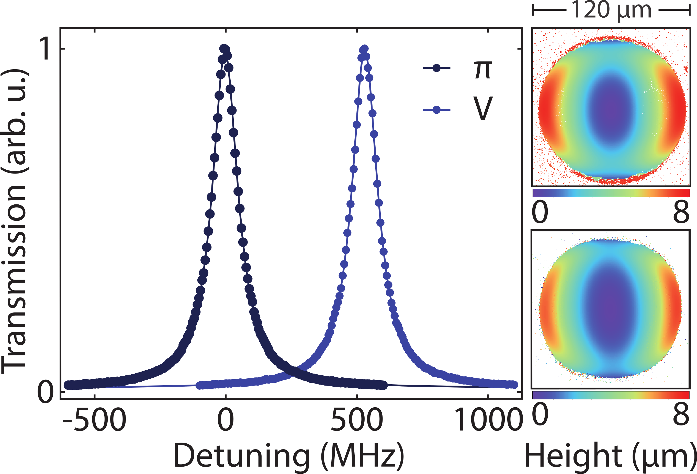
Cavity Birefringence
Leart Zuka
Notes:
Notes:
Previously only concidering cavity with single cavity mode
But: we’re using a birefringent cavity, meaning we have two polarization eigenmodes
π mode: resonant to the c↔e transition
V mode: 500 MHz detuned
Why this matters: π-polarized light couples to the atom → state-dependent reflection. V-polarized light is always off-resonant → no coupling. This polarization selectivity is what creates the conditional reflection we need for the gate.
How it's made: The cavity mirrors are shaped elliptically during fabrication to create the frequency splitting.

Slide 10
Atom-state dependent reflection
Atom in uncoupled state
& photon is - polarized
Atom in coupled state
& photon is - polarized
⇒ Photon gets reflected with
π – Phase shift
⇒ Photon gets reflected with no
π – Phase shift
Leart Zuka
Notes:
Notes:
Now it becomes interesting to look at the actual effect the atomic state and also the polarization of the photons have on the reflection on the latter
Two main cases:
Atom in uncoupled state u
Atom in coupled state c
If the atom is in uncoupled state u, pi polarized photon is able to enter the cavity, bounce around (not shown here), and exit the cavity with a pi phase shift if it didn’t get lost
If the atom is in the coupled state c, due to the interaction of cavity and atom, vacuum rabi splitting will occur on the excited state, meaning we’re no longer resonant, and the otherwise resonant photon, won’t be able to enter and will get reflected off of the first cavity mirror without a pi phase shift

Slide 11
Atom-state dependent reflection
Atom in either state
& photon is - polarized
⇒ Photon gets reflected with no
π – Phase shift
Leart Zuka
Notes:
Notes:
For the sake of completeness, let’s also look at the V polarized case which has same outcome regardless of atomic state
Due to the birefringence of the cavity, the V eigenmode of the cavity is 500MHz detuned, meaning we’re not resonant, and the V polarized photon will get reflected off the first cavity mirror without a pi phase shift

Slide 12

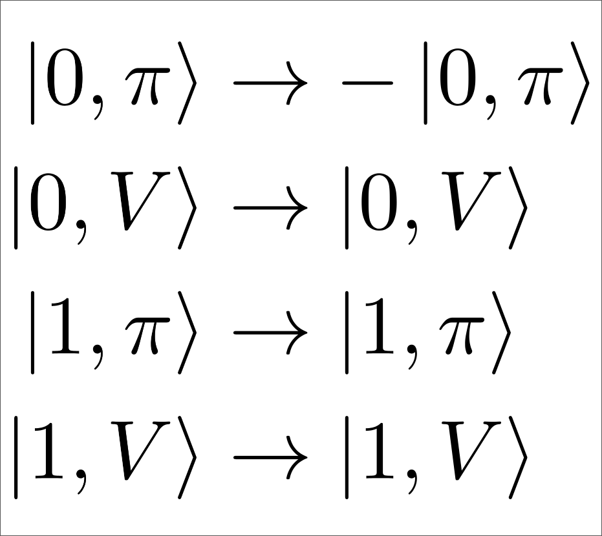
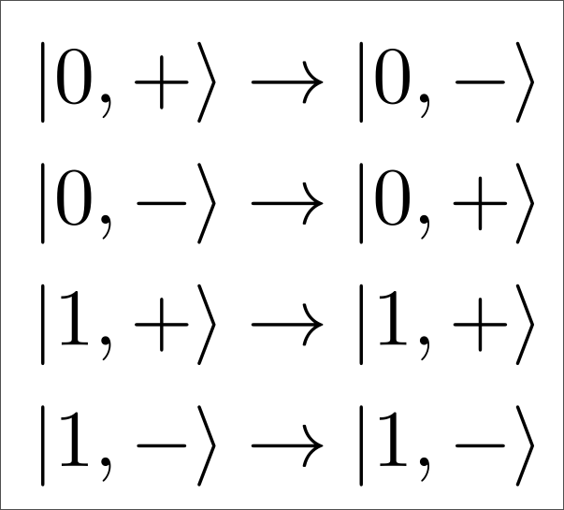
Atom-Photon Gate Protocols
CPF – Basis:
Photonic Eigenbasis =
Atomic Eigenbasis =
CNOT – Basis:
Photonic Eigenbasis =
Atomic Eigenbasis =
Leart Zuka
Notes:
Using the knowledge from the previous slides, we’re now able to have a look at the actual outcome of our reflection gate.
On the left we can see the behavior for the case where we’re preparing the atom either in the coupled (1) or uncoupled state (0). Here we used a notation commonly used in quantum computing hence the renaming.
And the photon is going to be either pi or v polarized. So we’re in the eigenbasis of our birefringent cavity. With that, after the reflection, only the 0,pi case will experience a phase shift and we’re left with the following reflection, which forms a CPF gate
If we now put the photon is a eigenbasis that is formed of a superposition of the eigenbasis of the birefringent cavity (here named +/-), only the pi part of our photon will experience the phase shift, meaning it will flip from plus to minus and vice cerca, which will realize a CNOT gate.

Slide 13


Reflection Amplitudes in Reality
Issues:
1. Missmatch between and
2. Missmatch between and
Fixable Brewster Window Array
Fundamental set by cavity parameters
Leart Zuka
Notes:
Previously we were looking at the ideal case, meaning our photon will always get reflected with perfect unity
Reality is often not that and thus dissapointing
Can calculate reflection amplitudes and phase shifts based off cavity parameters which give insight to how our gate will behave
Two things to point out:
Missmatch between pi and v mode
Missmatch between 0 and 1
First one can be fixed with a brewster window array
Second one is fundamental as its only dependent on the cavity parameters themselves, more on that later

Slide 14
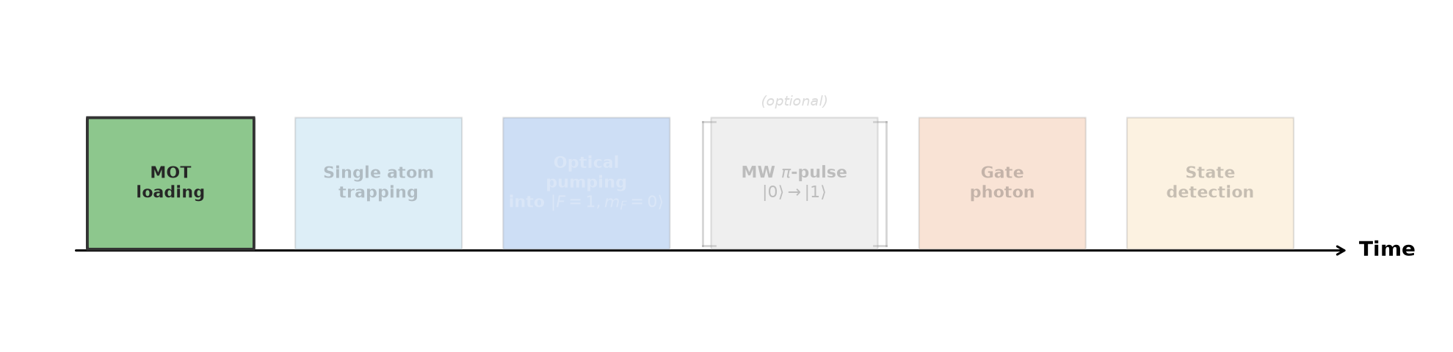
Atomic Qubit Preperation
Leart Zuka
Notes:
Note:
Here we can see the birefringent cavity, and two mirror surfaces that sit on top of each of the fibers which will be important in just a second
--------------------------------------
First step of the atomic qubit preparation is the so called MOT loading phase
---------------------------------------------
Here a UV LED integrated into the vacuum chamber will be switched on, that will cause multiple rubidium atoms to release into the chamber
--------------------------------------------
By using the MOT to bunch them together, and an ensemble of lasers to cool and trap this cloud of atoms we end up with a bunch of Rubidium atoms above our cavity crossing point

Slide 15
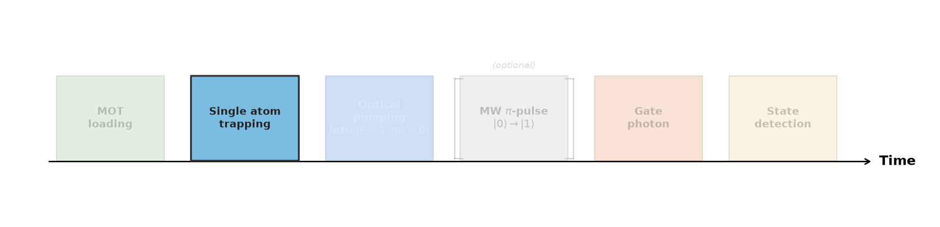
Atomic Qubit Preperation
Leart Zuka
Notes:
Once we switch off the MOT
------------------------------------------
Cloud of atoms will fall down due to gravity
------------------------------------------
Our vertical trap laser will switch on at the right time and thus trap a single rubidium atom at the point of maximum coupling
------------------------------------------
This will leave use with single Rb87 atom in our cavity with the energy scheme being the one portraid on the left
------------------------------------------
Pi mode of cavity resonant from F=2,mf=0 to F=1,mf=1 level
V mode 500 MHz blue detuned
------------------------------------------
And now we want to prepare atom in our |0> and |1> clock states

Slide 16
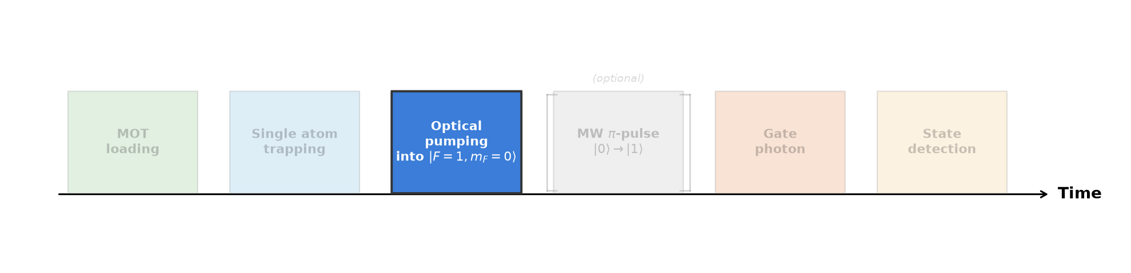
Atomic Qubit Preperation
2-2’- Pumper
1-1’ π - Pumper
Leart Zuka
Notes:
First atom is pumped into the F=1 mf=0 so our |0> clock state
------------------------------------------
This is done by using two laser beams
2-2’ pumper and 1-1’ pi pumper
Have their name from being resonant to the respective transition
Pi pumper has another feature that being that it is pi polarized
------------------------------------------
Keeping these beams on for around 340mus will lead to a preparation in the |0> clock state

Slide 17
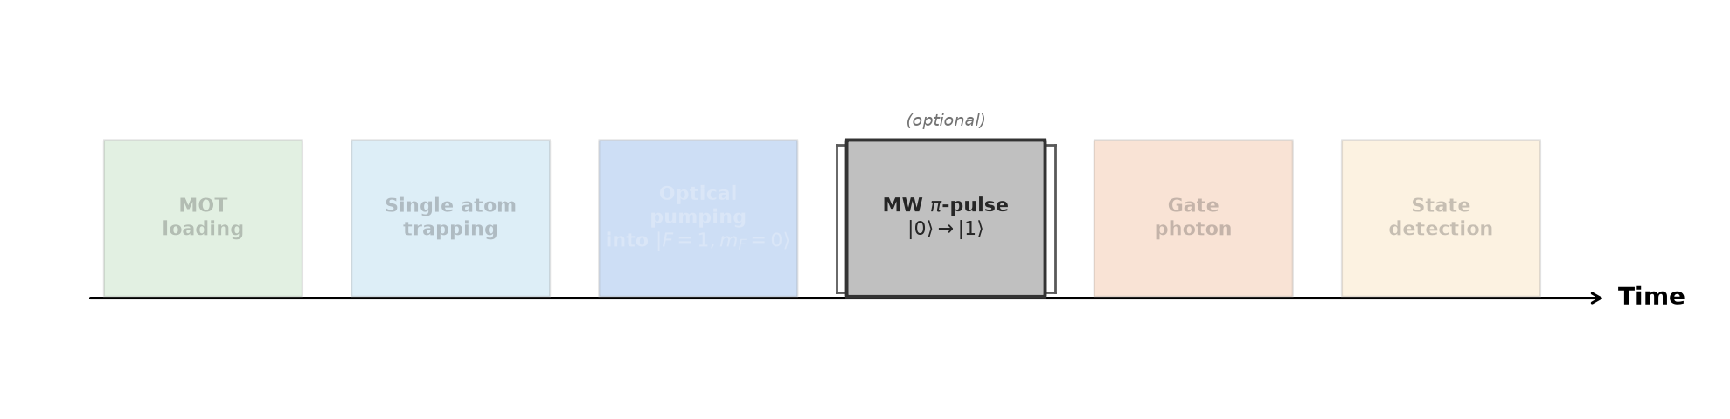
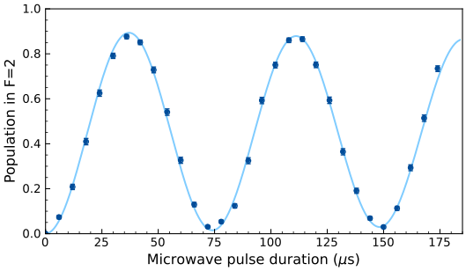
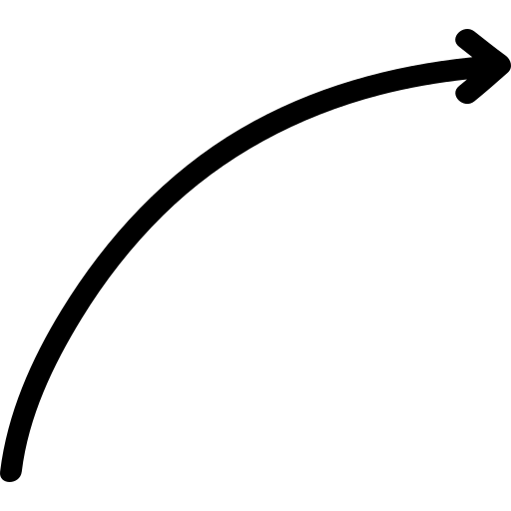
Atomic Qubit Preperation
Leart Zuka
Notes:
In order to now prepare the atom in the coupled |1> clock state, we’re using a microwave drive to transfer our states from |0> to the |1> state
------------------------------------------
On the right we can then see how by scanning the pulse duration one is able to observe the rabi flopping behavior between these two states

Slide 18
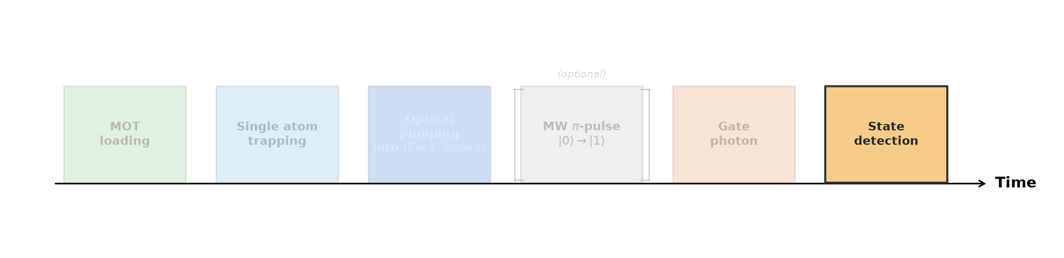
Atomic Qubit Preperation
SD – Beam
2-3’
Leart Zuka
Notes:
Reading out the atom is done by shining our state detection beam which is resonant to the 2-3’ transition of the d2 line
------------------------------------------
If atom sits in |1>, the atom will get excited and emit photons into the cavity which can get detected
------------------------------------------
If atom sits in |0>, atom will not get excited and won’t emit photons, thus also telling us that the atom was not in |1> and rather in |0>

Slide 19
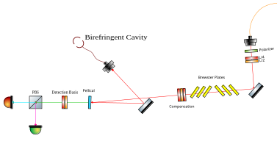

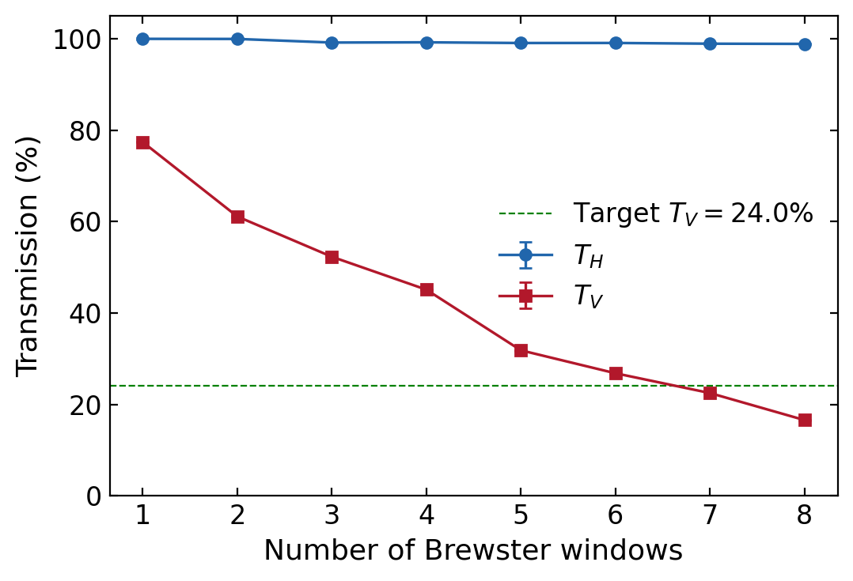
Photonic Qubit Path
Leart Zuka
Notes:
Notes:
The Photonic Qubit path serves the purpose of sending a photon, with a specific frequency and polarization, towards the cavity, without introducing and losses that are polarization dependent, and later detect the reflected photon, in a specific polarization basis
------------------------------------------
The two waveplates at the beginning after the polarizer complete the purpose of setting the incomming polarization precicely to the one we want. Furthermore these are automatic waveplates, which can be remotely controlled, so there’s no error when setting the polarization as the settings always remain the same.
------------------------------------------
The next component I want to highlight is the stack of compensation waveplates, which allow us to map the incoming H and V polarizations of our light, to the pi and V eigenmodes of the birefringent cavity, ensuring proper gate behavior
------------------------------------------
Next is the pellicle, which is used to couple in the light for the photonic qubit into the birefringent cavity in reflection. This setup was chosen, as the pellicle introduces very few polarization dependent losses, and since we’re using weak coherent beams, we don’t care that much about the fact that only a small portion will get reflected from the pellicle.
------------------------------------------
Second to last are the brewster plates which serve the job of actually including polarization dependent losses into our path. This may seem contradictory at first, but since our birefringent cavity already introduces polarization dependent losses (which I covered in the beginning), one needed to compensate this by introducing losses into the V polarization which was getting reflected better than the H/pi polarization, in order to maximise the truth table overlap for the actual gate mechanism.
------------------------------------------
Finally we have the detection basis waveplates, which are again automatically controllable, allowing to set the detection basis precicely

Slide 20
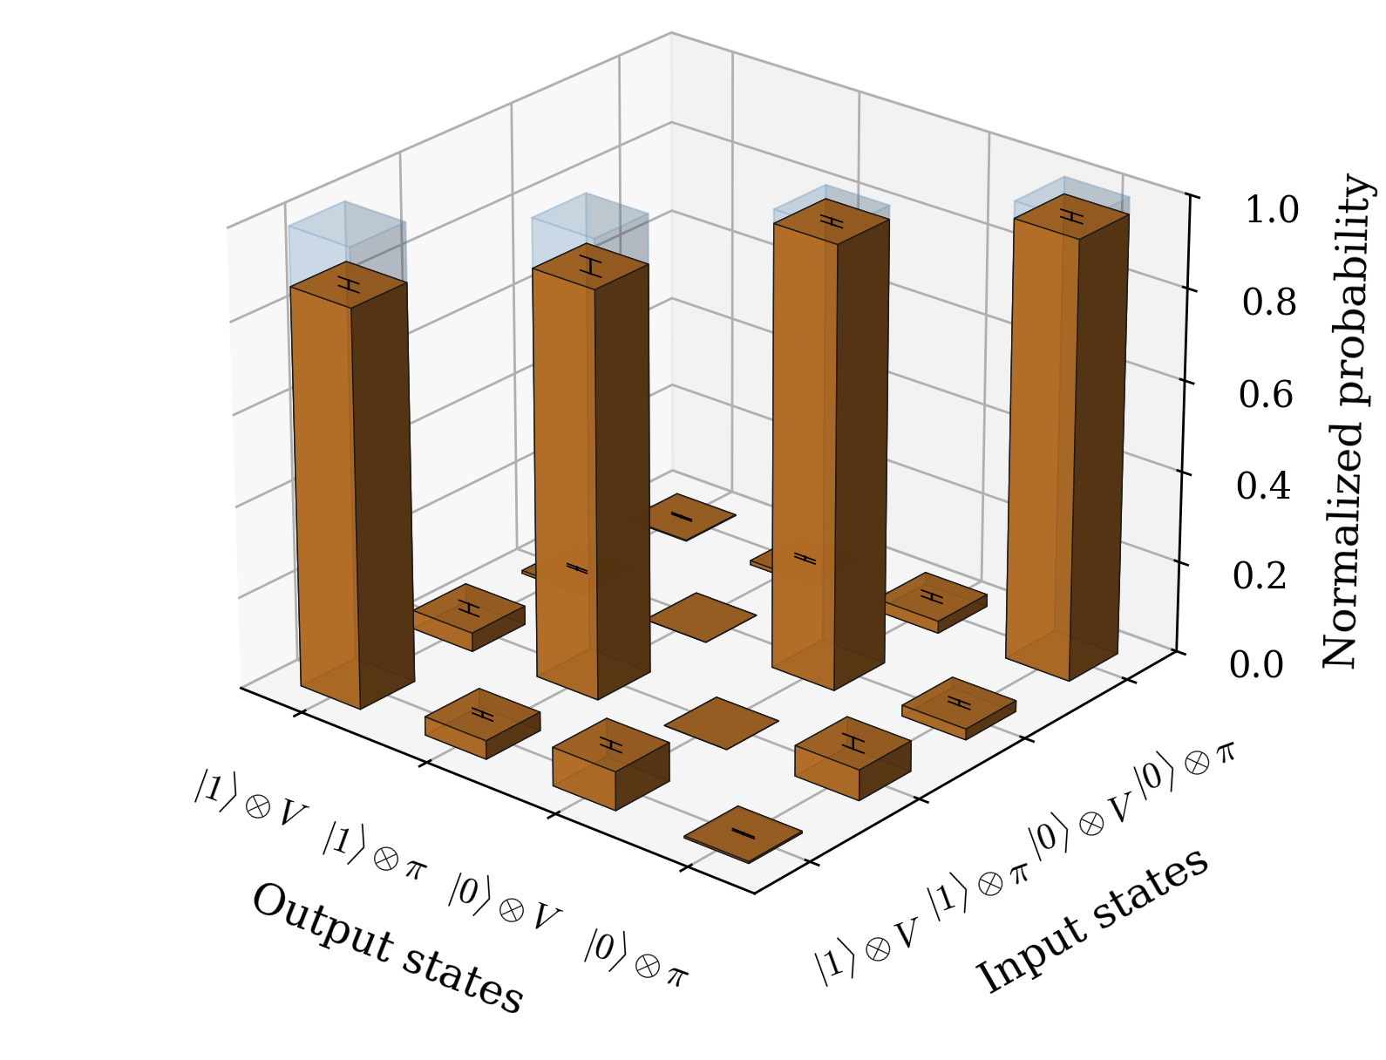
CPF Truth Table
Leart Zuka
Notes:
Looking now at the truth table for the CPF basis, meaning that the photon will either be pi or V polarized and atom will either be initialized in the coupled or uncoupled state
measures the probability of detecting a specific state
Meaning that even though the 0 pi polarized case should technically have a minus sign from the phase flip of the pi photon, it won’t be visible here.
For this measurement 0.1 mean input photons were used, and 7 brewster plates that were slotted in
Achieved overlap with an ideal CPF truth table here is: (92.41±0.52) %

Slide 21
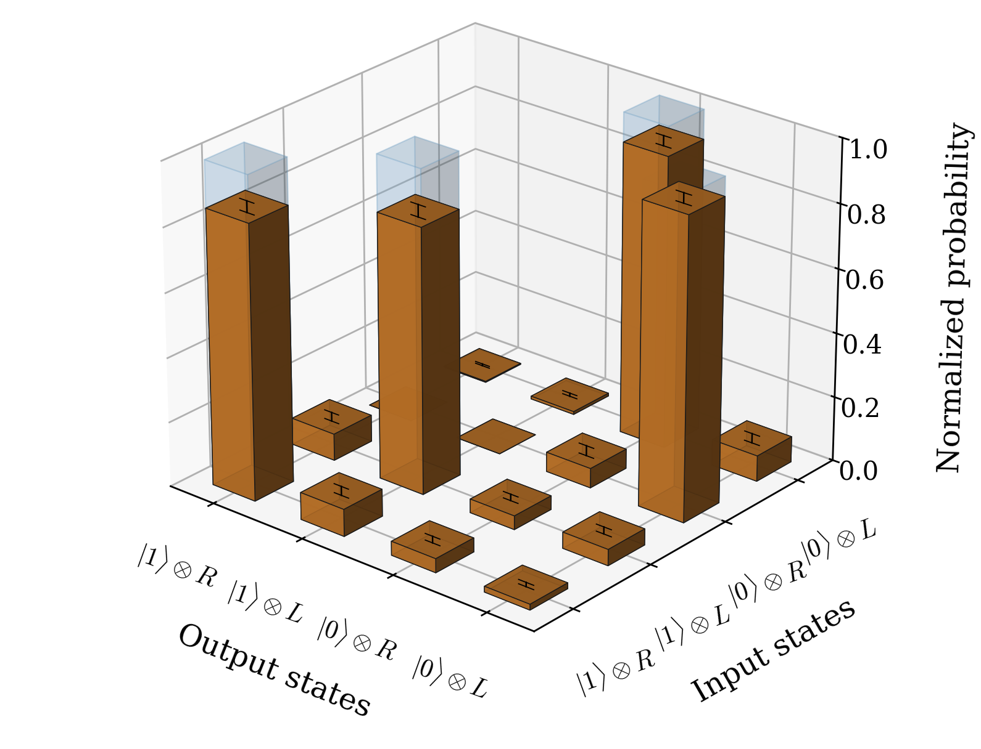
CNOT Truth Table
Leart Zuka
Notes:
Case where we can see the phase flip is when we switch over to the CNOT basis
Meaning photon will be either plus or minus polarized (here done by using the R or L polarized light), and preparing atom in either coupled or uncoupled state
Similar settings here: so 0.1 mean input photons and 7 brewster plates
Achieved overlap: (88.15±0.86) %

Slide 22
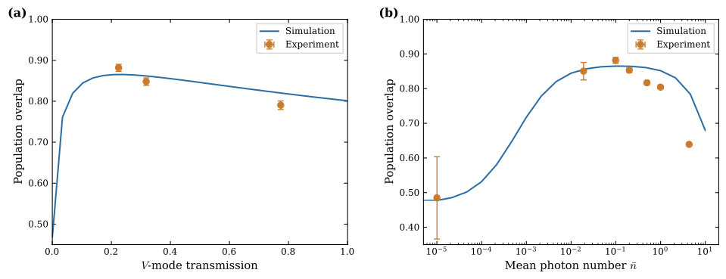

Brewster Window & Photon Number Scan
Leart Zuka
Notes:
Settings that were used weren’t chosen at random
I used a QuTip simulation to fully simulate the behavior of the CNOT gate overlap for a scan of the V-mode transmission (experimentally achieved by changing amount of brewster plates) and the mean input photon number
On the left hand side is the scan for the V-mode transmission, where the peak is at 24%, so between 6-7 brewster plates.
On the right is the mean photon number scan, where one can see 3 distinct regions:
The low photon number regime, where there’s a drop in overlap due to the noise of the detectors
The high photon number regime, where there’s a drop in overlap due to high scattering rates from multi-photon scattering events
And the intermediate one, where the highest overlap is in the region of around 0.1 mean input photons

Slide 23
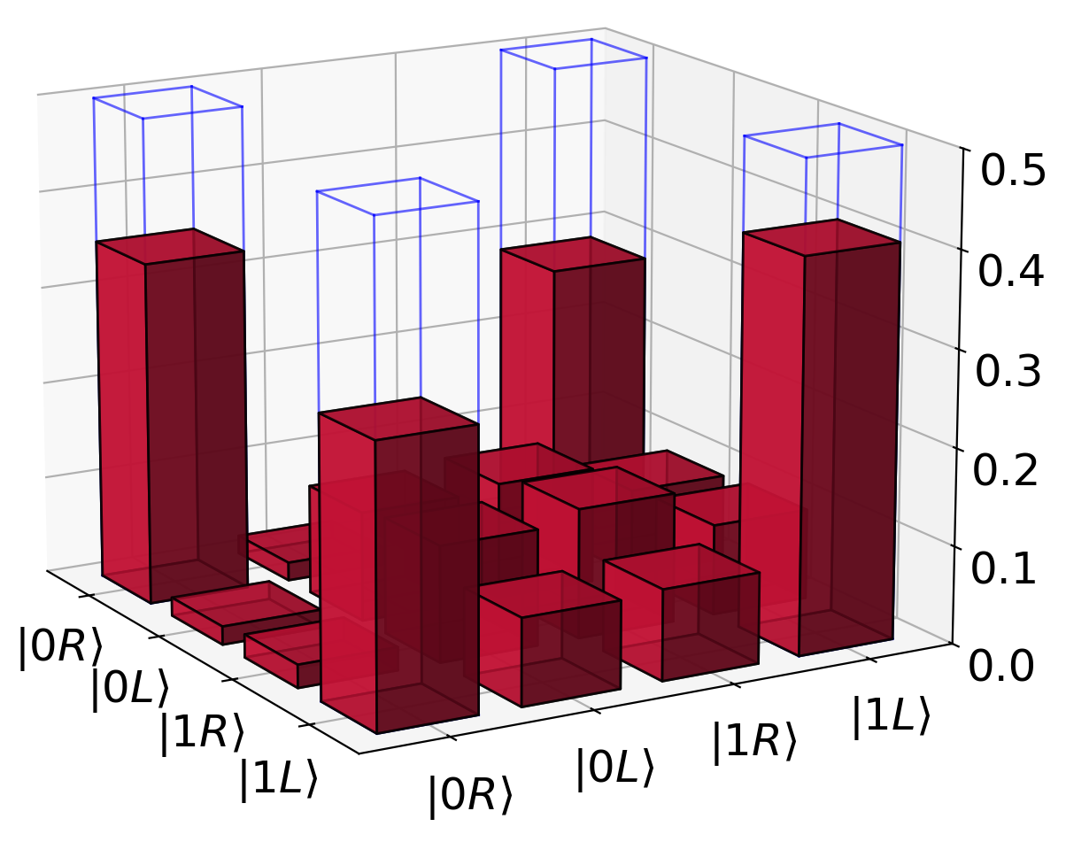
Bell State Generation
Leart Zuka
Notes:
As a final cherry on top, one is able to generate entanglement between the atom and the photon using the same gate principles as before. Showing that we have a true quantum logic gate
Here one prepares also the atom in a superposition basis by making the microwave pulse only half as long
By then setting detection waveplates and subsequent microwave pulses in a way that photon and atom get read out in X/Y/Z basis, as it is common procedure for a bell state measurement, one gets the following density matrices
Calculating the fidelity with the expected bell then gives: F = ⟨Φ+| ˆρ |Φ+⟩ = 65.90 ± 1.73%, error computed with monte carlo technique, where this value is compatible with the results taken from for the cnot truth table
Not the best result, but it is above 50% threshold with greater than 2 sigmas, showcasing the ability to generate bell states, and thus the quantumness of the gate

Slide 24

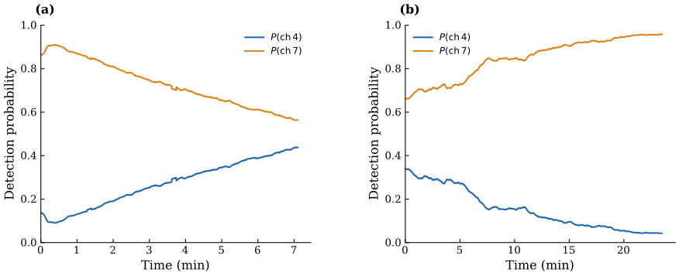
Limitations & Imperfections
Asymmetric reflection amplitudes
Imperfect atomic state preparation
Thermal sensitivity of the experimental setup
High photon number deviation in simulation
Leart Zuka
Notes:
Notes:
There’s a missmatch in cavity reflection amplitudes between the coupled and uncoupled case when sending pi polarized light
That arises from the cavity parameters themselves, and would require changing the entire cavity itself, which isn’t feasible, considering the cavity was never meant to perform a logic gate in the first place
---------------------------------------------
Furthermore another limitation is the imperfect atomic state preparation, which can be seen in the scan of the MW pulse duration, where I was only able to reach a probability of preparing |1> with around 88%. Most likely because the prep in |0> so F=1 mf=0 wasn’t that good, and some of the states leaked over to mf=+/- 1
--------------------------------------------------------
In the setup there’s the UV LED that was used during the loading of a single atom, however this one heats up some portion of the cavity fiber (either the tip or the mount or whatever), which will then lead to a drift of the double resonance of the cavity, which can be seen in the reflection. Start off with nice separation and as you turn on they drift towards one another (bad). And they drift apart when turning off UV lamp. Was mitigated to some extent by making measurements not as long (thus not allowing setup to heat up as much), and introducing cool down periods between measurements so that the separation between both detector channels goes back to its thermal equilibrium
------------------------------------------------------------
Experiments suggest much steaper drop in CNOT gate overlap as opposed to simulation, still remains to be investigated

Slide 25
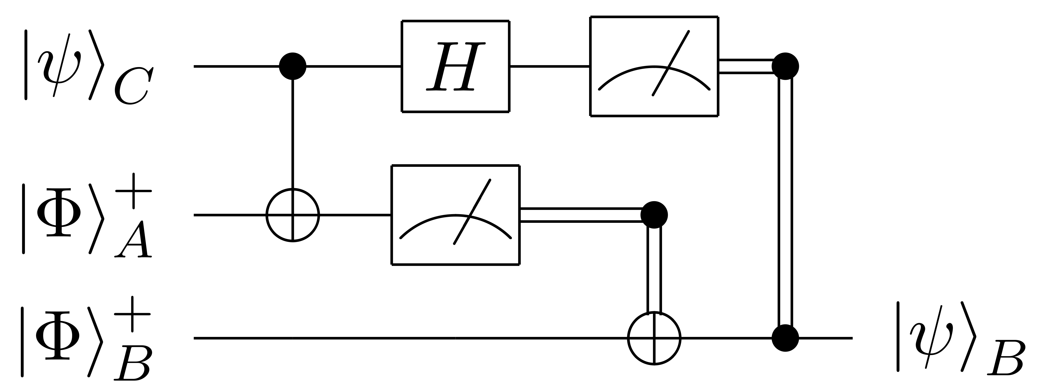
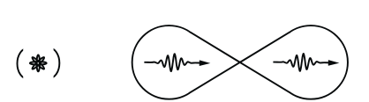
Summary & Outlook
Three preliminaries each quantum node must fulfill:
  Storage of quantum information
  Processing quantum information via quantum logic gates
  Generation of entanglement
~94.7% Brekenfeld et. al.; Nature; 647–651 (2020)
~66% Bell-State Fidelity
~87% Chiarella et. al.; Phys. Rev. Letter 135, 240802 (2025)
Reiserer, A., et al., Nature 508, 237–240 (2014)
Leart Zuka
Notes:
In summary: able to realize an atom-photon quantum gate using atomic clock states and a birefringent cavity
Looking back at the preliminaries, this means that for myself, I will be putting a check mark at the last point missing
What’s left to do is, to improve the bell state fidelity, as that’s the figure of merit to improve
Once that is done, use gate for various protocols, such as quantum teleportation, or generation of photon-photon entanglement via already existing quantum memory

Slide 26
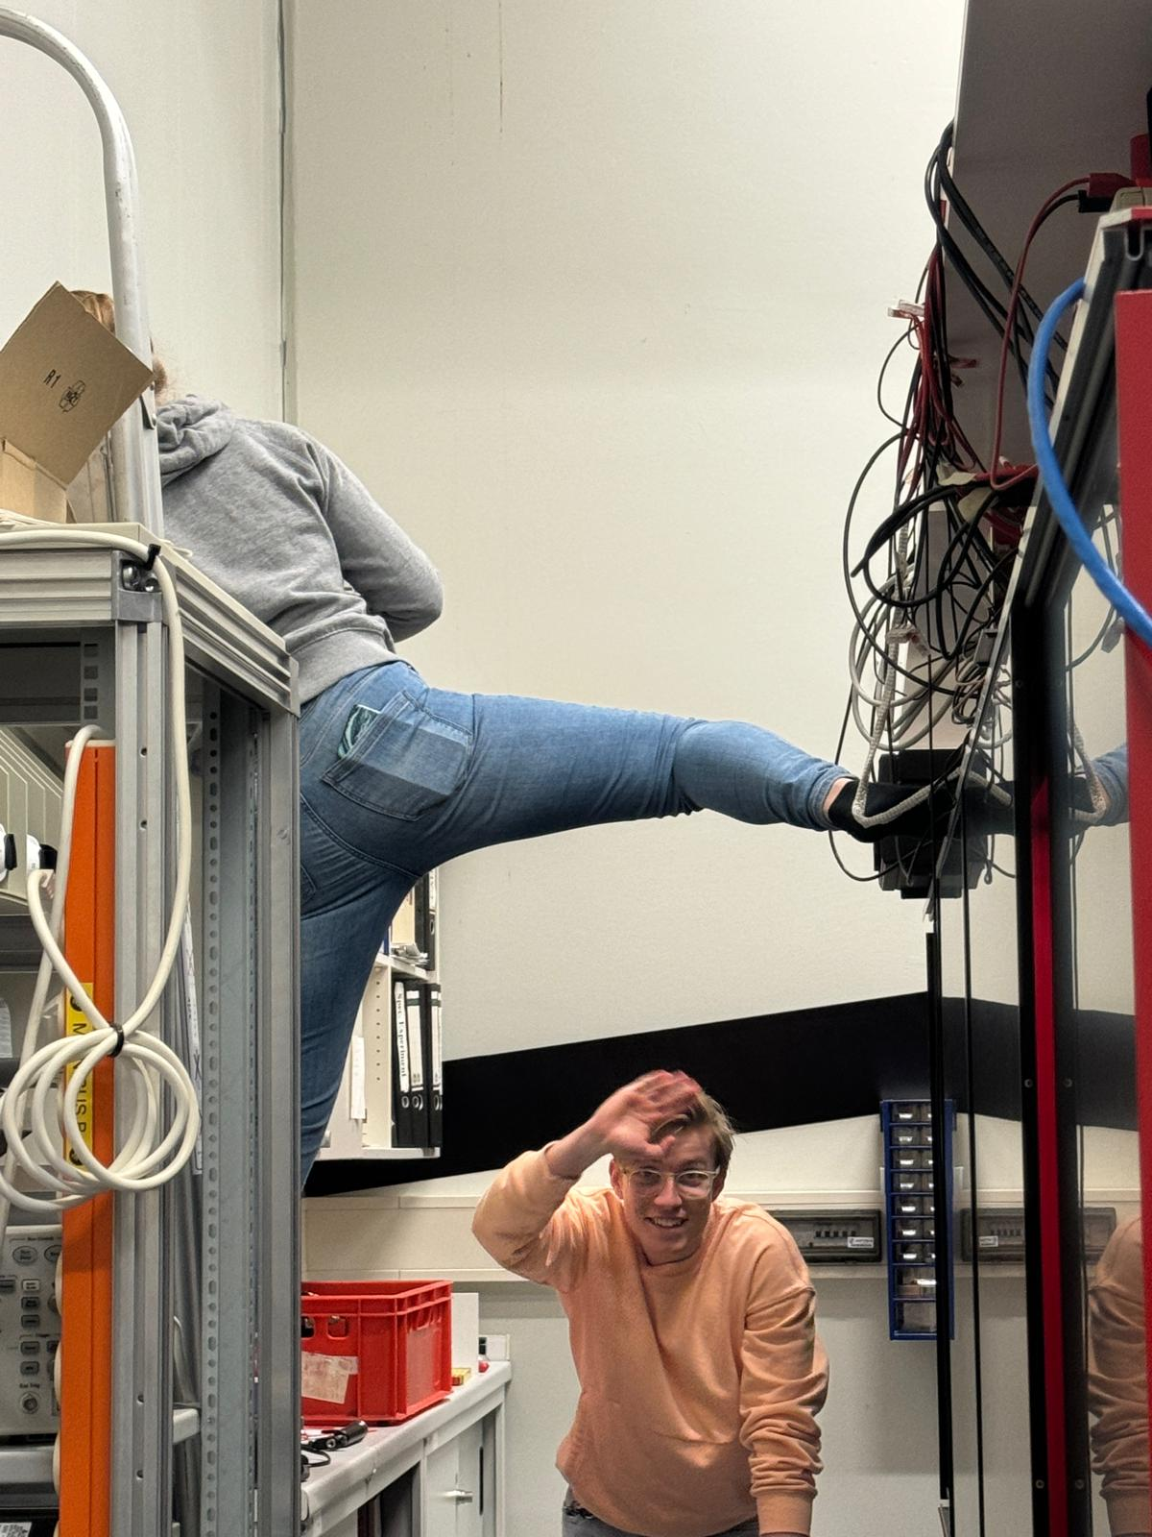
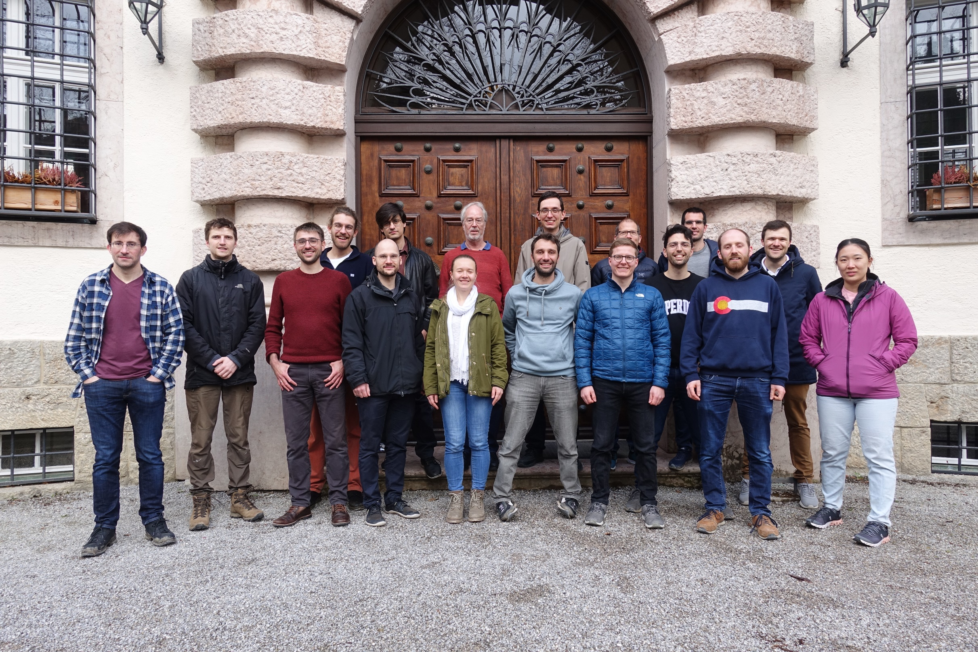
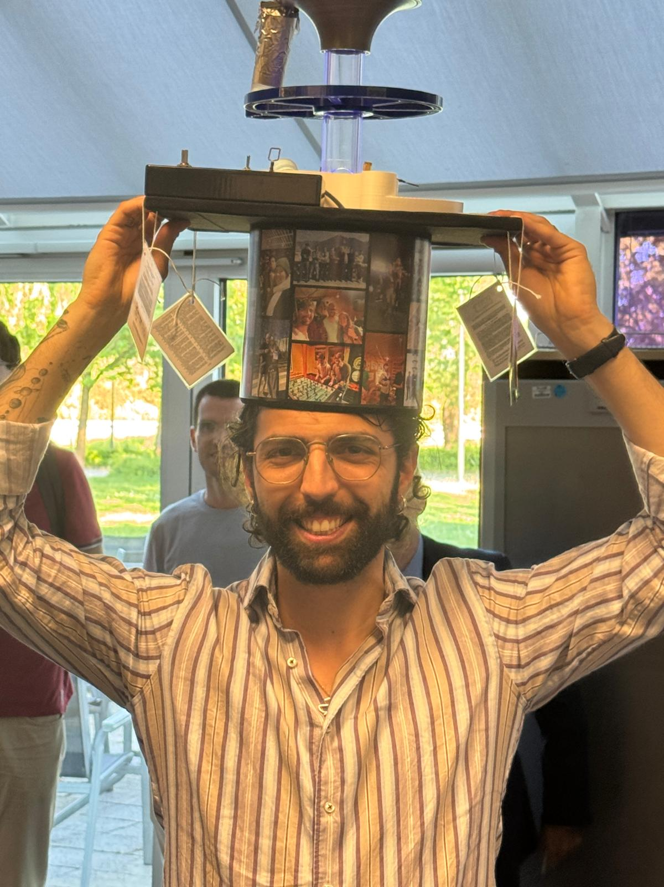

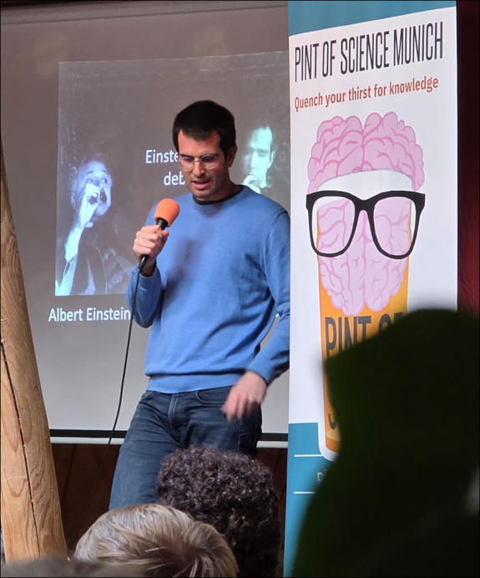

Thank you!!
Leart Zuka

Slide 28

Atomic Qubit Preperation
2-2’- Pumper
Leart Zuka
Notes:
Note:
The beginning of our gate always requires us to first pump into one specific state of our Rubidium87 D_2 line: That one being the 5S1/2 F=1 m_F = 0 clock state (highlighted in green)
The way one achieves this is by optically pumping the atom in the desired state, using two laser beams.
In order to then prepare the atom in this specific state, is by employing a laser beam that repeatedly excites the atom from a level one wishes to depopulate to a level where it will then decay to various ground states, which are just determined by the branching ratios of the respective transition.
Example: One of our beams is the so called ‘2-2’ pumper. That’s because it is resonant to the 2-2’ transition here. Once the 2-2’ pumper is switched on, it excites all the states that sit on the F=2 level up to the F=2’ level
These then decay to either back to the F=2 level or the F=1 level. If they end up back in F=2, this process just repeats until just purely due to statistics, almost no states are in F=2. Should they end up in F=1 the folliwing happens. For the 2-2’ pumper, the F=1 level is dark, meaning that it isn’t resonant to any of the transitions that would excite the states from the F=1 level to any other level. Therefor all states in F=1, rest remain untouched.

Slide 29
Atomic Qubit Preperation
2-2’- Pumper
1-1’ π - Pumper
Leart Zuka
Notes:
Note:
However we don’t just want to prepare the atom in the atom on the F=1 level, but more specifically in the m_F=0 state.
For that we will be needing the second laser, the so called `1-1-pi-pumper`
It employs the same strategy as the 2-2’ pumper, with the only extra twist that the laser beam itself, has a pi polarization. Meaning that it only drives the transitions where the delta m_F = 0 for the transition. This would then make our F=1 m_F=0 state dark, precicely what we want.
If one now employs two beams simaltaneously, we are

Slide 30
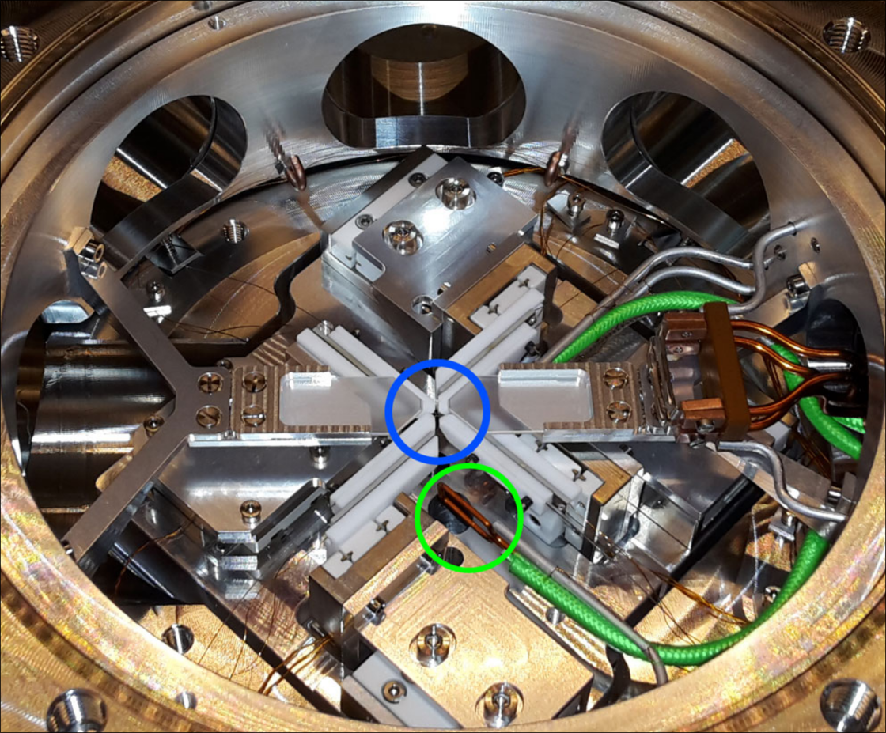
Atomic Qubit Preperation
Chiarella, 2020
Leart Zuka
Notes:
Note:
Now that we have successfully prepared the atom in the |0> state, we now also need a way of preparing it in the coupled |1> state in order to fully realize a our gate.
The way this is done in this work, is by using the microwave antennas shown in the image to drive the transition from |0> to |1>
By scanning the duration of the microwave pulse, one is able to prepare |1> state with a probability of around 88%
The remaining 12% most likely end up in the mF = ±1 state of the F=1 hyperfine manifold.

Slide 31
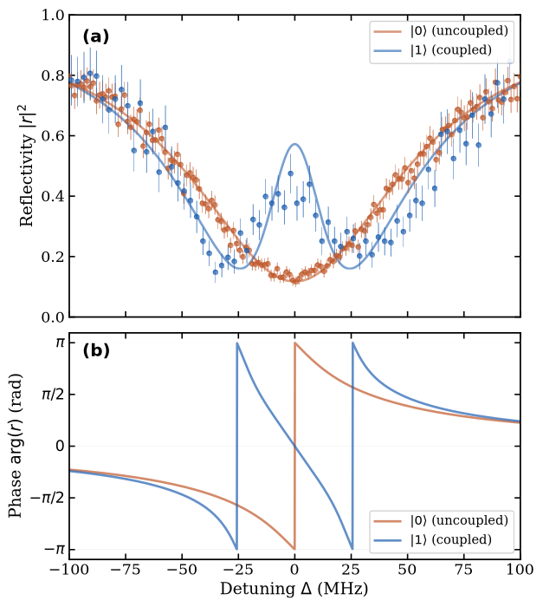
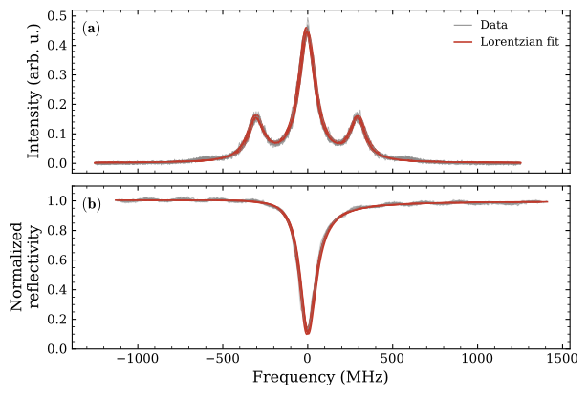
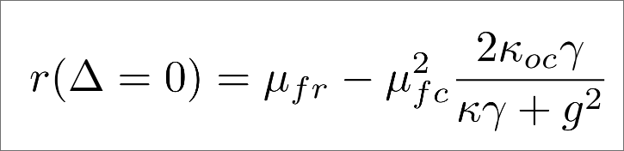
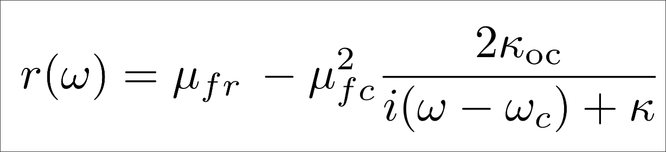
Cavity Parameter Characterization
Leart Zuka
Notes:
In order to estimate the overlap between the experimentally realizable and ideal CNOT gate, one first needs to determine various experimental parameters.
More specifically the ones needed are the cavity decay rate kappa, the coupling strength g, and the mode matching parameters mu_fc and mu_fr which arise from the fact that we’re using a fiber cavity
The cavity decay rate and mode matching parameters are obtained by scanning the frequency of a pi polarized beam while phase modulating it with a 300MHz EOM. Fitting the function seen to the reflection signla, one is able to obtain these parameters
For the coupling strength one performs a normal mode spectroscopy, where the atom is prepared in the coupled state, and the freuqency of a pi polarized beam is scanned, giving us the reflection spectrum on the right.

