Slide 1


GIT

Slide 2



Software Develop Collaboration History
people
SCM
copy paste
software configuration systems
VCS
version control systems

Slide 3
VCS
Centralized Version Control
事实标准：SVN
Distributed Version Control
事实标准：GIT

Slide 4
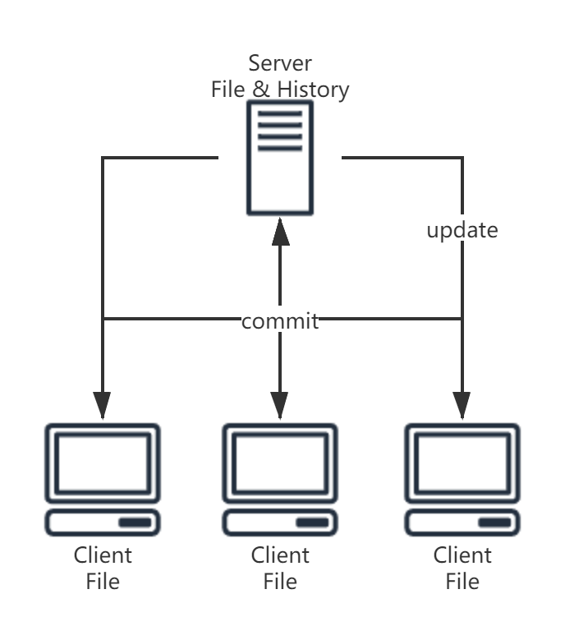
Centralized Version Control
最新的文件和历史记录全部记录在Server
Client不保存History
Cons
Server Down只能够从Client端同步文件，History会丢失 -- sigle piont of failtures
Client端需要频繁与Server端同步
拉取History需要Internet链接
大部分的操作都需要与Server端交互，Slow

Slide 5
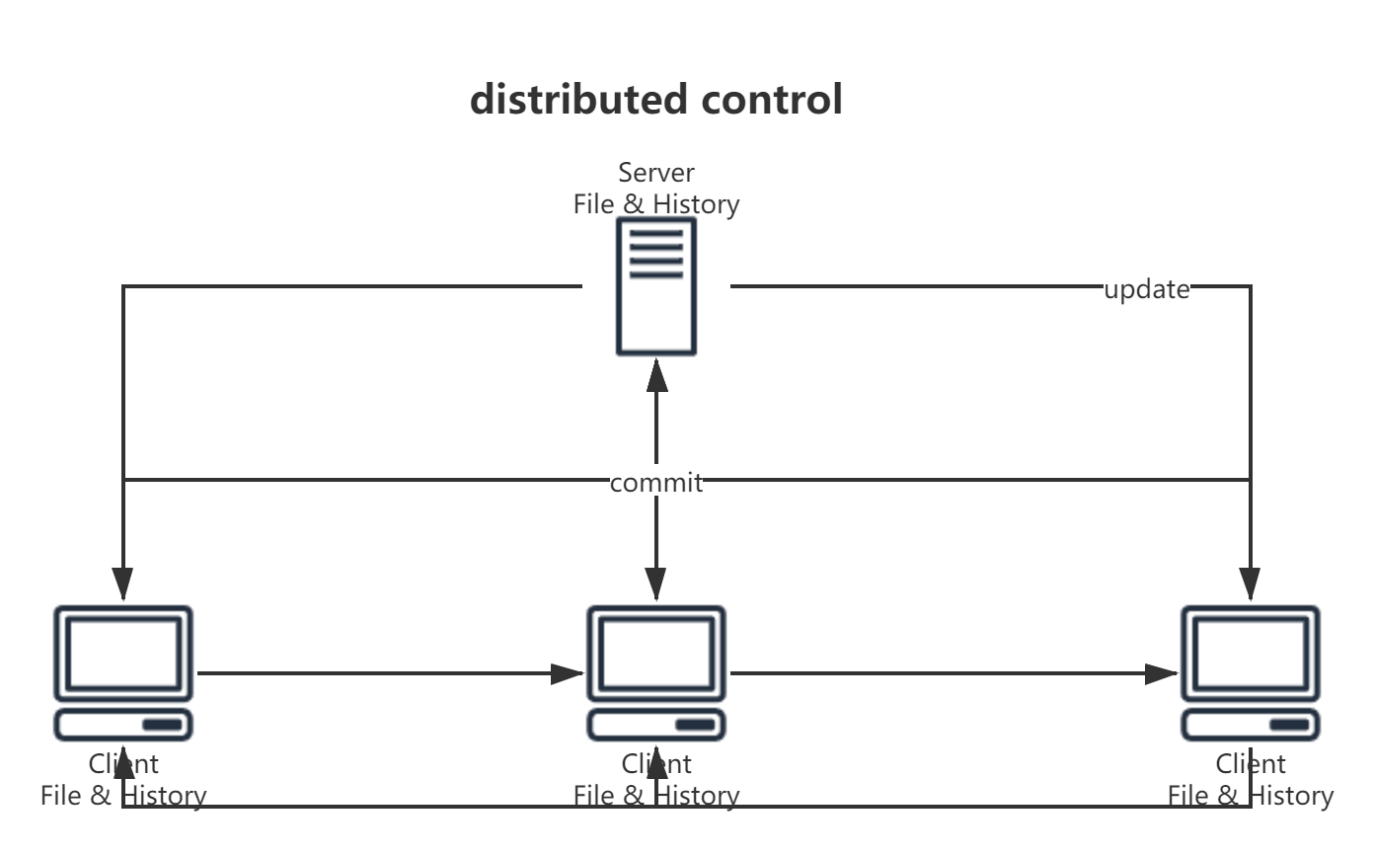
Distributed Version Control
Git - fast, scalable, distributed revision control system
Fast：可以与服务端零链接
Scalable: 可以在本地建立私有branch
Distributed: No sigle point of failtures

Slide 6
Git Version Database
Contact addressable filesystem
Simple key-value data store
Key:
SHA-1 hash (Everything is hashed)
Value:
本质: binary files
Commits: Actual git commits
Trees: Directories Structure of Filesystem
Blobs: Content of files/data

Slide 7
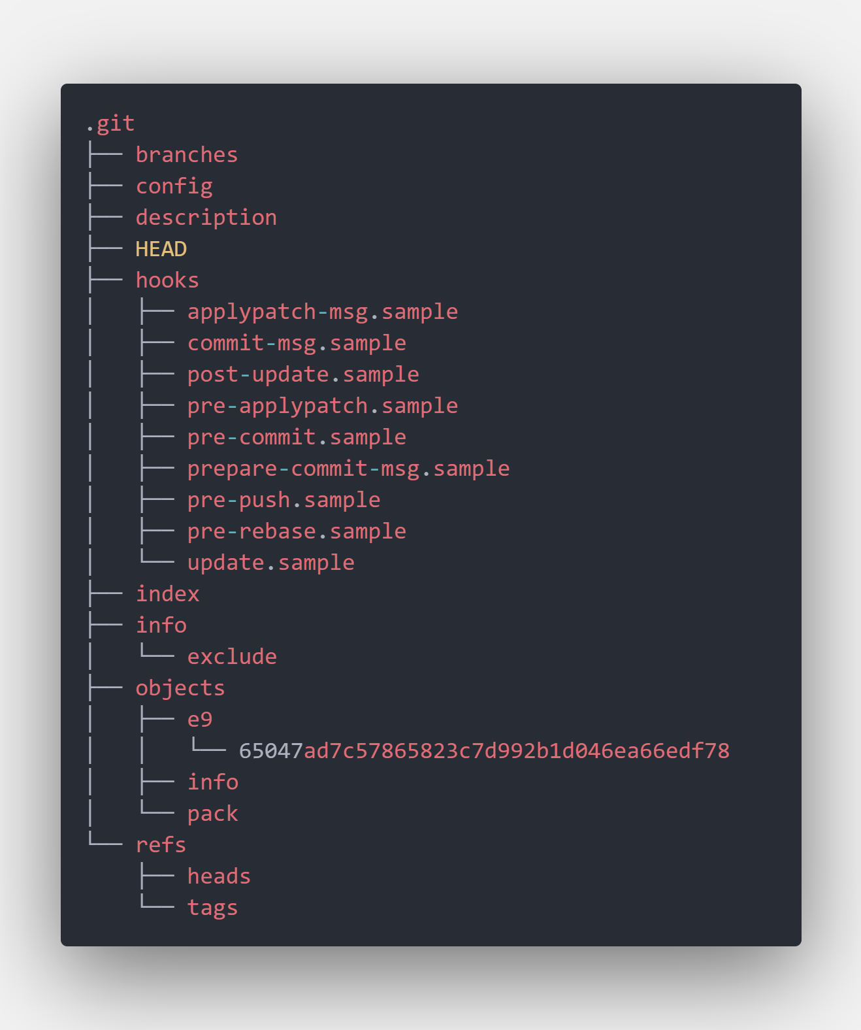
Trees
基于树的结构存储

Slide 8
Git commands
git init
Git做了什么？
1. 根据git初始模板创建.git文件夹
2. HEAD文件中写入“ref: refs/heads/master”内容

Slide 9
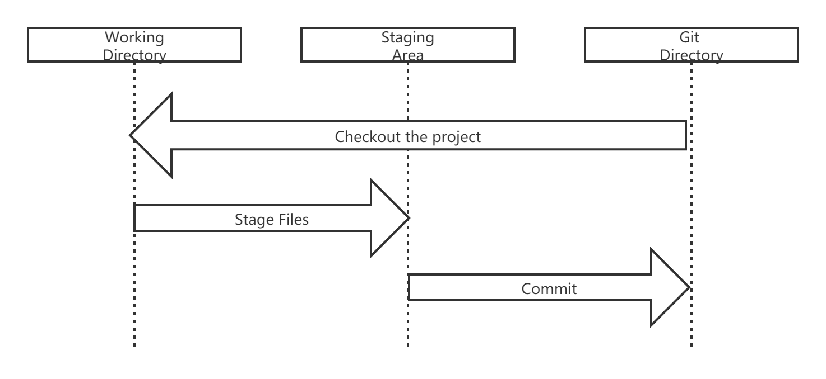
Git Data Flow

Slide 10
Git commands
git add
Git做了什么？
git hash-object -w --stdin
-- 文件内容做一个hash生成Blob hash content存进Objects(Data Store)
-- objects: tree结构 hash前两位 + hash尾数
git update-index --add --cacheinfo tag + hash + tag + filename
-- stage files存进index (Staging Area) binary
-- index: tag + hash + tag + filename
git ls-files --stage
-- 将index(Staging Area)文件转换成可读流输出到终端
-- format: https://github.com/git/git/blob/master/Documentation/technical/index-format.txt

Slide 11
Git commands
git commit
Git做了什么？
git log
-- 查看commit
git cat-file -t | -p [commitid]
-- t: id的类型 p: id的信息

Slide 12
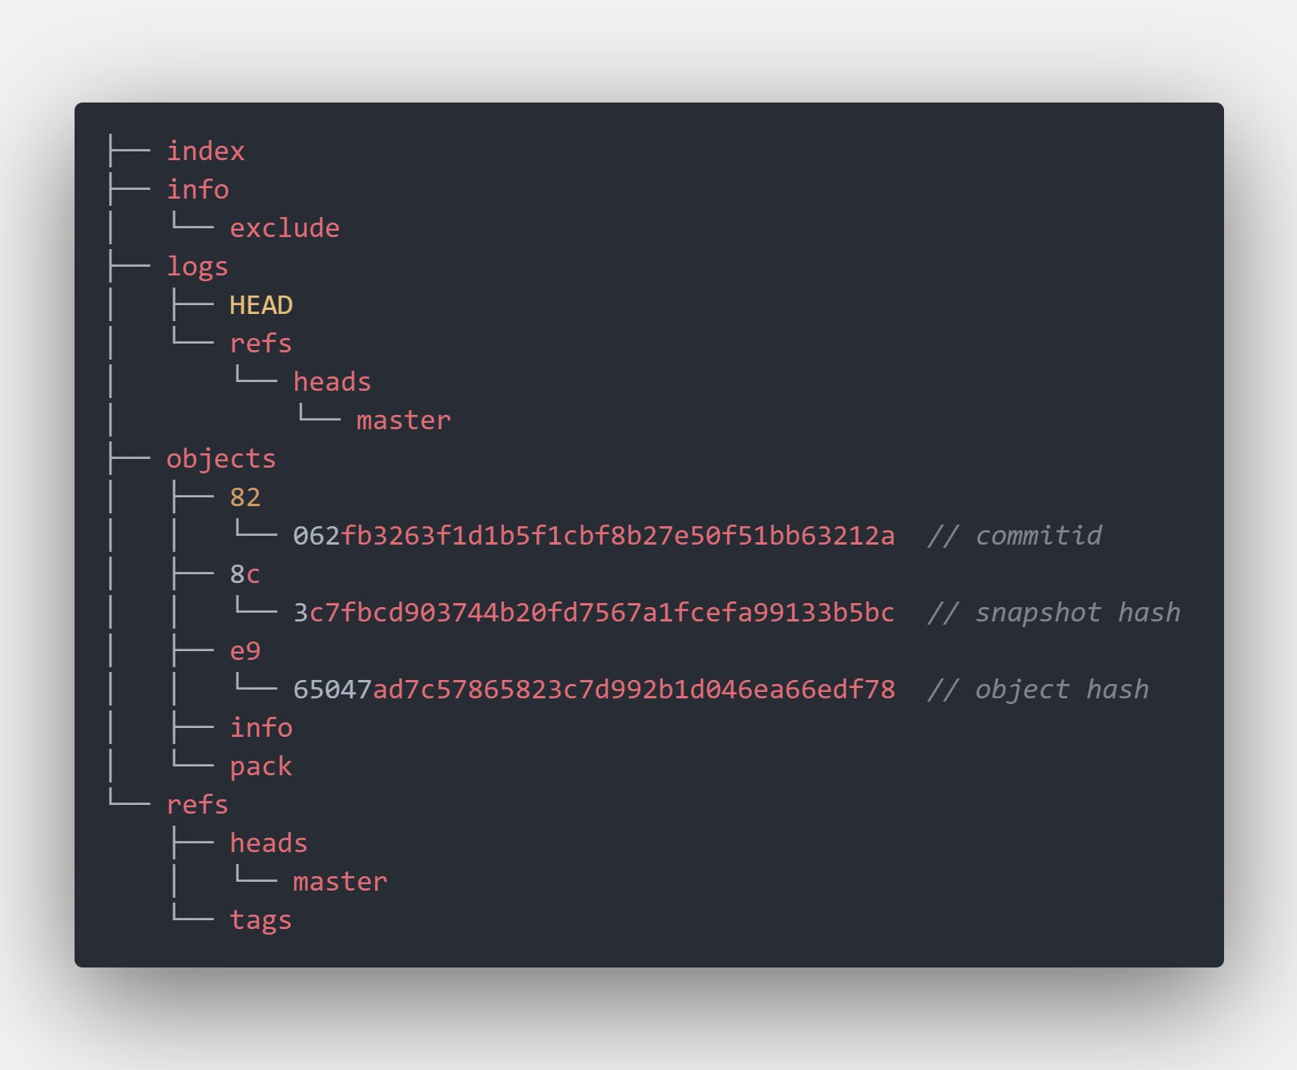
Objects
commit之后的.git变动
怎么去模拟git commmit?

Slide 13

谢谢

