Slide 1
Private traits and attributes are
predictable from digital records
of human behavior
JING CHEN YUXUAN LIU

Slide 2
Contents
01
02
03
04
Problem & Motivation
Method
Result
Take-away
Problem
Motivation
Data process
SVD
Fit model
Cross Validation
Performance evaluation
Comparison
Analysis

Slide 3
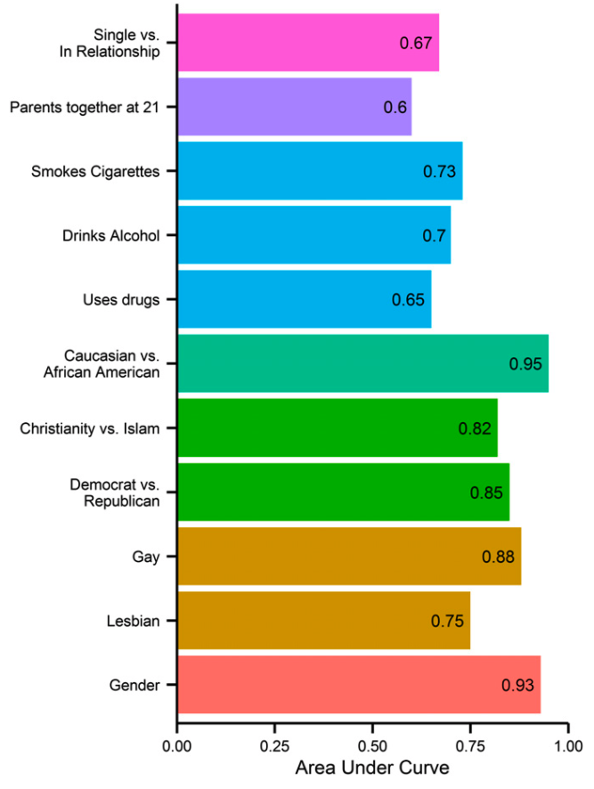
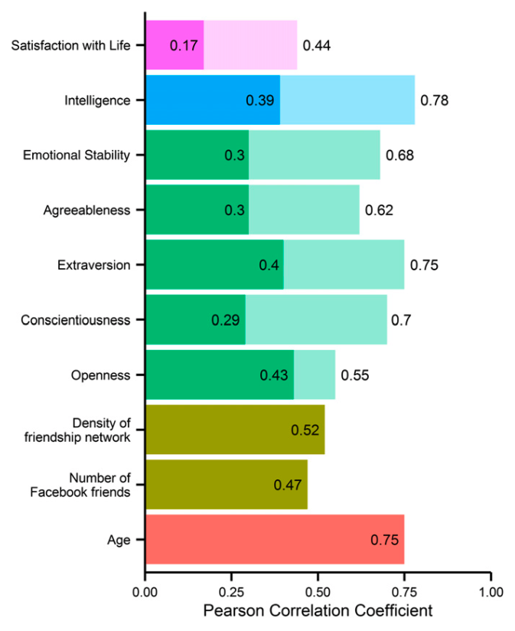
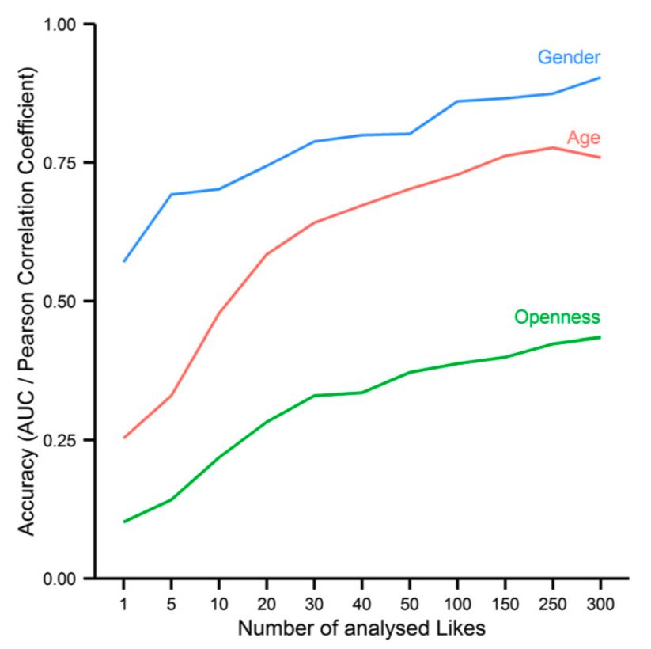
Problem
Use Facebook likes to predict users’ attributes
Only predict some of the attributes because of limited dataset
Generate charts

Slide 4
Motivation
Accurate prediction helps us to better know our users
Improve products and services
Targeted advertising

Slide 5
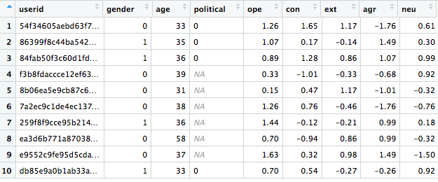
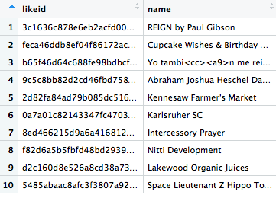
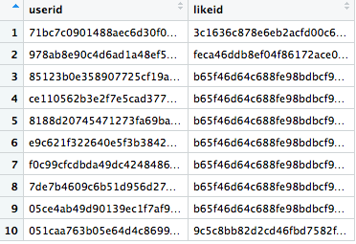
Method
Data process
Users
110,728
X
9
Likes 1,048,575 X 2
Userslikes 10,612,326 x 2

Slide 6
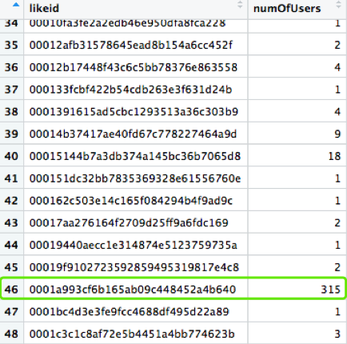
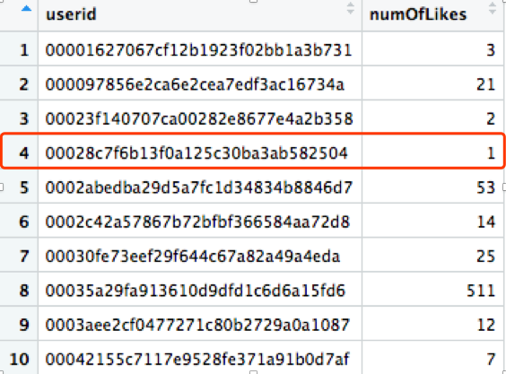
Method
Data process
Userslikes 10,612,326 x 2
Group by likeid
1
Group by userid
2

Slide 7
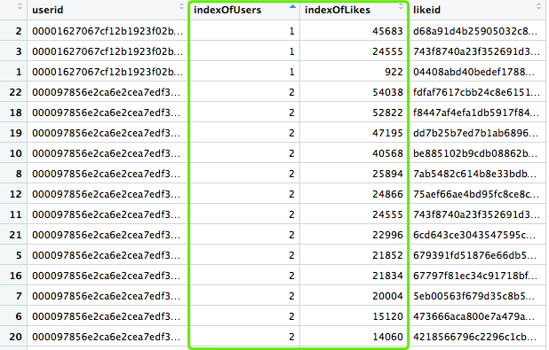
Method
Data process
Userslikes 10,612,326 x 2
Group by likeid
1
3
Merge
Group by userid
2

Slide 8
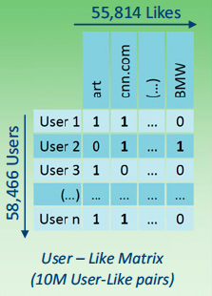
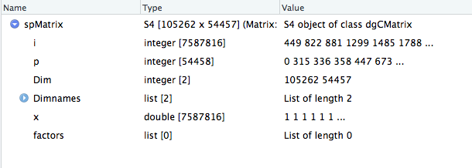
Method
Construct sparse matrix
Sparse Matrix(87Mb)
Dense Matrix(42Gb)

Slide 9
Method
SVD
54,457 Likes
Top100
Components
105,262 Users
105,262 Users
SVD
U

Slide 10
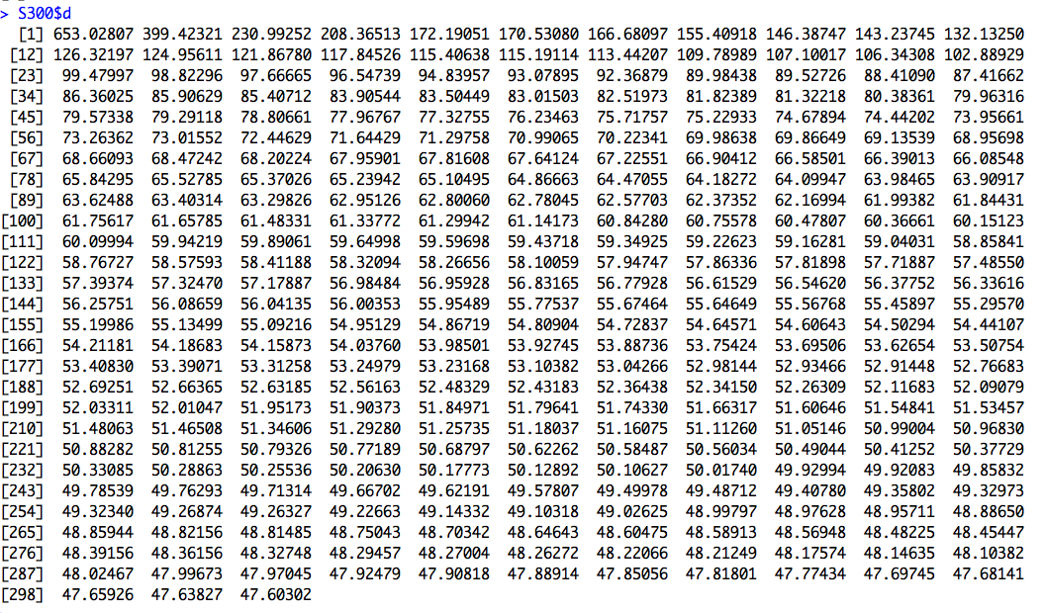

Method
SVD
Some ideas
Top 100 components only explained less than 71.88% variance of original matrix.
At least 90% is acceptable.

Slide 11
Method
model
Dichotomous Variables
Gender
Political(large number of NA)
Logistic Regression Model
Numeric Variables
Emotional Stability
Agreeableness
Conscientiousness
Openness
Extraversion
Age
Linear Regression Model
(also tried other models)

Slide 12
Method
Cross Validation
10 Folds cross validation
Predicted value
Actual value
Train set
Test set

Slide 13
Method
Amount of Data Available and Prediction Accuracy
Train set
500 Users with >= 300 Likes
Test set

Slide 14
Method
Amount of Data Available and Prediction Accuracy
300 Loops
userid
0 | 1 | 1 | 0 | 1 | … | 1 | 1 | 0 | 0
Loop 1
0 | 0 | 1 | 0 | 0 | 0 | 0 | 0 | 0 | 0
1 like
Loop 2
0 | 1 | 0 | 0 | 1 | 0 | 0 | 0 | 0 | 0
2 likes
Loop 3
.........
3 likes
0 | 1 | 0 | 0 | 0 | 0 | 1 | 1 | 0 | 0
Loop 300
0 | 1 | 0 | 0 | … | … | … | 1 | 1 | 1
300 likes

Slide 15
Result
Evaluation criteria
Dichotomous Variables
Gender
Political(large number of NA)
AUC
Numeric Variables
Emotional Stability
Agreeableness
Conscientiousness
Openness
Extraversion
Age
Pearson Correlation Coefficient

Slide 16
Result
Performance evaluation
The underlying network connectivity infrastructure needs to respond to change requests with the same agility. The underlying network connectivity infrastructure needs to respond to change requests with the same agility.

Slide 17
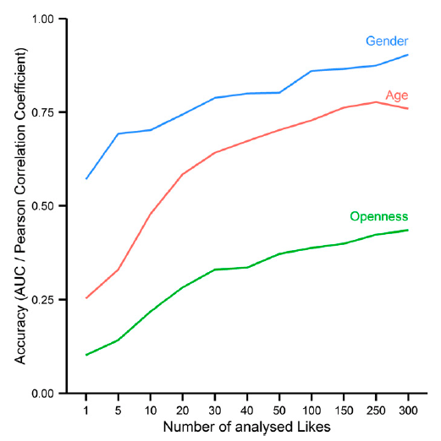
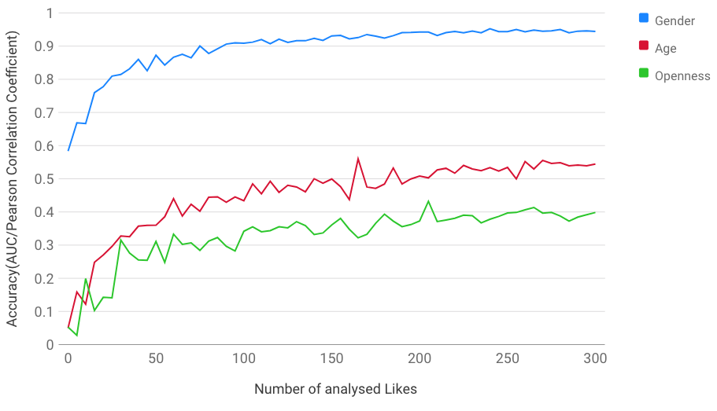
Result
Result comparison
Paper
Reproduced result

Slide 18
Result
Result comparison
 | Paper | Linear/logistic | XGBOOST
Gender | 0.93 | 0.86 | 0.86
Political | 0.85 | 0.78 | 0.79
Age | 0.75 | 0.42 | 0.57
Emotional Stability | 0.3 | 0.22 | 0.22
Agreeableness | 0.3 | 0.18 | 0.18
Conscientiousness | 0.29 | 0.21 | 0.22
Openness | 0.43 | 0.34 | 0.39
Extraversion | 0.4 | 0.23 | 0.24

Slide 19
Result
Result comparison
 | 100Components | 300Components
Gender | 0.858 | 0.879
Political | 0.785 | 0.792
Age | 0.421 | 0.469
Emotional Stability | 0.223 | 0.241
Agreeableness | 0.181 | 0.200
Conscientiousness | 0.211 | 0.232
Openness | 0.336 | 0.360
Extraversion | 0.229 | 0.252

Slide 20
Take-away
Analysis
The main reason for the difference between reproduced result and original result is the different dataset we use
Try some other kinds of model will be helpful to enhance prediction performance
Choosing reasonable K in SVD results in better prediction accuracy

Slide 21
THANKS!

