Slide 1

SIARM
Smart Institution Academic Resource Management
James Murdza | Level 3 SWE | IUGET Bonaberi | 2025 2026

Slide 2
Student Information
Name
James Murdza
Department
Software Engineering
Level
Level 3 | Sixth Semester
Matricule
IUGET/2026/SWE/0011
Topic
SIARM: Smart Institution Academic Resource Management
Academic Year
2025 / 2026
Affiliated with the University of Bamenda | IUGET Bonaberi Campus
SIARM | IUGET Bonaberi
Bachelor Project | 2026

Slide 3
Background
Fragmented
Manual
Opaque
Separate tools for grades, fees, attendance
Paper roll call, typed transcripts
No real time KPIs for leadership
Offline
Slow
Fraud
Students lose access without internet
Parents queue for hours to enrol
Paper receipts easily forged
SIARM | IUGET Bonaberi
Bachelor Project | 2026

Slide 4
Objectives
1
Unified academic platform for IUGET
2
Role aware architecture (Student, Lecturer, Staff, Admin, Parent)
3
5 channel tuition payment with privacy guarantee
4
Automated student enrolment from one form or CSV
5
QR verifiable receipts, results, transcripts, ID cards
6
Offline capable Progressive Web Application
SIARM | IUGET Bonaberi
Bachelor Project | 2026

Slide 5
Literature Review
Chen and Wang (2021)
Okafor and Eze (2022)
Cloud SIS in developing countries
Mobile payment in African HE
40% faster enrolment
78% prefer mobile money
40
78% prefer mobile money
SIARM | IUGET Bonaberi
Bachelor Project | 2026

Slide 6
Methodology | 5 Sprints (Agile Scrumban)
S1
Foundations
S2
Student & Lecturer
S3
Staff & Admin
S4
Parent Portal
S5
Polish & Defence
Reason: Requirements evolved weekly. Waterfall would have locked a stale specification. Agile allowed mid course corrections.
SIARM | IUGET Bonaberi
Bachelor Project | 2026

Slide 7
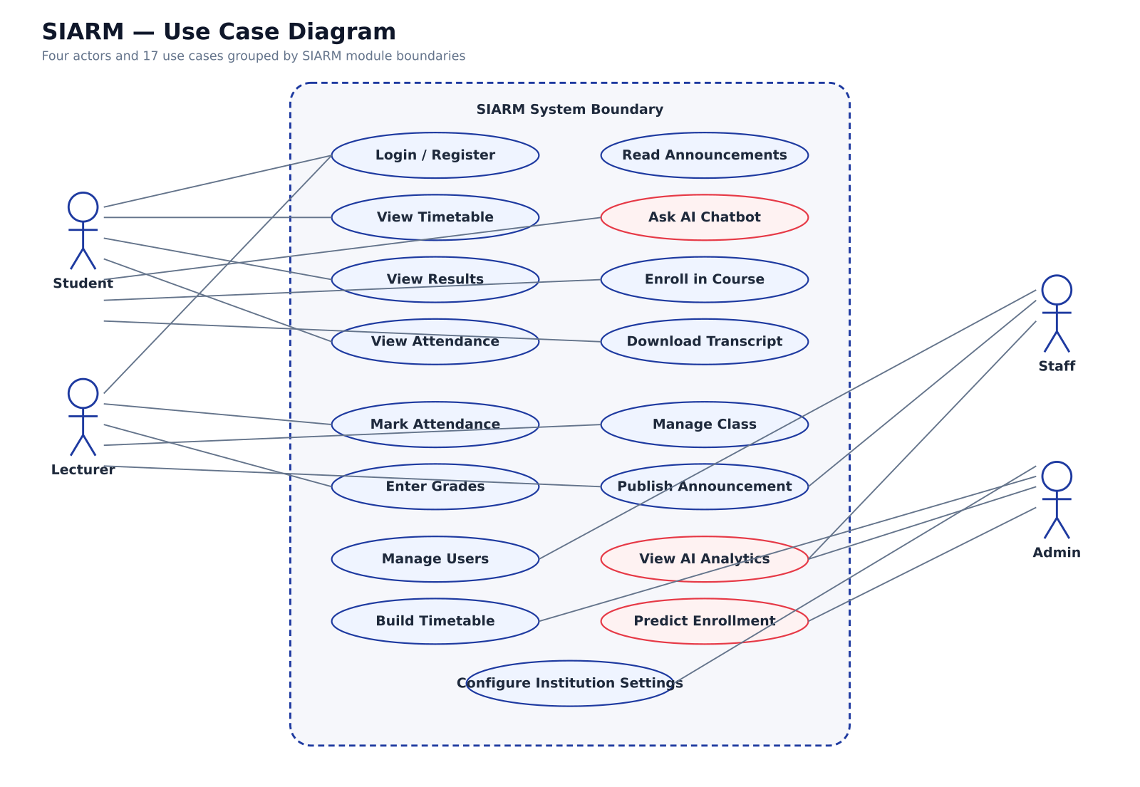
Use Case Diagram
SIARM | IUGET Bonaberi
Bachelor Project | 2026

Slide 8
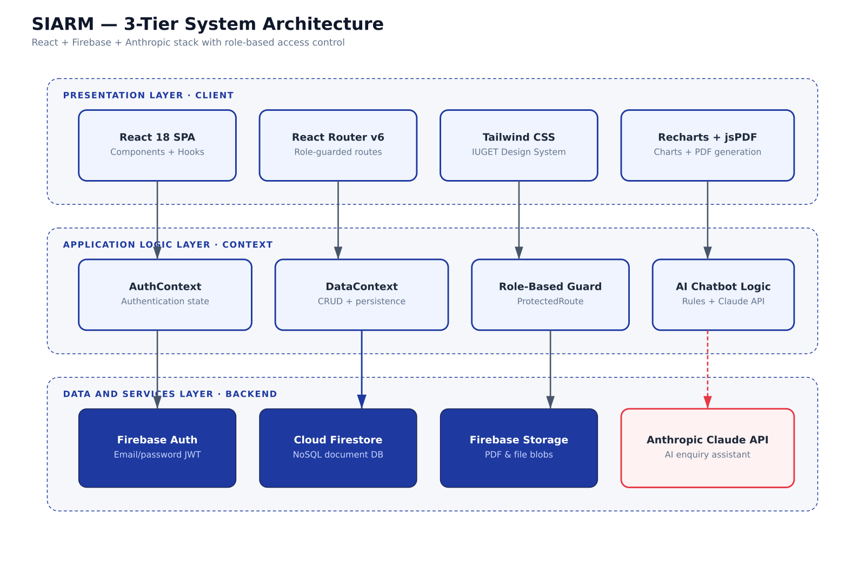
System Architecture
SIARM | IUGET Bonaberi
Bachelor Project | 2026

Slide 9
Results
25/25
92
96
Tests Passed
Performance
Accessibility
100
100
482 kB
Best Practices
SEO
Bundle Size
SIARM | IUGET Bonaberi
Bachelor Project | 2026

Slide 10
Findings & Limitations
Findings
Limitations
6 problems identified, all addressed
Chat uses mock data, not real time
5 role architecture effective
Payment flows are simulations
Mobile money integration achievable
Mock API, no persistent DB
PWA delivers offline capability
Tested with ~50 students only
Automated enrolment works
SIARM | IUGET Bonaberi
Bachelor Project | 2026

Slide 11
Future Work
Native Mobile Apps
Biometric Attendance
Live Payment APIs
Multi Tenant SaaS
Exam Scheduling
Library Module
SIARM | IUGET Bonaberi
Bachelor Project | 2026

Slide 12
Conclusion
SIARM consolidates admissions, attendance, timetable, results, transcripts, ID cards, tuition payment, financial tracking, and parent registration into a single role aware web platform.
All 8 specific objectives achieved. 25/25 tests passing. Ready for IUGET pilot.
Affiliated with the University of Bamenda
SIARM | IUGET Bonaberi
Bachelor Project | 2026

Slide 13
Thank You
Open for Questions
James Murdza | Level 3 SWE | IUGET Bonaberi

