Slide 1
Comparison data ENTSOE-EMBER

Slide 2
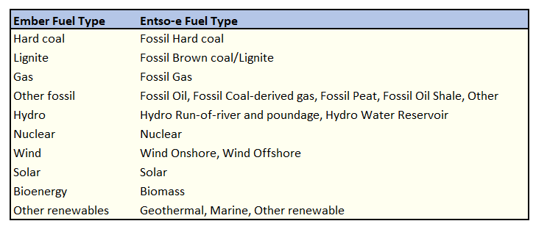

Methodology
Use of EMBER classification
What is plotted is the relative error $e= \frac{|ENTSOE−EMBER|}{|EMBER|}$

Slide 3
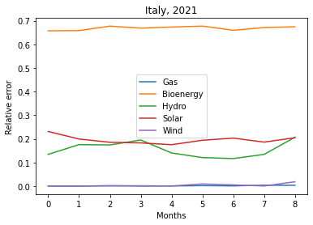
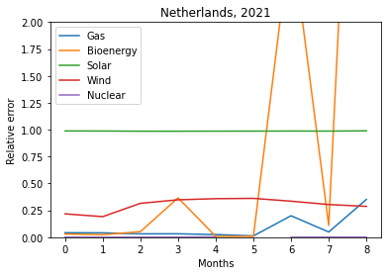
Italy 2021
Netherlands 2021

Slide 4
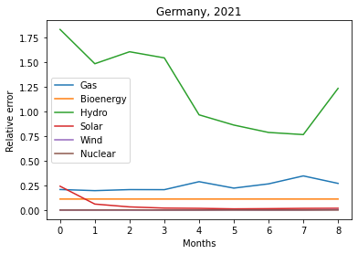
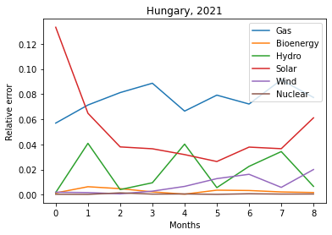
Germany 2021
Hungary 2021

Slide 5
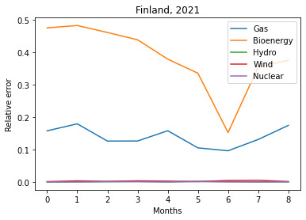
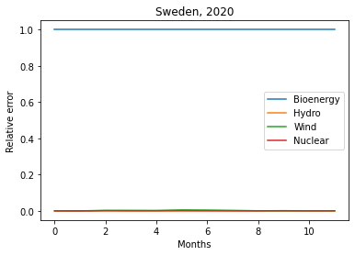
Finland 2021
Sweden 2021

Slide 6
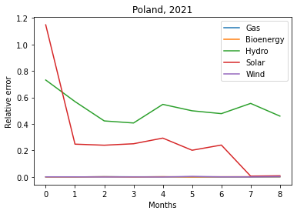
Poland 2021

