Slide 1
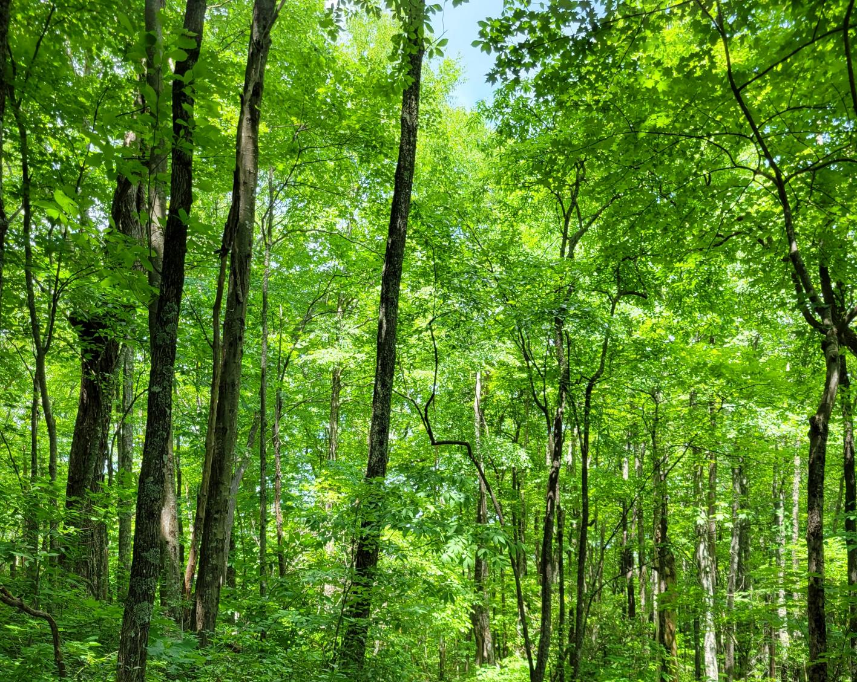






Regulation and modeling nonstructural carbohydrate dynamics
Scott W. Oswald, Doug P. Aubrey,
Dan M. Ricciuto, Jeff M. Warren
Ecological Society of America, Montréal, QC
August 18, 2022

Slide 2
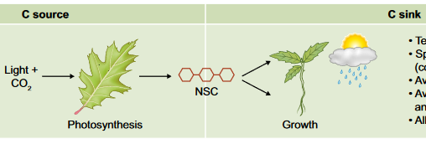
Fig 1. Fatichi et al. 2019
Respiration
Storage
Nonstructural carbohydrates = NSC = sugars + starch

Slide 3
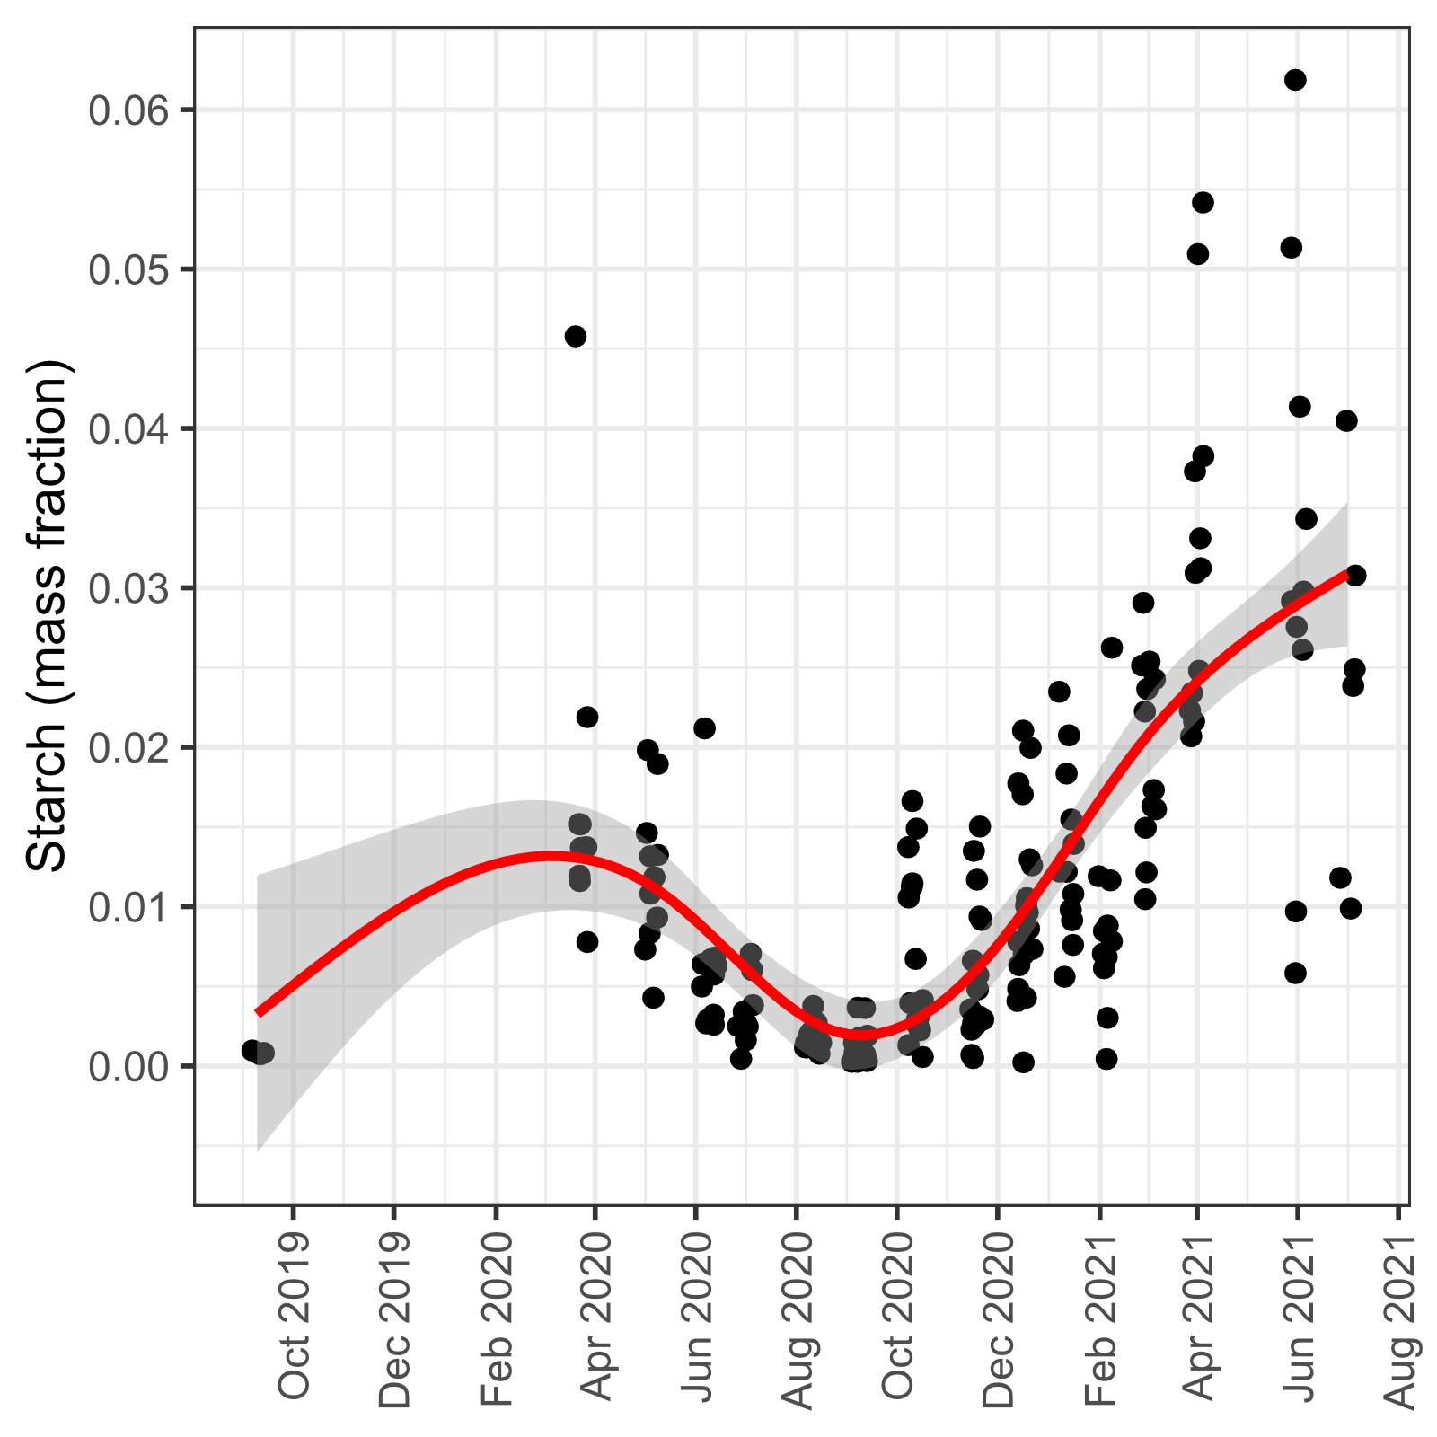
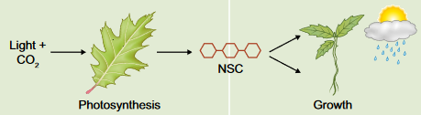
From here to there…
Loblolly Pine Saplings (Pinus taeda)
From processes to dynamics
Respiration
Storage

Slide 4
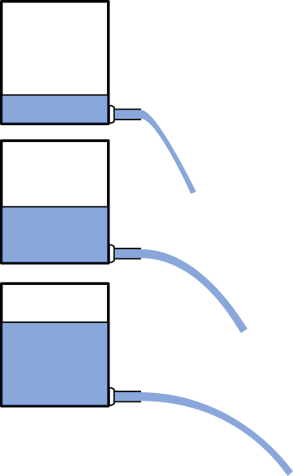
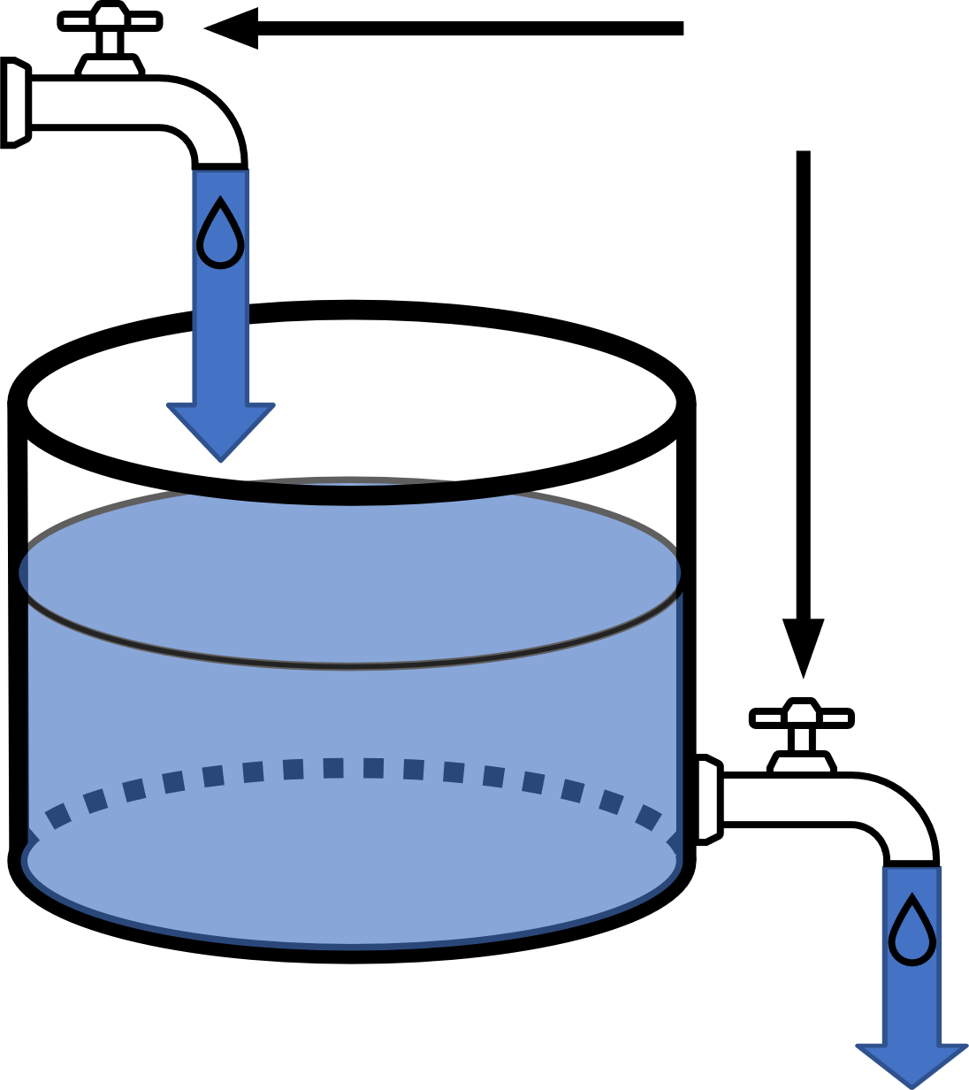

Carbon mass balance analogy
Photosynthesis = NSC supply
Environment influence
changes valves
NSC
Respiration + Growth = NSC Demand
$$\frac{d}{dt}\left[NSC\right]=supply−demand$$

Slide 5
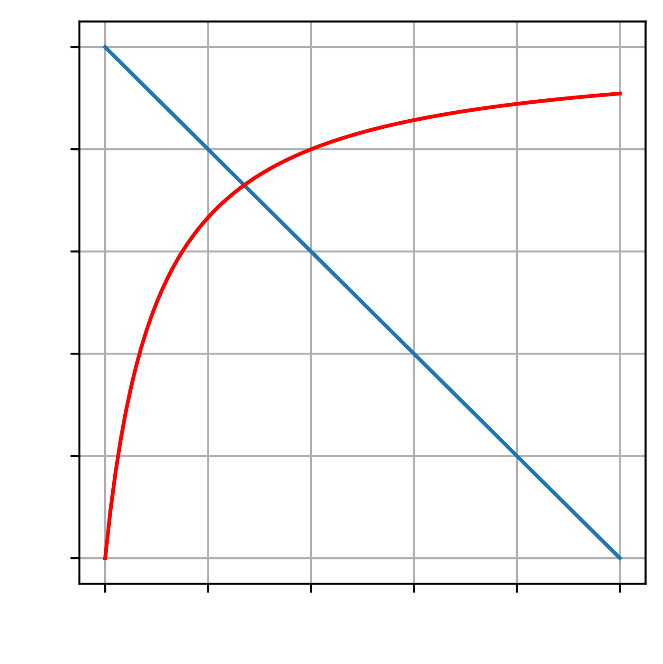
Supply and demand feedback = how inflow and outflow depends on NSC
Demand
Rate
Supply
NSC

Slide 6
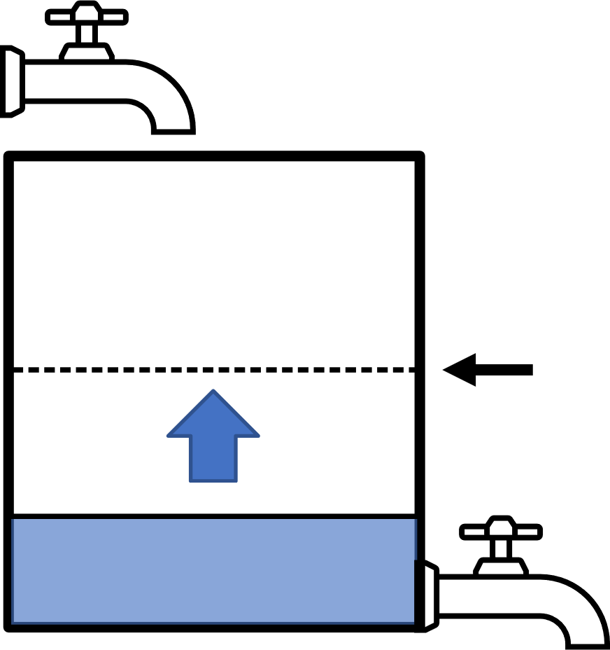
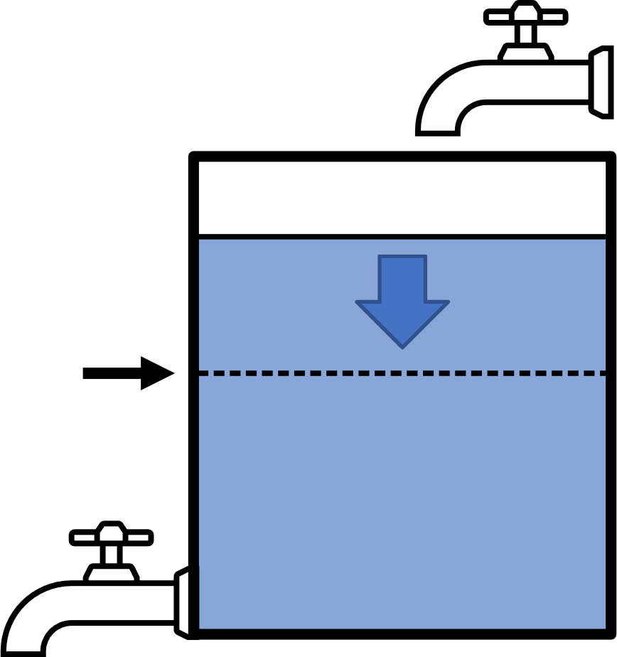


In constant environment
NSC supply and demand
feedback determines response + dynamics
Demand
$$Supply>Demand$$
$$Demand>Supply$$
Balance point
Rate
Supply
NSC

Slide 7
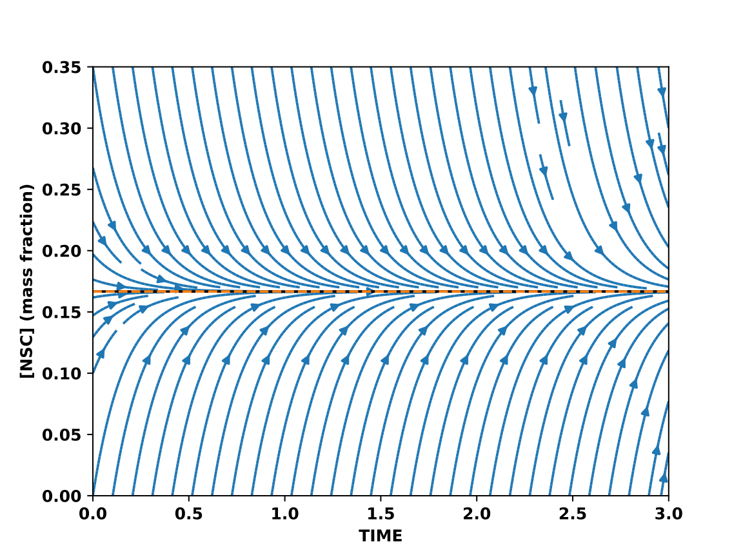
Balance point
=
Long-term NSC response
=
Attractor

Slide 8
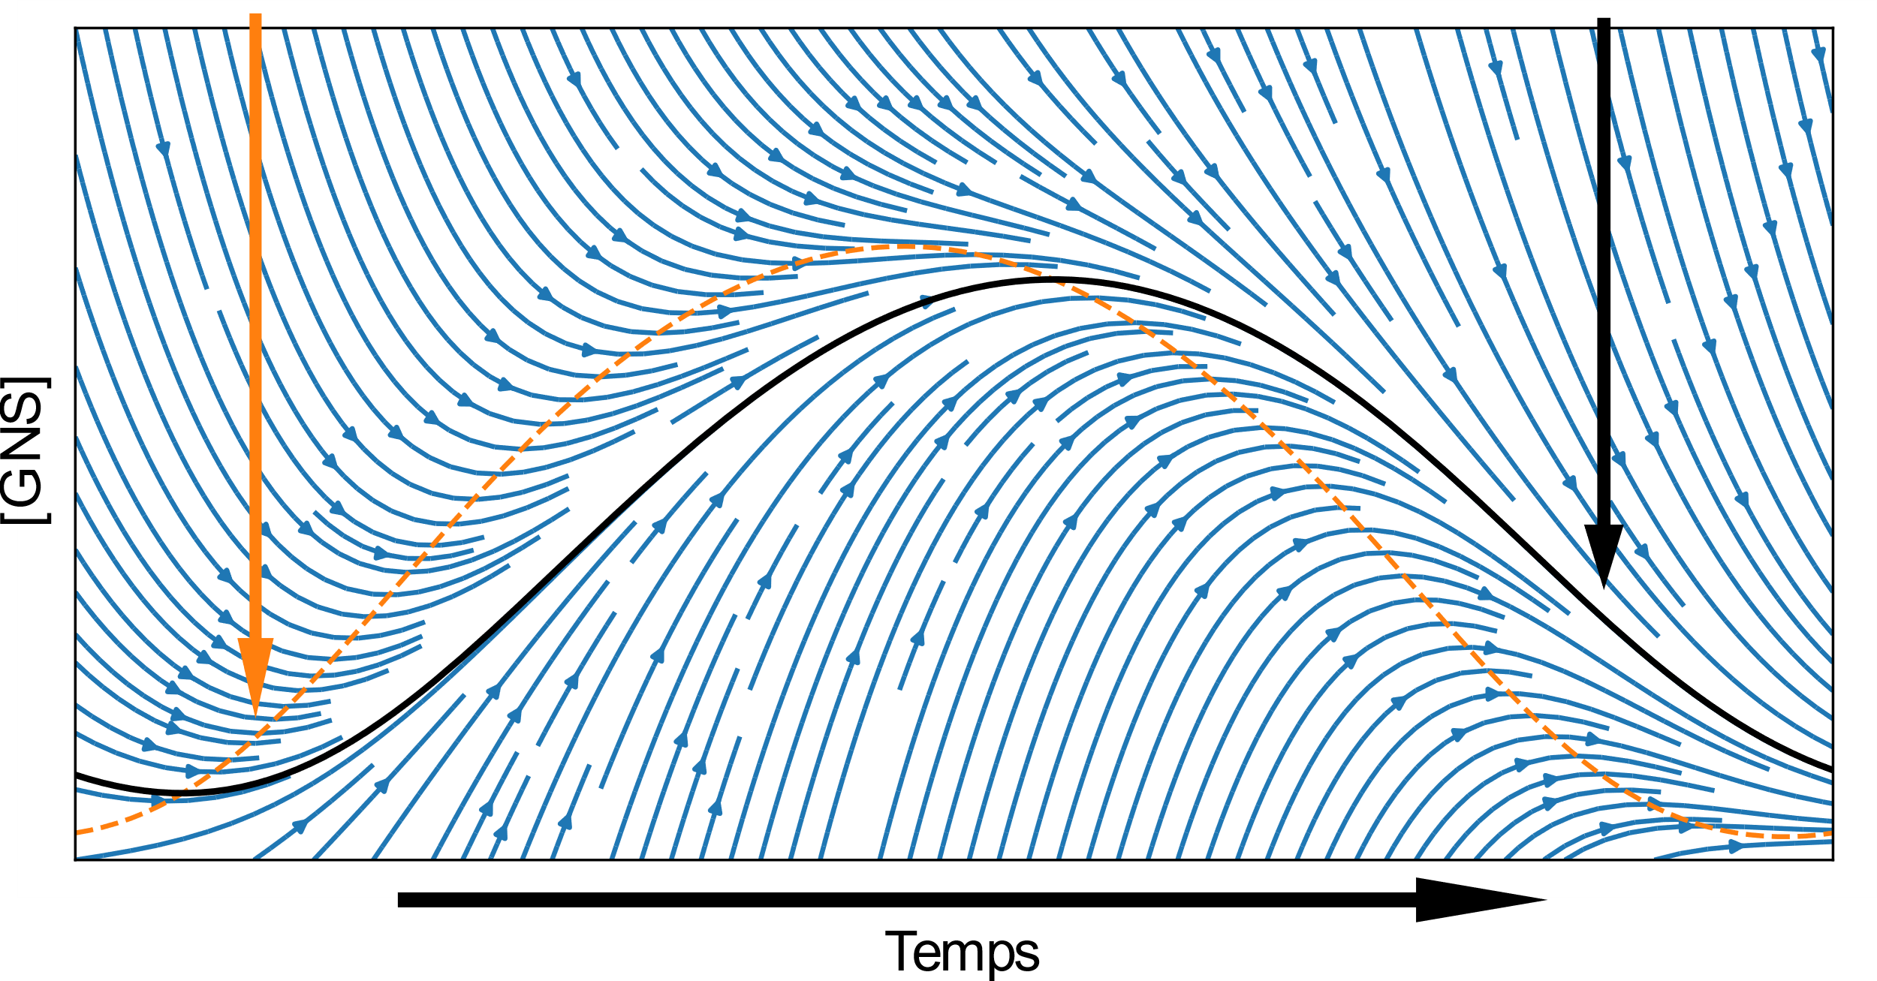
Changing environment changes
Long-term NSC response =
Balance point
Attractor
[NSC]
Time

Slide 9
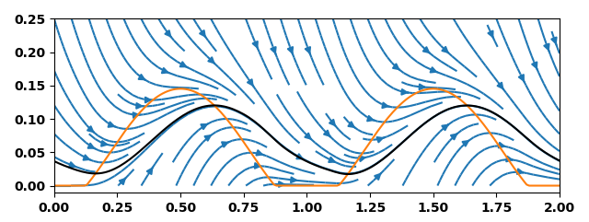
Balance point
Attractor
Environment
only affects supply
NSC (mass fraction)
Time (y)
Environment
only affects demand

Slide 10
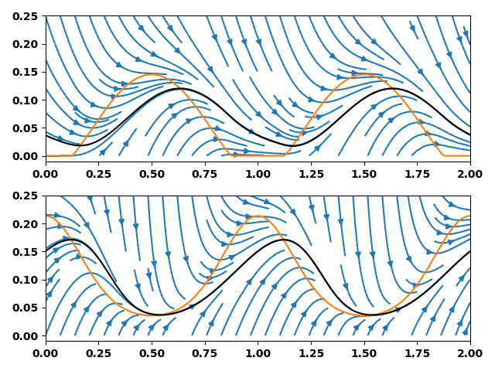
Balance point
Attractor
Environment
only affects supply
NSC (mass fraction)
Environment
only affects demand
Time (y)

Slide 11
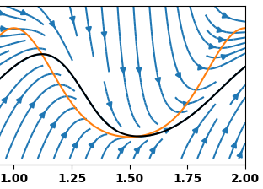
Mature Turkey Oak
(Quercus laevis)
Loblolly Pine Saplings (Pinus taeda)
Mature Longleaf Pine (Pinus palustris)

Slide 12
Summary
Photosynthesis = NSC supply
Adjustable
Demand
Complex dynamics possible with simple regulation
Rate
Supply
NSC
Regulation form determines balance point and attractor
NSC
Respiration + Growth = NSC Demand
Questions? Comments?
Hiring? Vous engagez?
leaves.and.lemmas@gmail.com
Slides available at:
www.leaves-and-lemmas.com

