Slide 1

WHEN WE TALK ABOUT GENDER BIAS
Men are promoted at 30% higher rates than women during their early career stages
Women are paid 79 cents on the dollar of their male colleagues (that drops drastically to 39 cents for the top 2% of wage earners in the U.S.)
In a study of 21,980 firms from 91 countries, just over 50% of firms didn’t have any female executives (only 11% of firms had all female executives)

Slide 2

WHEN WE TALK ABOUT GENDER BIAS
Is there a gender gap in salary?
Is there any gender bias reflecting in salary difference between male and female who works for New York Government?
Where the tax has been spent?

Slide 3
GENDER GAP IN SALARY
seethroughny.net
Top 8000
OUT OF 1,126,185 RESULTS
SeeThroughNY is designed to become the hub of a statewide network through which taxpayers can share, analyze and compare data from the state, counties, cities, towns, villages, school districts and public authorities throughout New York.
Selenium

Slide 4
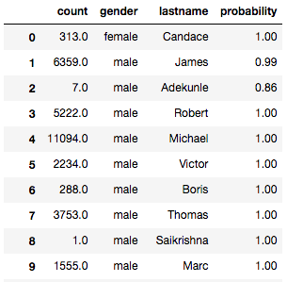
GENDER GAP IN SALARY
Genderize
Predict gender based on first name
Out of 8000 entries, 7862 predictions returned,
Prediction rate is 98%
Keep the entries with probability greater than 90%
The final dataset is consist of 7609 entries

Slide 5
GENDER GAP IN SALARY
MEN
85%
WOMEN
15%
Variables: Name Job Title Agency Total Pay Government Branch Year
Total Pay range from $1,187,506 to $ 184,667 per year

Slide 6
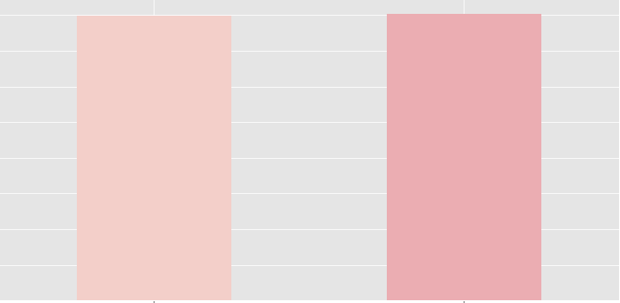
GENDER GAP IN SALARY
Average salary for males and females
213585.98
213621.01
200000
125000
50000
female
male

Slide 7
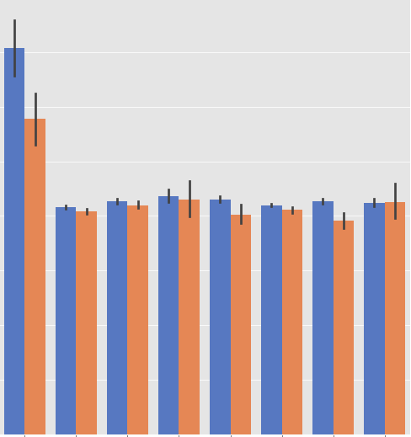
GENDER GAP IN SALARY
Branch Pay Histogram
1: Public Authority
Gender
350000
2: New York City
Male
Female
3: Schools
4: Special Districts
250000
5: Villages
6: Counties
150000
7: Cities
8: Towns
50000
0
1
2
3
4
5
6
7
8

Slide 8
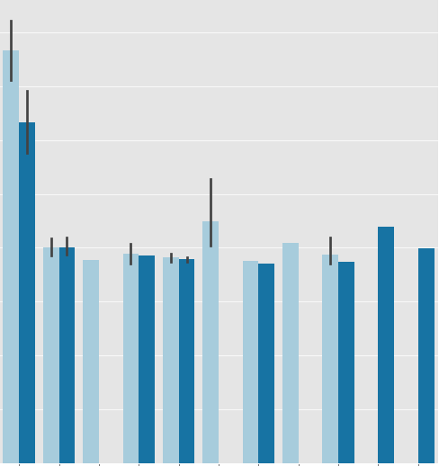
GENDER GAP IN SALARY
1: Cancer Institute
2: Municipal Authorities
3: Development Authority of the North Country
4: Affordable Housing Corporation
5:Dormitory Authority
6:Rochester-Genesee Regional Transportation
7:Urban Development Corporation
8:Central New York Transportation
9:Energy Research
10:Niagara Frontier Transportation
11:Hudson River Park Trust
Gender
400000
Male
Female
300000
200000
100000
0
1
2
3
4
5
6
7
8
9
10
11

Slide 9

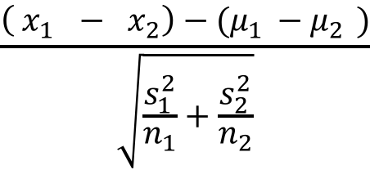
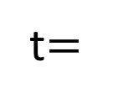
GENDER GAP IN SALARY
$$\frac{\left( x_{1 }− x_{2}\right)−(μ_{1 }−μ_{2 })}{\sqrt{\frac{s_{1}^{2}}{n_{1}}+\frac{s_{2}^{2}}{n_{2}}}}$$
t$=$
Two sample T-Test for salary gap
in Roswell Park Cancer Institute
With p-value < 0.01, there is a statistically significant difference between female and male's salary in Roswell Park Cancer Institute

Slide 10
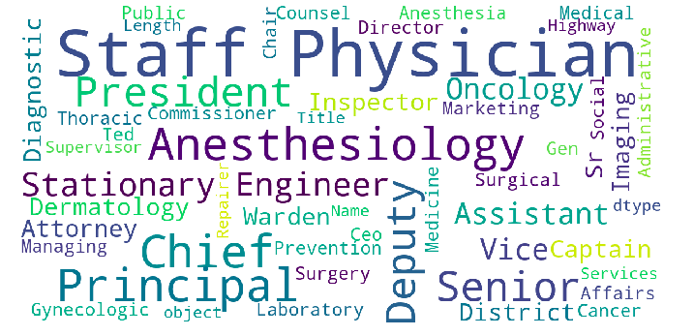
GENDER GAP IN SALARY
Word Cloud for Female Titles

Slide 11
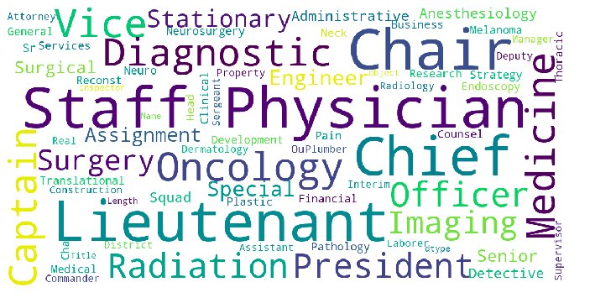
GENDER GAP IN SALARY
Word Cloud for Male Titles

Slide 12
GENDER GAP IN SALARY
Captain
Chief
Physician
Administrative
Male
The percentage of males and females with same job title
Female

Slide 13




GENDER GAP IN SALARY
Captain
Chief
Physician
Administrative

Slide 14
GENDER GAP IN SALARY
Conclusion
There is no significant difference regarding the average pay between males and females for top 8000 employees for New York Government
Females and males working professionals in Roswell Park Cancer Institute are paid differently
Future Improvement
Scrape more data to avoid bias
Dataset with more variables eg. Work years/working experience
Logistic regression

