Slide 1
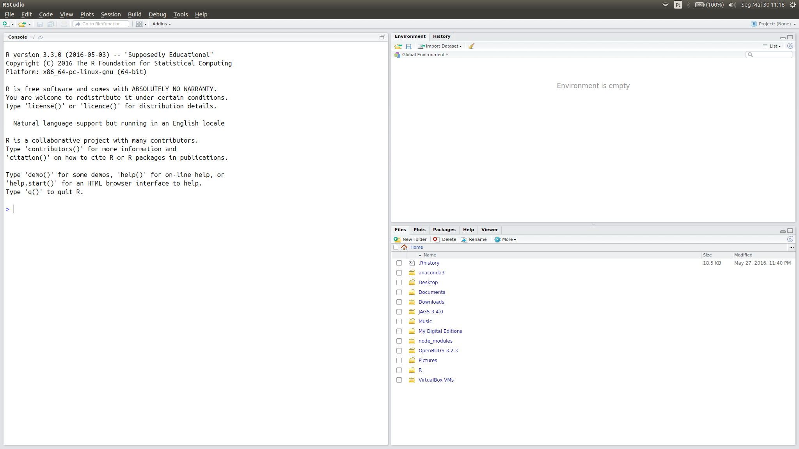
Barra de menu
Barra de Tarefas
Painel History atrás de Environment
Ícone de redimensionamento
Barra de tarefas do painel Environment
Painel Environment
Paineis atrás de Files
'
Painel Console
Barra de tarefas do painel Files
Painel Files

