Slide 1
算法复杂度
————————complexity
brucehan
2020-06-07

Slide 2

学习的哲学思考
从公式、公理、定律、规范、制度等一系列上层设计出发，进行操作、执行、推理、演绎等
基于实践、经验、教训等既定历史存在，总结规律、运用数理知识进行分析、归纳，得出最佳实践
正则表达式
自动机
词典
知识库
体系结构
贝叶斯
决策树
SVM
神经网络
强化学习

Slide 3
NLP技术栈
落地场景
搜索
广告
信息流
智能客服
直播
文本分类
信息抽取
信息检索
阅读理解
机器翻译
语音识别
领域任务
问答系统
推荐系统
多轮交互
自动摘要
知识图谱
情感计算
语义
embedding
分词
词性标注
命名体
基础技术
语义相似性计算
关系抽取
句法分析
语言模型
底层原理
机器学习
神经网络
逻辑推理
经验规则

Slide 4
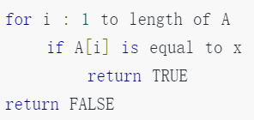
类型1：迭代算法的复杂度

Slide 5
类型2：递归类算法复杂度

Slide 6




Merge Sort (归并排序)
$$T\left(n\right)=2T\left(\frac{n}{2}\right)+O(n)$$
输入：[3,4,1,6,7,2,5,9]
sort
$$T(n)$$
sort
[3,4,1,6]
[7,2,5,9]
divide
sort
sort
$$2T(n/2)$$
merge
$$O(n)$$
[1,3,4,6]
[2,5,7,9]
[1,3,4,6]
4
5
6
7
9
1
2
3
输出：[1,2,3,4,5,6,7,9]
[2,5,7,9]

Slide 7



Merge Sort (归并排序)
$$T\left(n\right)=2T\left(\frac{n}{2}\right)+O(n)$$
输入：[3,4,1,6,7,2,5,9]
$$\ln{n}$$
[3,4,1,6]
[7,2,5,9]
$$n+n\log_{2}{n}$$
$$O(n\log_{2}{n})$$
[3,4]
[1,6]
[7,2]
[5,9]
[3]
[4]
[1]
[6]
[7]
[2]
[5]
[9]
[3,4]
[1,6]
[2,7]
[5,9]
[1,3,4,6]
[2,5,7,9]
输出：[1,2,3,4,5,6,7,9]

Slide 8
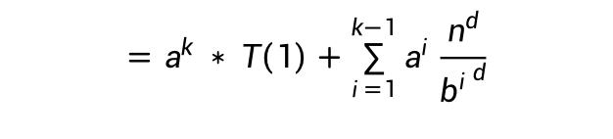
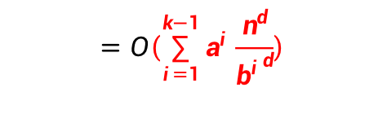






一般情况
递归算法时间复杂度 有如下形式：
$$T\left(n\right)=a ∗ T\left(\frac{n}{b}\right)+O(n^{d})$$
$T(n)=a^{2} ∗ T\left(\frac{n}{b^{2}}\right)+a∗\frac{n^{d}}{b^{d}}+$ $n^{d}$
$$T\left(\frac{n}{b}\right)=a ∗ T\left(\frac{n}{b^{2}}\right)+O(\frac{n^{d}}{b^{d}})$$
$=a^{3} ∗ T\left(\frac{n}{b^{3}}\right)+a^{2}∗\frac{n^{d}}{{b^{2}}^{d}}+$ a*$n^{d}+n^{d}$
$$T\left(\frac{n}{b^{2}}\right)=a ∗ T\left(\frac{n}{b^{2}}\right)+O(\frac{n^{d}}{{b^{2}}^{d}})$$
……
$$=a^{k} ∗ T\left(1\right)+\sum_{i=1}^{k−1}{a^{i}}\frac{n^{d}}{{b^{i}}^{d}}$$
……
$$T\left(\frac{n}{b^{k}}\right)=a ∗ T\left(\frac{n}{b^{k+1}}\right)+O(\frac{n^{d}}{{b^{k}}^{d}})$$
$$=O\left(\sum_{i=1}^{k−1}{a^{i}}\frac{n^{d}}{{b^{i}}^{d}}\right)$$

Slide 9







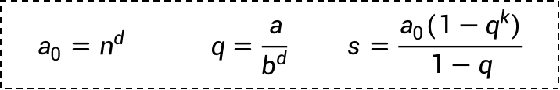

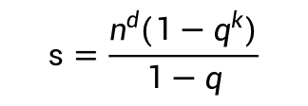
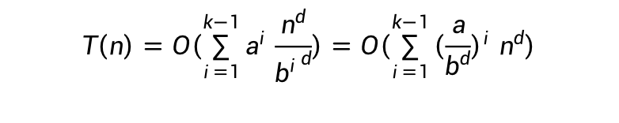
一般情况
$$T\left(n\right)=O\left(\sum_{i=1}^{k−1}{a^{i}}\frac{n^{d}}{{b^{i}}^{d}}\right)=O\left(\sum_{i=1}^{k−1}{{\left(\frac{a}{b^{d}}\right)}^{i}}n^{d}\right)$$
$$a_{0}=n^{d} q=\frac{a}{b^{d}} s=\frac{a_{0}(1−q^{k})}{1−q}$$
当q<1 即$\frac{a}{b^{d}}<1$
$$s=c∗a_{0}$$
$$T\left(n\right) =O(n^{d})$$
当q=1 即$\frac{a}{b^{d}}=1$
$$s=k∗a_{0}$$
$$T\left(n\right) =O({k∗n}^{d})$$
当q>1 即$\frac{a}{b^{d}}>1$
$$s=\frac{n^{d}(1−q^{k})}{1−q}$$
$$T\left(n\right) =O(n^{d}∗q^{k})$$

Slide 10







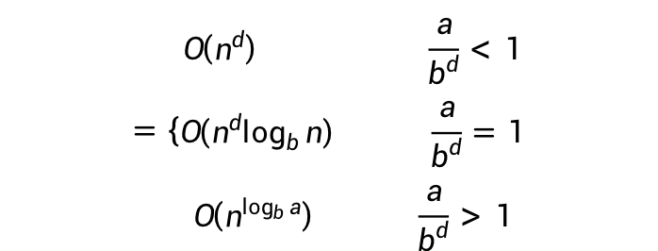
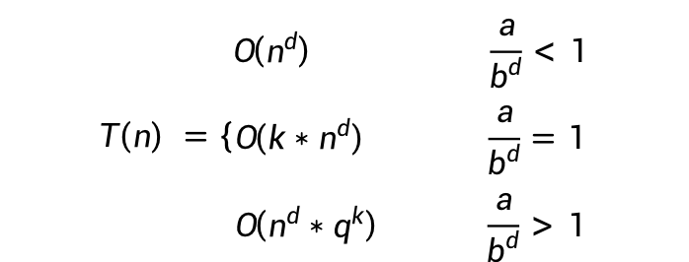
一般情况
$$T\left(n\right) =\left\{\begin{aligned}O\left(n^{d}\right) \frac{a}{b^{d}}<1 \\ O\left({k∗n}^{d}\right) \frac{a}{b^{d}}=1 \\ O\left(n^{d}∗q^{k}\right) \frac{a}{b^{d}}>1\end{aligned}\right.$$
$$=\left\{\begin{aligned}O\left(n^{d}\right) \frac{a}{b^{d}}<1 \\ O\left({n^{d}log}_{b}{n}\right) \frac{a}{b^{d}}=1 \\ O\left(n^{\log_{b}{a}}\right) \frac{a}{b^{d}}>1\end{aligned}\right.$$
$$k=\log_{b}{n}$$
$$O\left({k∗n}^{d}\right)=O({n^{d}log}_{b}{n})≤O({n^{d}log}_{2}{n})$$
$$O\left(n^{d}∗q^{k}\right)=O\left(n^{d}∗{\left(\frac{a}{b^{d}}\right)}^{\log_{b}{n}}\right)=O\left(n^{d}∗\frac{a^{\log_{b}{n}}}{b^{d\log_{b}{n}}}\right)$$
$$=O\left(n^{d}∗\frac{a^{\log_{b}{n}}}{n^{d}}\right)$$
$$=a^{\frac{\log_{a}{n}}{\log_{a}{b}}}$$
$$=n^{\frac{1}{\log_{a}{b}}}$$
$$=n^{\log_{b}{a}}$$
$$=a^{\log_{b}{n}}$$

Slide 11
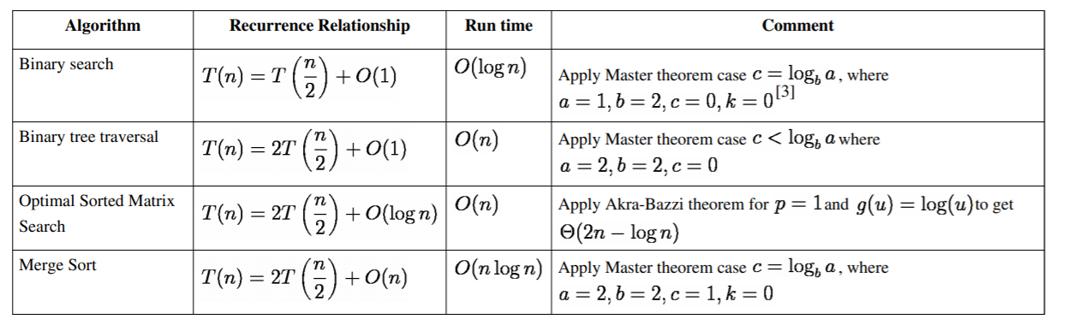
Application to common algorithms

Slide 12
Compute Time Complexity for Other Case
Fibonacci Number
f(n) = f(n-1) + f(n-2)
f(n)
2⁰
O(2^{n})
f(n-1)
f(n-2)
2¹
f(n-2)
f(n-3)
f(n-3)
f(n-4)
2²
f(n-3)
f(n-4)
f(n-4)
f(n-5)
f(n-4)
f(n-5)
f(n-5)
f(n-6)
2³
…

Slide 13
Compute Space Complexity for Recurrence
Fibonacci Number
f(n) = f(n-1) + f(n-2)
f(6)
$$O(n)$$
f(5)
f(4)
f(1)
f(2)
f(4)
f(3)
f(3)
f(2)
f(2)
f(3)
f(1)
f(2)
f(1)
f(2)
f(3)
f(2)
f(2)
f(1)
f(2)
f(1)
f(3)
f(2)
f(3)
f(4)
f(4)
f(5)
f(2)
f(1)
f(6)

Slide 14
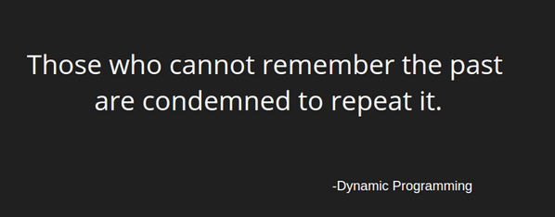
Dynamic Programming
(DP)

Slide 15
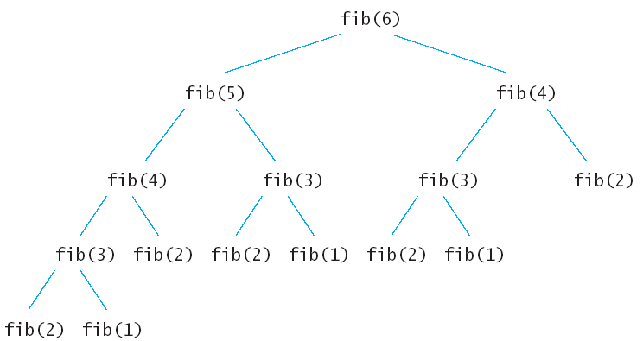
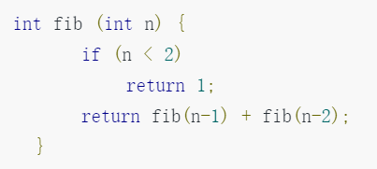
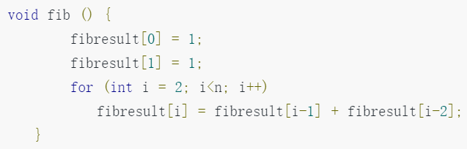
Compute Fibonacci Numbers
Recursion
DP
Fibonacci (n) = Fibonacci(n-1) + Fibonacci(n-2)

Slide 16
Backpack Problem
 | Item1 | Item2 | Item3 | Item4 | Item5
Value | $5 | $10 | $3 | $2 | $3
Weight | 4kg | 8kg | 3kg | 5kg | 2kg
 | 0 | 1 | 2 | 3 | 4 | 5 | 6 | 7 | 8 | 9 | 10
0 | 0 | 0 | 0 | 0 | 0 | 0 | 0 | 0 | 0 | 0 | 0
1 | 0
2 | 0
3 | 0
4 | 0
5 | 0

Slide 17
Backpack Problem
 | Item1 | Item2 | Item3 | Item4 | Item5
Value | $5 | $3 | $10 | $2 | $3
Weight | 4kg | 3kg | 8kg | 5kg | 2kg
 | 0 | 1 | 2 | 3 | 4 | 5 | 6 | 7 | 8 | 9 | 10
0 | 0 | 0 | 0 | 0 | 0 | 0 | 0 | 0 | 0 | 0 | 0
1 | 0 | 0 | 0 | 0 | 5 | 5 | 5 | 5 | 5 | 5 | 5
2 | 0 | 0 | 0 | 3 | 5
3 | 0
4 | 0
5 | 0
DP(2, 4) = max{DP(1, 4), DP(1, 4-3) + 3}

Slide 18
Backpack Problem
 | Item1 | Item2 | Item3 | Item4 | Item5
Value | $5 | $3 | $10 | $2 | $3
Weight | 4kg | 3kg | 8kg | 5kg | 2kg
 | 0 | 1 | 2 | 3 | 4 | 5 | 6 | 7 | 8 | 9 | 10
0 | 0 | 0 | 0 | 0 | 0 | 0 | 0 | 0 | 0 | 0 | 0
1 | 0 | 0 | 0 | 0 | 5 | 5 | 5 | 5 | 5 | 5 | 5
2 | 0 | 0 | 0 | 3 | 5
3 | 0
4 | 0
5 | 0
DP(2, 4) = max{DP(1, 4), DP(1, 4-3) + 3}

Slide 19
Backpack Problem
 | Item1 | Item2 | Item3 | Item4 | Item5
Value | $5 | $3 | $10 | $2 | $3
Weight | 4kg | 3kg | 8kg | 5kg | 2kg
 | 0 | 1 | 2 | 3 | 4 | 5 | 6 | 7 | 8 | 9 | 10
0 | 0 | 0 | 0 | 0 | 0 | 0 | 0 | 0 | 0 | 0 | 0
1 | 0 | 0 | 0 | 0 | 5 | 5 | 5 | 5 | 5 | 5 | 5
2 | 0 | 0 | 0 | 3 | 5 | 5 | 5 | 8 | 8 | 8 | 8
3 | 0 | 0 | 0 | 3 | 5 | 5 | 5 | 8 | 10 | 10 | 10
4 | 0 | 0 | 0 | 3 | 5 | 5 | 5 | 8 | 10 | 10 | 10
5 | 0 | 0 | 3 | 3 | 3 | 8 | 8 | 8 | 8 | 11 | 13

Slide 20
Minimum Edit Distance
(MED)
“ABC”
“BC”

Slide 21
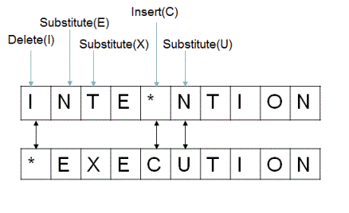
Minimum Edit Distance
(MED)

Slide 22
Minimum Edit Distance
(MED)
A1A2A3 ... Am
B1B2 ... Bn
if Am == Bn
if Am != Bn
1+
1+
1+
A1A2A3 ... Am-1
A1A2A3 ... AmBn
A1A2A3 ... Am-1
A1A2A3 ... Am-1Bn
B1B2 ... Bn-1
B1B2 ... Bn
B1B2 ... Bn
B1B2 ... Bn
Insert
Delete
Replace

Slide 23
Minimum Edit Distance
(MED)
 | “” | E | X | E | C | U | T | I | O | N
“”
I
N
T
E
N
T
I
O
N
 | “” | E | X | E | C | U | T | I | O | N
“” | 0 | 1 | 2 | 3 | 4 | 5 | 6 | 7 | 8 | 9
I | 1 | 1 | 2 | 3
N | 2
T | 3
E | 4
N | 5
T | 6
I | 7
O | 8
N | 9

Slide 24
Minimum Edit Distance
(MED)
 | “” | E | X | E | C | U | T | I | O | N
“” | 0 | 1 | 2 | 3 | 4 | 5 | 6 | 7 | 8 | 9
I | 1 | 1 | 2 | 3 | 4 | 5 | 6 | 6 | 7 | 8
N | 2 | 2 | 2 | 3 | 4 | 5 | 6 | 7 | 7 | 7
T | 3 | 3 | 3 | 3 | 4 | 5 | 5 | 6 | 7 | 8
E | 4 | 3 | 4 | 3 | 4 | 5 | 6 | 6 | 7 | 8
N | 5 | 4 | 4 | 4 | 4 | 5 | 6 | 7 | 7 | 7
T | 6 | 5 | 5 | 5 | 5 | 5 | 5 | 6 | 7 | 8
I | 7 | 6 | 6 | 6 | 6 | 6 | 6 | 5 | 6 | 7
O | 8 | 7 | 7 | 7 | 7 | 7 | 7 | 6 | 5 | 6
N | 9 | 8 | 8 | 8 | 8 | 8 | 8 | 7 | 6 | 5

