Slide 1

DIVISION OF ARTIFICIAL INTELLIGENCE AND MACHINE LEARNING
23AI2014 Project Requirement Specification
ODD SEMESTER 2026-2027
END SEMESTER VIVA VOCE EXAMNIATION
HANDWRITING FORGERY DETECTION USING DEEP LEARNING: PAGE-LEVEL, MULTI-REFERENCE VERIFICATION
SDG Addressed: SDG 16 – Peace, Justice and Strong Institutions
SUPERVISED BY
S. D. Lalitha, Associate Professor
PRESENTED BY
Lincy Jenita J (URK23CS5079)
Notes:
Introduce the problem: deciding whether a questioned handwritten page belongs to a writer whose earlier pages are available.

Slide 2

AGENDA
Abstract
Problem Definition, Scope And Objectives
Literature Survey
Proposed System Architecture
Implementation
Results And Discussion
Conclusion
References
Outcome Specific Supporting Evidence

Slide 3
ABSTRACT
Deciding whether a questioned handwritten page matches a writer's earlier pages is a recurring problem in disputed exams, wills and contracts. We built a page-level verifier: a ResNet-18 trained from scratch embeds a whole page as an attention-pooled bag of ink patches, and one or several reference pages are fused into a calibrated verdict (consistent, inconclusive, likely forged).
Tested on held-out writers and on a corpus never used for tuning, it roughly halves the error of frozen DINOv2 features, but it is fooled by deliberate style change. No public data show one person imitating another, so these are not forgery detection rates.
2.35%
7.30%
3.3%
32%
IAM test EER
CVL test EER
Firemaker, natural writing
Firemaker, disguised
Notes:
Numbers are mean over three seeds on held-out test writers. EER = equal error rate; lower is better.

Slide 4
PROBLEM DEFINITION
A questioned answer sheet: the owner offers earlier genuine scripts as references.
The unit of evidence is a complete script, not a word, sentence or signature.
Task: given N reference pages of a claimed writer and one questioned page, return a similarity score and a verdict.
Hard because a writer varies (pen, mood, text), forgers imitate, and no public data show one person copying another.
N reference pages
claimed writer
Questioned page
one full script
Verifier
page embedding + fusion
Verdict
consistent / inconclusive / likely forged
Notes:
The example in the original proposal: another person copies answers and imitates the owner's handwriting; the owner supplies previous exam papers as references.

Slide 5
SCOPE AND OBJECTIVES
In scope
Out of scope (first paper)
English full pages (IAM, CVL, Firemaker)
1 to 5 reference pages per writer
Writer-disjoint test, cross-corpus test
Calibrated three-way verdict, CPU demo
Four Indian languages (data collection paused)
Real impersonation data (none public)
Learned imitation generators
Word-level and signature verification
Research questions
RQ1
How well does a page-level model separate writers, and does it beat untrained and frozen-feature baselines?
RQ2
Do extra reference pages help, and which fusion rule is best?
RQ3
Does it transfer to a new scanner and protocol (Firemaker), including disguised writing?
RQ4
Which training ingredients matter: distillation, pooling, content matching, mining, patches, augmentation?
Notes:
Indian languages are a planned second phase; downloads were paused by decision until the English paper is done.

Slide 6
LITERATURE SURVEY
Work | Level | What it does | Gap for our task
DeepWriter (Xing, Qiao 2016) | text patches | CNN for text-independent writer identification | identifies, does not verify a claim
FragNet (He, Schomaker 2020) | fragments | fragment network for writer identification | closed-set identification
Self-supervised ViT (Raven et al. 2024) | pages | unsupervised writer retrieval | ranks pages, no verdict
Attention verifier (Shaikh et al. 2020) | pairs | writer-independent verification | one pair, not many references
Self-supervised verification (Chauhan et al. 2024) | pairs | pre-training for verification | pairs, no calibration
SigNet (Dey et al. 2017) | signatures | Siamese signature verification | signatures, not full pages
Writer identification answers "which writer"; verification work compares pairs of words, patches or signatures. Little of it combines a whole questioned page with several references, reports calibrated support, or is allowed to say "inconclusive".
Notes:
Only abstracts of the cited arXiv papers were read; no numbers from other papers are quoted.

Slide 7
RESEARCH GAP AND OUR POSITION
Page-level
Multi-reference
Calibrated verdict
A complete script is the unit of evidence, embedded as an attention-pooled bag of 64 ink patches.
One to five reference pages are fused (mean, max, top-2, centroid) and compared on one fixed set of writers.
Thresholds fixed on validation data; the system may answer inconclusive.
To our knowledge no prior writer-verification work combines these elements; we do not claim any single component is new. Distillation and likelihood-ratio reporting each have precedent.
Honest protocol: writer-disjoint splits, test sets used once, a cross-corpus test never used for tuning.
Notes:
A web search on 2026-11-05 found precedent for distillation in signature verification and for likelihood-ratio reporting in forensics; the wording stays 'to our knowledge'.

Slide 8
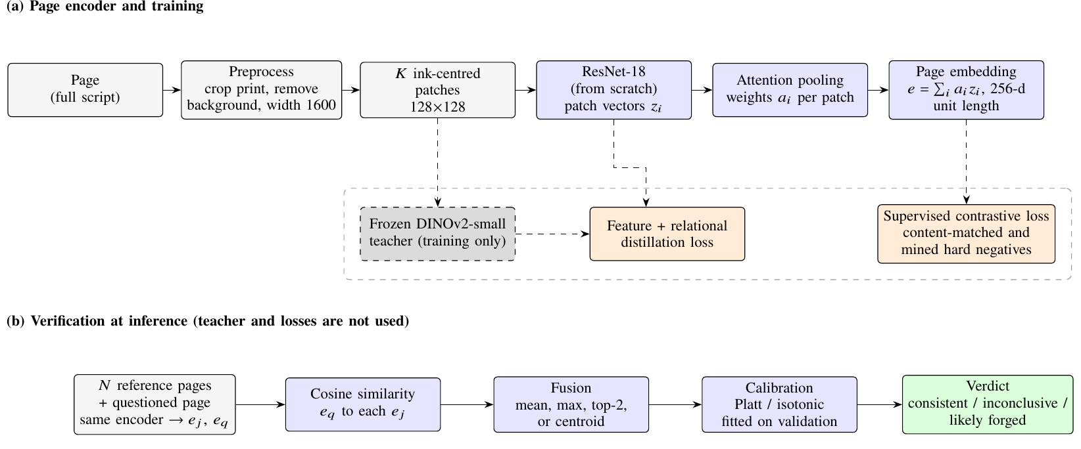
PROPOSED SYSTEM ARCHITECTURE
(a) Training: each page becomes ink-centred 128 × 128 patches, encoded by a ResNet-18 trained from scratch and pooled by attention into a 256-d page embedding. A frozen DINOv2-small teacher is used only during training.
(b) Inference: the questioned page is compared with N references with the same encoder, scores are fused, calibrated and turned into a verdict.
Notes:
The shipped model is the student alone; the teacher is not needed at inference.

Slide 9
MODEL AND TRAINING OBJECTIVE
Encoder
ResNet-18 (1 channel, random init) → 256-d patch vectors; attention pooling a_i = softmax(wᵀ tanh(V z_i)); page embedding is L2-normalised. 16 patches per page in training, 64 in evaluation.
Loss
Supervised contrastive loss (τ = 0.1) on batches of 12 writers × 2 pages. 40% of batches are content-matched CVL batches (all writers copy the same texts); half use nearest-neighbour writers. Plus feature and relational distillation from frozen DINOv2-small (weights 0.5 + 0.5).
Verdict
Fuse N reference scores (mean, max, top-2, centroid), calibrate with Platt or isotonic regression fitted on validation only. Consistent if the score is at or above the 99th percentile of validation impostors; likely forged at or below the 1st percentile of genuine scores; otherwise inconclusive.
Notes:
Distillation is described as an adopted technique, not a contribution; the ablation later shows it did not clearly help at 40 epochs.

Slide 10
DATASETS AND PREPROCESSING
Corpus | Train writers / pages | Validation | Test
IAM | 507 / 1262 | 50 / 190 | 99 / 392
CVL (English) | 217 / 909 | 31 / 127 | 62 / 254
Firemaker | – | – | 250 / 1000
IAM: forms by many writers; the copy used is a third-party Kaggle one (official registration pending).
CVL: all writers copy the same texts, which gives content-matched hard negatives. English texts only.
Firemaker: test only, never used for tuning. Page 3 is self-disguise, not imitation of another person.
Preprocessing: crop printed form parts, remove paper tone and scanner shading, resize to width 1600, drop blank and duplicate pages. Splits are writer-disjoint.
Notes:
Kaggle real-vs-generated pages are font-rendered text and are used only for a synthetic-page false-accept test.

Slide 11
IMPLEMENTATION
Software
Training and hardware
Docker image handwriting-train:0.1 (PyTorch 2.6, CUDA 12.4)
timm ResNet-18, DINOv2-small teacher, OpenCV, scikit-learn
One module per stage: prep_cache, manifests, data, model, train, eval, multiref, verdict, report
Unit tests (pytest) including a label-shuffle leak test
FastAPI demo (CPU) and a live training dashboard
Laptop: RTX 4050 (6 GB), i7-13650HX, 15 GB RAM
AdamW, lr 3e-4, cosine, up to 120 epochs, mixed precision, EMA 0.999
Three seeds, about 50 min and 26 s per epoch each
Seven 40-epoch ablations, one GPU job at a time
Every table and figure is generated from the run files by report.py
raw pages
prep_cache
manifests
train
eval
report
paper
Pipeline: each stage reads the previous stage's files, so any table can be regenerated.
Notes:
Everything heavy ran on one laptop GPU, niced and serialised with a lock.

Slide 12
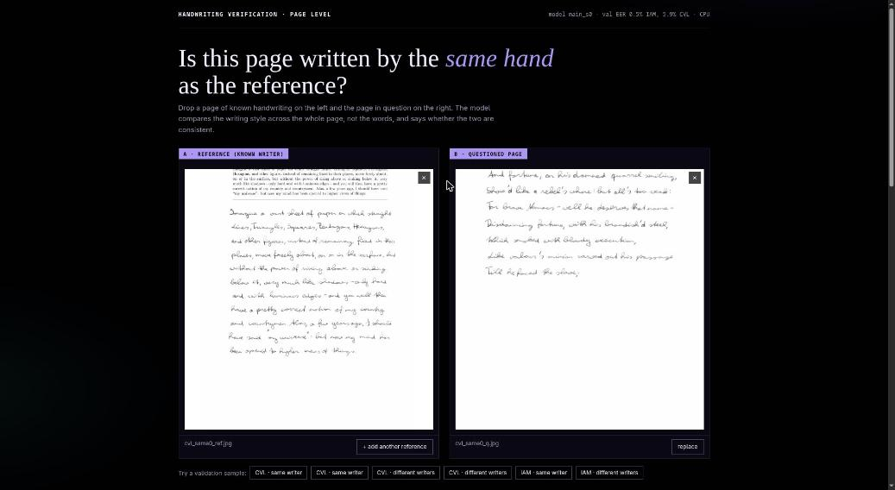
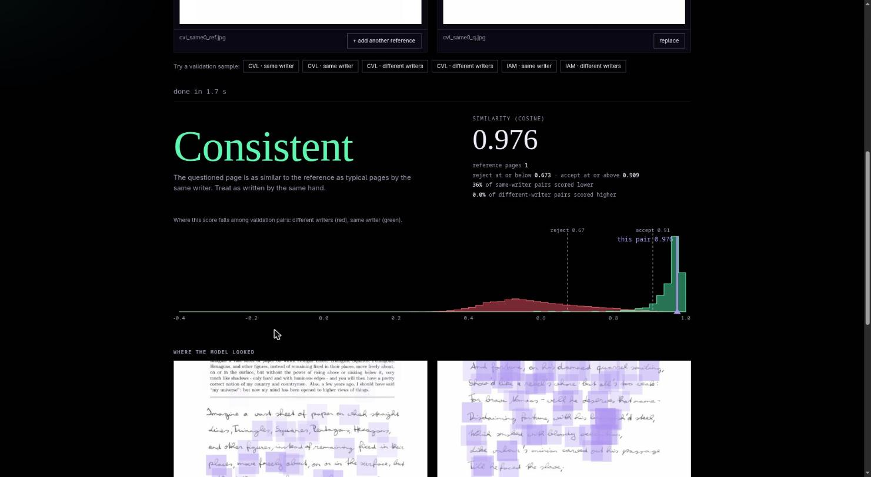
LIVE DEMONSTRATION
Upload a reference page and a questioned page
Verdict, score and where it falls among validation pairs
Runs on CPU in about 2 to 3 seconds per comparison; one to five reference pages.
Shows the calibrated verdict, similarity score, validation score distributions and attention heatmaps.
Limits are printed on the page: it scores style similarity, not forgery directly.
Notes:
Demo URL on the presenting machine: http://localhost:8010. Sample pairs come from the validation set, so they look better than unseen data.

Slide 13
RESULTS: MAIN COMPARISON
2.35 ± 0.12
IAM EER (%), AUC 0.996
7.30 ± 0.29
CVL EER (%), AUC 0.968
Mean ± sd over three seeds, 99 IAM and 62 CVL test writers.
The student halves the error of the frozen teacher on both corpora. Test is worse than validation (IAM 0.90 ± 0.31%), so validation numbers were optimistic.
Strict operating point: at 1% false rejects, 80.2% of CVL impostors are accepted, so one page pair is weak evidence.
Notes:
Baselines HOG and frozen DINOv2 are deterministic, the random CNN is averaged over three seeds.

Slide 14
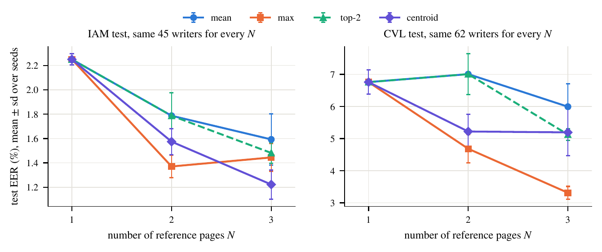
RESULTS: MORE REFERENCE PAGES
Same writers for every N (45 IAM, 62 CVL). Centroid fusion: IAM 2.25 → 1.57 → 1.22; CVL 6.76 → 5.22 → 5.19 (N = 1, 2, 3).
With five references, 17 IAM writers: 0.81 against 1.96 for one.
On CVL the max rule is best at N = 3 (3.31), but the centroid was the rule chosen on validation, so this is a post-hoc observation.
Bootstrap intervals overlap: the gain is consistent in direction but not established.
Notes:
An earlier version let the writer set shrink with N and was discarded because it confounded N with writer difficulty.

Slide 15
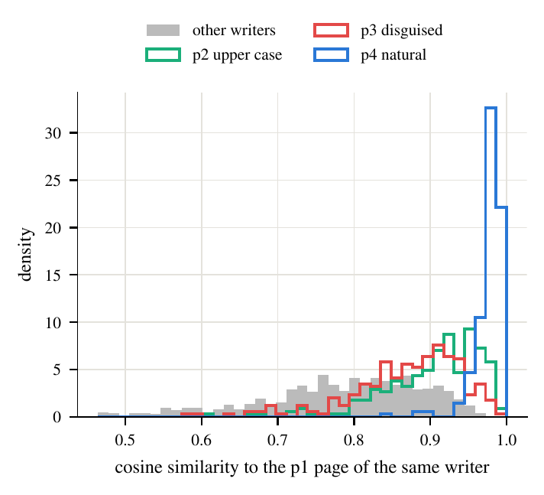
RESULTS: CROSS-CORPUS AND DISGUISE
Firemaker pair | EER (%) | Same-writer cos.
p1 vs p4 (natural) | 3.33 ± 0.25 | 0.978
p1 vs p2 (upper case) | 23.87 ± 0.47 | 0.906
p1 vs p3 (disguised) | 32.00 ± 0.59 | 0.874
Natural writing transfers across corpora (3.3% EER) on 250 writers never used for tuning.
Upper case and deliberate disguise break it: same-writer cosine falls from 0.98 to 0.87 while other writers stay near 0.79.
A writer who changes style can be rejected, and a forger who copies a style is helped.
Seed 0, 250 writers
Notes:
Firemaker page 3 is self-disguise, not impersonation, so it is a stress test of intra-writer variation, not a forgery rate.

Slide 16
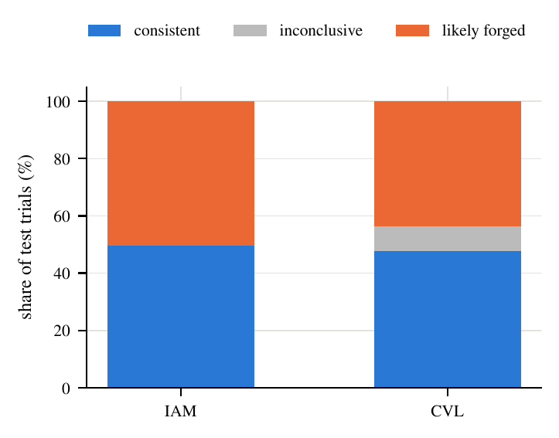
RESULTS: CALIBRATED VERDICTS
 | CVL | IAM
Consistent (%) | 47.8 | 49.7
Inconclusive (%) | 8.5 | 0.0
Likely forged (%) | 43.7 | 50.3
Error on decided (%) | 2.8 | 0.7
ECE raw / Platt / isotonic | 0.22 / 0.076 / 0.020 | 0.22 / 0.070 / 0.009
Three references, thresholds from validation only. On CVL, 8.5% of trials are inconclusive and 2.8% of the decided ones are wrong.
IAM is separable on validation, so one threshold is used and there is no inconclusive band; do not read this as evidence that the problem is easy.
Raw cosine scores are not probabilities (ECE about 0.22); isotonic regression is the best calibrator.
Notes:
The first IAM three-way numbers had overlapping thresholds because of a bug in my rule; it was fixed and the verdict recomputed from the saved scores (see FIXES.md).

Slide 17
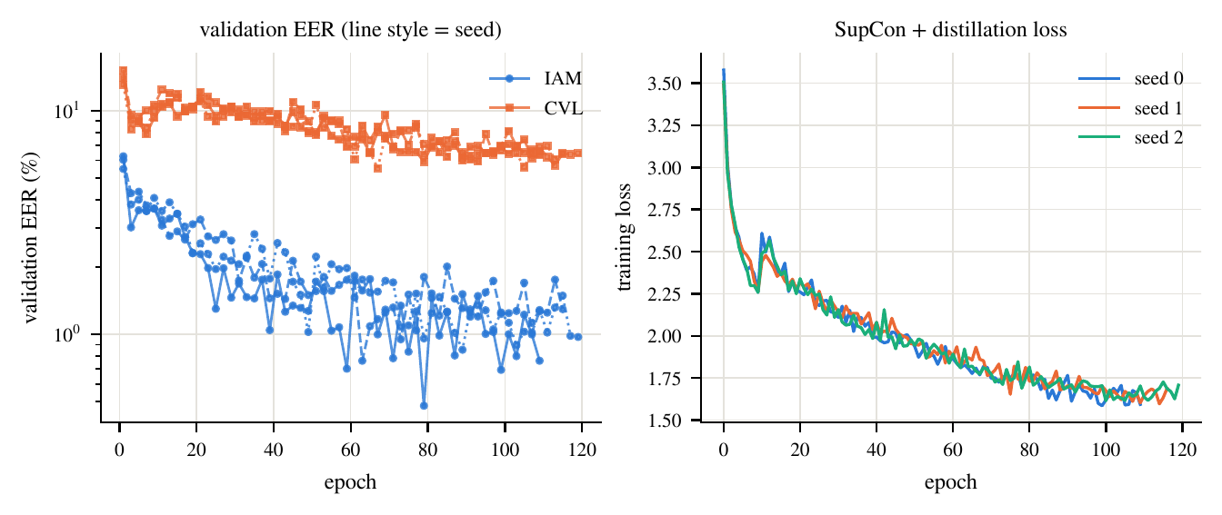
ABLATIONS AND TRAINING BEHAVIOUR
Variant (40 epochs, 1 seed) | IAM | CVL | Mean
Full model (40 epochs) | 1.72 | 8.98 | 5.35
No distillation | 1.22 | 7.53 | 4.38
Mean pooling | 2.47 | 8.10 | 5.29
No content-matched batches | 1.71 | 7.42 | 4.57
No writer mining | 2.05 | 8.45 | 5.25
8 patches per page | 2.53 | 7.77 | 5.15
No augmentation | 1.74 | 8.02 | 4.88
Validation EER (%).
No ingredient shows a clear benefit; three ablations beat the full 40-epoch model, but one seed cannot tell if that is real.
Main 120-epoch runs reach 3.19 to 3.57 mean val EER.
Notes:
We do not claim that distillation, content-matched batches or mining help; the paper says so.

Slide 18
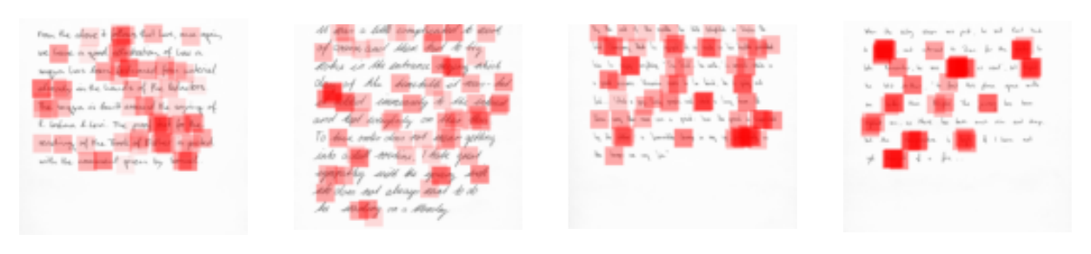
LIMITATIONS
No real impersonation data. Impostors are other writers, an easier case than a skilled forger.
Disguise breaks the model. Firemaker p3 is self-disguise, reported as a stress test.
Synthetic pages are fonts. Accepted for 0.03% of pairs on IAM thresholds; real unknown pages behave alike, so it says little about imitation.
Corpus effects. IAM pages share scanner and pen, so IAM is optimistic; the IAM copy is third-party.
Scale. English only, three seeds, one-seed ablations, one laptop GPU.
Attention maps are a visualisation only: dropping top-attended patches lowers the score by 0.0043 vs 0.0022 for random.

Slide 19
CONCLUSION AND FUTURE WORK
Conclusion
Future work
A page-level verifier trained from scratch halves the error of frozen DINOv2 (2.35% IAM, 7.30% CVL EER).
It transfers to a new corpus for ordinary writing (3.3%).
Extra references and a calibrated, abstaining verdict help.
It does not survive deliberate style change, and no ablated ingredient is shown to help.
Volunteer-copied impersonation set per language
Handwriting generators to test learned imitation
Multi-seed ablations at the full schedule
A larger validation set to choose the fusion rule
Four Indian languages (data collection paused)
Page-level verification works for ordinary writing, but real impersonation data are needed before it can be called forgery detection.

Slide 20
REFERENCES
[1] L. Xing, Y. Qiao, “DeepWriter: A Multi-Stream Deep CNN for Text-independent Writer Identification,” arXiv:1606.06472, 2016.
[2] S. He, L. Schomaker, “FragNet: Writer Identification using Deep Fragment Networks,” arXiv:2003.07212, 2020.
[3] S. Dey et al., “SigNet: Convolutional Siamese Network for Writer Independent Offline Signature Verification,” arXiv:1707.02131, 2017.
[4] M. A. Shaikh et al., “Attention based Writer Independent Handwriting Verification,” arXiv:2009.04532, 2020.
[5] M. Chauhan et al., “Self-Supervised Learning Based Handwriting Verification,” arXiv:2405.18320, 2024.
[6] T. Raven, A. Matei, G. A. Fink, “Self-Supervised Vision Transformers for Writer Retrieval,” arXiv:2409.00751, 2024.
[7] M. Oquab et al., “DINOv2: Learning Robust Visual Features without Supervision,” arXiv:2304.07193, 2023.
[8] K. He et al., “Deep Residual Learning for Image Recognition,” arXiv:1512.03385, 2015.
[9] P. Khosla et al., “Supervised Contrastive Learning,” arXiv:2004.11362, 2020.
[10] U.-V. Marti, H. Bunke, “The IAM-database,” Int. J. Document Analysis and Recognition, 2002.

Slide 21
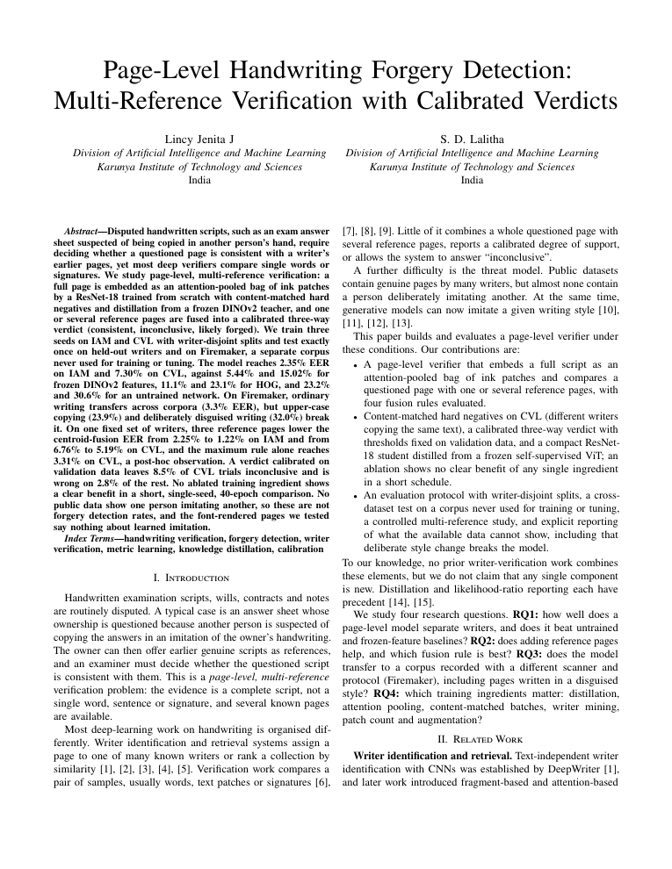
OUTCOME SPECIFIC SUPPORTING EVIDENCE
Selected outcome: Journal publication
Paper draft: 8 pages, IEEEtran, 270-word abstract, six result figures and eight tables; submission venue not yet chosen.
Every number is generated from the run files and mapped to its evidence file.
Code, unit tests, run logs and Docker setup are in the project repository.
Working demo and live training dashboard.
Pending: citation check, author block confirmation, official IAM registration.
First page of the paper draft

