Slide 1
BIG DATA (BDTT) · IA3 PROJECT
ThreadSense
Discovering Which Reddit Communities You Belong In
A MongoDB MapReduce pipeline over 1,013,000 Reddit posts
Lebi · B.Tech AI & DS · Karunya Institute of Technology and Sciences · Faculty: Dr. Grace Mary Kanaga E.
Notes:
Title slide. One line: we recommend which Reddit communities a piece of text belongs in, using MapReduce on MongoDB.

Slide 2
Problem statement
Reddit has thousands of communities. A newcomer cannot tell which ones fit their question, and analysts have no compact view of how communities relate.
1,013
Input: any piece of text
Output: the 5 best-fit subreddits, with the words that drove each score
Also: a map of how 1,013 communities relate
Built as a batch big-data pipeline, evaluated on unseen posts
communities to choose from
0.1%
chance of a random guess being right
ThreadSense · IA3 Big Data
2
Notes:
The task is a 1,013-way choice, so random guessing is 0.1%. Everything we report is against that.

Slide 3
Dataset
Reddit self-post classification task (Kaggle, mswarbrickjones)
1,013,000
1,013
~147
39
posts
subreddits
words per post
categories
Unstructured text: titles and bodies with markdown, links and HTML entities
About 1,000 posts per subreddit; fields: id, subreddit, title, selftext
Limit: no author and no timestamp, so the recommender is content-based, not per-user
Limit: balanced classes make the baseline near zero by construction
ThreadSense · IA3 Big Data
3
Notes:
Be upfront: the dataset has no author or time, which is why we pivoted from per-user to content-based. kaggle.com/datasets/mswarbrickjones/reddit-selfposts

Slide 4
Methodology: a batch pipeline
Ingest
Clean
Split
Job 1
Job 2
Job 3
Job 4
1,013,000
1,012,997
911k / 101k
8.1M counts
69,944 words
1,013 subs
top-5 + eval
Job 1: word counts per subreddit, each word once per post (MapReduce)
Job 2: TF-IDF inverted index, weight = (1 + ln c) × ln(N / df) (MapReduce)
Job 3: cosine similarity between subreddit vectors (MapReduce)
Job 4: score pasted text against the index; evaluate on 10% held-out posts
ThreadSense · IA3 Big Data
4
Notes:
Every step logs records in, records out and duration to MongoDB; the UI reads those logs. Held-out posts are never seen by Jobs 1 to 3.

Slide 5
Tools used
Storage + MapReduce
MongoDB 7.0 (mapReduce command)
Pipeline runner
Python 3.12, pymongo
Back end
FastAPI, Pydantic
Front end
Next.js, TypeScript, Tailwind
Data source
Kaggle CLI
Everything runs in
Docker Compose, with healthchecks
ThreadSense · IA3 Big Data
5
Notes:
Hadoop and Spark were not needed: the brief asks for MongoDB and MapReduce, and this size runs on one machine. They are the scale-out path.

Slide 6
MapReduce code (Jobs 1 and 2)
// Job 1: map
function () {
var seen = {};
var words = this.text.split(' ');
for (var i = 0; i < words.length; i++) {
var w = words[i];
if (w.length < 3 || w.length > 20
|| STOP[w] || seen[w]) continue;
seen[w] = 1;
emit(w + '|' + this.subreddit, 1);
}
}
// Job 1: reduce
function (key, values) {
return Array.sum(values);
}
// Job 2: finalize (TF-IDF)
function (key, v) {
var df = v.p.length;
if (df > MAX_DF)
return {p: [], df: df};
var idf = Math.log(N_SUB / df);
var out = v.p.map(function (x) {
return [x[0],
(1 + Math.log(x[1])) * idf];
});
out.sort(function (a, b) {
return b[1] - a[1]; });
return {p: out.slice(0, TOP), df: df};
}
ThreadSense · IA3 Big Data
6
Notes:
Map emits word|subreddit once per post. Reduce sums. Job 2's reduce concatenates postings and finalize turns counts into TF-IDF. Full code is in the report and the repo.

Slide 7
Results: recommendation quality
72.6%
top-1 accuracy
89.1%
hit rate at 5
5,000 held-out posts, 1,013 classes. The baseline is near zero because classes are balanced.
ThreadSense · IA3 Big Data
7
Notes:
The absolute number is what matters: 72.6% on a 1,013-way choice. We say honestly that the baseline gap is large by construction.

Slide 8
MapReduce vs aggregation pipeline
Same task, same output: 388,647 documents
Aggregation is about 2x faster
The index helps only slightly: run time is word splitting, not lookup
MongoDB deprecated mapReduce; it still runs on 7.0
ThreadSense · IA3 Big Data
8
Notes:
Word counts for 50 subreddits. Identical output, so the comparison is fair. This supports MongoDB's decision to deprecate mapReduce.

Slide 9
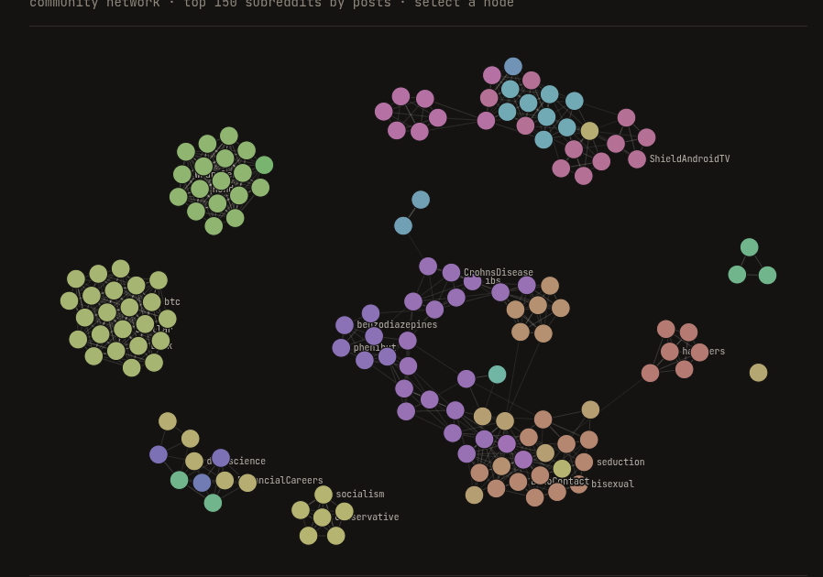
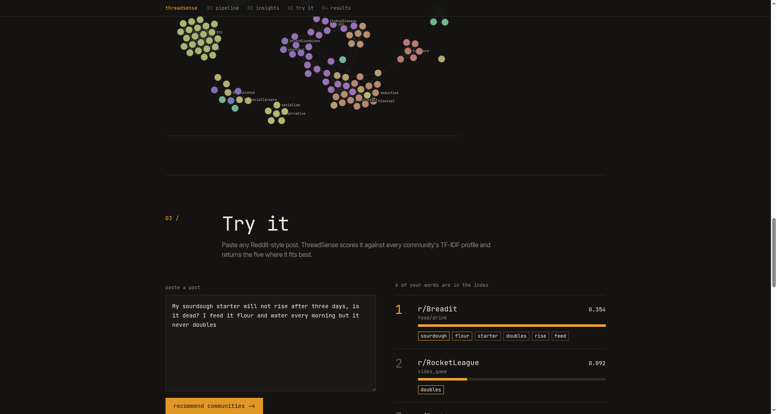
Visualizations and demo
Paste a post, get the top 5 communities and the words behind each score
Community network from Job 3: related subreddits cluster
Sourdough post → r/Breadit first
ThreadSense · IA3 Big Data
9
Notes:
The UI only reads precomputed results. The recommender scores text against the stored TF-IDF index; it does not run MapReduce live.

Slide 10
Conclusions and future work
What we showed
Limits and next
1M posts became 69,944 TF-IDF words and 1,013 community profiles in about 12 minutes
72.6% top-1 and 89.1% top-5 on unseen posts
Related communities cluster sensibly
Aggregation beats mapReduce about 2x
Batch and laptop scale, not real-time or petabyte
No author or time: add them for per-user and trends
Try embeddings against TF-IDF
Scale out with Hadoop or Spark, stream with Kafka, graph in Neo4j
ThreadSense · IA3 Big Data
10
Notes:
Code: github.com/lebiraja/threadsense (private). Dataset: kaggle.com/datasets/mswarbrickjones/reddit-selfposts

