Slide 1
Aid and Aids
PEPFAR, trade, and contagious disease
Logan Stundal^{1,2} Sonal Pandya³ David Leblang^{2,3}
Slides prepared for APSA 2023, Los Angeles
Biocomplexity Institute, University of Virginia
Batten School of Public Policy, University of Virginia
Department of Politics, University of Virginia
Notes:
Objectives for talk
Plausibility probe
Grounding in literature
President's Emergency Plan for AIDS Relief
Motivation – conjectures of relationship between trade and disease
Bad policy – trade shock related to covid lockdowns
Bad science – very early in the pandemic the WHO suggested (incorrectly) that covid may have spread to initial outbreak location of Wuhan through seafood trade networks
Some trade mechanisms
heterogenous populations with higher prevalence of HIV engaged in trade
(E.g. Emily Osters work on SSA truck drivers as a pathway for HIV when exports increase)
Trade based connections establishing new migration routes
Trade leads to economic development and therefore increases health capacity

Slide 2
Do we observe evidence of international trade-based HIV diffusion?
Notes:
PEPFAR reauthorization
President's Emergency Plan for AIDS Relief
Program successes, reauthorization controversy, pivot towards a “sustainability approach”
Data here
IHME HIV incidence – Global Burden of Disease Study
PEPFAR – USAID’s Foreign Aid data
Trade – (Imports + Exports) – CEPII Gravity Database

Slide 3
Do we observe evidence of international trade-based HIV diffusion?
H1 – Global trade connectedness provides a diffusion pathway for HIV incidence.
Notes:
PEPFAR reauthorization
President's Emergency Plan for AIDS Relief
Program successes, reauthorization controversy, pivot towards a “sustainability approach”
Data here
IHME HIV incidence – Global Burden of Disease Study
PEPFAR – USAID’s Foreign Aid data
Trade – (Imports + Exports) – CEPII Gravity Database

Slide 4
Do we observe evidence of international trade-based HIV diffusion?
H1 – Global trade connectedness provides a diffusion pathway for HIV incidence.
H2 – Trade with PEPFAR recipients moderates the effect for PEPFAR aid.
Notes:
PEPFAR reauthorization
President's Emergency Plan for AIDS Relief
Program successes, reauthorization controversy, pivot towards a “sustainability approach”
Data here
IHME HIV incidence – Global Burden of Disease Study – NORMALIZED BY POPULATION
PEPFAR – USAID’s Foreign Aid data
Trade – (Imports + Exports) – CEPII Gravity Database

Slide 5
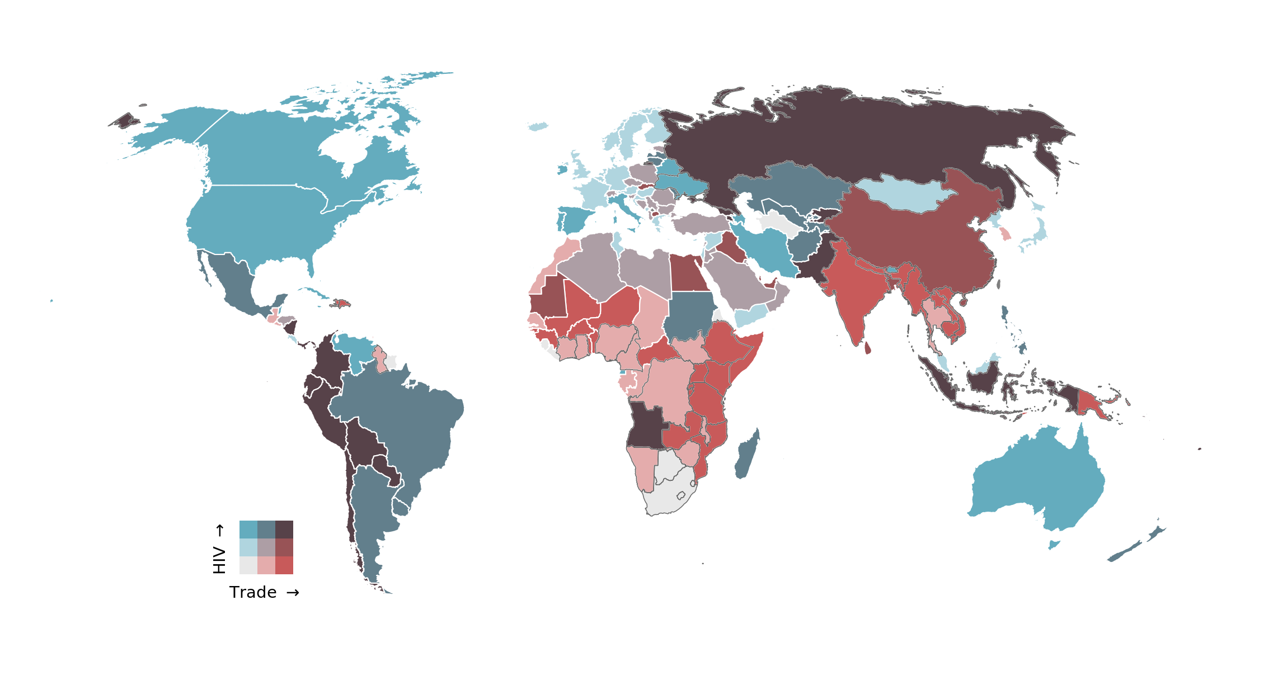
H1 - Global trade connectedness provides a diffusion pathway for HIV incidence
Notes:
PANEL
2005 – 2018 (13 years) PEPFAR begins 2004
Colors represent percent change from year 1 to year 13 binned from low to high

Slide 6
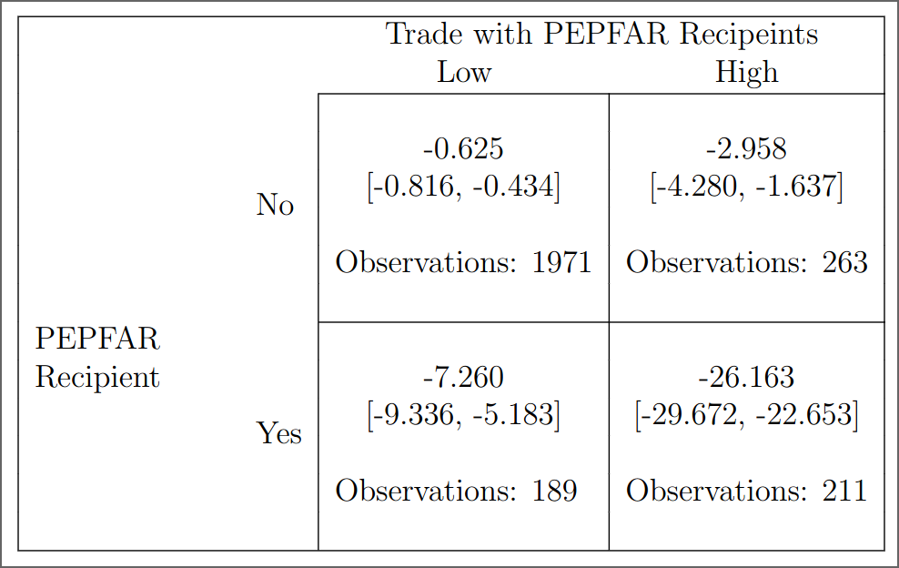
H2 - Trade with PEPFAR recipients moderates the effect for PEPFAR aid
Notes:
Values – median HIV incidence change across countries who:
received pepfar or not
have high or low trade with other pepfar recipients.

Slide 7
H2 - Trade with PEPFAR recipients moderates the effect for PEPFAR aid

Slide 8
H2 - Trade with PEPFAR recipients moderates the effect for PEPFAR aid

Slide 9
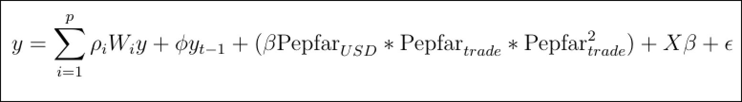
Notes:
High-order spatiotemporal autoregressive model
Bayesian markov chain monte carlo
HIV – first difference + fd lag
Country and year fixed effect
All but (1) have controls
OECD health aid
Public health spending
GDP per capita
Population density
Internet acces (reporting)
Live expectancy
Infant mortality

Slide 10
Trade
Distance
Migration
(H1)
Notes:
High-order spatiotemporal autoregressive model
Bayesian markov chain monte carlo
HIV – first difference + fd lag
Country and year fixed effect
All but (1) have controls
OECD health aid
Public health spending
GDP per capita
Population density
Internet acces (reporting)
Live expectancy
Infant mortality

Slide 11
(H2)
Trade
Distance
Migration
(H1)
Notes:
High-order spatiotemporal autoregressive model
Bayesian markov chain monte carlo
HIV – first difference + fd lag
Country and year fixed effect
All but (1) have controls
OECD health aid
Public health spending
GDP per capita
Population density
Internet acces (reporting)
Live expectancy
Infant mortality

Slide 12
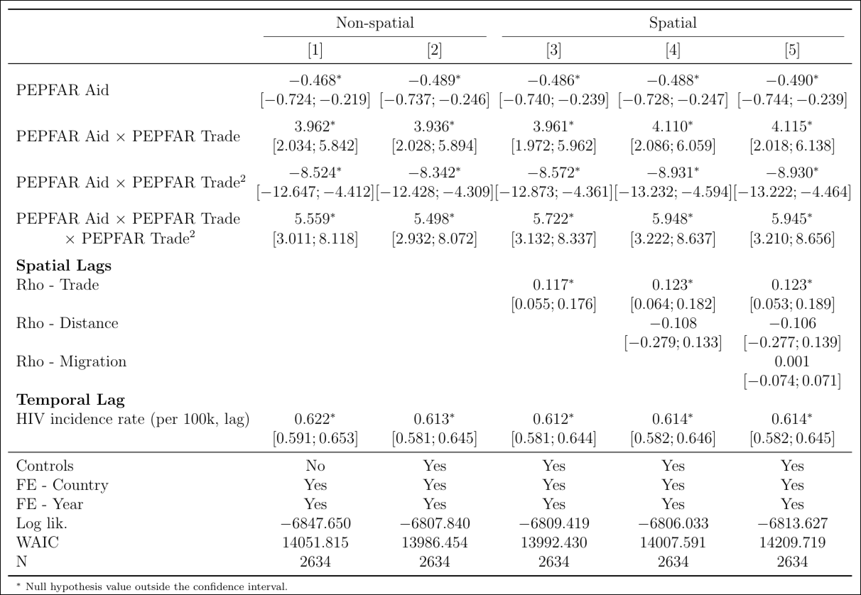
Notes:
ALL MODELS HAVE:
Country and year fixed effects
All but (1) have controls
OECD health aid
Public health spending
GDP per capita
Population density
Internet acces (reporting)
Live expectancy
Infant mortality

Slide 13
Notes:
ALL MODELS HAVE:
Country and year fixed effects
All but (1) have controls
OECD health aid
Public health spending
GDP per capita
Population density
Internet acces (reporting)
Live expectancy
Infant mortality

Slide 14
Notes:
ALL MODELS HAVE:
Country and year fixed effects
All but (1) have controls
OECD health aid
Public health spending
GDP per capita
Population density
Internet acces (reporting)
Live expectancy
Infant mortality

Slide 15
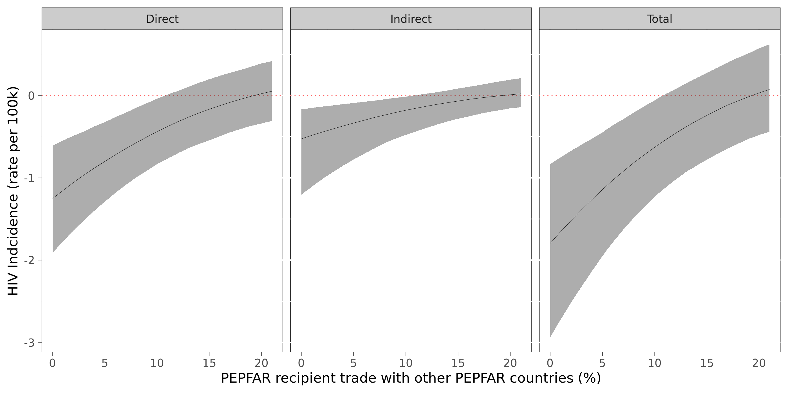
LRSS conditional effects of PEPFAR aid on HIV incidence as trade with other PEPFAR recipients increases
Notes:
Marginal effect of PEPFAR becomes statistically insignificant at 12-15% depending on model
LRSS effects occur over a 4-10 year period
Indirect effect (trade-based diffusion) accounts for between 14 – 45% of the total response

Slide 16
LRSS conditional effects of PEPFAR aid on HIV incidence as trade with other PEPFAR recipients increases
Notes:
Marginal effect of PEPFAR becomes statistically insignificant at 12-15% depending on model
LRSS effects occur over a 4-10 year period
Indirect effect (trade-based diffusion) accounts for between 14 – 45% of the total response

Slide 17
LRSS conditional effects of PEPFAR aid on HIV incidence as trade with other PEPFAR recipients increases
Notes:
Marginal effect of PEPFAR becomes statistically insignificant at 12-15% depending on model
LRSS effects occur over a 4-10 year period
Indirect effect (trade-based diffusion) accounts for between 14 – 45% of the total response

Slide 18
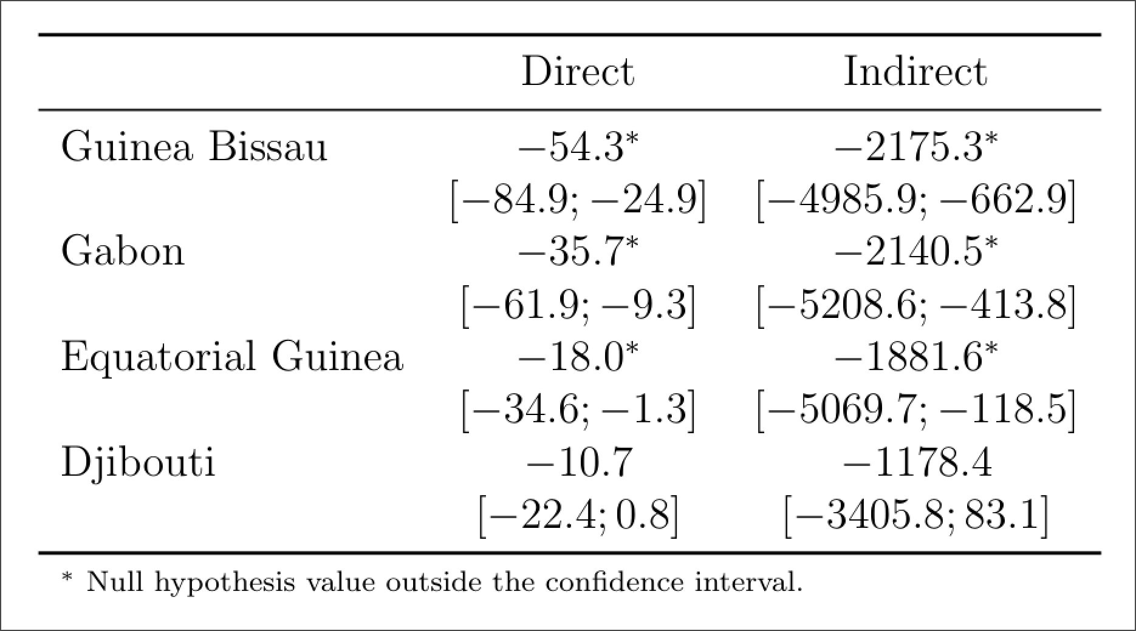
PEPFAR aid allocation counterfactual
Notes:
Cases
Have never received PEPFAR
Have median annual trade with PEPFAR recipients of less than 12%
Hav an HIV incidence rate 2 deviations above median
cname ihme_hiv ihme_hiv100k
1 Guinea-Bissau 1650 87.8
2 Gabon 2631 123.
3 Equatorial Guinea 7449 513.
4 Djibouti 903 86.8
Trade shock = median among PEPFAR recipients (~$2.9 per capita) – for these countries that would equate to 3-6 million USD which is slightly below the 3rd quartile of PEPFAR aid allocations.

Slide 19
PEPFAR aid allocation counterfactual
Notes:
Cases
Have never received PEPFAR
Have median annual trade with PEPFAR recipients of less than 12%
Hav an HIV incidence rate 2 deviations above median
cname ihme_hiv ihme_hiv100k
1 Guinea-Bissau 1650 87.8
2 Gabon 2631 123.
3 Equatorial Guinea 7449 513.
4 Djibouti 903 86.8
Trade shock = median among PEPFAR recipients (~$2.9 per capita) – for these countries that would equate to 3-6 million USD which is slightly below the 3rd quartile of PEPFAR aid allocations.

Slide 20
PEPFAR aid allocation counterfactual
Notes:
Cases
Have never received PEPFAR
Have median annual trade with PEPFAR recipients of less than 12%
Hav an HIV incidence rate 2 deviations above median
cname ihme_hiv ihme_hiv100k
1 Guinea-Bissau 1650 87.8
2 Gabon 2631 123.
3 Equatorial Guinea 7449 513.
4 Djibouti 903 86.8
Trade shock = median among PEPFAR recipients (~$2.9 per capita) – for these countries that would equate to 3-6 million USD which is slightly below the 3rd quartile of PEPFAR aid allocations.

Slide 21
PEPFAR aid allocation counterfactual
Notes:
Cases
Have never received PEPFAR
Have median annual trade with PEPFAR recipients of less than 12%
Hav an HIV incidence rate 2 deviations above median
cname ihme_hiv ihme_hiv100k
1 Guinea-Bissau 1650 87.8
2 Gabon 2631 123.
3 Equatorial Guinea 7449 513.
4 Djibouti 903 86.8
Trade shock = median among PEPFAR recipients (~$2.9 per capita) – for these countries that would equate to 3-6 million USD which is slightly below the 3rd quartile of PEPFAR aid allocations.

Slide 22
Indirect effects:
Top-3 reductions
PEPFAR aid allocation counterfactual
Guinea Bissau
China
Pakistan
Portugal
Gabon
China
India
France
Equatorial Guinea
China
United States
India
Notes:
Cases
Have never received PEPFAR
Have median annual trade with PEPFAR recipients of less than 12%
Hav an HIV incidence rate 2 deviations above median
cname ihme_hiv ihme_hiv100k
1 Guinea-Bissau 1650 87.8
2 Gabon 2631 123.
3 Equatorial Guinea 7449 513.
4 Djibouti 903 86.8
Trade shock = median among PEPFAR recipients (~$2.9 per capita) – for these countries that would equate to 3-6 million USD which is slightly below the 3rd quartile of PEPFAR aid allocations.

Slide 23
Conclusion
Trade connections serve as a pathway for disease diffusion, amplifying impulses that increase or decrease disease incidence.
PEPFAR matters most when distributed to countries with fewer trade opportunities with other PEPFAR recipients.
PEPFAR authorization ends this month. The program has pivoted towars a “sustainability approach” to aid delivery.
Notes:
Limitations : use total trade values rather than export volume which may be a better measure.

