Slide 1
Each script should represent single transformation or analysis procedure
data_frame
data_frame
data_frame
clean.R
histogram.R
mean_read_length.R
data_frame_cleaner
A number
or statistics
plot
smth else
A number
or statistics
somewhere
inside the script
data_frame
data_frame_modified
modified in a meaningful way
but not written in output
notthebestscript.R

Slide 2
Each script should output the data in human-readable* format
plot.png, .tif, .pdf
data_frame.txt, .xls, .xlsx
sequences.fa
annotated_sequences.txt
reads.bed, .tsv
data_frame
smth else
A number
or statistics
somewhere
inside the script
data_frame
data_frame_modified
please install R to see the
result =(
notthebestscript.R
* - including humans with no R installed on their computer

Slide 3
Each script should output meaningful transformation,
not the intermediate result
melting, transposing, blah-blahing
and other procedures
which don’t have any biological relevance
but are important for processing
Write
human-readable
data_frame
data_frame
Processing
processing_script.R
melting, transposing, blah-blahing
and other procedures
which don’t have any biological relevance
but are important for processing
I am cool bioinformatician,
so I wrote the data with
100 additional columns
that you will never get
data_frame
notthebestscript.R

Slide 4
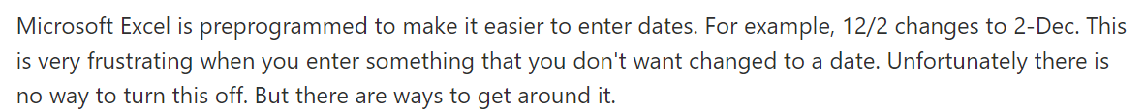
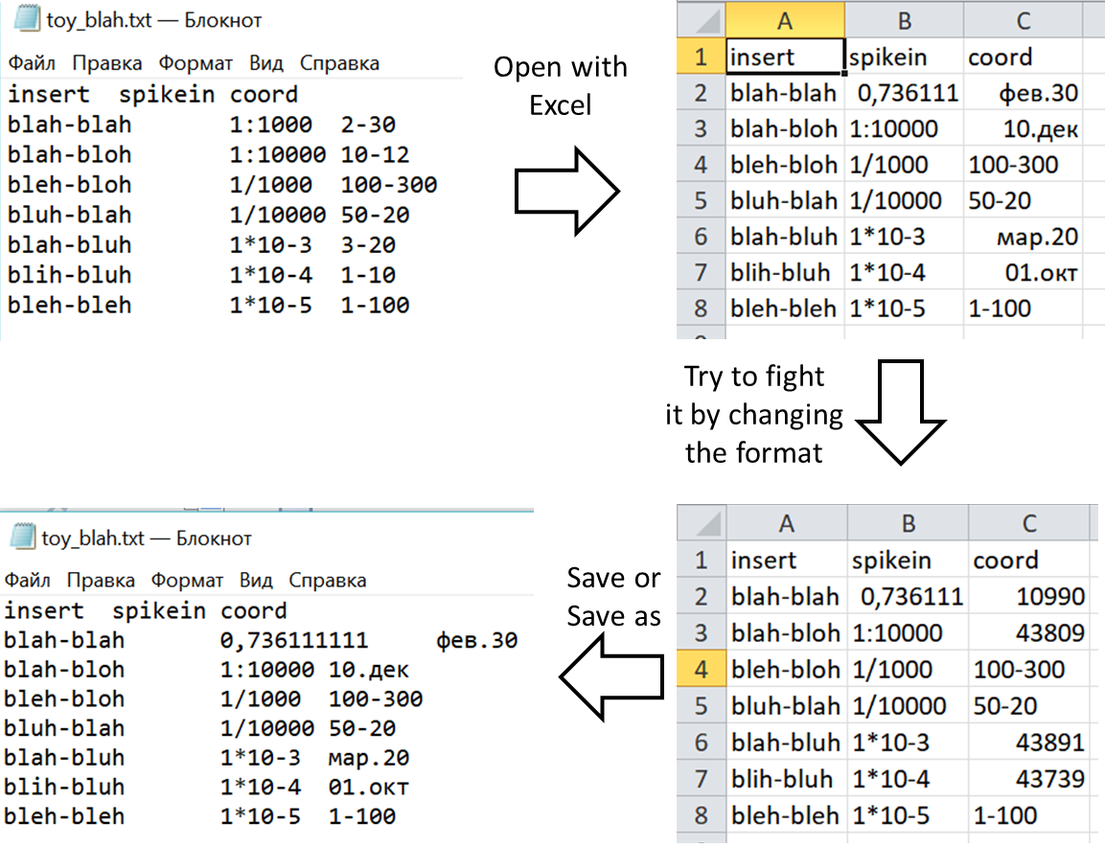
NEVER. TRUST. EXCEL.
“
”
*
Workaround on the next slide!
* - if you create a table in Excel

Slide 5
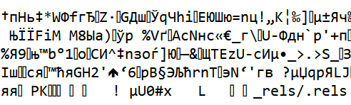
Workaround:
open the file in Notepad
if you see smth like that congrats you found Maya calendar
don’t fret, it’s encoded
Install newest version of Java for 64-bit architecture (https://www.java.com/en/download/manual.jsp).
In R install package “rJava”, import it, then install and import “xlsx” library.
read.xlsx to import your table.
Voila. Check the 1:1000 spike-ins and coordinates
How? For example, you want to check the V.contig.coords (it has the highest probability of being turned to a date)
code: sum(str_detect(all_insertsM$V.contig.coord, "[b-mo-zB-MO-Z]"))
It shows you the number of dates in V.contig.coords column (for Mathilde’s table it was 192)
or simply run the script data_cure.R

