Slide 1

Lebohang Molefe
Extracts valuable insights from data through leveraging the interplay between finance and data analysis.

Slide 2

H
L
k
H
L

Slide 3

Cataracts Detection Model

Slide 4




Cataracts
Cataracts is associated as the clouding of a normally clear lens of the eye. It develops slowly and wont initially disturb eyesight early on. However, if let untreated may result in blindness.
Definition
Leading cause of Cataracts is aging
Injury to the eye that damages the eye lens tissue
Long term use of steroid medication
Causes
Clouded, blurred or dim vision
Fading or yellowing of eye colour
Sensitivity to light and glare
Increasing difficulty with vision in the evenings
Symptoms
Cataracts removal surgery which is a generally safe and effective procedure
Treatment

Slide 5
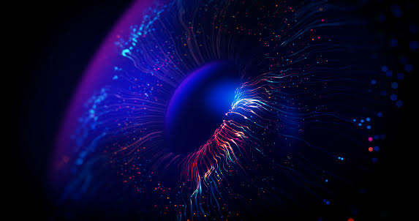
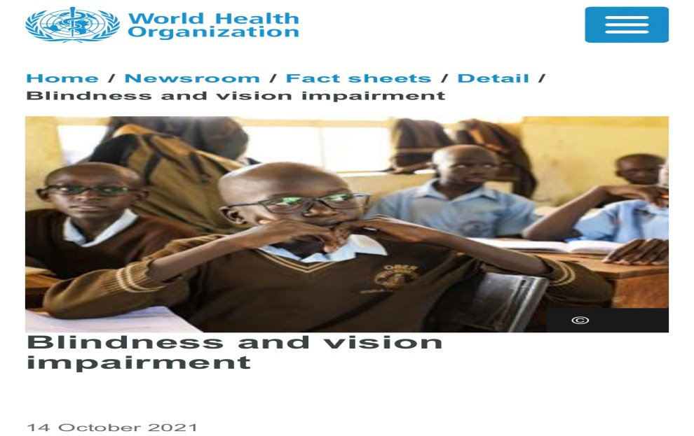
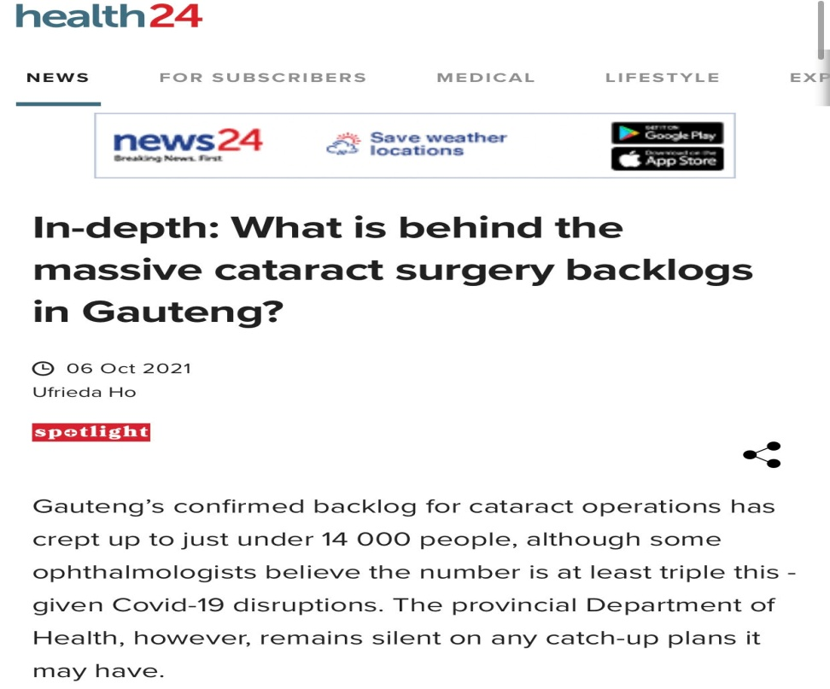
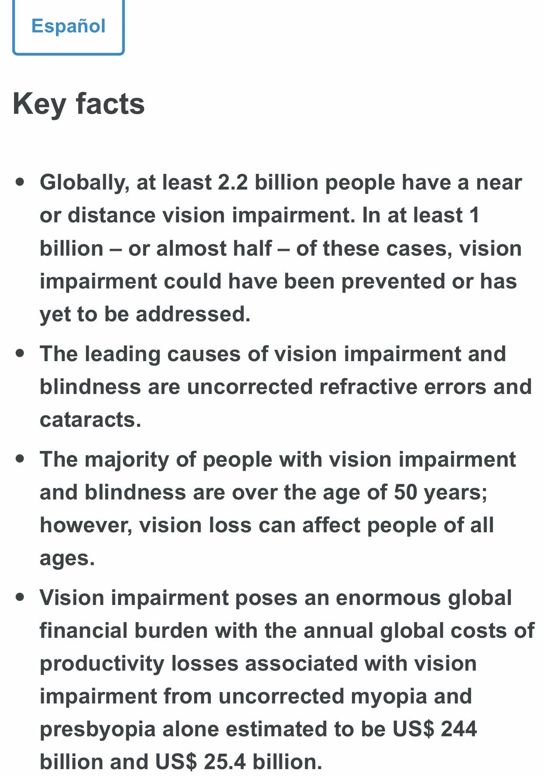
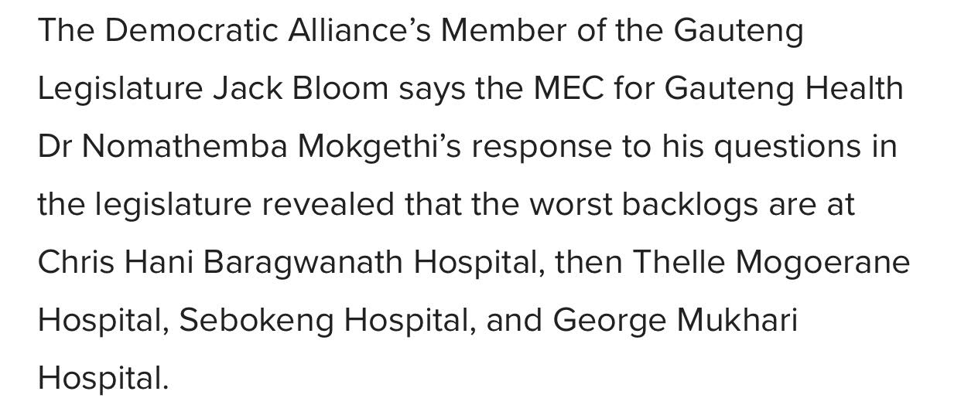
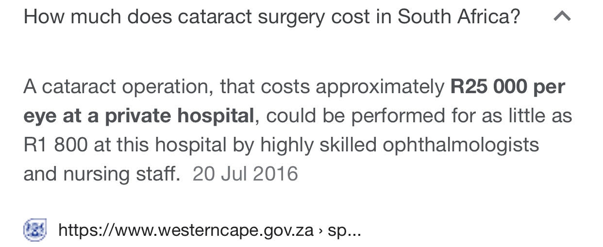
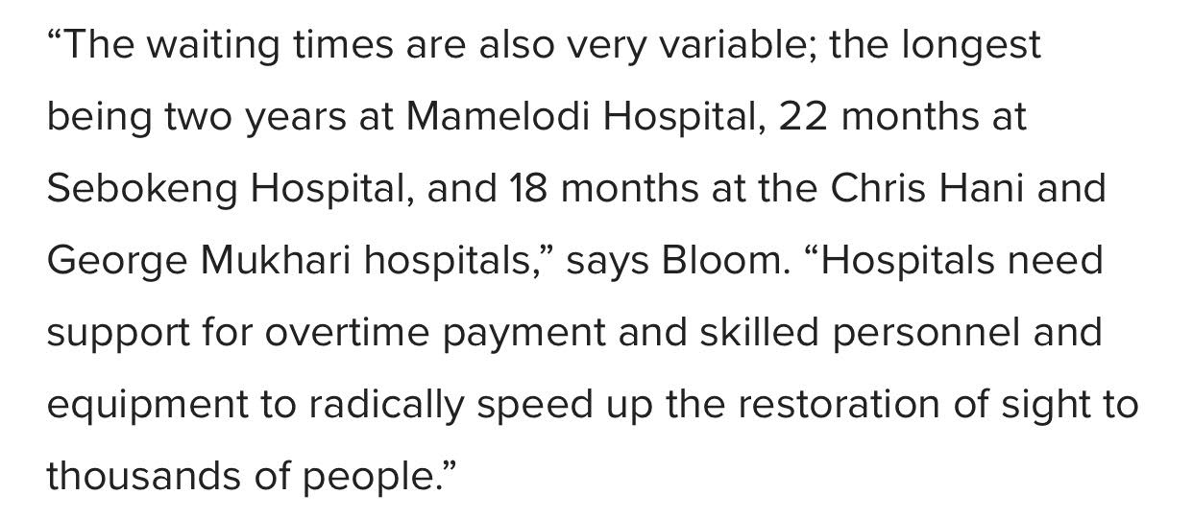
Problem

Slide 6


Slide 7
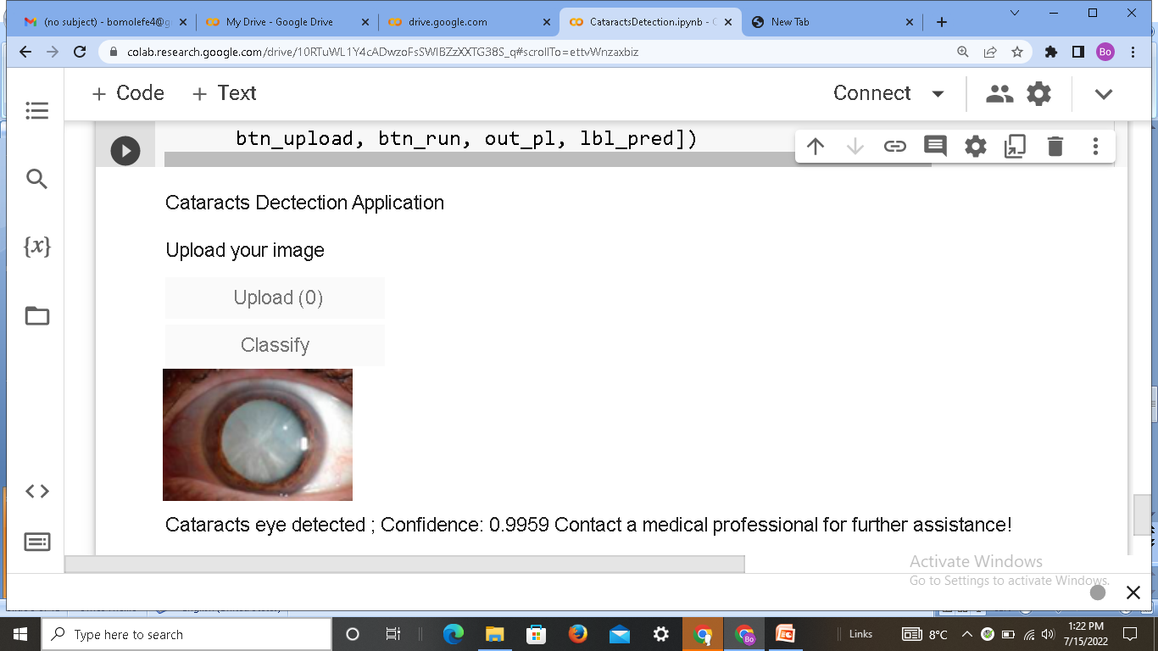
Solution

Slide 8


Slide 9


Slide 10
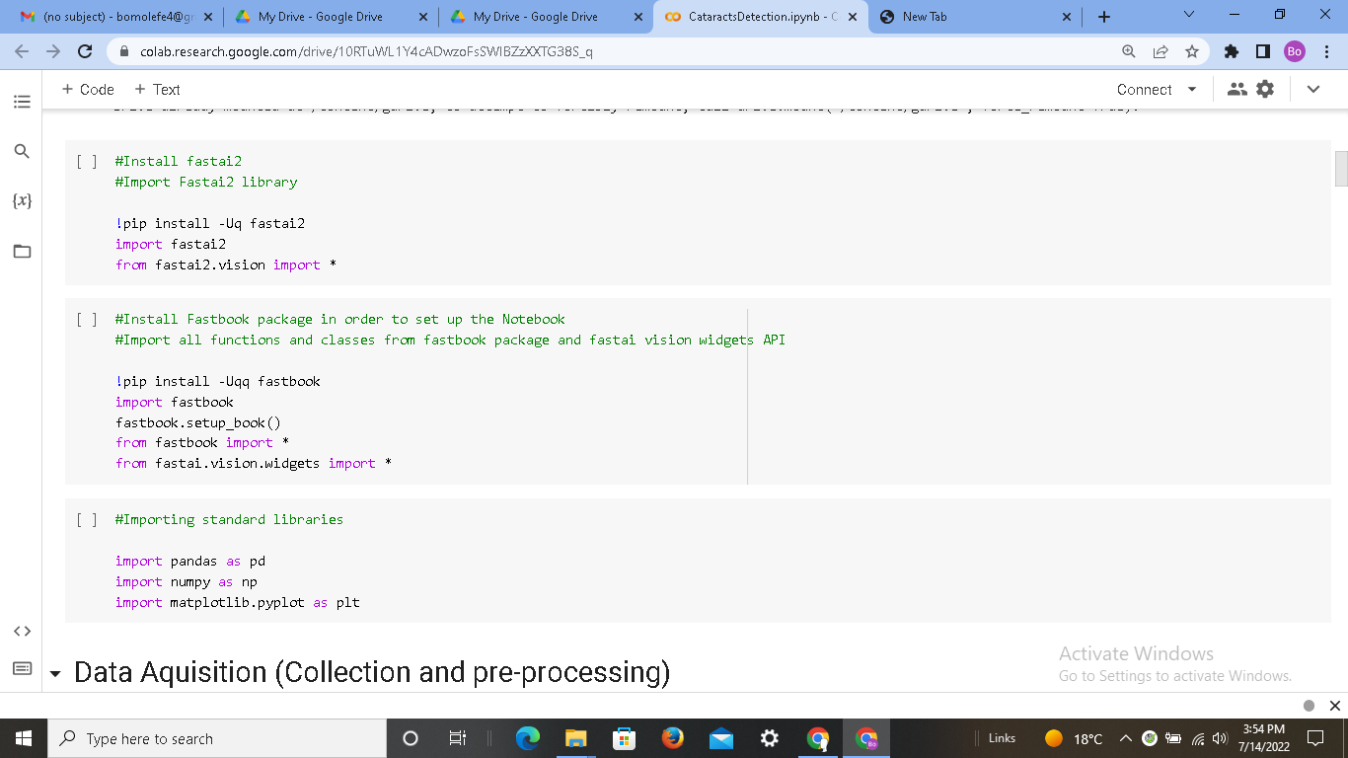


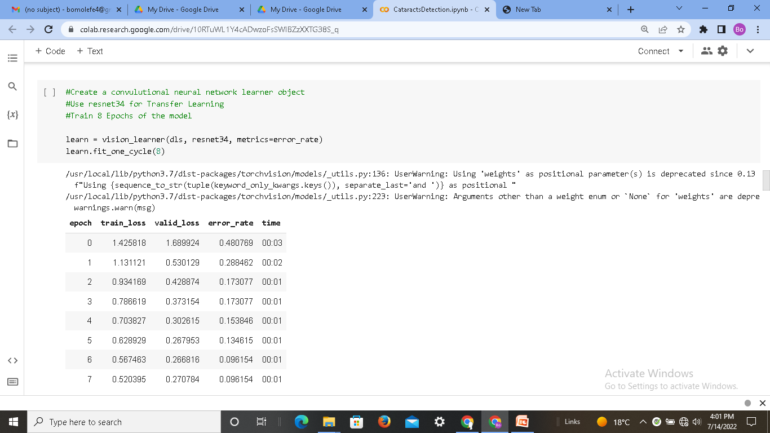
0verview

Slide 11



Image classification applications
Insurance: Records information on driver behavior and helps insurers gain insight on individual driver profiles.
Finance industry: Security measure to verify user identity. Access control to company premises or resources.
Marketing industry: Image recognition algorithms can be used to get information about a persons identity, gender and mood.

Slide 12


github.com/lebohangmolefe
lebohangemolefe@gmail.com
Thank you

