Slide 1
密钥K
明文P
AES加密算法
密文C

Slide 2
Block 0
Block 1
Block 2
Block 3
…
Block n-3
Block n-2
Block n-1
Block n
Block 0
Block 1
…
Block m-1
Block m
Cache
memory

Slide 3
Block 0
Block 1
…
Block m-1
Block m
…
Block n(m-1)
Block n(m-1)+1
…
Block n(m-1)+m-1
Block nm
Block 0
Block 1
…
Block m-1
Block m
Cache
memory

Slide 4
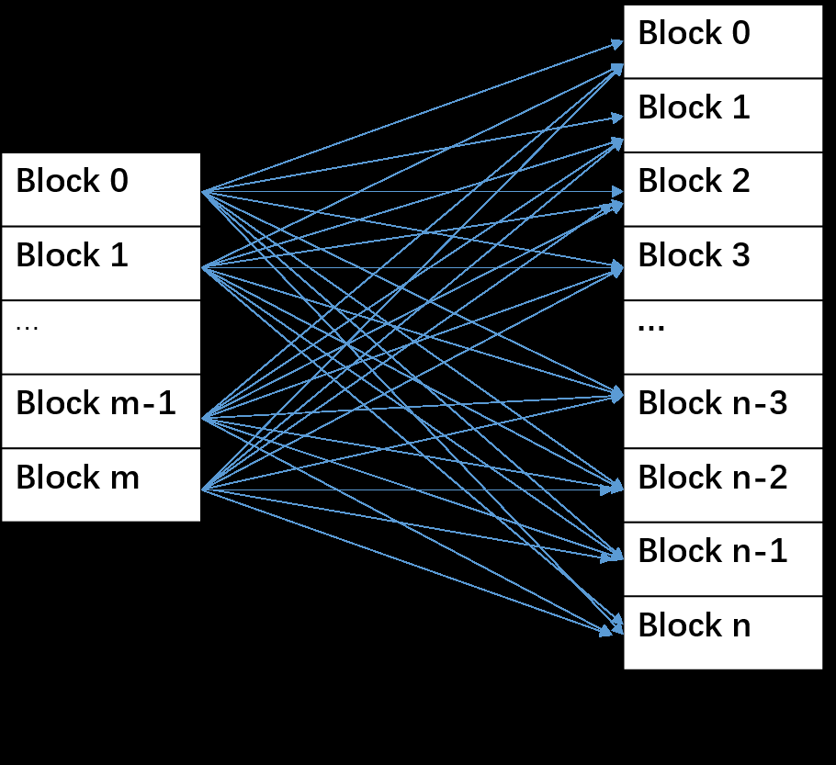

Slide 5
论密钥加
字节代替
行移位
第1轮
列混淆
论密钥加

Slide 6
Core 0
Core 1
Core 2
Core 3
L1
L1
L1
L1
L2

