Slide 1
Chao: « Modelling The Cytotoxic T-Cell Response »
PhD Thesis by Dennis Chao, U. New Mexico, Prof. Stephanie Forrest. Joint work with Alan Perelson (Santa Fe) and Miles Daveport (Sidney, AUS)
Further studied by Eric Winnington, EPFL Master Thesis, due March 2005
Contents
  Chao’s model
  Results in Chao’s dissertation
  Results by Eric Winnington

Slide 2
1. Chao’s Model Focuses on CTL response
Goal: model CTL response
  dynamics
  role of affinity
  role of distribution of naive/memory CTLs
Macroscopic model
  no detail on tissue, lymphocyte trafficking, immune system elements other than CTLs
  model is: number of cells of each type (tissue, infected, various CTLs) + virus load as a function of time
  stochastic model; randomness is in T-cell repertoire, binding and lifetime and reproduction
    stage structured approach == numerical approximation of Markov process

Slide 3
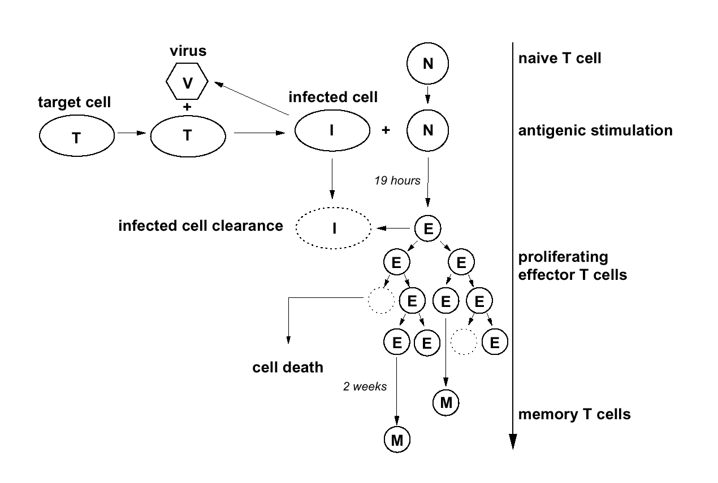
Elements present in Model
source: Dennis Chao’s dissertation

Slide 4
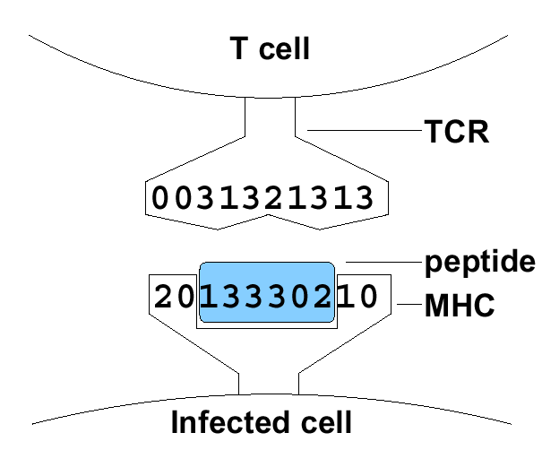
TCR Matching
Affinity is measured by 1 out of 3 hypothetical bit matching rule
  Hamming distance (alphabet size =3, string length=32+48)
  Xor distance (an ad-hoc distance ??? : d(3,1)=2 d(3,0)=3 d(2,1)=3 d(5,10)=15)
  alphabet size = 128, string length=4+6
  Modified L¹ (Manhattan) distance: sum of distances modulo n ; n = 16 d(1,5)=4, d(0,15)=1; alphabet size = 32, string length=4+6
Distance between pMHC and TCR is sum of distances between digits
Calibrated by fitting mouse data
  T-cell repertoire
  number of responding clones
  per epitope
source: Dennis Chao’s dissertation

Slide 5
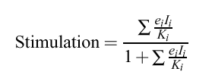
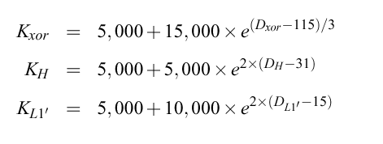
Avidity and Affinity
avidity (== recruitment rate) of a naïve T-cell into Activated T-cell is saturating function of affinity and epitope density e:
recruitment rate = γ Stimulation
with γ = maximum recruitment rate (1 per day)
constant K implemented in model as a function of distance MHC/peptide <-> TCR so as to match experimental data on mouse
source: Dennis Chao’s dissertation

Slide 6
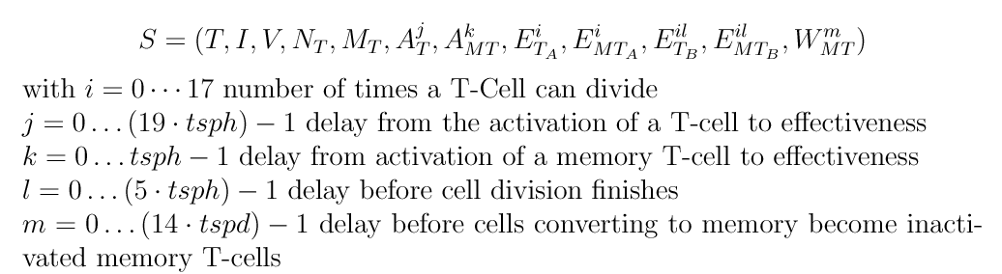
The Complete Model
One separate sub-model for each CTL clone
  multiple T-cell populations are modelled as distinct populations
  all CTLs in one clone have identical TCRs
Complete model (for one clone) is
source: Eric Winnington, EPFL

Slide 7
Evolution of Model State is Random
composition of T-cell clone (number of T-cells in each category) evolves randomly, based on presence of antigen and affinity
  eg: naïve T-cell
same for viral load and number of infected tissue cells
laws of evolution are based on the increment functions given next
Example
  Recruitment rate of naïve T-cells is given by avidity formula seen earlier; call it μ ;
  (is a function of I, number of infected cells)
    proba that a given cell becomes recruited between t and t+dt is
    μ dt + o( dt)
  N_{T}: number of naive T-cells in one clone is thus random
    we have a markov process with state S = (T, I, V, N_{T}, …)

Slide 8
The Simulator Approximates the Markov Process using the Stage Structured Approach
The simulator advances time by increments δ =10 mn
For example, the value of N_{T} is updated according to
where B is the binomial distribution
See next for the complete list of evolution equations
This is an approximation valid for small δ
  the approx is that μ depends on state S, assumed constant during 10 mn

Slide 9
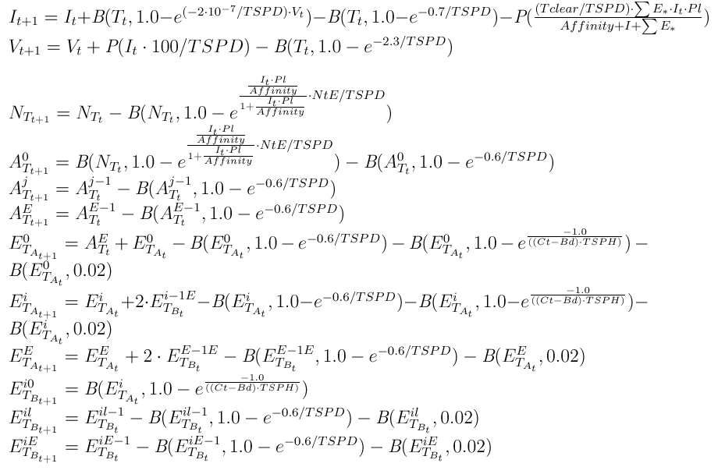
source: Eric Winnington, EPFL

Slide 10
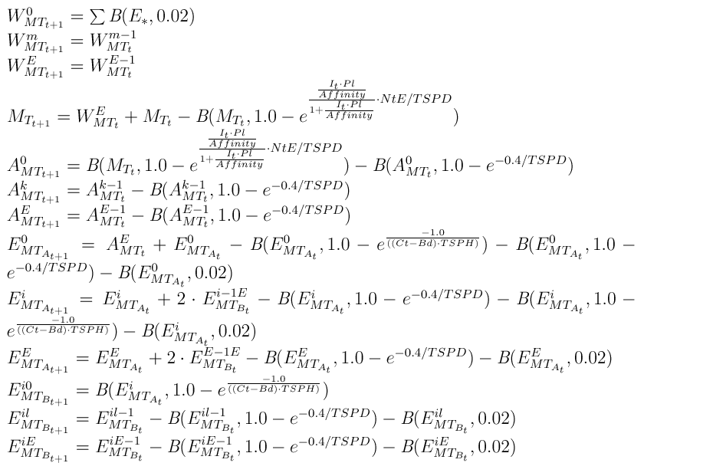
source: Eric Winnington, EPFL

Slide 11
How the model is run
generate one or several pMHC complexes
generate the T-cell clones that cross-react to them
  only those CTLs that can react to pathogen are explicitly created in the simulator (this is called « Lazy Evaluation »)
submit clones to positive and negative selection (thymus)
start one stage-structured instance per T-cell clone and run the model step by step

Slide 12
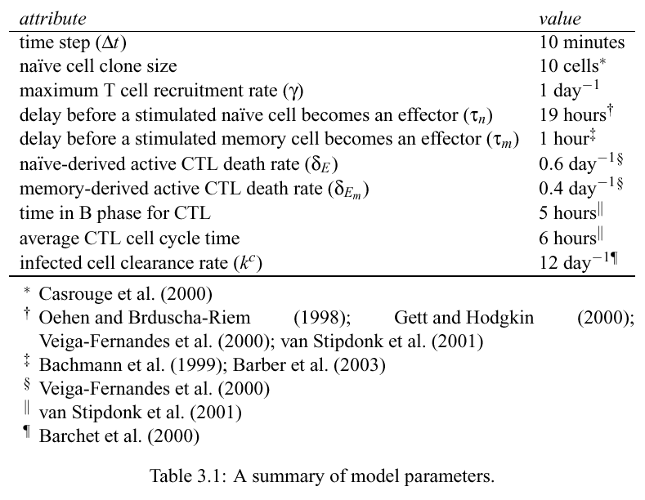
Parameters of Model
source: Dennis Chao’s dissertation

Slide 13
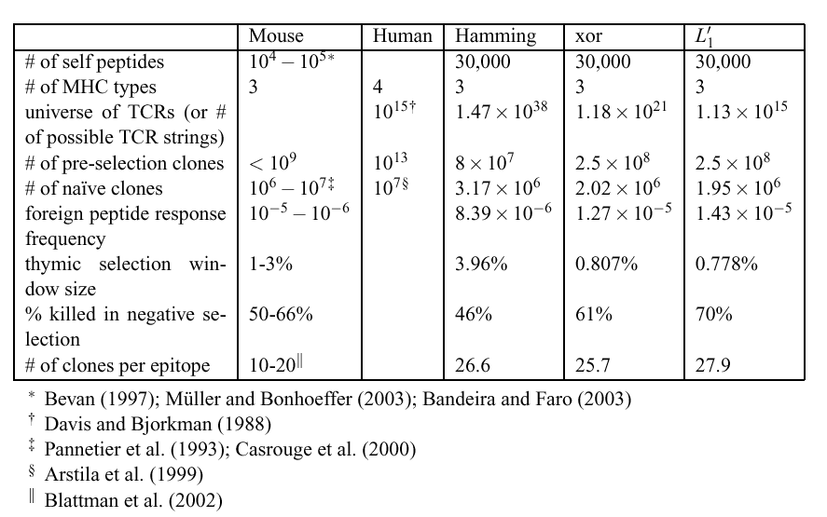
Model is fitted to the mouse
source: Dennis Chao’s dissertation

Slide 14
Other Modelling Assumptions
CTLs do not interact with non infected self cells
Virus can mutate
  implemented as change in one digit of the peptide in MHC/peptide complex
  implemented by probability p that a virus in newly infected cell undergoes one mutation
T-cell exhaustion

Slide 15
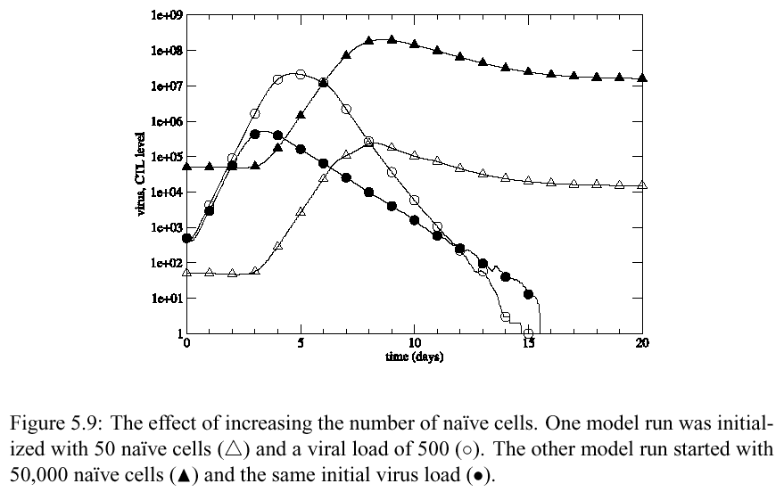
2. Chao’s Result Example
Impact of CTL clone size
smaller initial clone size induces a larger virus load peak and then a faster decay
source: Dennis Chao’s dissertation

Slide 16
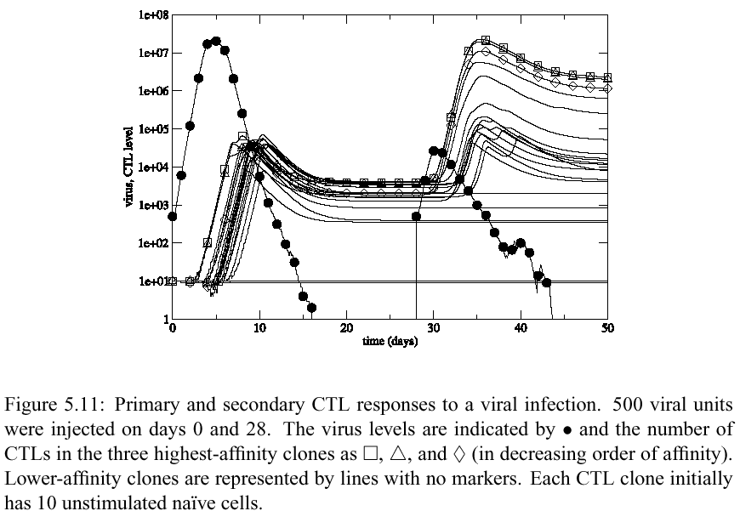
Example: Clonal Composition of CTL Response
secondary response has a higher affinity
source: Dennis Chao’s dissertation

Slide 17
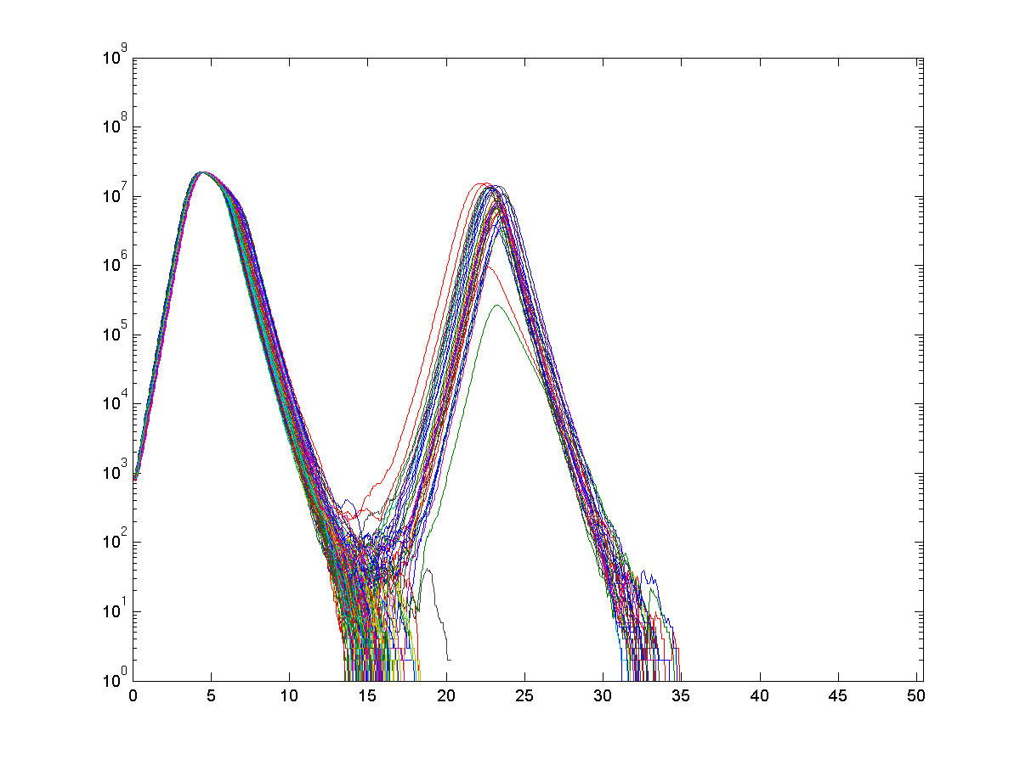
3. Eric Winington’s Result Example
The Immune Response is Random
The same model can be run more extensively and one finds random results
  randomness due to naïve T-cell repertoire
Viral load
ca. 20% of simulation
runs do not clear virus
in 20 days
days
source: Eric Winnington, EPFL
1kHN

Slide 18
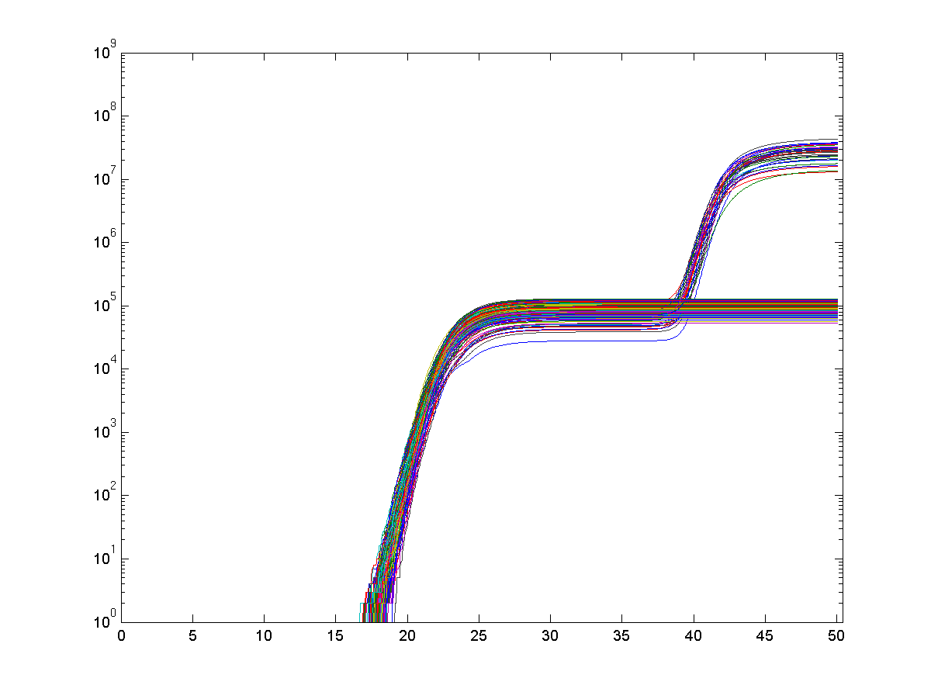
Secondary reaction without re-infection may occur with small probability
Not cleared by primary reaction (after 20 days)
5h Hamming 15.0%
Manhattan 31.7%
Xor 31.0%
1k Hamming 22.5%
Manhattan 31.5%
Xor 37.0%
memory T-cells
source: Eric Winnington, EPFL
1kHN

Slide 19
Conclusion
The examples show what we can do and what a stochastic model can tell us
We would like now to apply this and other types of modelling to specific cases of interest

Slide 20
Checklist
how many TCRs per CTL?
How is avidity computed in the model ?
How is epitope mapped to MHC/peptide complex ?
Multiple epitopes / antigen specificity: how does the model reflect this ?
  how are the original T-cells created from the model ?
  H: all T cells are same, I different pathogen types
  what does « T-cell specific to a particular antigen » mean ?
  is there more than one antigen specificity anywhere in the applications of the model ?
Replace : in effector mediated clearance Poisson by Binomial
Compare to ODE method (mean values)
Can auto-immunity occur in this model ? (a peptide—MHC complex close to many self complexes)

