Slide 1



A Robust Reputation System for Mobile ad hoc Networks
MICS
Mobile Information and Communication Systems
Jean-Yves Le Boudec
joint work with
Sonja Buchegger

Slide 2
What is Immune System for a Network ?
Set of functions that aim at making network immune to
  Bugs
  Malicious / non desired behaviour
Exists in the form of
  Anti-virus, anti-spam
  Intrusion detection systems
In self-organized networks
  Misbehaviour detection / correction software for mobile ad-hoc networks
  Applies to any function, focus today is on routing
    Key to network health
    Ad-Hoc networks more vulnerable than traditional networks

Slide 3
An Immune System for Ad-Hoc Routing
Set of functions that aim at making network immune to
  Bugs
  Malicious / non desired behaviour
Focus today : routing, specifically DSR
Principles: [BucheggerLeBoudec, Mobihoc 2002, « CONFIDANT »]
  Nodes
    monitor each other’s behaviour
    classify others as misbehaving or not
    deny service to nodes classified as misbehaving
  Information looses its value exponentially with time
    Allows redemption
Issue in this talk
  Propagation of first hand information
  The original CONFIDANT paper assumed nodes receive classification reports from trusted “friends” – too restrictive assumption
  We developed a reputation system that does not need trusted friends

Slide 4
The CONFIDANT Reputation System
Goal:
  Distribute first hand observations to all network participants.
  Avoid false accusations and praise
  Fully distributed and self-organized.
Assumptions
  Persistence of node identity
  Authentication of the mapping (message source, node identity)
  Otherwise no a-priori trust between nodes

Slide 5
Reputation Systems Keeps 3 Types of Record
Nodes
observe who they can observe
periodically broadcast their observations to all neighbours (ttl=1)
keep 3 types of records for every other node
  First hand :
    directly observed behaviour, if any
  Reputation :
    based on own first hand and received reports
    synthesis of first and second hand information (majority opinion)
    Reflect perceived behaviour of other node as protocol agent
    used to classify other nodes as regular/misbehaved
  Trust :
    based on received reports
    Reflects perceived behaviour of others nodes as reputation agents
    used to classify other nodes as trustworthy/not trustworthy

Slide 6

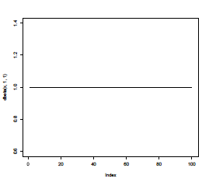
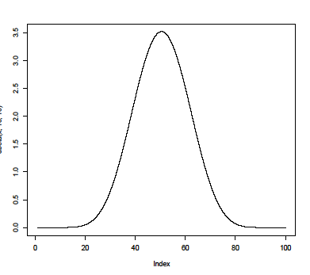
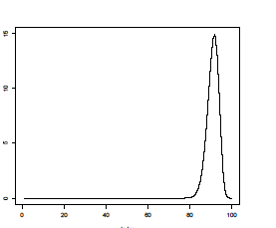
Bayesian Approach
The three types of records are based on the same Bayesian approach; we explain it for First Hand Observation
Node i believes that
  node j behaves as a simulator that produces wrong behaviour with proba θ
  θ is drawn from a B(α, β) distribution (= the prior)
The prior B(α, β) is the record
  Modified by Bayesian inference + aging mechanism. Let s = 0 or 1 (misbehave) be the result of one observation. Then (with u = 0.999)
B(1,1)
Node i has no information on node j
B(10,10)
Node i has balanced information on node j
B(100,10)
Node i has converged information on node j

Slide 7
Reputation is Derived From First-Hand Information
F(i,j)
R(i,j)
T(i,k)
i
j
F(k, j)
k
F(k,j)
R(k,j)
T(k,j)
F(k, j) = (α, β) =
All nodes broadcast their first hand observations
Node i uses own + received first-hand information to build its reputation record for node j

Slide 8
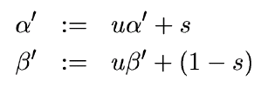



How Reputation is Made
Node i makes direct observation on j
  R(i,j) is updated according to
Node i receives from node k the first hand observation report F(k,j)
  Should received report F(k,j) be accepted (see later) ?
  If no, node i does not update reputation record
  If yes, i updates reputation record R(i,j), using
  (with w = 0 to 0.1)
Node i classifies node j according to Bayesian control. Node j is considered by i as:
with and r = 0.75
regular
regular
misbehaved

Slide 9



Deciding Whether to Accept Received Report
Node i receives from k the (alleged) report F(k,j)
  if i thinks that k is trustworthy then F(k,j) is accepted
  else i does a deviation test:
  if report F(k,j) deviates largely from R(i,j) then reject else accept
Deviation Test is
with d =0.5,

Slide 10

How Trust is Made
F(i,j)
R(i,j)
T(i,k)
i
j
F(k,j)
k
F(k,j)
R(k,j)
T(k,j)
Node i maintains a trust rating T(i,k): a rating of k as reputation agent
  T(i,k) expresses how much k deviates from i’s belief (based on majority opinion and i’s first hand info)
Let T(i,k)=B( γ, δ); i decides that k is (with t =0 to 1, typical t=0.25)

Slide 11
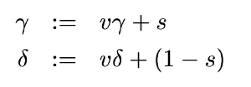
How Trust Rating is Computed
F(i,j)
R(i,j)
T(i,k)
i
j
F(k,j)
k
F(k,j)
R(k,j)
T(k,j)
Node i performs deviation test on received report; (s = 1 means the test is positive).
T(i,k) = (γ, δ ) is updated according to
(with v = 0.999)

Slide 12


Example 1: E Joins Network, B misbehaves but does not lie
C F R T
E F R T
A
A
B
E
B F R T
B
C
A
C
D
B
A
A F R T
D
B
D F R T
D
A
B

Slide 13
Nodes Publish First Hand Information
C F R T
E F R T
A
A
E F
B
E
B F R T
B
A
C
A
C
B
C F
A
D
C
B
B F
B
A F
D F
A
A
B
A
D
D
B
A F R T
D
B
D F R T
D
A
B

Slide 14
E Accepts Reports and Classifies B
C F R T
E F R T
A
A
B
E
B F R T
B
C
A
C
D
B
A
A F R T
D
B
D F R T
D
A
B

Slide 15

Example 2: Node C comes and starts lying
C F R T
E F R T
A
A
B
E
B F R T
D
C
A
C
C F
A
D
B
A
D F
A
A F R T
D
B
D F R T
D
A
B

Slide 16
E does Deviation Test and Does Not Believe C
C F R T
E F R T
A
A
B
E
B F R T
D
C
A
C
C F
A
D
B
A
D F
A
A F R T
D
B
D F R T
D
A
B

Slide 17
E updates classification; views C as liar and A as regular
C F R T
E F R T
A
A
B
E
B F R T
D
C
A
C
D
B
A
A F R T
D
B
D F R T
D
A
B

Slide 18
Example 3: Gain Trust and Then Lie
E F R T
E F R T
A
A
E
B bad
A good
E
B
C
B
B good
A bad
C
C
B
C
B
A
A
D
D
1. C says the truth to gain confidence; E trusts C
2. C says B good A bad; E believes C
(and A and D), gets blurred picture on A and B, but
majority opinion prevails. C’s trust decreases
E F R T
E F R T
A
A
E
E
B
C
B
C
B good
A bad
B bad
A good
C
B
C
B
A
A
D
D
3. C continues to lie; E does not believe C
4. C says the truth again; trust becomes better.

Slide 19
Example 4: Brainwashing
1. E surrounded by liars.
No first hand information on B
E believes and trusts liars
« brainwashed »
E
B
2. E moves to a healthier place. E does not believe the truth but does not update B’s reputation either, which fades out. Trust in the liars also fades out. E has now no opinion on B and can start believing the truth.
E
B

Slide 20
Example 5 Stealthy Lying Attack
Attackers lie a little bit to gradually worsen reputation
  But the many little lies do not accumulate (reputation fading)
  For a more effective attack, liars need to lie more
  They will not be trusted anymore

Slide 21
Features of the Reputation System
Only first hand information is propagated
All information needs to be re-enforced otherwise it fades out
Separate behaviour as
  Protocol agent
  Reputation agent
Reputation and Trust are made by the system
  reputation made out of direct experience and second hand information; use to detect problems
  trust made out of reports; used to control use of second hand information

Slide 22
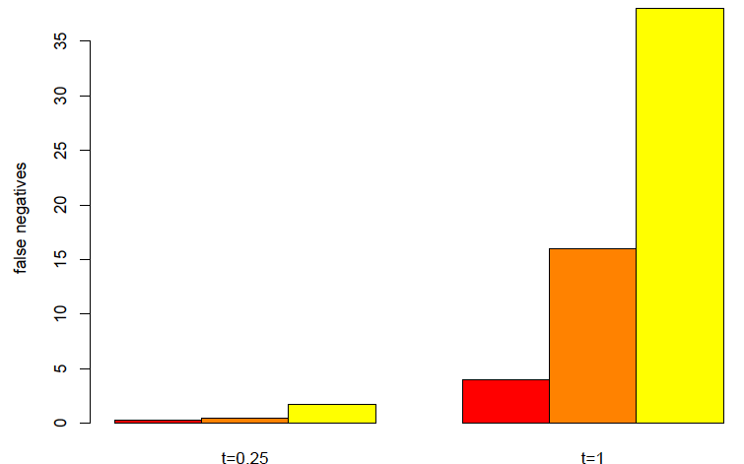
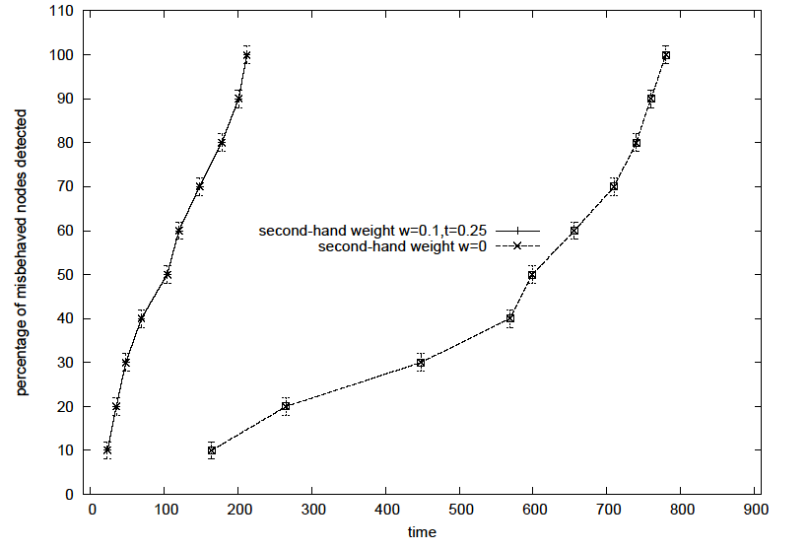
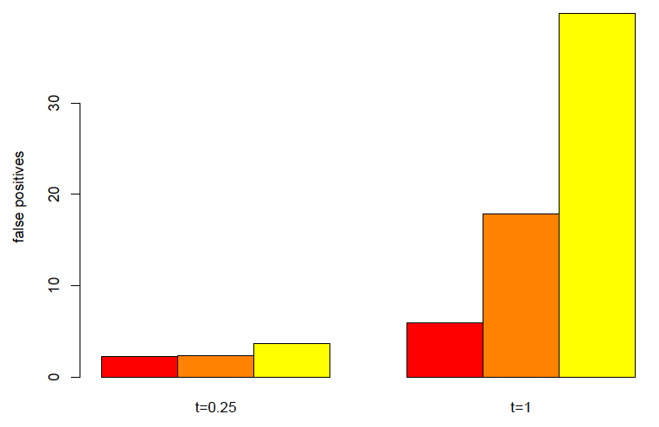
Performance Evaluation
Mobile network with random waypoint
Reputation decreases time to detect all misbehaving nodes and false positive / false negative
Without Reputation (w=0)
Without trust (t=1)

Slide 23
Conclusions
CONFIDANT with the reputation system provides elements of an immune system for ad-hoc network
  analytical performance evaluation is work in progress
issues for future work
  privacy versus observability
  identity persistence

Slide 24
Artificial Immune Systems
CONFIDANT with the reputation system provides elements of an immune system for ad-hoc network
Other Artificial Immune Systems exist
  Some are bio-inspired, i.e. try to apply solutions of the natural immune system
  Confidant is not a-priori bio-inspired, but there are many analogies
    Aging out
    Secondary response
  Immune System functions can be classified as
    « innate » : code is given by system design
    « adaptive » : functions of immune system evolve based on experience
Confidant is an « innate » immune system
  We are exploring, in addition, the concept of « adaptive » immune system
  Potential:
    can react to entirely new attacks
    Second response to an attack is quicker than first

Slide 25
More Details
S. Buchegger, J. Y. Le Boudec
"A Robust Reputation System for Mobile ad hoc Networks"
Technical report No. IC/2003/50
S. Buchegger, Cedric Tissieres, J. Y. Le Boudec
"A Test-Bed for Misbehavior Detection in Mobile Ad-hoc Networks --- How Much Can Watchdogs Really Do?"
Technical report No. IC/2003/72, November 2003.
S. Sarafijanovic, J. Y. Le Boudec
"An Artificial Immune System Approach with Secondary Response for Misbehavior Detection in Mobile Ad-Hoc Networks"
Technical report No. IC/2003/65 / Conference BioAdit 2003

