Slide 1
Perfect Simulation and Stationarity of a Class of Mobility Models
Jean-Yves Le Boudec (EPFL)
Milan Vojnovic (Microsoft Research Cambridge)

Slide 2
Contents
Issues with mobility models
The random Trip Model
Stability
Perfect Simulation

Slide 3
Mobility models are used to evaluate system designs
Simplest example: random waypoint:
  Mobile picks next waypoint M_{n} uniformly in area, independent of past and present
  Mobile picks next speed V_{n} uniformly in [v_{min}; v_{max}]
  independent of past and present
  Mobile moves towards M_{n} at constant speed V_{n}
M_{n-1}
M_{n}

Slide 4
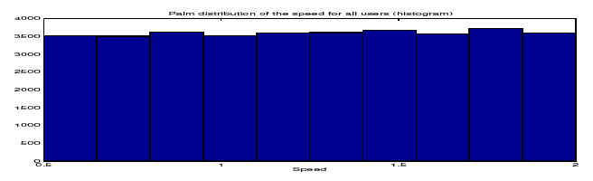
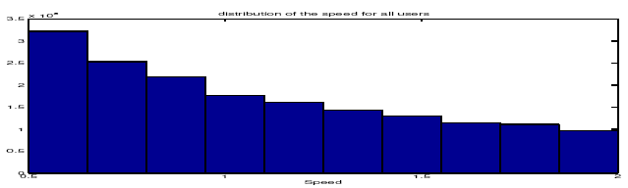
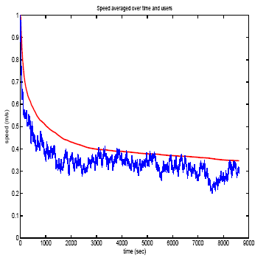
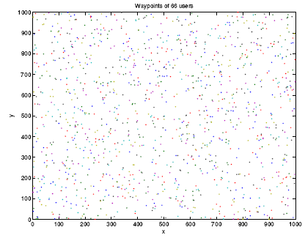
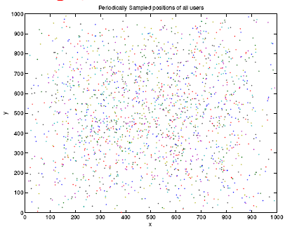
Issues with this simple Model
Distributions of speed, location, distances, etc change with simulation time:
Distributions of speeds at times 0 s and 2000 s
Samples of location at times 0 s and 2000 s
Sample of instant speed for one
and average of 100 users

Slide 5
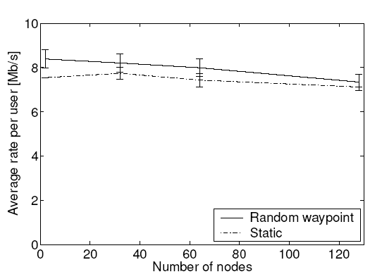
Why does it matter ?
A (true) example: Compare impact of mobility on a protocol:
  Experimenter places nodes uniformly for static case, according to random waypoint for mobile case
  Finds that static is better
Q. Find the bug !
A. In the mobile case, the nodes are more often towards the center, distance between nodes is shorter, performance is better
The comparison is flawed. Should use for static case the same distribution of node location as random waypoint. Is there such a distribution to compare against ?
Random waypoint
Static

Slide 6
Issues with Mobility Models
Is there a stable distribution of the simulation state ( = Stationary regime) reached if we run the simulation long enough ?
If so,
  how long is long enough ?
  If it is too long, is there a way to get to the stable distribution without running long simulations (perfect simulation)

Slide 7
Contents
Issues with mobility models
The random Trip Model
Stability
Perfect Simulation

Slide 8
The Random Trip model
Goals: define mobility models
  That are feature rich, more realistic
  For which we can solve the issues mentioned earlier
Random Trip [L-Vojnovic-Infocom05] is one such model
  mobile picks a path in a set of paths and a speed
  at end of path, mobile picks a new path and speed
  evolution is a Markov process
Random Waypoint is a special case of Random Trip
Examples of random trip models in the next slides

Slide 9
RWP with pauses on general connected domain

Slide 10
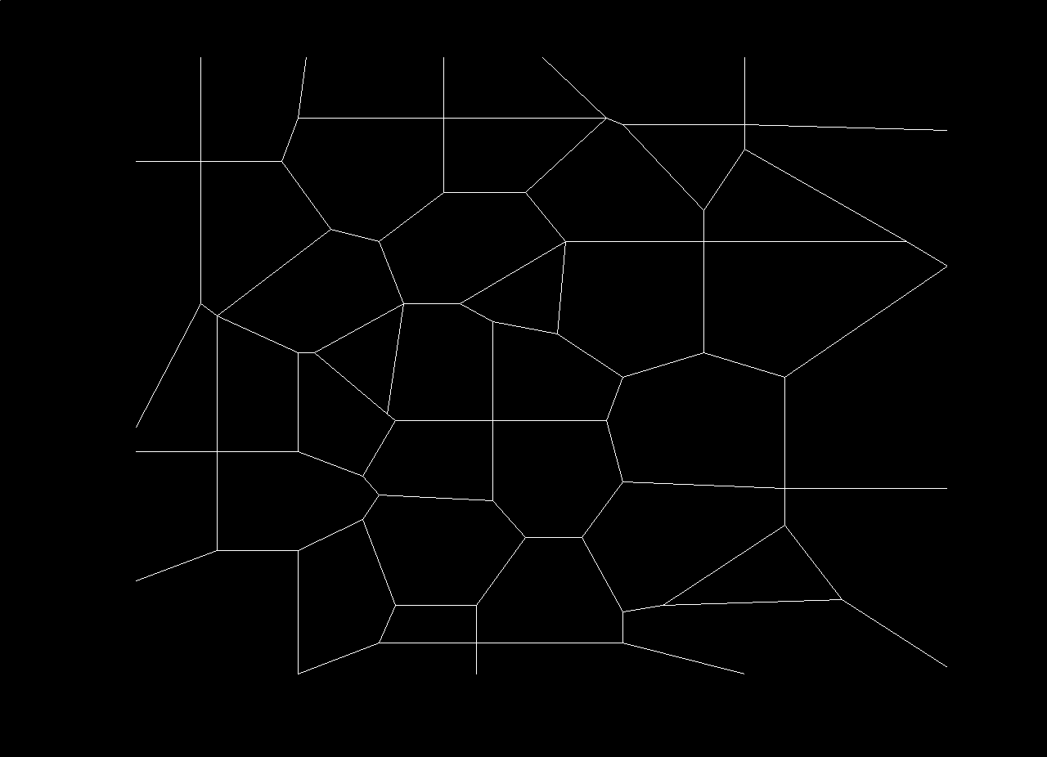
City Section

Slide 11
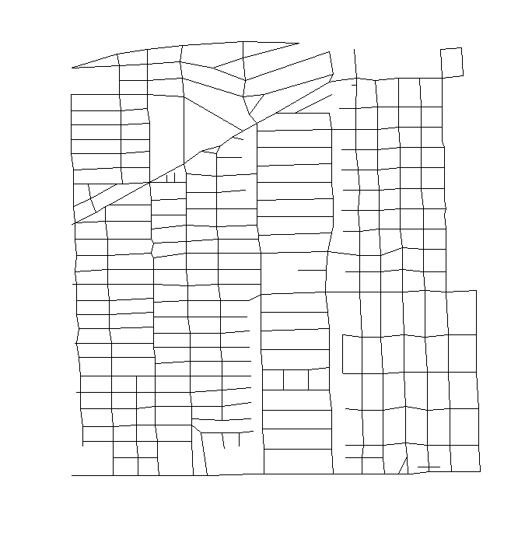
Space graphs are readily available from road-map databases
Example: Houston section, from US Bureau’s TIGER database
(S. PalChaudhuri et al, 2004)

Slide 12
Restricted RWP (Blažević et al, 2004)

Slide 13
Random Walk with Reflection

Slide 14
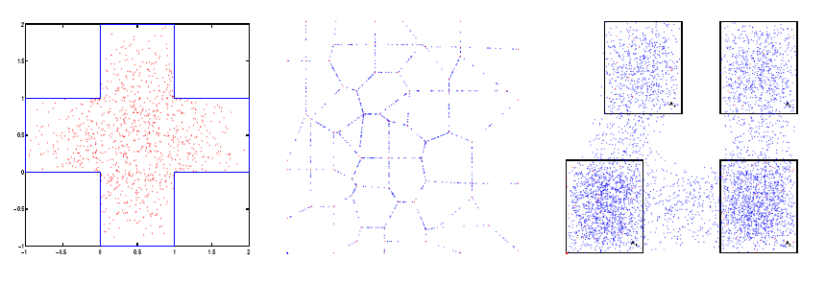
The Issues remain with Random Trip Models
Samples of node locations after 2000 s of simulated time
  (At t=0 node location is uniformly distributed)

Slide 15
Contents
Issues with mobility models
The random Trip Model
Stability
Perfect Simulation

Slide 16
Solving the Issue
1. Is there a stationary regime ?
Answer:
  there is a stationary regime for random trip iff the expected trip time is finite.
Application to random waypoint with speed chosen uniformly in [v_{min},v_{max}]
  Yes if v_{min} >0, no if v_{min}=0
  Solves a long-standing issue on random waypoint.

Slide 17
A Fair Comparison
If there is a stationary regime, we can compare different mobility patterns provided that
  They are in the stationary regime
  They have the same stationary distributions of locations
Example: we revisit the comparison by sampling the static case from the stationary regime of the random waypoint
  Run the simulation long enough, then stop the mobility pattern
Static, same node location as RWP
Random waypoint
Static, from uniform

Slide 18
Contents
Issues with mobility models
The random Trip Model
Stability
Perfect Simulation

Slide 19
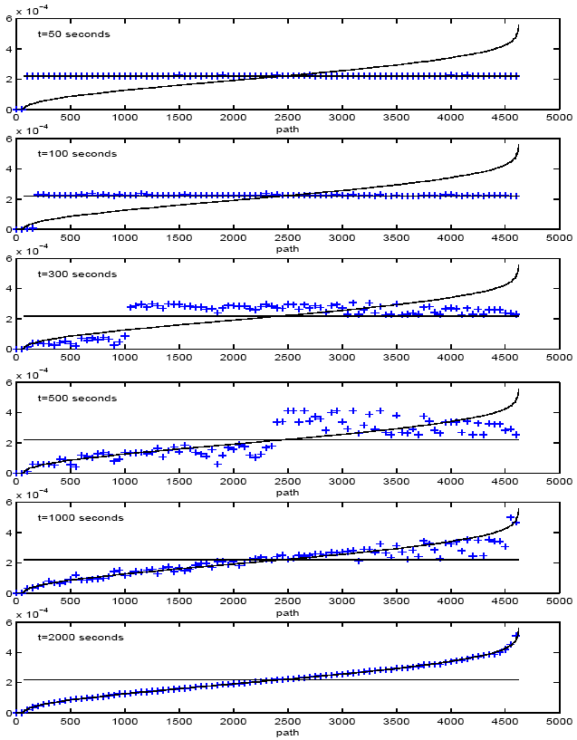
Solving the Issue
2. How long is long enough ?
It can be very long
  Initial transient longs at least as large as typical simulation runs

Slide 20
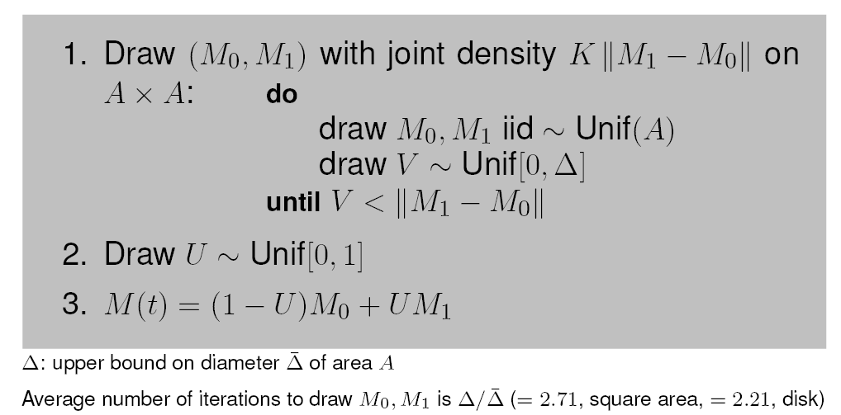
But we do not need to wait that long…
There is an alternative to running the simulation long enough
Perfect simulation is possible (stationary regime at time 0) thanks to a perfect sampling algorithm of random trip
  Computationally simple sampling algorithm
  Obtained by using Palm Calculus
  Example for random waypoint:

Slide 21
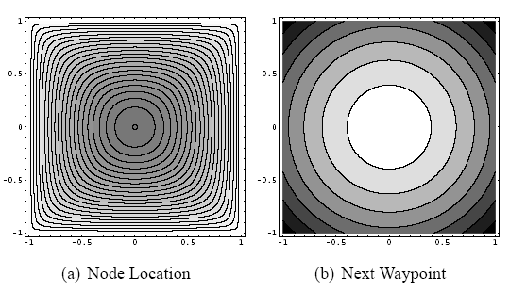
The stationary distribution of random waypoint is obtained in closes form
Contour plots of density of stationary distribution

Slide 22
Conclusion
The random trip model provides a rich set of mobility models for single node mobility
Using Palm calculus, the issues of stability and perfect simulation are solved
Random Trip is implemented in ns2 (by S. PalChaudhuri) and is available at
http://ica1www.epfl.ch/RandomTrip/

