Slide 1
Haggle:
An Innovative Paradigm for Autonomic Opportunistic Communication

Slide 2
Key Data
Type of project: FET Integrated Project
8 Partners: Thomson, CAMCL, Uppsala, EPFL,
SUPSI, CNR, Eurecom, Martel
Start date: January 1st 2006
Duration: 48 Months (end of December 2009)

Slide 3
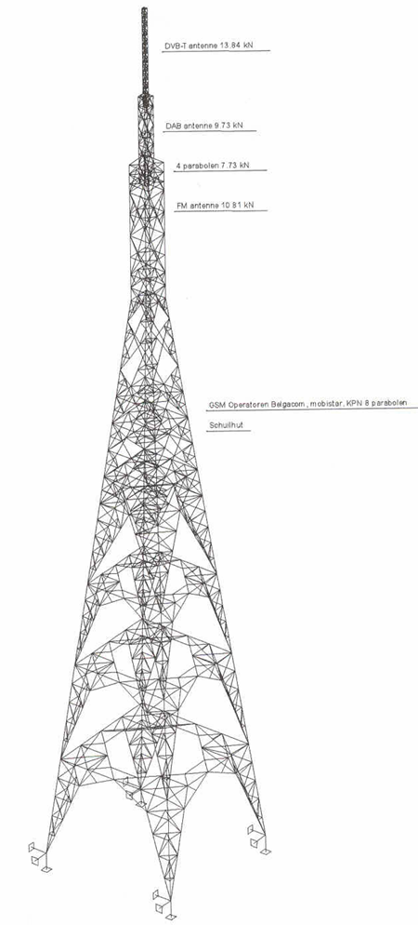




Infrastructure based services
But mobile phones and PDAs are still working….
No infrastructure
Every terminal is also a router
Mobility change topology

Slide 4


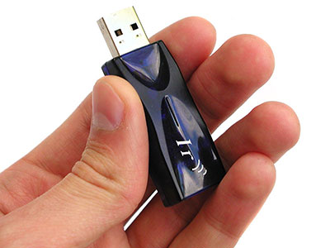






No alternative to infrastructure services
Internet
Phone
Today
OR …
Tomorrow

Slide 5

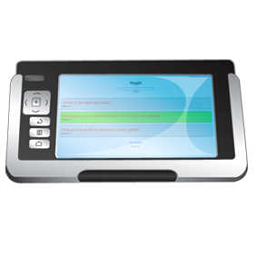
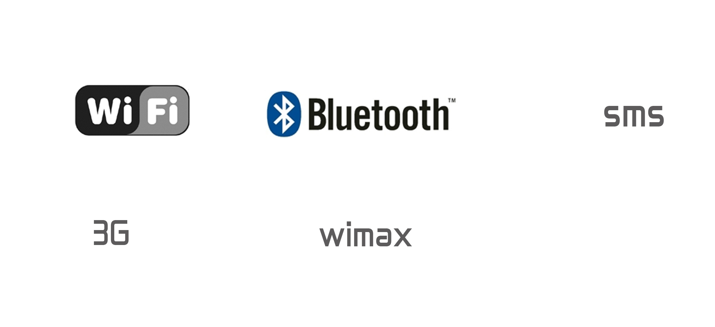
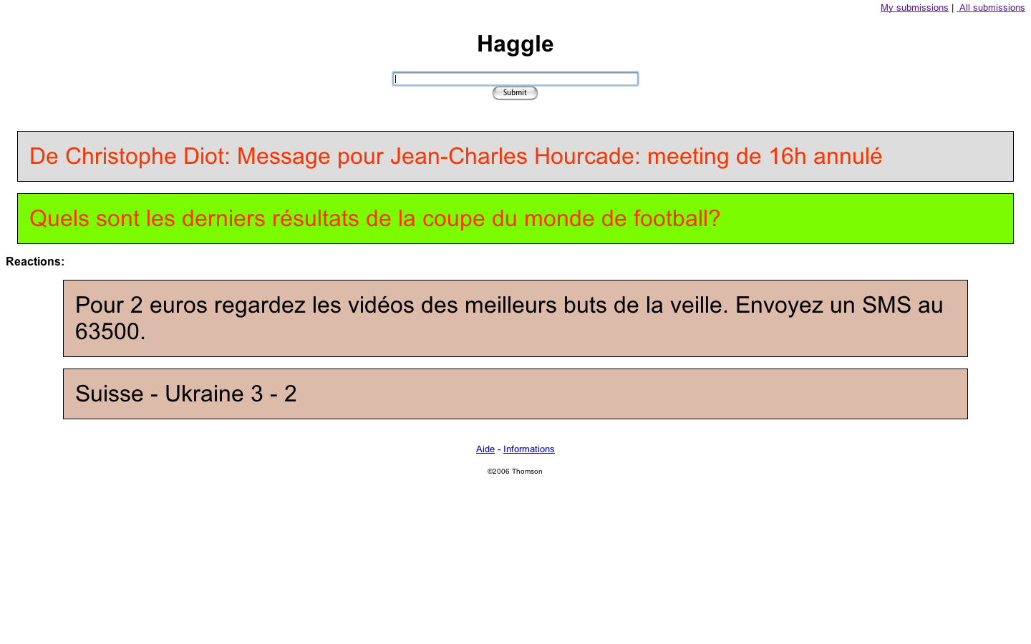



How does it work?
SUBMIT
GSM
Internet
Notes:
Cette démonstration illustre par deux exemple ce que peut amener la convergence des services. Notre démo s’appuie des terminaux expérimentaux: Téléphones, assistants personnels et ordinateurs portables, point d’accès,
équipés de la plus part des technologies de communication sans fils disponibles aujourd’hui, WiFi et Bluetooth, téléphonique cellulaire et internet.
Nous avons rajoute
Une interface simple et unique qui permet de rentrer des requêtes. On peut tout voir dans un reseau comme une requête en communication …
Un moteur de recherche pair à pair qui ne nécessite pas de connexion à un serveur, et qui sait exploiter les ressources locales.
Et enfin une infrastructure de communication opportuniste qui permet d’utiliser indifféremment toutes les technologies de communications disponibles sur chaque équipement expérimental.
Donc plus de câbles, plus de logiciels de communication spécifiques a chaque marque et chaque technologie, et enfin plus de pilotes.
Comme pour toutes les démonstrations de technologies qui sont censées résoudre tous nos problèmes sans que ca se voie, nous allons faire appel à votre imagination. Passons sur l’écran a votre droite qui représente ce que vous verriez si vous aviez un des terminaux expérimentaux dont quelques prototypes circulent dans la salle. Je vais essayer de vous expliquer ce qui se passe vraiment entre ces appareils.

Slide 6
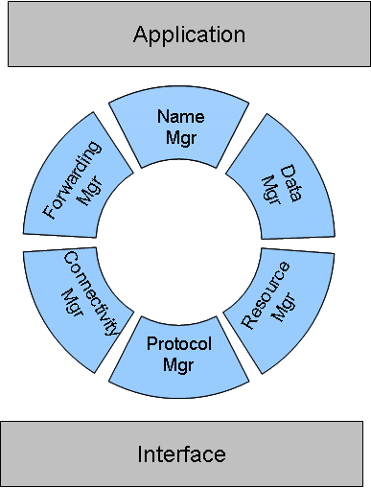
Achievements
The 1st version of (INFANT) Haggle Node Managers, compatible with the following global architecture:
Available on sourceforge
Email client and chatting application
Opportunistic forwarding paradigms with context information
Or by flooding (today’s talk)

Slide 7
Achievements (continued)
An analysis of the security implications of being able to take forwarding decisions without inspecting the contents of packets.
Collection of ´connectivity traces from two communities:
  IEEE Infocom 2006 conference in Barcelona. (100 Bluetooth iMotes)
  Hong Kong students
Discovery of some software errors and Bluetooth limitations
Mobility modelling testbed (APE) established in order to replicate the experiments

Slide 8

Control of Spread in Epidemic Forwarding
Jean-Yves Le Boudec
joint work with
Alaeddine El Fawal and Kave Salamatian
EPFL/I&C/ISC-LCA-2

Slide 9
Contents
Self Limiting Epidemic Forwarding
Control of Spread / TTL
Performance Evaluation
Methodology: deriving fluid model

Slide 10
Self-Limiting Broadcast
Broadcast is used in Haggle as one mechanism for opportunistic forwarding
  Initial phase
  Last resort

Slide 11
Performance Issues with Broadcast
Known to quickly deteriorate performance “cost of flooding”
  Many enhancements proposed (e.g. probabilistic forwarding)
  Enhancements work if magical parameters are set well
However there are cases where broadcast is desirable
to support specific apps based on limited broadcast
    Chat on a jammed highway, urban area
    Coupon application
No assumption about connectivity
  From intermittent to very rich

Slide 12
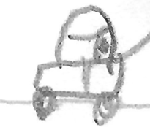


Example of Large Scale Use
[ELS-2006] A. El Fawal, J.-Y. Le Boudec, K. Salamatian. Performance Analysis of Self-Limiting Epidemic Forwarding. Technical report LCA-REPORT-2006-127.

Slide 13
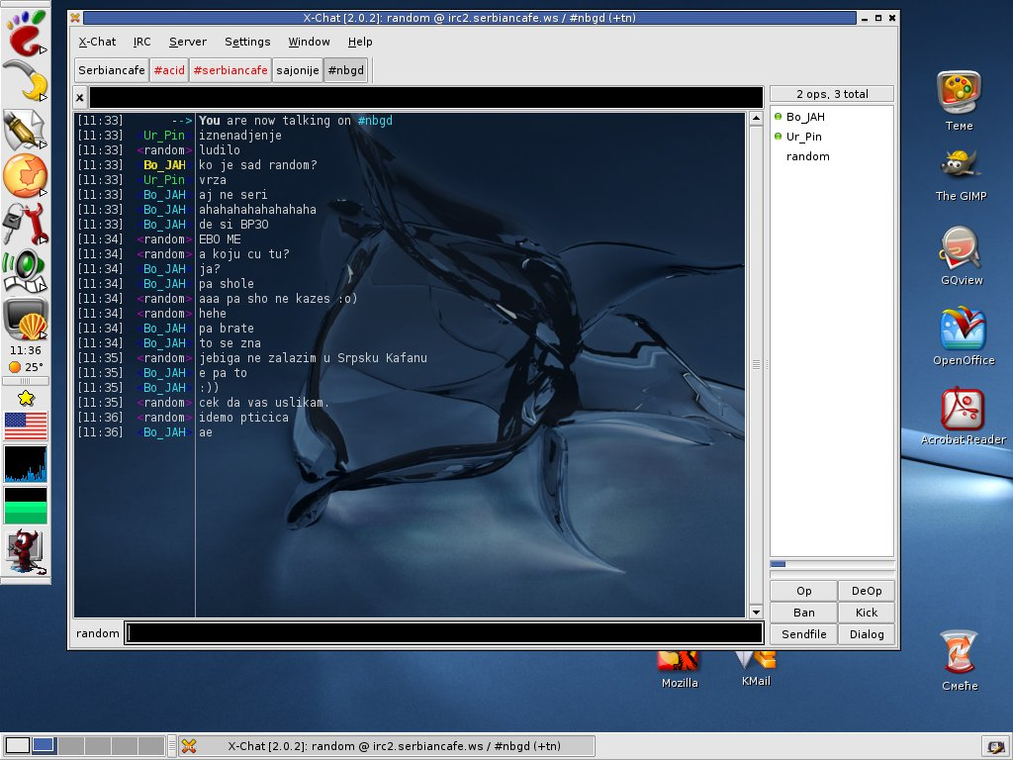

Mental Model of Epidemic Forwarding
App
One node
Epidemic Buffer
N=2 M= 3 Stored TTL = 221.88 From xxx Text=“…..”
N=0 M= 0 Stored TTL = 221.88 From self Text=“…..”
N=6 M= 1 Stored TTL = 221.88 From xxx Text=“…..”
Transmitted packet
N=2 M= 1 Stored TTL = 221.88 From xxx Text=“…..”
TTL = 34 IP source= …..
N=4 M= 1 Stored TTL = 221.88 From xxx Text=“…..”
N=5 M= 3 Stored TTL = 221.88 From xxx Text=“…..”
stored packet
Scheduler
MAC Layer

Slide 14
Control / performance issues
A Possible classification:
  Control of forwarding factor
    How many times a message is repeated
    The classical issue addressed in the literature
  Control source injection rates
  Scheduling
  Control of spread
    How many nodes are reached by a message
    Our focus today

Slide 15
Spread Control
Limiting the spread is implicitly assumed to be done by TTL
  But there are many options and issues
  We present the options then evaluate the performance

Slide 16
Contents
Self Limiting Epidemic Forwarding
Control of Spread / TTL
Performance Evaluation
Methodology: deriving fluid model

Slide 17
Classical TTL
Implicitly assumed in almost all existing works
    CD: “4 hops is enough”
When receiving a packet for the first time, decrement TTL (if >0) and store in epidemic buffer
When relaying the packet: send with stored TTL
If transmit multiple times, all with same stored TTL

Slide 18
Stored TTL
Same as classical TTL but
  decrement stored TTL for every send event
Equivalent to the forwarding token counter used in “Spray and Focus”
TTL = log₂ (token)
Thrasyvoulos Spyropoulos, Konstantinos Psounis, and Cauligi Raghavendra, “Spray and Wait: An Efficient Routing Scheme for Intermittently Connected Mobile Networks,” in proceedings of ACM SIGCOMM workshop on Delay Tolerant Networking (WDTN-05), August 2005

Slide 19
Aging
Same as TTL but the stored TTL is decremented at receive events
  Selective aging:
  Decrement stored TTL of this packet when a duplicate is received
  Global aging:
  Decrement stored TTL of all packets when any packet is received by some (very) small amount
A fine granularity is obtained by allowing Stored TTL to be non integer

Slide 20
Contents
Self Limiting Epidemic Forwarding
Control of Spread / TTL
Performance Evaluation
Methodology: deriving fluid model

Slide 21
Performance Evaluation
Method:
  Simulation JIST-SWANS + analytical model with fluid limit ODE of continuous time markov chain
  Performance metrics
    Spread: number of nodes that receive one message
    Spread factor: number of transmission events for one message
    Injection rate (for a flow controlled source)
    Buffer usage
  We looked for the applicability of a scheme to a large set of environments
    Mobile VANETs
    Infinite grid
    Infocom –like traces

Slide 22
Working Hypotheses
We used a virtual rate scheduler, serves packet no earlier than according to packet’s vrate, otherwise fair queuing per source
Control of forwarding factor done by vrate = a ^{Nrcv Nsnd} with a < 1
Self packet is removed when one duplicate is received
An issue is support for broadcast
  Naive (CTSless) broadcast does not work -> we use Pseudo-Broadcast whenever possible (crowded area), otherwise we revert to CTSless with indication of presence
  Our implementation of broadcast in Java is now available
  [2] and sourceforge

Slide 23
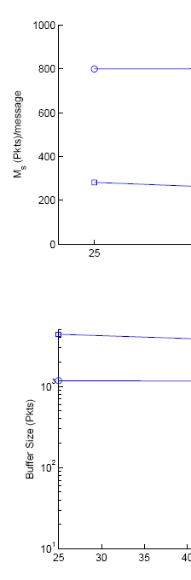
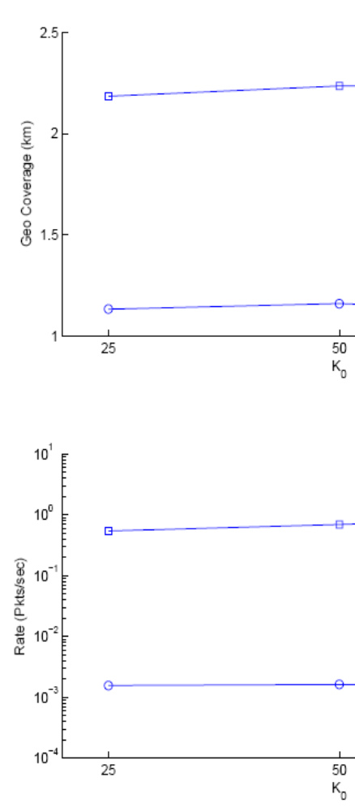
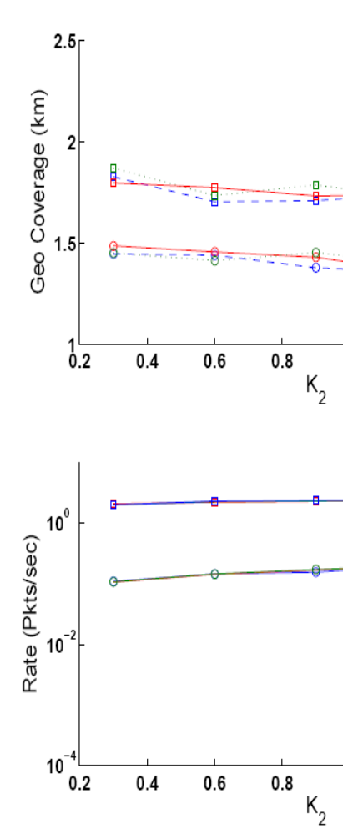
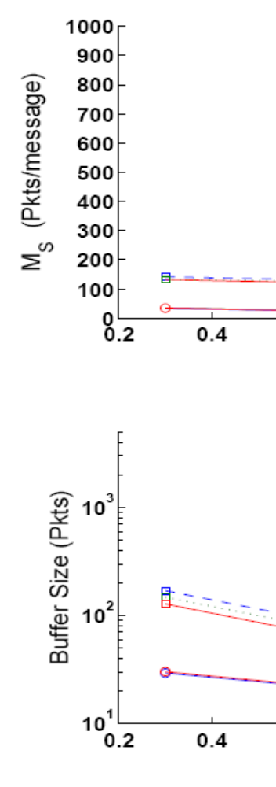
storedTTL
aging
jam
1
2
5
Fluid highway
3
Fluid highway
1
2
3
4
jam
5
4
Fluid highway
1
3
Fluid highway
2
1
5
jam
3
4
jam
4
5
2

Slide 24
Findings
ClassicalTTL or StoredTTL need to adapt the max TTL to the environment
  Rich connectivity (traffic jam) requires a very small max TTL, not suitable in other environments
Worse, in very dense environments, ClassicalTTL and StoredTTL suffer from collapse
In contrast, aging is robust to all situations
  The performance in overall much better
  Higher spread and rate with smaller buffer sizes

Slide 25
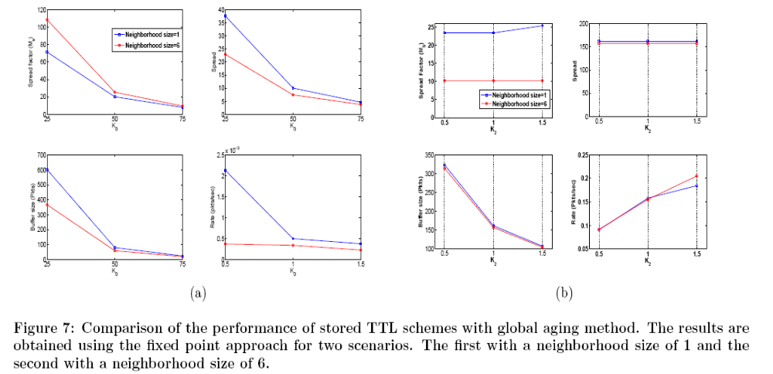
Results, Infinite Line

Slide 26
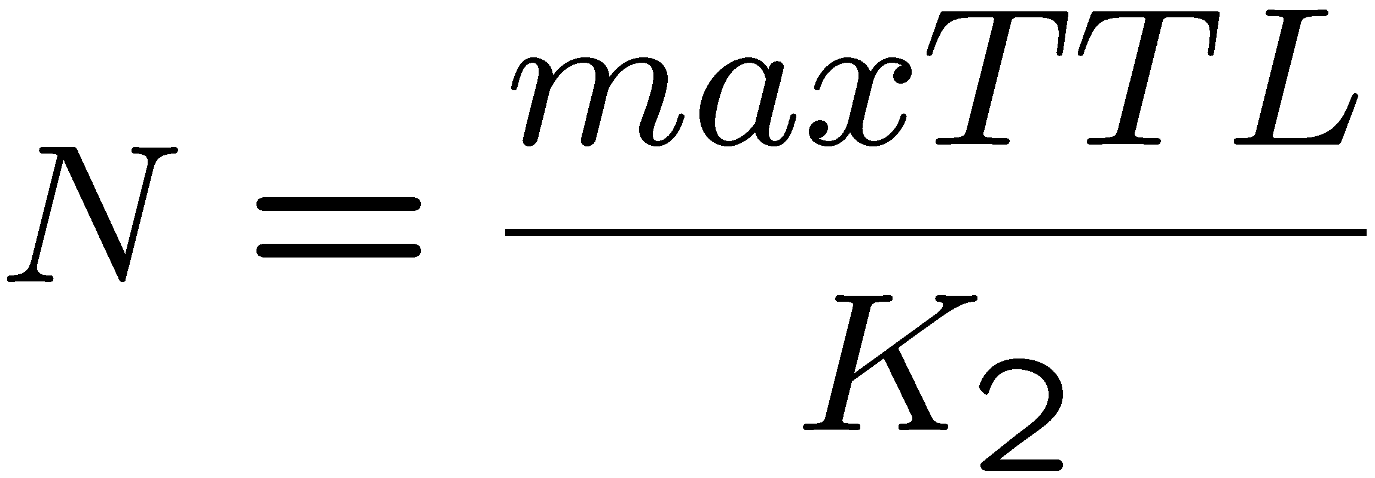
Reducing TTL of stored packets based on receive activity is an effective congestion control
Apply Little’s formula and find the operational law:
N is maintained constant independent of congestion status
Average number of
packets
in epidemic buffer
Decrease per
Receive event

Slide 27
Contents
Self Limiting Epidemic Forwarding
Control of Spread / TTL
Performance Evaluation
Methodology: deriving fluid model

Slide 28
We use a novel method to systematically derive a fluid model
Applicable to cases with “many small things”
Derived from chemistry and physics

Slide 29
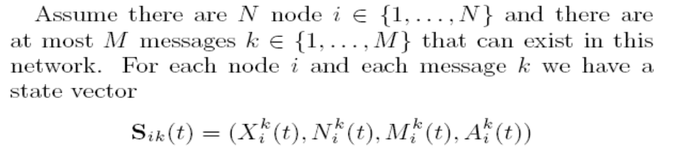
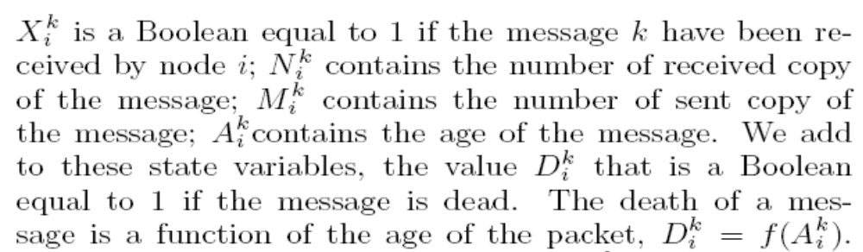
The Microscopic model for Epidemic Forwarding
The model is complex, O(A^{N^2}) states
N: nb nodes A: a fixed integer
Can we use simple approximations ? What is the corresponding fluid model ?

Slide 30
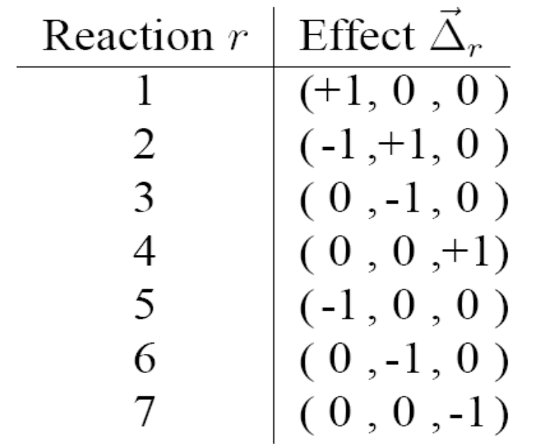
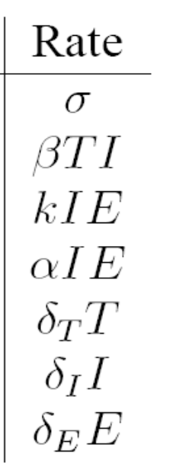
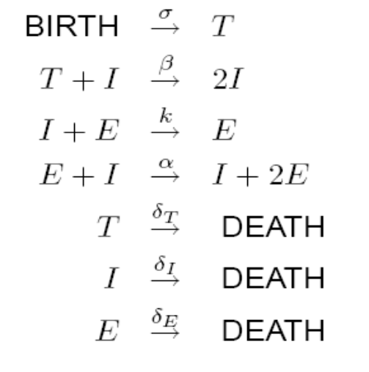
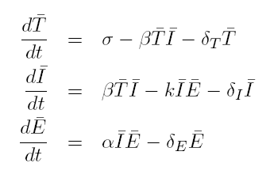
We Use a Systematic Method for Derivation of Fluid Model
Define the state variables
Pick functions of interest of the state variable
Define the transitions jumps Δ_{r} and rates h_{r}(x) of microscopic model
Compute the generator and write the ODE
Implemented for models of the type below in the TSED tool at
http://ica1www.epfl.ch/IS/tsed/index.html

Slide 31
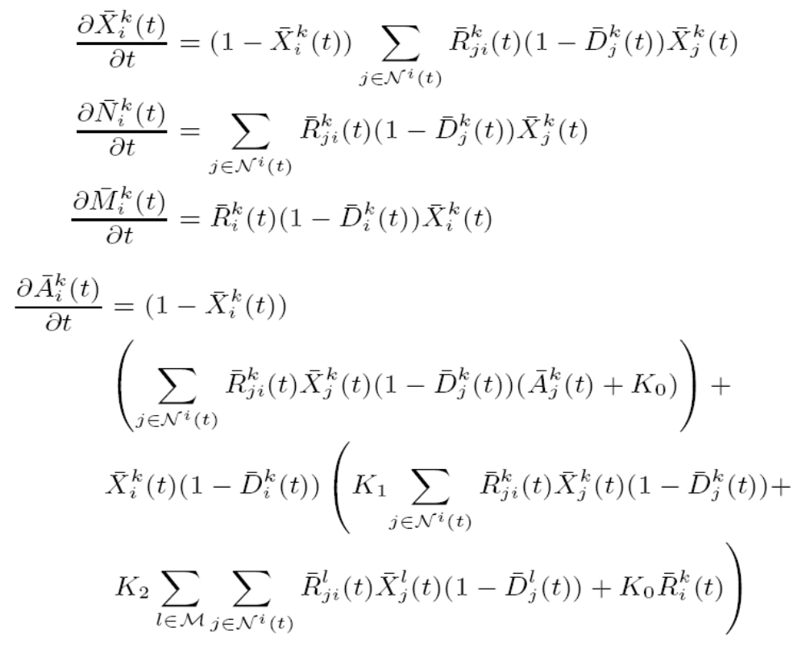
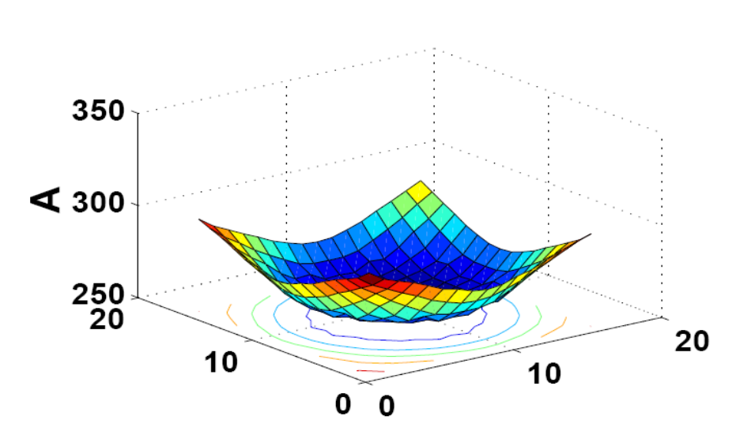
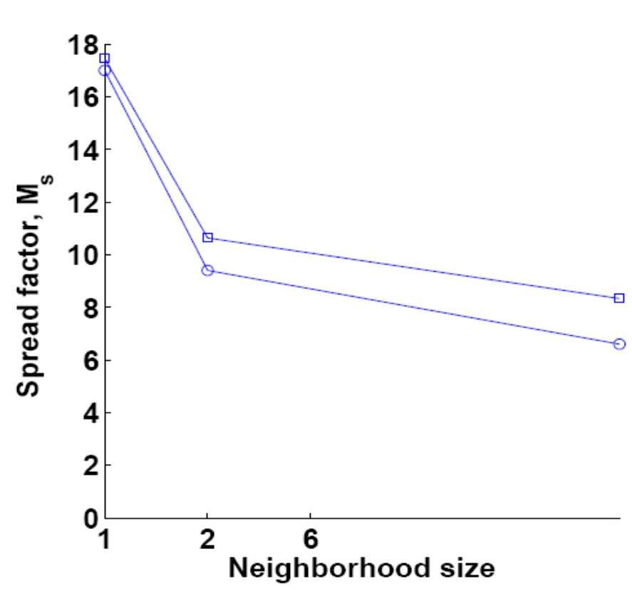
Application to Self-Limiting Epidemic Forwarding
A: Age of packet sent by node in middle
ODE
simulation
There is description complexity, but no modelling complexity

Slide 32
References
[1] A. El Fawal, J.-Y. Le Boudec and K. Salamatian
Performance Analysis of Self Limiting Epidemic Forwarding
EPFL Technical Report, 2006.
[2] MAC layer functions for SLEF / Keller, Lorenzo – 2006 [LCA-STUDENT-2006-005]

Slide 33
Conclusion
We have investigated a novel approach to TTL management, based on decrement on packet reception
We have shown that it improves the usability of epidemic forwarding to case where it otherwise would congest
It can enable new applications to share information locally

