Slide 1
Packet Scale Rate Guarantee for non-FIFO Nodes
J.-Y. Le Boudec (EPFL)
joint work with A. Charny (Cisco)

Slide 2

What is PSRG
(Packet Scale Rate Guarantee) ?
Defines how a node compares to Generalized Processor Sharing (GPS)
  simple
  mathematically exact
  qualifies the behaviour of complex routers or subnetworks
  gives bounds on delay and backlog
« a node is PSRG (r, e) for a flow » means:
  this flows is guaranteed a rate r, with latency (error term) e

Slide 3
Definition of
Packet Scale Rate Guarantee with rate r and latency e
d(n) ≤ f(n) + e
f(n) = max{a(n), min[d(n-1), f(n-1)]}+ L(n)/r
d(n) : departure time for packet n
a(n) : arrival time
f(n) : virtual finish time, f(0) = 0
L(n) : length in bits for packet n

Slide 4
f(n) = max{a(n), min[d(n-1), f(n-1)]}+ L(n)/r
L(n)/r
f(n-1)
d(n-1)
a(n)
f(n)
d(n)
L(n)/r
a(n)
f(n-1)
d(n-1)
f(n)
d(n)
L(n)/r
a(n)
d(n-1)
f(n-1)
f(n)
d(n)

Slide 5
Known Properties of PSRG:
[Infocom ‘01, BBCCL]
Delay Bound :
D_{max} = e + sup_{t}[α(t)/r-t]
α(t) : arrival curve for input
Backlog Bound :
B_{max} = sup_{t}[α(t)-(rt-e)⁺]
α(t)
r
D_{max}
e

Slide 6
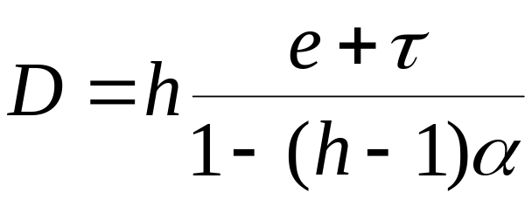
Known Delay Bounds for PSRG
Infinite buffer bound for α ≤ 1/(h-1) [CL QoFIS00]
Delay from Backlog : delay ≤ Q/r + e Q: backlog upon arrival
1
delay
0.8
0.6
1 MB
h=10
e = 2 MTU/r
r=150 Mb/s
C=5R
0.4
0.4 MB
0.2
0.1 MB
0.05
0.1
0.15
0.2
0.25
α

Slide 7
Concatenation Rule for PSRG:
[Infocom ‘01, BBCCL]
PSRG(r₁,e₁)
Concatenation (FIFO per flow):
r = min(r₁,r₂), e = e₁+ e₂+ L_{max}/r
PSRG(r₂,e₂)
⇔
PSRG(r,e)

Slide 8
Modeling a router as a PSRG node
Decompose flow processing into delay elements and queuing points (schedulers)
Delay element is PSRG (r = +, e = δ)
We know (r,e) for existing schedulers
  RFC 3247
Apply concatenation rule

Slide 9
Why Use PSRG ?
The definition of DiffServ Expedited Forwarding (EF) is based on PSRG
  RFC 3246
  gives a formal definition of « allocating a rate » that solves known contradiction in original definition ([Infocom ‘01, BBCCL])
  i.e. when guaranteeing a rate r, you need to specify an error term e
The definition is verifiable

Slide 10
Why Use PSRG ?
Qualify a router without exposing details
  still be able to compute values like jitter increase due to multiplexing
Many queueing papers still assume a router can be modeled as a single queueing point
  concept of busy period not relevant in a system with delay elements, use PSRG instead!

Slide 11
Other Abstract Node Models Exist; why use PSRG instead ?
Guaranteed Rate [Goyal, Lam, Vin 96]
  d(n) ≤ f(n) + e
  f(n) = max{a(n), f(n-1)}+ L(n)/r

Slide 12
Packet Scale Rate Guarantee
f(n) = max{a(n), min[d(n-1), f(n-1)]}+ L(n)/r
L(n)/r
a(n)
d(n-1)
f(n-1)
f(n)
d(n)
Guaranteed Rate
f(n) = max{a(n), f(n-1)]}+ L(n)/r
L(n)/r
a(n)
d(n-1)
f(n-1)
f(n)
d(n)

Slide 13
Other Abstract Node Models Exist; why use PSRG instead ?
Guaranteed Rate [Goyal, Lam, Vin 96]
Unlike PSRG, GR compares node to worst-case behaviour of GPS
  PSRG puts a bound on how node deviates from GPS, even when GPS scheduler is faster than guaranteed rate
Why bother ?
  important when micro-flows are aggregated
  GR has no delay from backlog bound
  delay bound for window flow control

Slide 14
Non-FIFO Nodes
what ? did you say non-FIFO ?
routers should be FIFO per flow
  all OK with per-flow scheduling
EF use aggregate scheduling
  routers are not FIFO per aggregate

Slide 15
Properties of PSRG (and GR) non-FIFO nodes
backlog and delay bounds from arrival constraints still hold
  proof: adaptive service curve [Cruz 98, BBCCL Infocom 01]
do the other properties still hold for non-FIFO ?
  delay from backlog
  concatenation

Slide 16
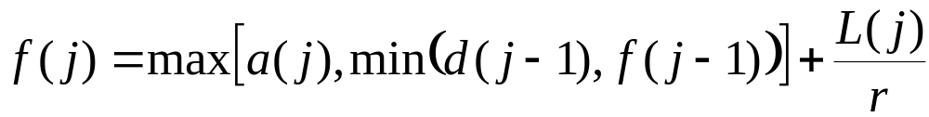
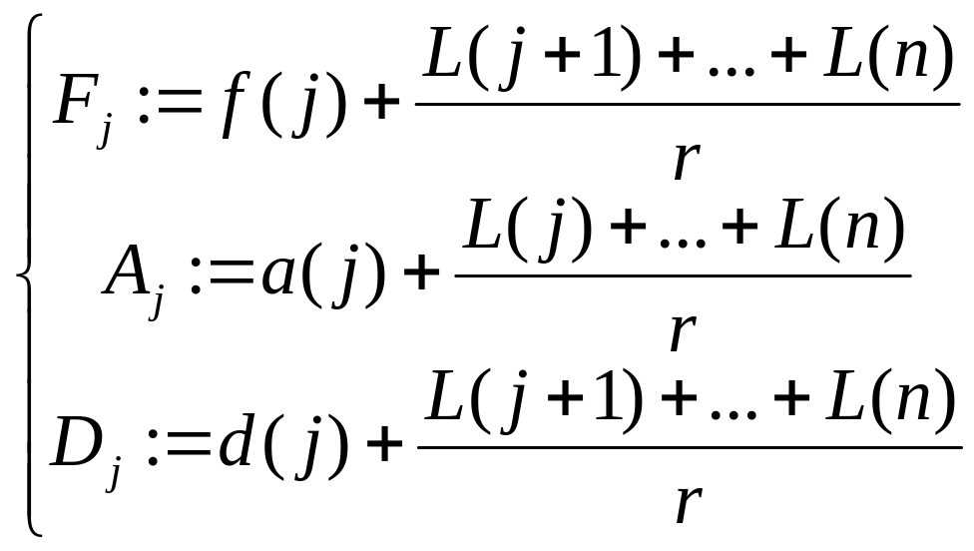
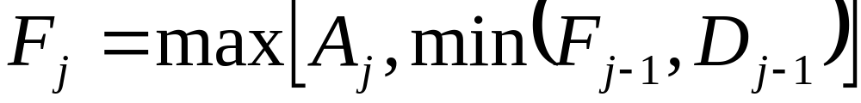
we can eliminate f(n) by solving
(1)
define
we obtain
(2)

Slide 17
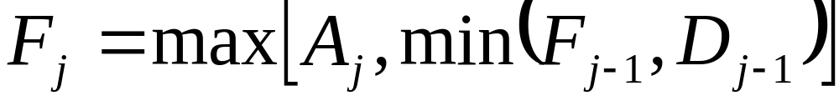
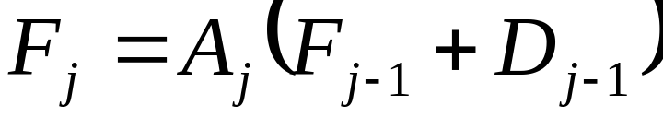
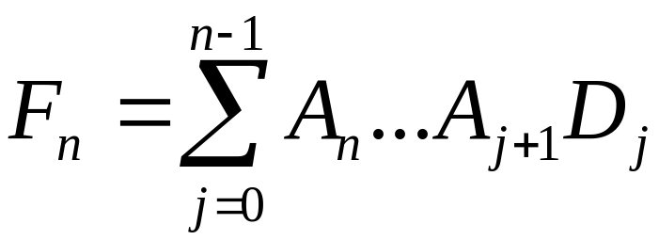
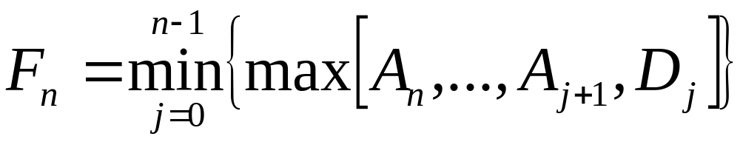
Min-Max Algebra
(2)
re-write (2) by the replacement rule
(min, max) -> (+,x) and obtain
use Gauss elimination
use the reverse replacement rule

Slide 18
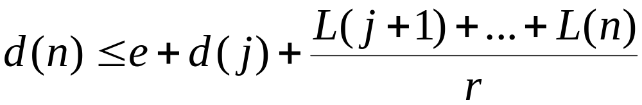
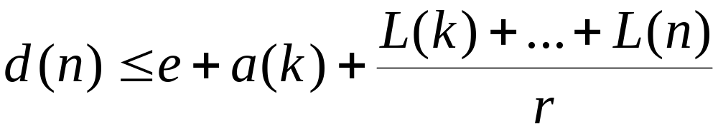
Alt. Characterization of PSRG
a node is PSRG(r,e)  for all n and all
0 ≤j ≤ n-1 either
(A)
or there is some k in [j+1,…, n] such that
(B)
interpretation: replaces busy period intuition

Slide 19
Applications
Delay from Backlog bound also holds in non-FIFO case
PSRG (r,e ) ⇒ delay ≤ Q/r + e
not an intuitive result !

Slide 20
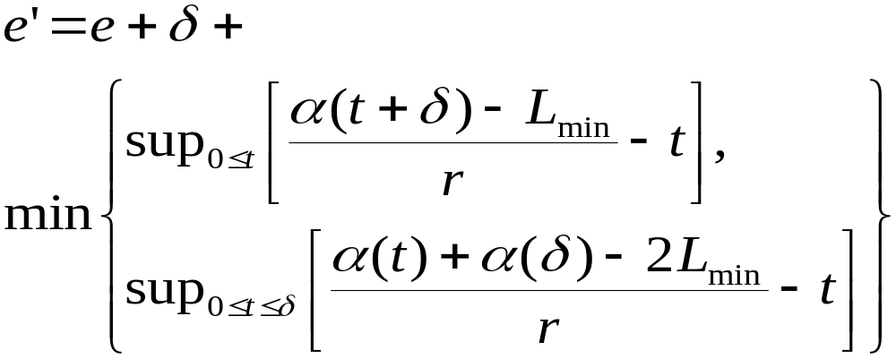
Concatenation of PSRG nodes
FIFO result does not hold
special case: internal switch with variable delay, followed by output queueing scheduler
a tight result is:
δ
PSRG(r,e)
PSRG(r, e’)

Slide 21
Increase in Latency by Pre-fixing a variable delay element
δ
r,e
- EF aggregate is (ρ, σ) - smooth, σ = 50 KB
- guaranteed rate is r = 100 Mb/s
r, e’
sec
PSRG, non FIFO
0.05
0.04
GRC, non FIFO
0.03
0.02
PSRG and GRC, FIFO
0.01
ρ in Mb/s
50
100
150
200

Slide 22
Conclusion
PSRG is an abstract node model that gives a meaning to « guarantee a rate »
  usable in practice to compute bounds
non-FIFO (per-flow) should be assumed when flows are aggregated (diffServ  intServ)
min-max algebra

